Slide 1
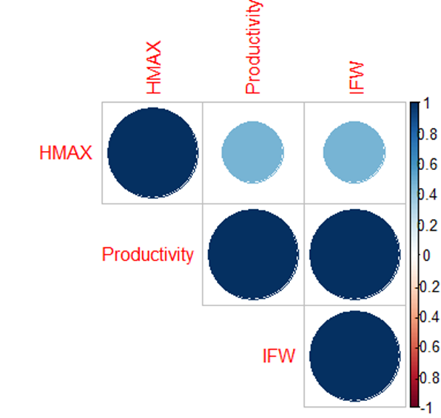
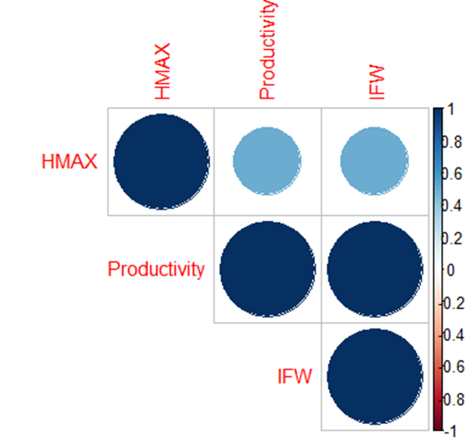
Brassica oleracea-Hidrogel
Brassica oleracea - Control
 | Productivity | IFW | HMAX
Productivity | NA | 0 | 3.88E-06
IFW | 0 | NA | 3.88E-06
HMAX | 3.88E-06 | 3.88E-06 | NA
 | Productivity | IFW | HMAX
Productivity | NA | 0 | 0.002609452
IFW | 0 | NA | 0.002609452
HMAX | 0.002609452 | 0.002609452 | NA

Slide 2
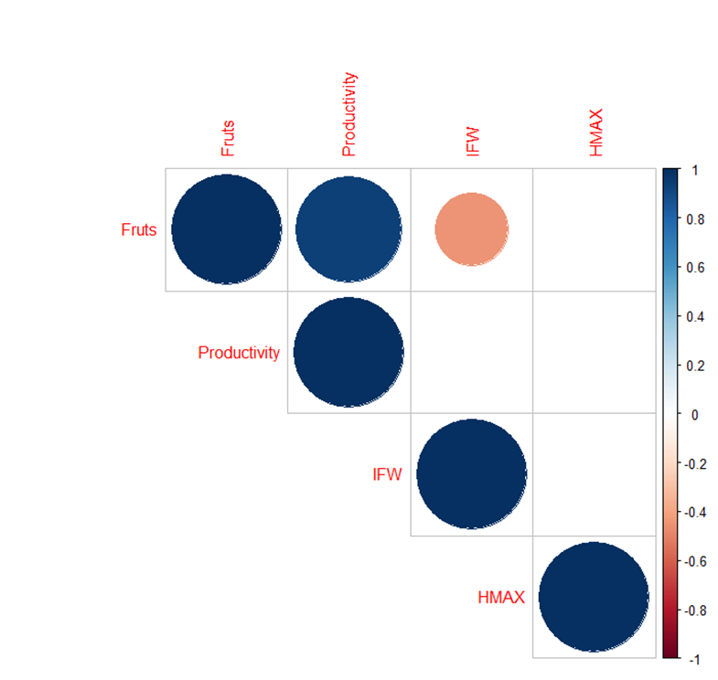
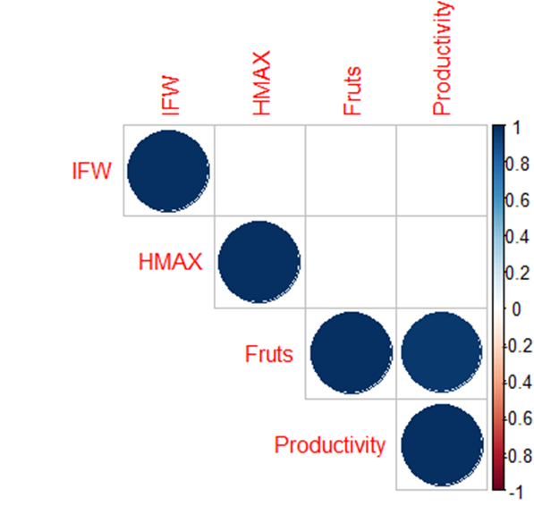
Capsicum annuum - Hidrogel
Capsicum annuum - Control
 | Fruts | Productivity | IFW | HMAX
Fruts | NA | 7.11E-14 | 0.01435659 | 0.7905759
Productivity | 7.11E-14 | NA | 0.60897795 | 0.42054666
IFW | 0.01435659 | 0.60897795 | NA | 0.22543423
HMAX | 0.7905759 | 0.42054666 | 0.22543423 | NA
 | Fruts | Productivity | IFW | HMAX
Fruts | NA | 1.70E-11 | 0.88752667 | 0.47117593
Productivity | 1.70E-11 | NA | 0.38139658 | 0.42089295
IFW | 0.88752667 | 0.38139658 | NA | 0.62886054
HMAX | 0.47117593 | 0.42089295 | 0.62886054 | NA

Slide 3
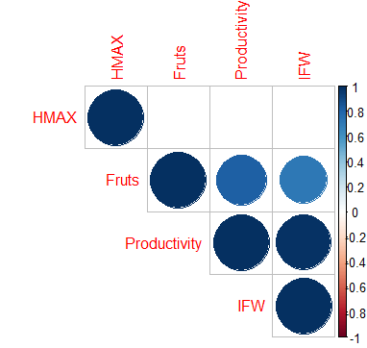
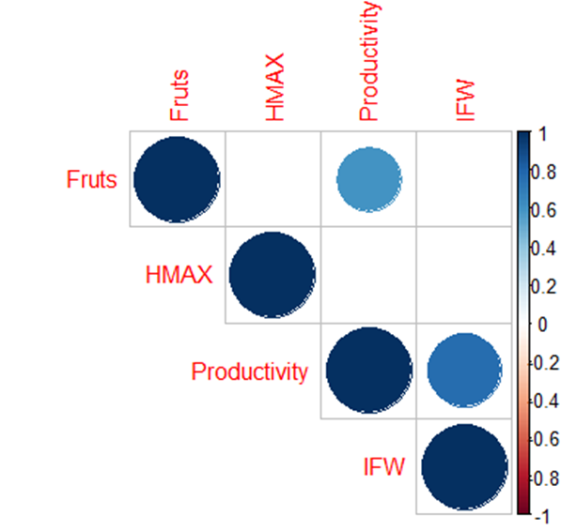
Citrullus lanatus - Hidrogel
Citrullus lanatus- Control
 | Fruts | Productivity | IFW | HMAX
Fruts | NA | 0.007928698 | 0.03066803 | 0.263740028
Productivity | 0.007928698 | NA | 2.93E-06 | 0.891696795
IFW | 0.03066803 | 2.93E-06 | NA | 0.930791889
HMAX | 0.263740028 | 0.891696795 | 0.930791889 | NA
 | Fruts | Productivity | IFW | HMAX
Fruts | NA | 0.039897565 | 0.99490126 | 0.847219726
Productivity | 0.039897565 | NA | 0.003867164 | 0.355385967
IFW | 0.99490126 | 0.003867164 | NA | 0.209844883
HMAX | 0.847219726 | 0.355385967 | 0.209844883 | NA

Slide 4
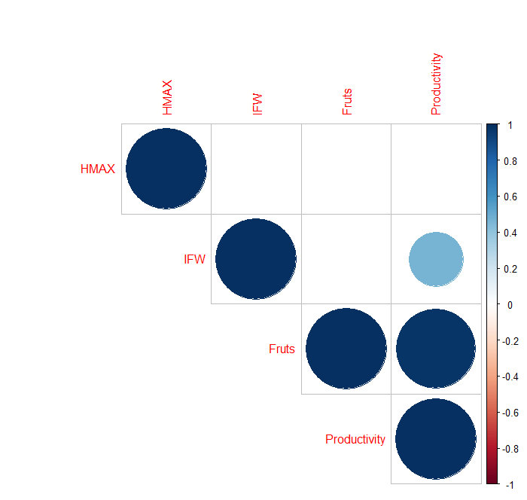

Cucumis sativus - Hidrogel
Cucumis sativus - Control
 | Fruts | Productivity | IFW | HMAX
Fruts | NA | 0.0398976 | 0.994901 | 0.847220
Productivity | 0.0398976 | NA | 0.003867 | 0.355386
IFW | 0.9949013 | 0.0038672 | NA | 0.2098449
HMAX | 0.8472197 | 0.3553860 | 0.2098449 | NA
 | Fruts | Productivity | IFW | HMAX
Fruts | NA | 8.04E-14 | 0.191846416 | 0.801886441
Productivity | 8.04E-14 | NA | 0.040528929 | 0.881741005
IFW | 0.191846416 | 0.040528929 | NA | 0.915238211
HMAX | 0.801886441 | 0.881741005 | 0.915238211 | NA

