Slide 1

GOOGLE DATA STUDIO An Introduction.
29 June 2017

Slide 2

Introduction
Contents
Introduction
Getting started with GDS
Adjust column width and row height
Fill cells with a colour
Add borders
Merge cells

Slide 3
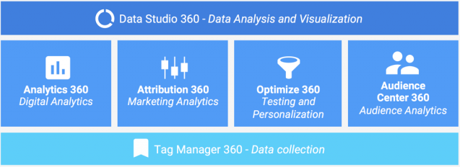
Introduction
What is Google Data Studio (GDS)
Google Data Studio (beta) is an online service that turns your data into informative dashboards and reports that are easy to read, easy to share, and fully customizable.
Data Studio is part of Google Analytics 360 Suite which is a platform used to evaluate and drive results. The Suite is comprised of 6 products, as schematized below.

Slide 4
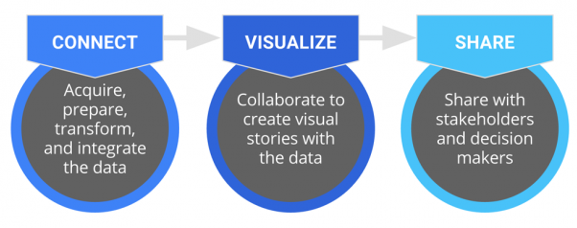
Overview of GDS
There are 3 key steps in using GDS
Connect - The first thing you have to do when working with data is making sure you have it. After adding your data, check whether any preparation is required (e.g. calculated fields, different formatting, cleaning up) in order to make the data useful.
Visualize - Creation of reports, sheets using the data
Share - Can share reports, insights with colleagues

Slide 5
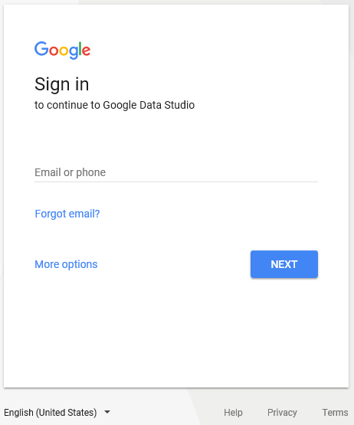
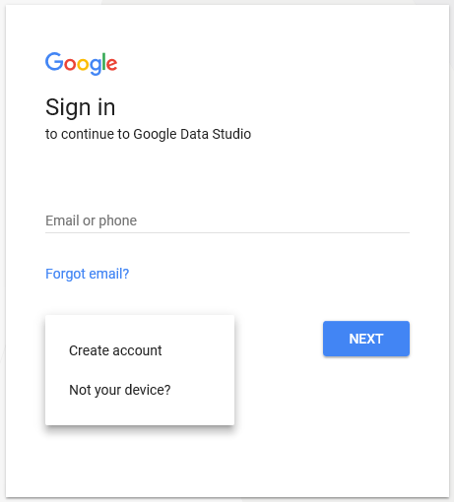
Getting started with GDS (1/2)
Skill 1:Applying Number Formats (Apply Formatting to a Range)
First, log in with the Google account you use to manage your Analytics and AdWords accounts.
If you don’t have one, use the sign up option to get started
Login at https://datastudio.google.com. You will see something similar to the following page.

Slide 6
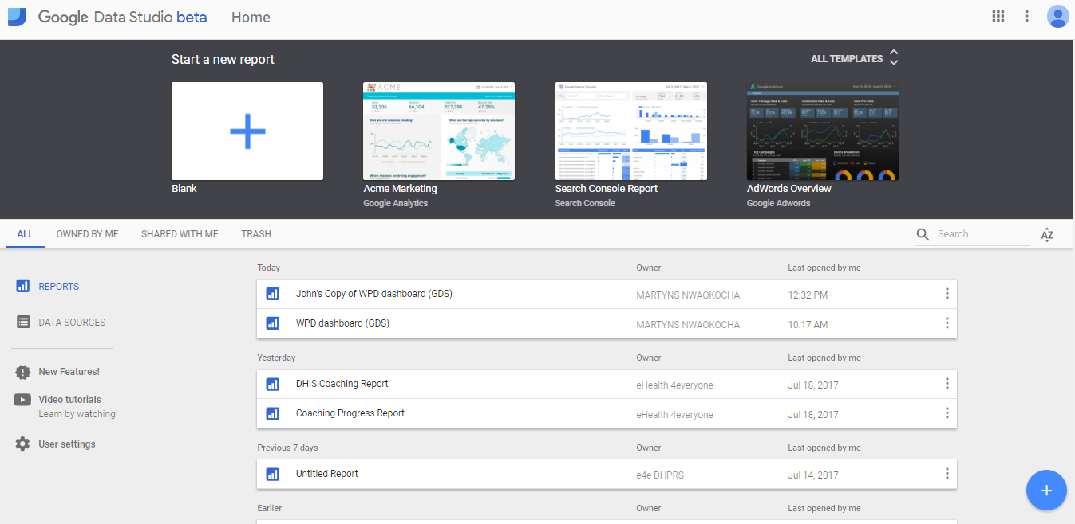

Getting started with GDS (2/2)

Slide 7

Adding data sources
These are the key steps to add a data source
Click on Data Sources
Click on the blue plus sign
Select from existing data sources or click “CREATE NEW DATA SOURCE”
Select from any of the 12 connectors currently present.
For this session, click on “Google Sheets”.
If prompted to choose a google account, select and provide the password of the google account containing the google spreadsheet.
After selecting a data source, rename it in the top left corner of the interface.
Click “Connect” at the top right corner of the screen.

Slide 8

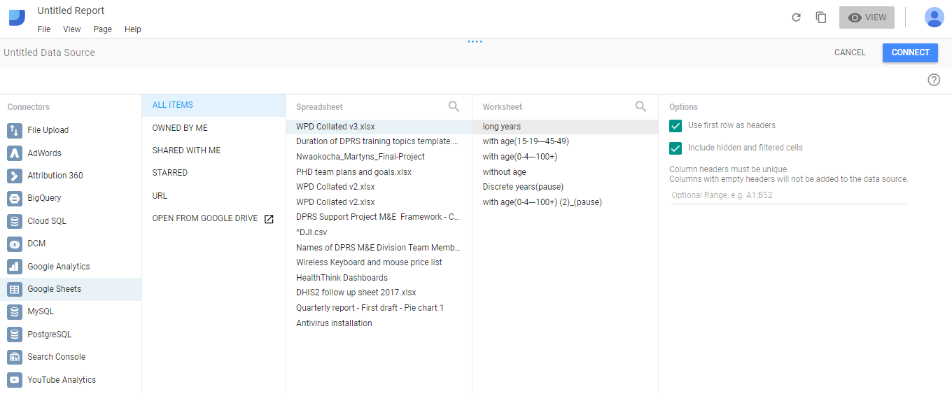
Adding data sources (2/2)

Slide 9
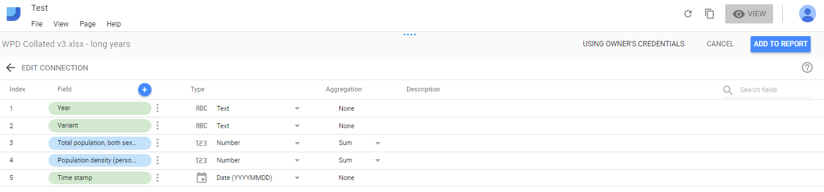
Editing Connections

Slide 10

Editing Connections
Operations associated with editing connections include
Creating calculated field(s)
Changing field type(s)
Modifying the aggregator type for a field.
Adding description(s) to field(s)
Creating/Adding to report

Slide 11
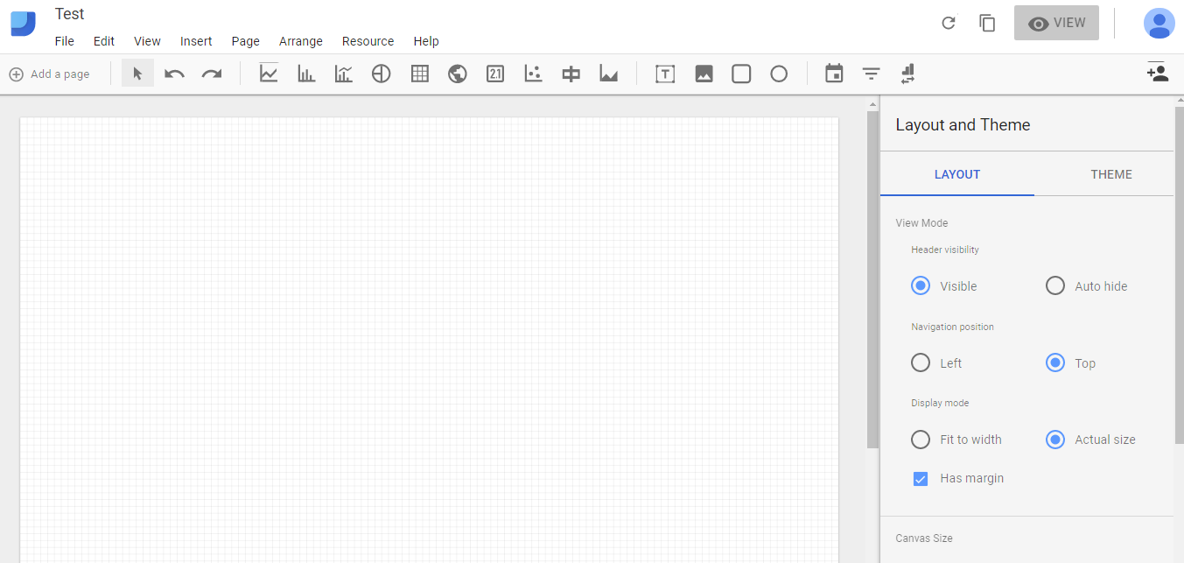
Building your report

Slide 12

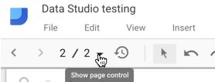
Taking it Further:
Working with Pages
There are two menus for accessing/working with pages
main toolbar
page control widget in top-left corner of your dashboard
The “Current page settings” option allows us to specify the data source for the page and control the background colour scheme.

Slide 13
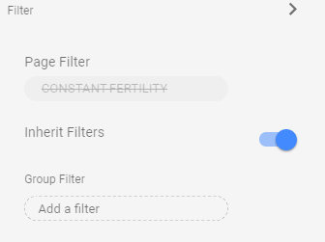
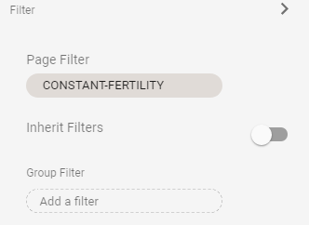
Taking it Further:
Adding and filtering data at page level
Implementing page level filters automatically enables the inherit filters on all chart objects.
Switching off the Inherit filters overrides the page level filter from that specific chart only.
1
2

Slide 14
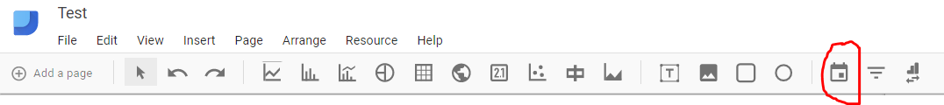
Taking it Further:
Adding Date Range filters
The Date Range filter is found at the top right position of the main toolbar.
The Date Range filter is added by selecting that icon and dragging out a shape on your report where you want the date filter to go.
By default the filter will be applied to all the charts, tables and scorecards on the current page.
We can restrict a date filter to work only with a single chart, or only specific, selected charts.
By grouping chart elements together with the Date Range filter and by highlighting them all at the same time, the filter will be applied to only those grouped elements.

Slide 15
Taking it Further:
Adding Filter Controls
A Filter Control is a control used to narrow down the displayed data in charts contained in a report.
Filter Controls are added in the same way as a Date Filter, by selecting the icon and then dragging out the required shape in the report page.
There are 4 menu options which can be seen at the side bar. They are
Data menu
Style menu

Slide 16
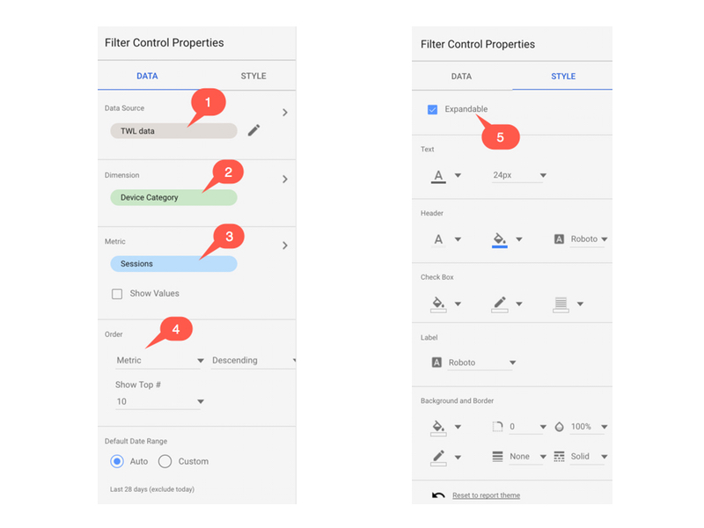
Formatting Cells (Skill 2 Visual)

Slide 17
Taking it Further:
Adding Filter Controls
Data Menu
The data source – Editable if required, but it will default to the page setting,
The dimension of the control filter: This is the dimension that is presented to users as a choice and will narrow down the data showing in charts and reports.
The metric to be displayed
The sort order and number of options to be displayed
Styles Menu
The checkbox to make the Control Filter expandable or no
Summary on Filter Controls
Like the Date Range filter, the Control Filter is applied to all chart elements in a page based off the same data source.
If you want to apply a filter control to only selected elements then you’ll need to group them.

Slide 18
Taking it Further:
Report-level vs Page-level elements
For reports with multiple pages, any element in your report can be set to be Report-level or Page-level.
Report-level elements are duplicated across all pages of your report, in the same position on each page
Making a chart element report-level also removes it from being governed by any filters you have on that page.

Slide 19
Taking it Further:
Creating calculated fields.
Intro
It’s possible to define new data fields to use in charts and reports
This involves adding new fields to a dataset, which we create by a custom calculation with existing data fields.
Steps
Under data source in page settings, click the edit icon to the right of the data source
This opens the data pane, showing all of the current fields in our dataset
Click the small blue plus above the current list of fields to add a new one
Enter a formula into the Formula input box a chart element report-level also removes it from being governed by any filters you have on that page.
Click “Create Field” on the right side and Google will add this new calculated field to the long list of fields in the dataset:
A little fx next to the name of your calculated field will appear to show that it’s a calculated field, based on a formula.

Slide 20
THE END
Thank You!

