Slide 1
Document-Image Enhancement for OCR on Insurance Claim Invoices
Digital Image Processing - Course Project 2026 (HSR-AIML-004, adapted to a DIP scope)
Shubham Verma (23CS3052)
Digdarshan Mishra (23CS3024)
Notes:
Introduce the project: we test which classical image-processing stages help a modern OCR engine read degraded insurance invoices.

Slide 2
Scanned claim documents arrive degraded
Skewed
Unevenly lit
Noisy or blurred
Pages photographed or fed at an angle
Shadows and gradients across the page
Sensor noise, camera shake, faint print
Question: which classical DIP stages actually improve a modern learned OCR engine - and which do nothing or hurt?
Outcome measured: character error rate (CER) and word error rate (WER) against known ground-truth text.
Notes:
Real claim scans are skewed, unevenly lit, noisy or blurred. The project asks which preprocessing stages help OCR, measured by CER and WER.

Slide 3
Synthetic invoices under seven conditions
clean
blur
noise
unevenLight
No degradation
Gaussian, sigma 2.2 px
Gaussian std 28 + 2% salt-and-pepper
Brightness ramp to 35%
lowContrast
skew
combined
Grey range 140-190
Rotation 3-8 degrees
Blur, contrast, light, noise at 40% + skew
20 generated A4 pages (1240 x 1754 px), random fonts and amounts, exact ground truth known. Seed 2026.
Notes:
Real claims are private, so we generated A4 invoices with known text. Each page is degraded under seven conditions. 20 pages per condition.

Slide 4
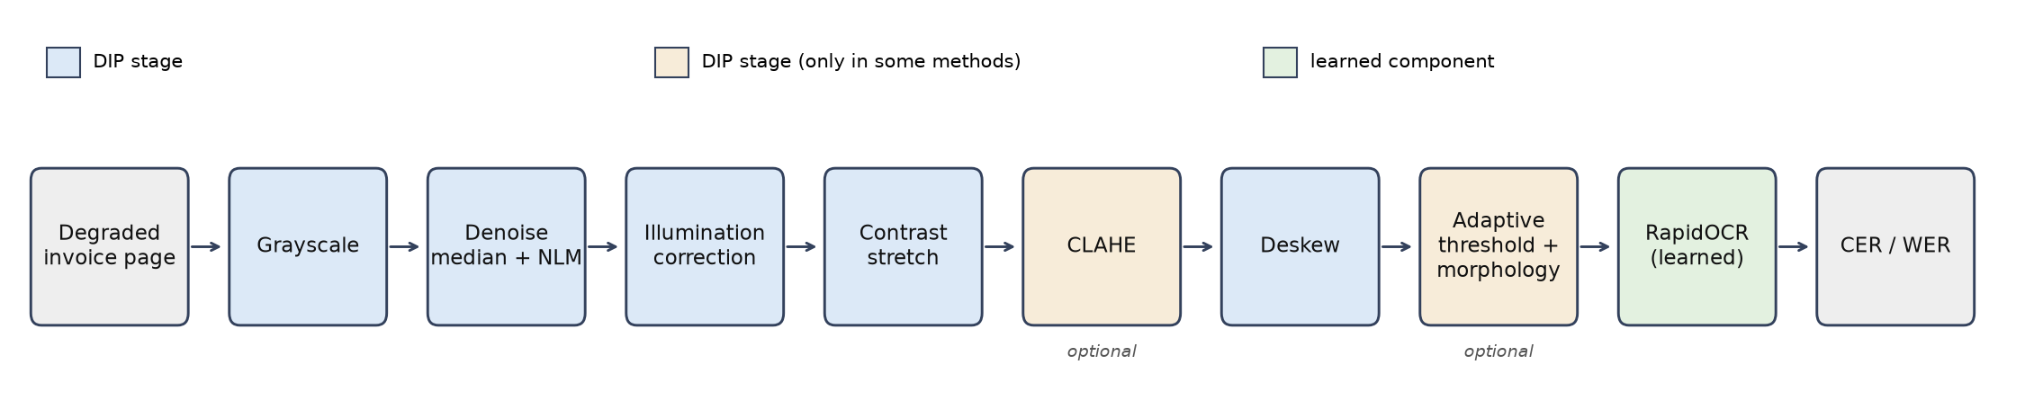
Pipeline: classical DIP stages, then a learned OCR
gray: no processing (baseline)
otsu: global threshold (classical baseline)
enhanced: denoise, illumination, stretch, deskew
enhancedClahe: enhanced + CLAHE
enhancedBinary: enhanced + adaptive threshold + morphology
Notes:
Five methods are compared. Only the OCR engine is learned; every other stage is classical DIP.

Slide 5
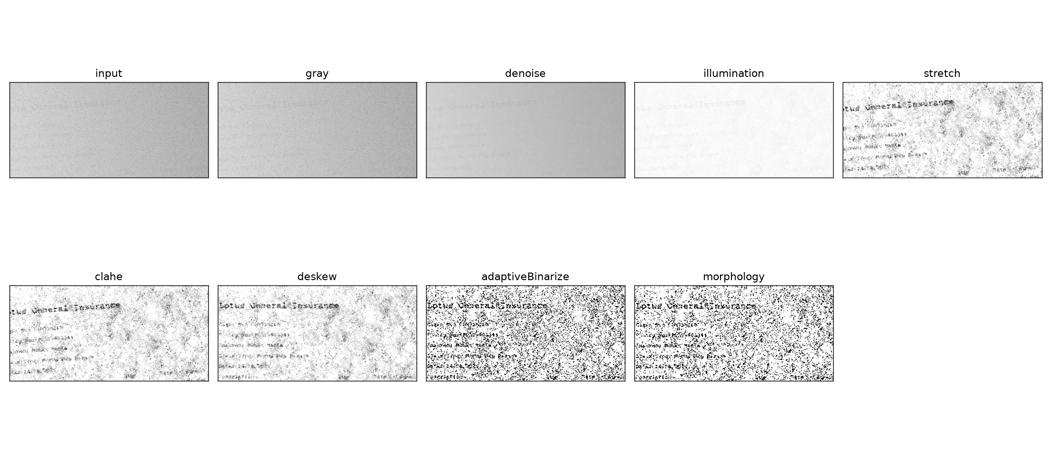
What each stage does to a hard page
Notes:
Intermediate images for one combined-condition page: illumination correction flattens the lighting, deskew straightens the lines.

Slide 6
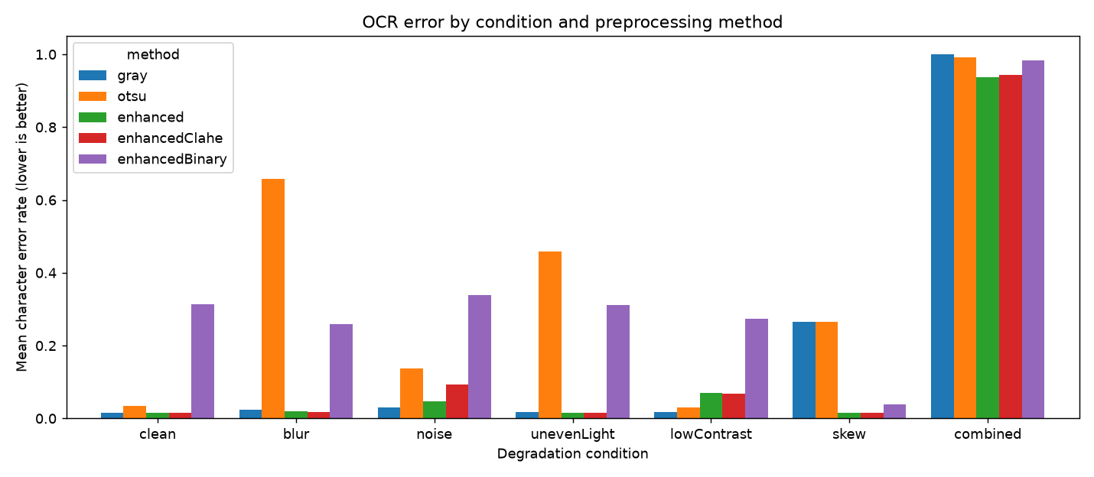
OCR error by condition and method
Mean CER over 20 pages per condition; lower is better.
Skew and uneven light are where processing matters.
Combined stays near 1.0 for every method.
Source: outputs/summary.md, 20 documents per condition, seed 2026.
Notes:
Mean CER per condition. gray is the untouched grayscale baseline.

Slide 7
Where processing clearly helps
0.264
→ 0.016
0.458
→ 0.015
0.03°
CER on skewed pages, gray vs enhanced (deskew)
CER on unevenly lit pages, Otsu vs enhanced
mean skew-estimation error (0.028° on skew pages)
A global threshold fails under uneven light and blur (Otsu CER 0.458 and 0.657); the enhanced pipeline restores 0.015 and 0.019.
Notes:
Deskew is the clear win. Illumination correction rescues the simple global threshold.

Slide 8
Where it does not help
0.030
→ 0.047
0.017
→ 0.071
0.313
0.94–
1.00
noise: gray vs enhanced
low contrast: gray vs enhanced
clean pages after binarisation (gray: 0.015)
combined condition, every method
The learned OCR already reads clean, blurred and unevenly lit pages untouched (CER 0.015-0.024).
Denoise and stretch distort faint strokes; binarisation removes grey-level cues. Not investigated further.
Notes:
Be upfront: enhancement does not beat the raw image on most conditions, and some stages hurt. Binarisation suits classical OCR, which we did not test.

Slide 9
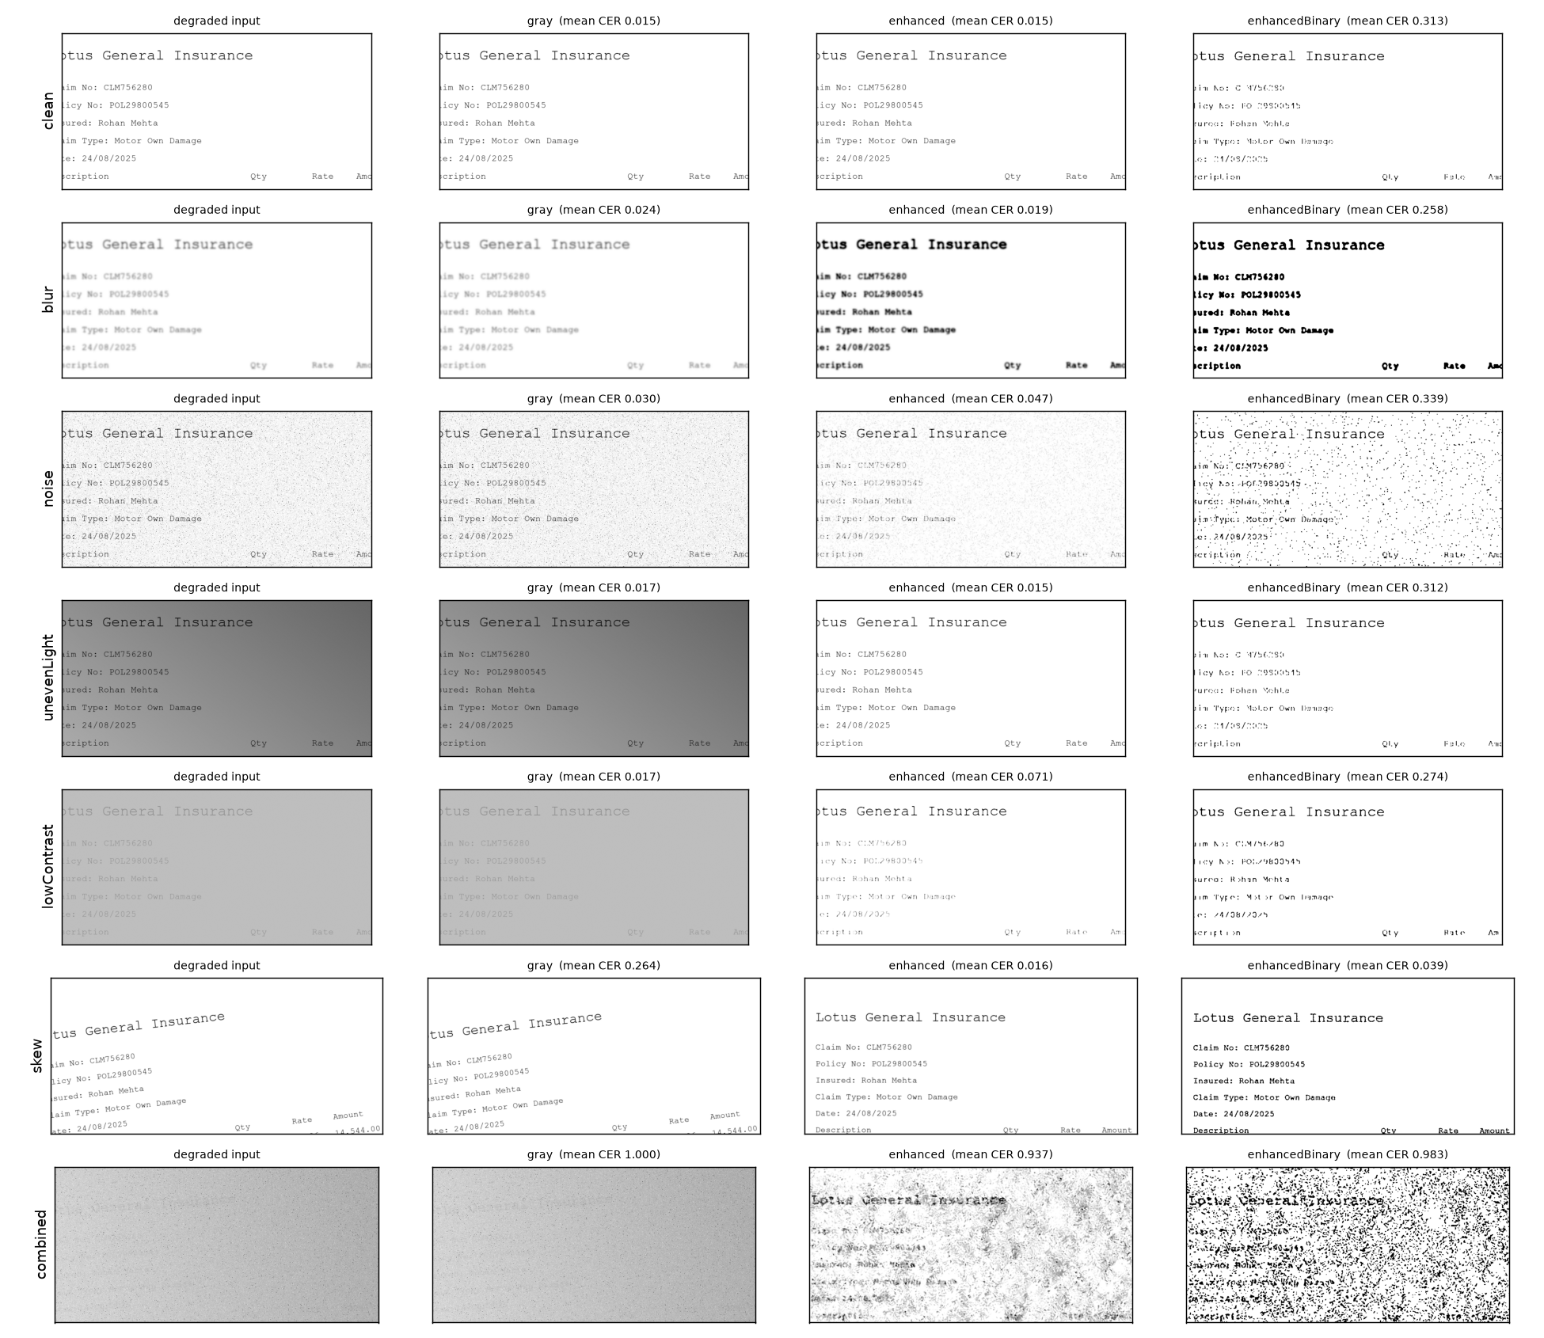
Every method on every condition
Rows: the seven conditions.
Columns: degraded input, gray, enhanced, enhancedBinary.
Enhanced output is flatter and straighter; on the combined page the text is still almost invisible, which is why every method fails there.
Notes:
Representative before and after crops for each condition.

Slide 10
Limitations
Synthetic pages with one fixed layout; may not transfer to real scans.
One OCR engine (RapidOCR). A classical engine such as Tesseract would likely respond differently to binarisation.
Parameters were adjusted after inspecting pilot pages of the same generator, with no held-out set.
20 pages per condition: differences of a few thousandths are not significant.
The ablation on the combined condition is a floor effect, not evidence either way.
Notes:
State the limitations directly; the tuned stages are likely to look better here than on new data.

Slide 11
Preprocessing should be selective and checked against the raw image
Deskew clearly pays off; illumination correction rescues a global threshold; on readable pages a modern OCR does as well untouched.
Shubham Verma: synthetic data, degradations, OCR evaluation, experiment runner
Digdarshan Mishra: DIP stages, pipeline, analysis, figures
Notes:
Both members can explain the full pipeline. Code, results and the report are in the repository.

