Slide 1
GUI Application Development Coursework 2 (group work)
NIBM

Slide 2
The Team
Navin Thamindu Chandrasiri | (DCSD202F-006)
Vileka Karunarathne | (DCSD202F-00)
Jalani Jayathilaka | (DCSD202F-00)
Thavindu Kumburegama| (DCSD202F-00)

Slide 3
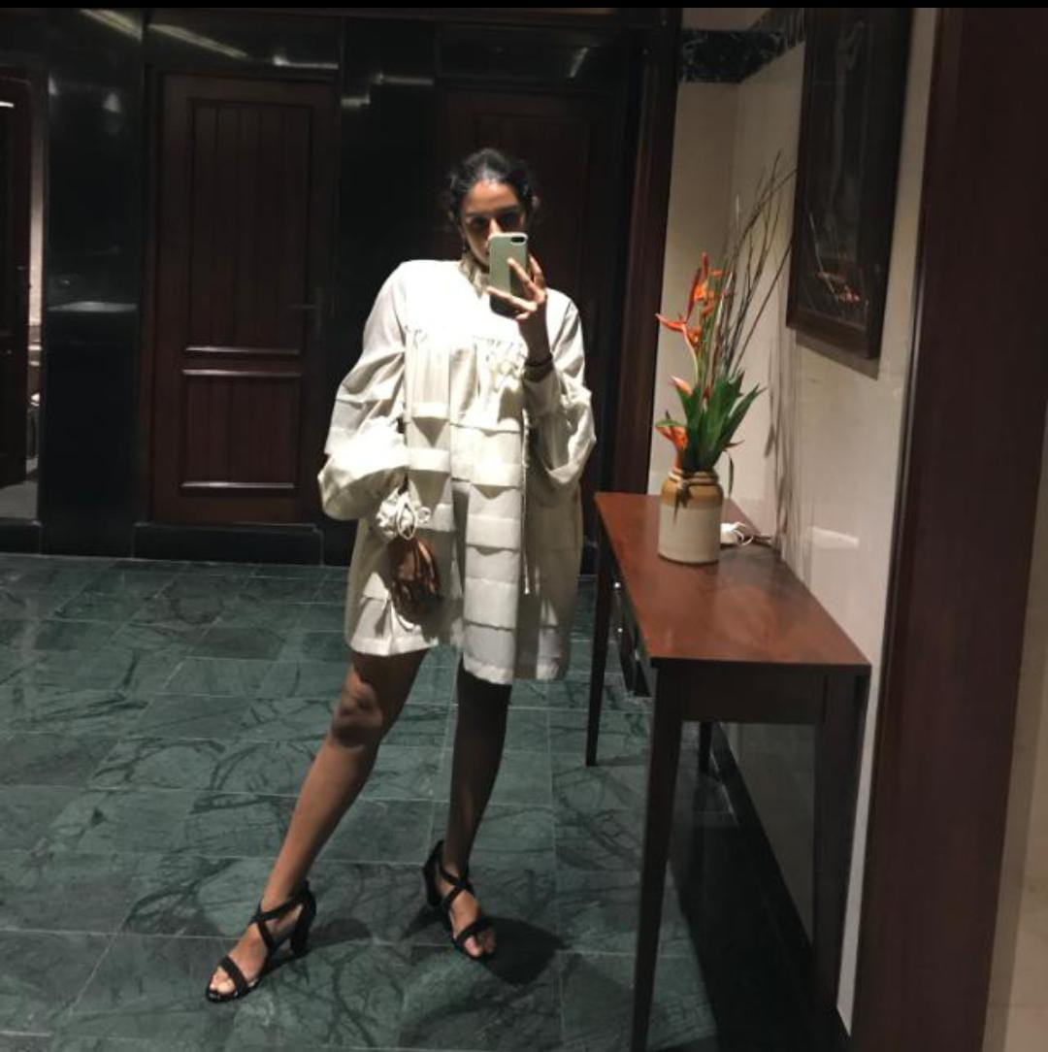
The Problem
Loves going through cloth designs
Jalani
Fashion Enthusiast
Family does not fancy letting her to go to public shops during COVID

Slide 4
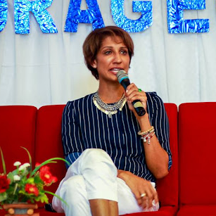
The Problem
Wants to improve customer experience
Gotara
Wants to maintain sales during COVID
Fashion Entrepreneur
Wants to find Sustainable strategy for selling

Slide 5
The Solution
Build a windows app to browse and buy flagship products
That would -
Allow users to login
Sort products according to color, style, and gender.
Have a digital Shopping Cart
Let admins to add new entries to the database

Slide 6

The Solution
FashionToast
The Digital High-End Fashion Store

Slide 7
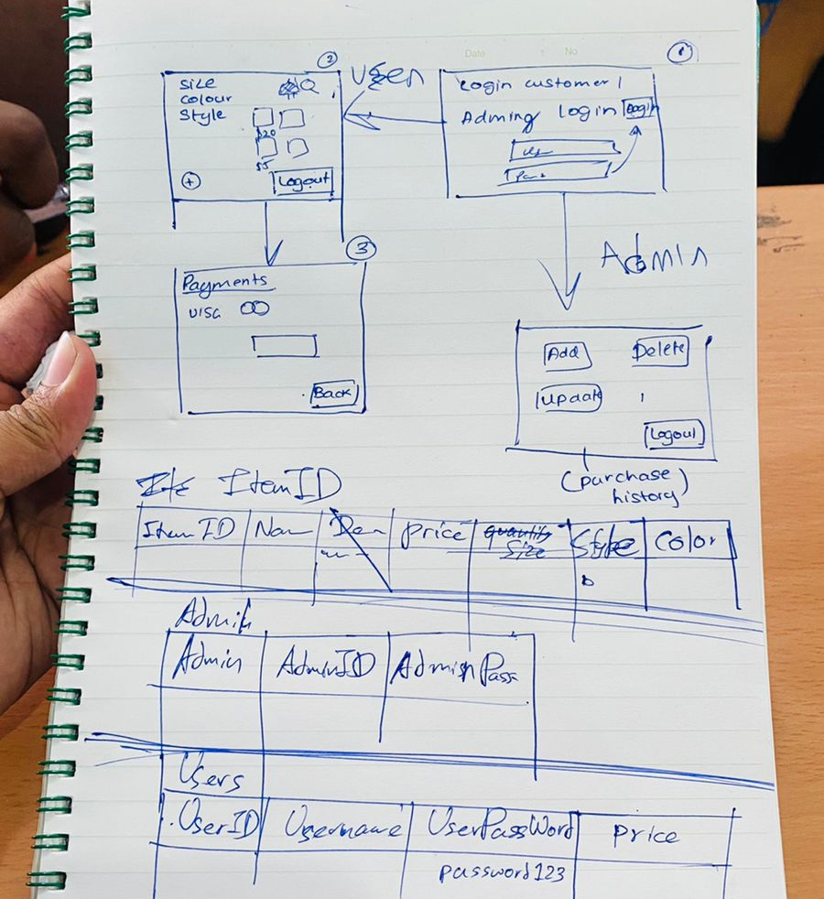
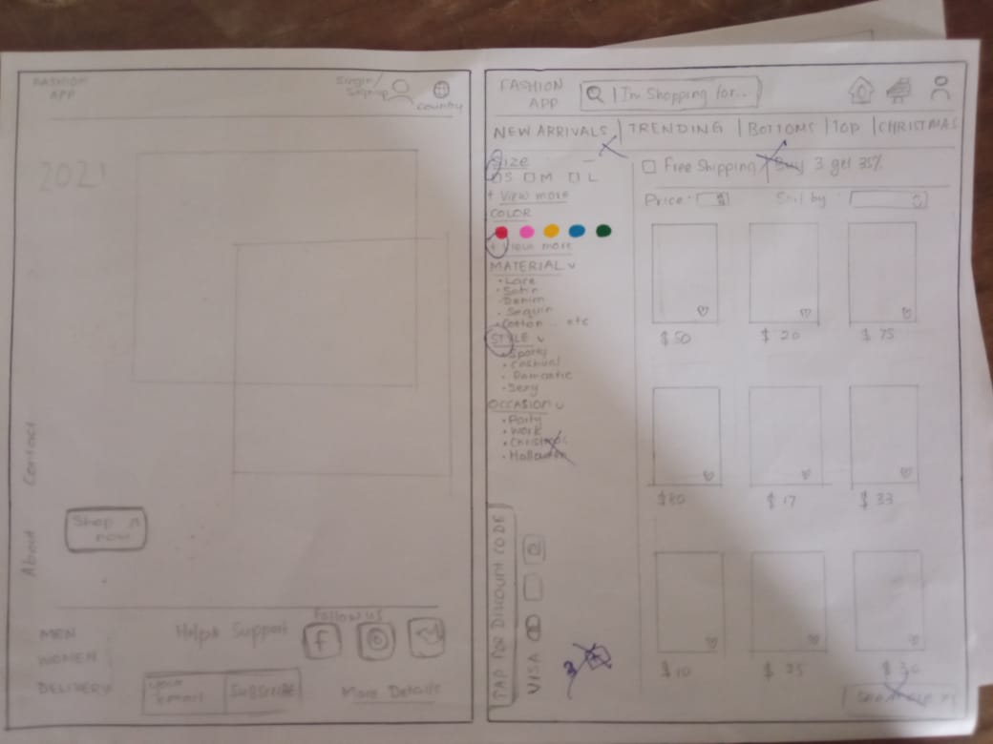
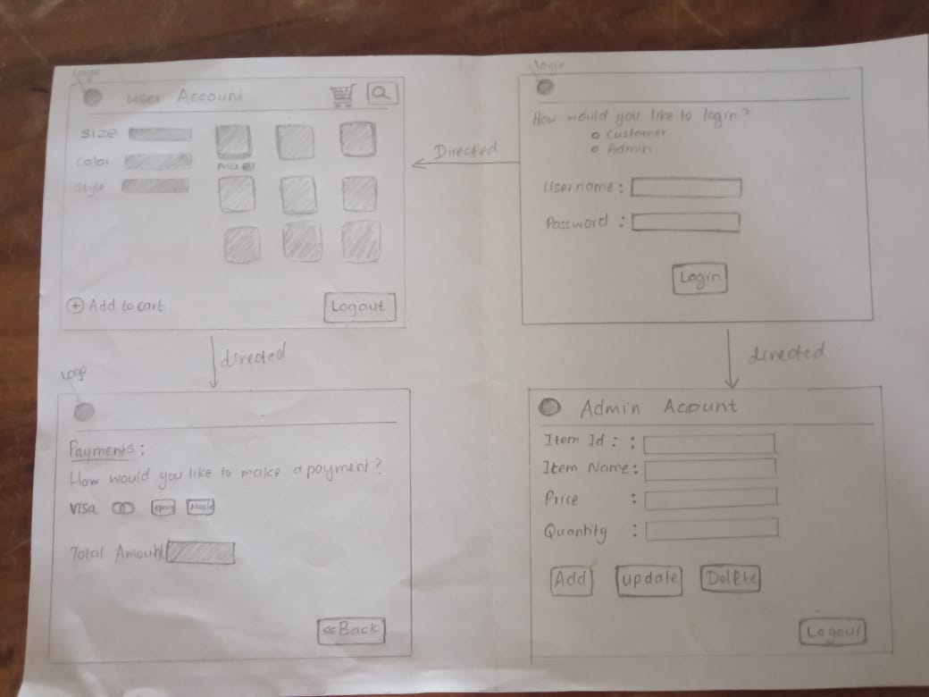
UI Designing

Slide 8
Demonstration

Slide 9
Used Technologies
Used C# .NET framework + WPF
Used GitHub for version controlling
Used Microsoft SQL Server Management Studio 18 for maintaining MySQL Databases
Used Microsoft Visual Studio 2019 to create WPF

Slide 10
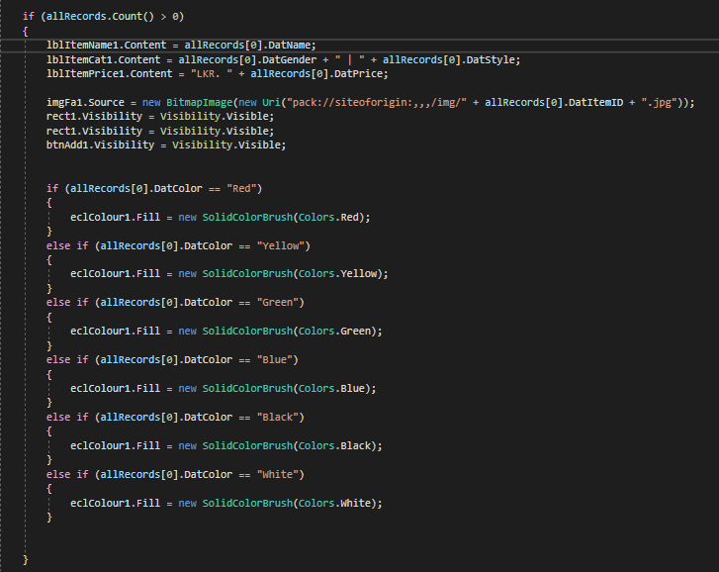
How it works
Auto-Generation (Simple Pseudo Code)
If (ItemEntries > 0){
Enable 1st component and set data;
}
If (ItemEntries > 1){
Enable 2nd component and set data;
}
If (ItemEntries > 2){
Enable 3rd component and set data;
}
If (ItemEntries > 3){
Enable 4th component and set data;
}
For single component ^

Slide 11
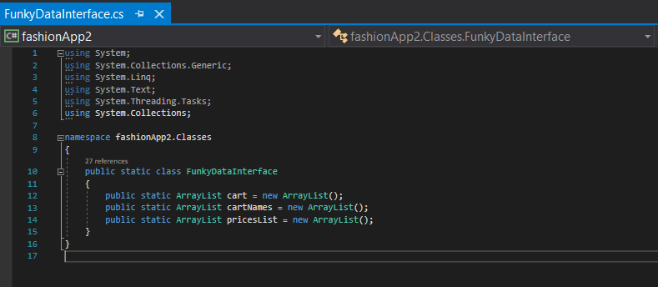
How it works
Holding Cart items while switching between windows
Separate class created as an interface to hold data

Slide 12
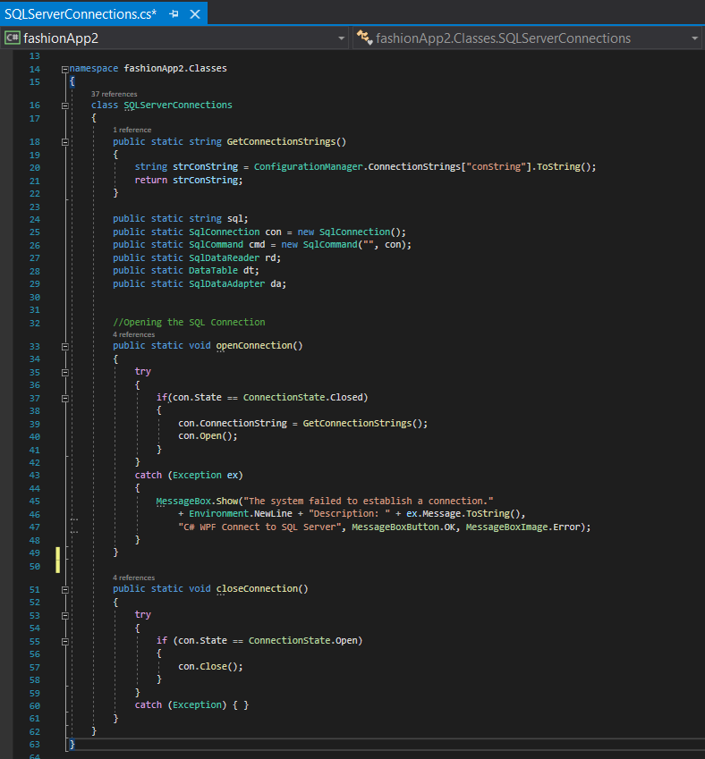
How it works
SQL Server Management
Separate class created for SQL Server Connection Management (Select, Add, Delete, Update)

Slide 13
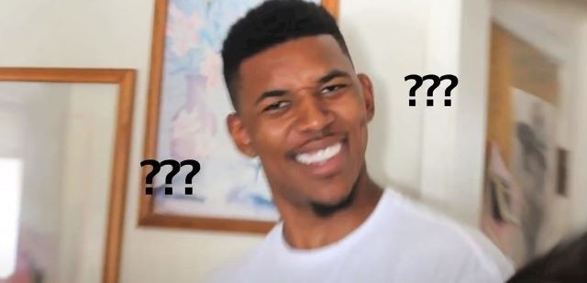
QnA Time

Slide 14
Thank You.

