Slide 1
Programming Fundamentals Coursework 2 (group work)
NIBM

Slide 2
The Team
Navin Thamindu | (dcsd202f-006)
Tharu Jayaweera | (dcsd202f-007)
Anupama Wanigasekara | (dcsd202f-008)
Supun Sandakalum | (dcsd202f-009)
Pathum Dhanushanka (dcsd202f-010)

Slide 3
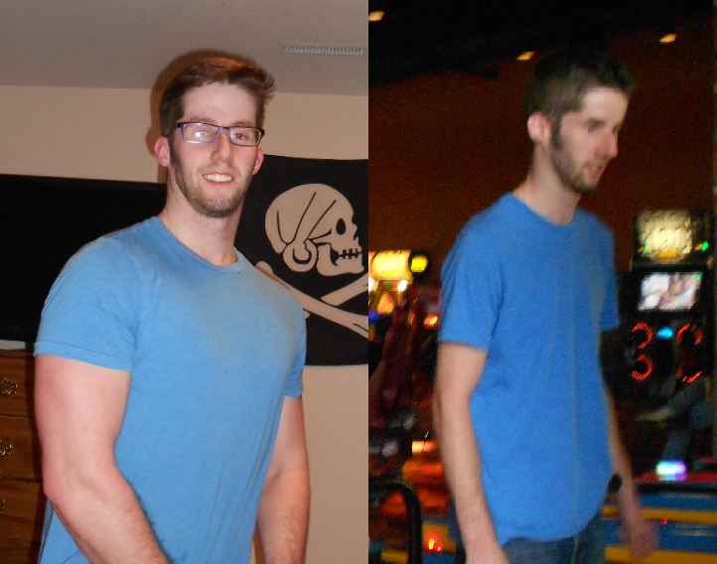
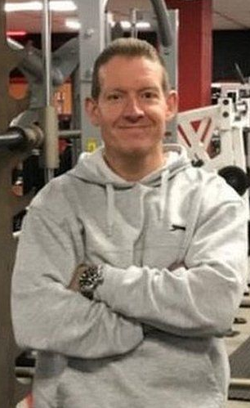
The Problem
Managing Sales
John
Gym Owner
Billing

Slide 4
The Problem
Managing Expenses
Linus
Skinny Boy
Selecting Products
Selecting Categories

Slide 5
The Problem
Linus
Avid Model
No Problems

Slide 6
The Problem
John
In need of an efficient
way to handle this
Gym Owner

Slide 7
The Solution
John wants to automate this process.
So why don’t we introduce a software.
That would -
Show available Products
Categorize Products
Digital Shopping Cart
Issues Bills for sales
Keep a log about sales

Slide 8

The Solution
SUPPLIMENT STORE
The supplement store management application

Slide 9
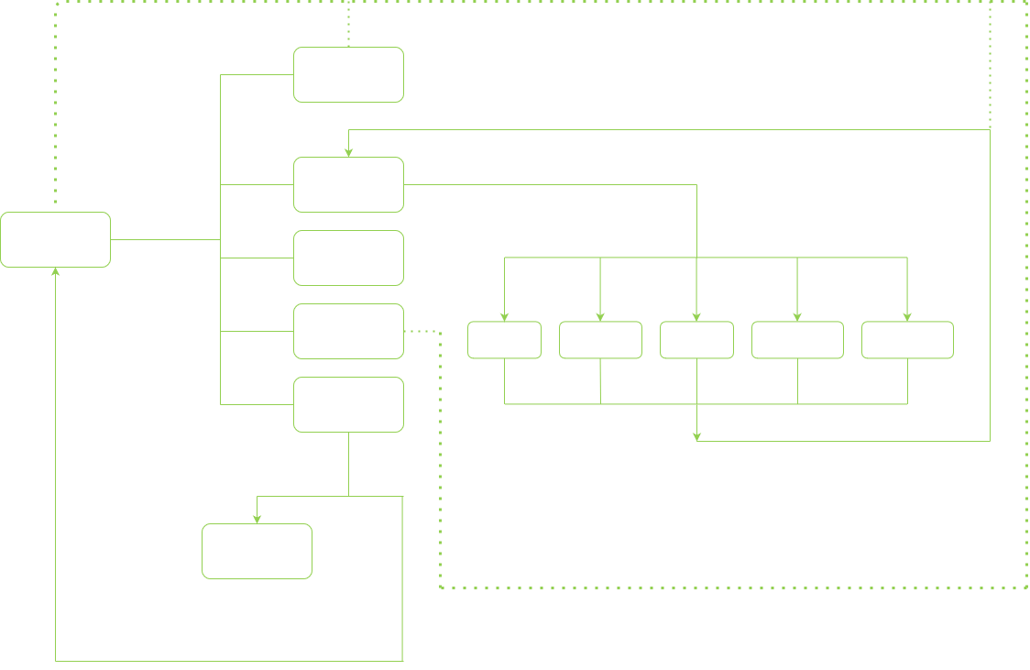
How it works
Writing to storage
Writing to storage / end session

Slide 10
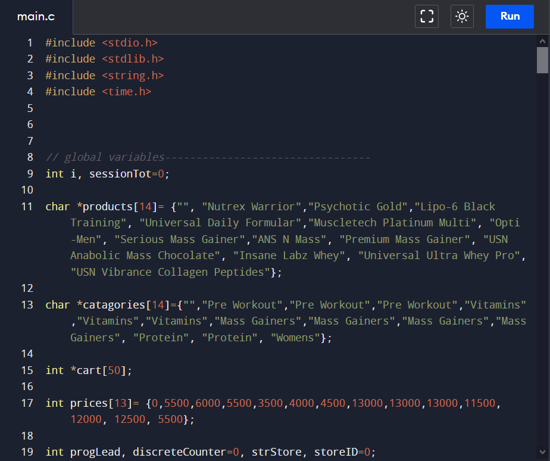
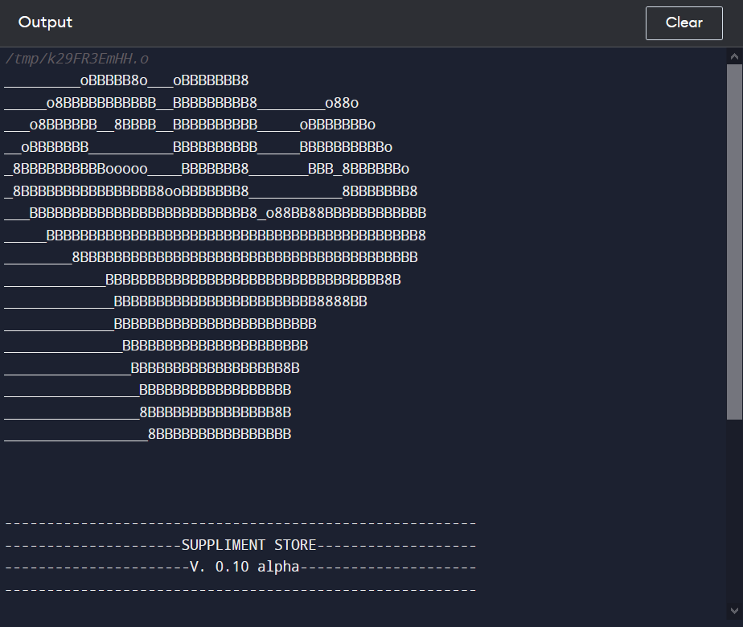
Demonstration

Slide 11
Used Technologies
Used C language
Used <stdio.h> library
Used <stdlib.h> library
Used <string.h> library
Used <time.h> library
Used mingw compiler
Used pastebin.com to share code
Used codeblocks for development and testing

Slide 12
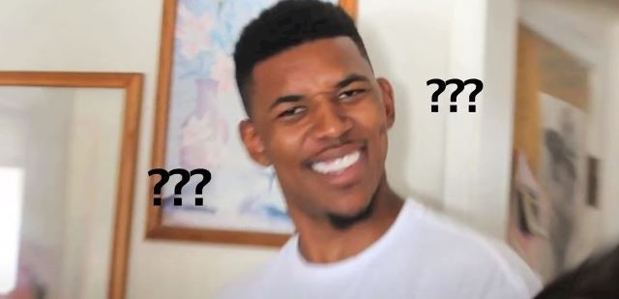
QnA Time

Slide 13
Thanks.

