Slide 1
Connecting R-Studio to Azure SQL Database
╠[[[_◊Ї_|≡₪|_Ї◊_]]]╣))_____________________________________________)
Jedi Jeremy O
SMU – Doing Data Science

Slide 2
Preface:
Maybe a little unconventional for the class, but being a Microsoft employee I wanted to share w/ the class how to connect R-studio to SQL Server as this is a vital data source for real-world data scientist.
From my experience as a cloud architect, as well as the data scientists & big data architects whom I work w/ at Microsoft, 80% of the data that we work with is still housed in a traditional database or data warehouse. [In fact this week did machine learning cloud architecture for a gas & oil company's data warehouse & sensor logs]
So not really conventional for the class, but hopefully you and my fellow students will find useful for real-world application

Slide 3
High Level Steps
NOTE: Assuming you have a SQL DB in Azure. This process can also be adopted for a SQL DB on premise.
Verify ODBC connector version in Windows 10
Configure ODBC connector
In R-Studio install RODBC package
Configure connection + credentials
Import data as data frame

Slide 4
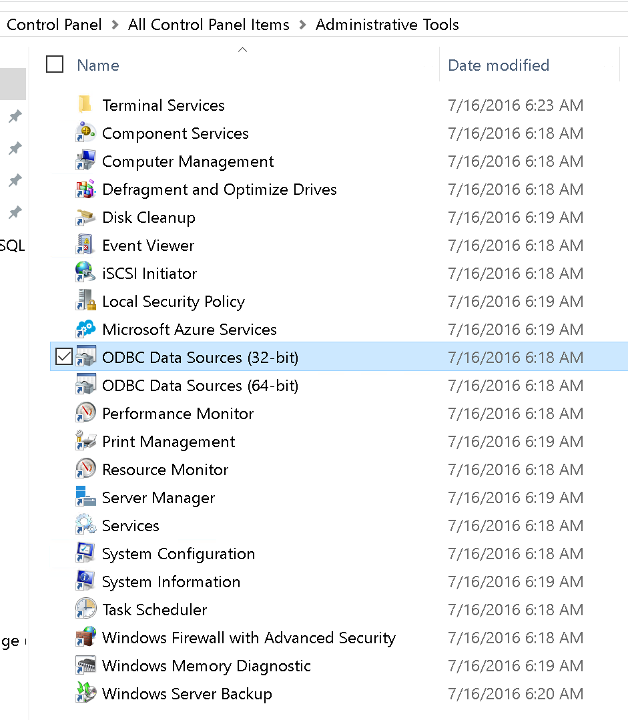
Find the ODBC Connector
NOTE: This is for Windows OS. Mac users see this URL:
https://docs.microsoft.com/en-us/sql/connect/odbc/linux-mac/installing-the-microsoft-odbc-driver-for-sql-server?view=sql-server-2017
In the search icon type Control Panel
Within the Control Panel locate & select Administrative Tools
Within Administrative Tools click on ODBC Data Sources 32-bit

Slide 5
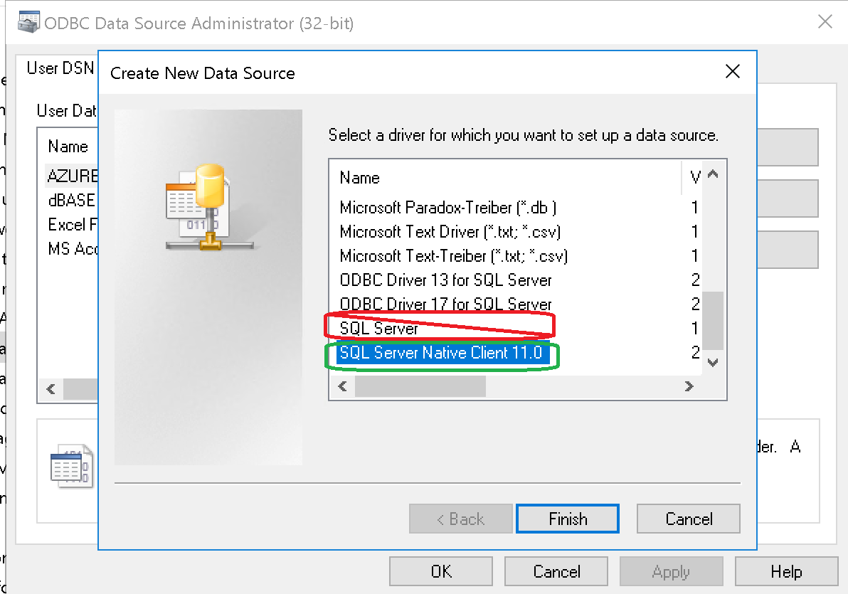
Verify Correct ODBC Connector Type
Download the updated ODBC connector:
https://docs.microsoft.com/en-us/sql/connect/odbc/microsoft-odbc-driver-for-sql-server
In the User DSN tab click Add
In the new window that opens look for an option that says SQL Server Native Client.
NOTE: the option that says only SQL Server is NOT the correct option. If you do not see SQL Server Native Client you need to download the correct ODBC connector

Slide 6
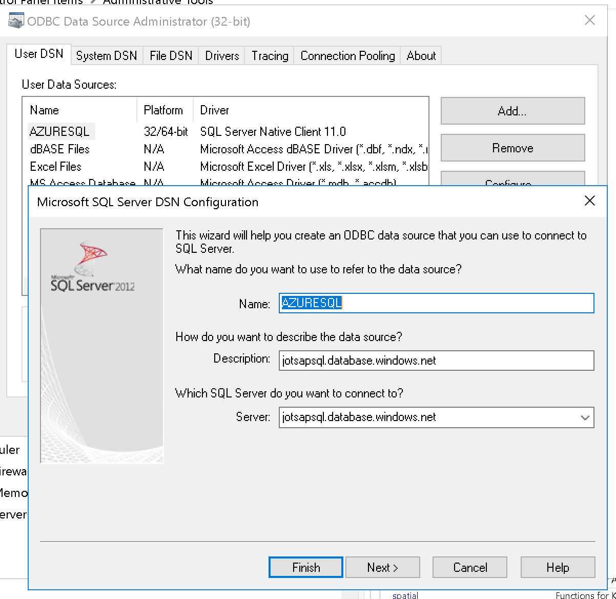
Configure ODBC Connection
You will need the following information at a minimum to configure the ODBC connection:
Server’s DNS name or IP address
Authorized account / username
Credential / password
Note the name you give. In this case I named mine AZURESQL.
Optionally you may want to set the default database to the one you are interested in.
Ex) Sales, Inventory, Customers, etc

Slide 7
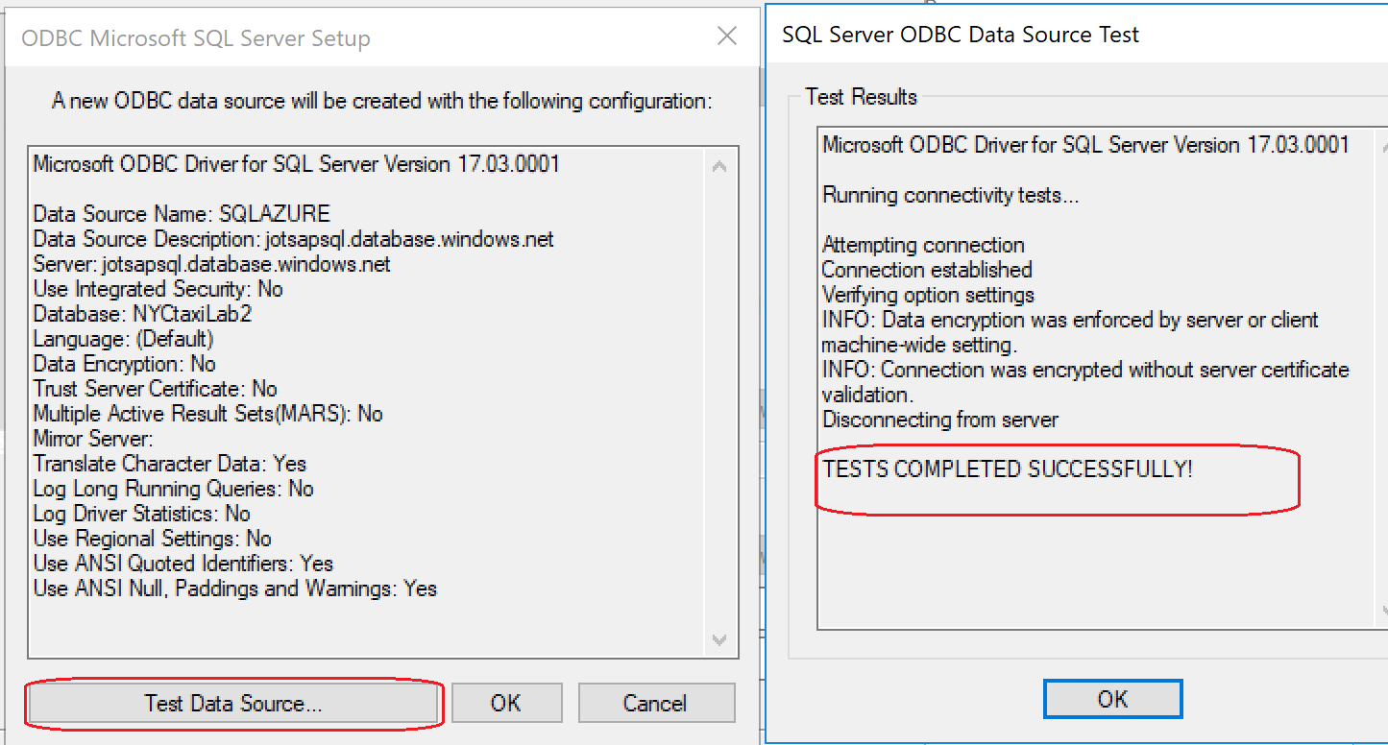
Test ODBC Connection
Validate the ODBC connection

Slide 8
The R Code To Connect To SQL
### SQL CONNECTION ###
# load RODBC library
library(RODBC)
# call previously configured ODBC connection "AZURESQL"
# note you will need to configure credentials
# NOT SECURE FOR PRODUCTION
odbcConnect("AZURESQL", uid = "sqladmin", pwd = "*******") -> azureodbc
# Imbeds following SQL statement: select top(10000) from trips_all
# Takes top 10000 rows w/ all columns from "trips_all" data base
# then outputs those results to taxi.df data frame
sqlQuery(azureodbc, "select top(10000) * from dbo.trips_all;" ) -> taxi.df
# verify taxi.df
head(taxi.df)
str(taxi.df)

Slide 9
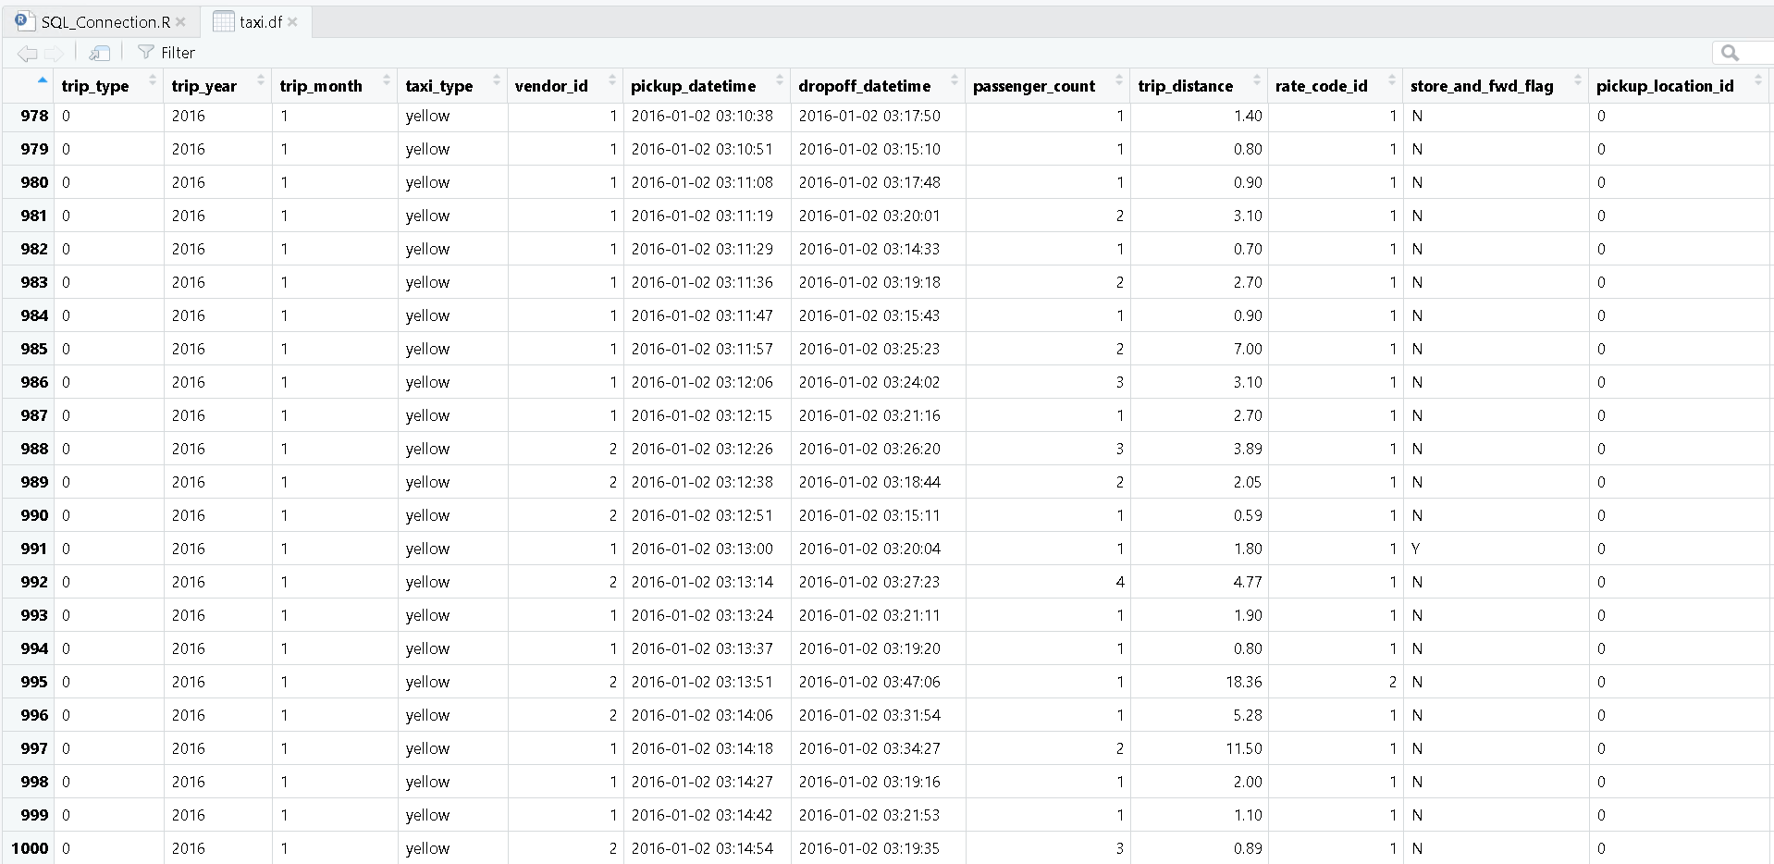
Screenshot of Results

Slide 10
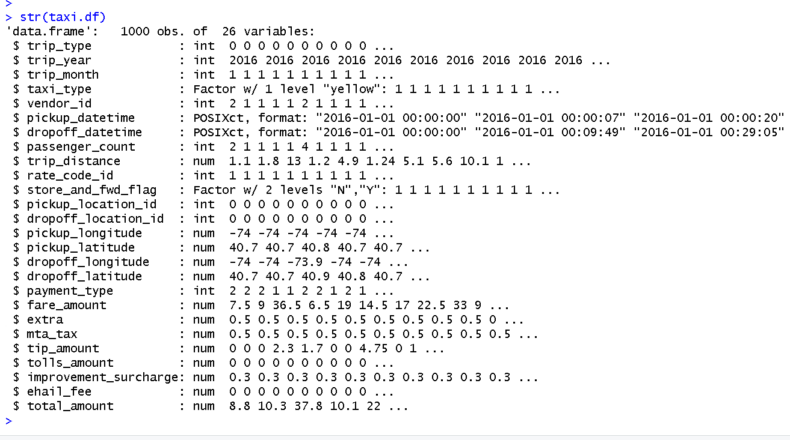
Looking at Ingested Data
Notice that datetime attribute is automatically categorized
[very convenient for timestamps on logs, sensor data, etc]

