Slide 1
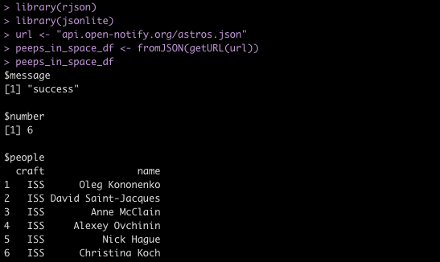
How many people are in space right now?
No key, username, or passcode required

