Slide 1






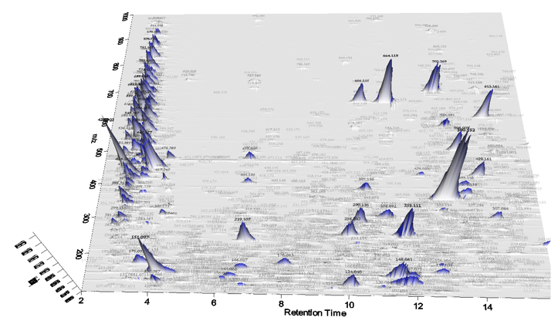


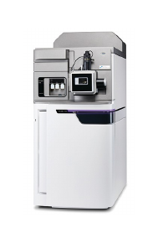

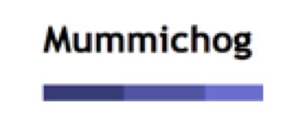

Blank Subtraction & Statistical Analysis
Unidentified Metabolites Search
mzXML files
Data Processing
File Format Transformation
Sample preparation
LC-HRMS
Report Generation
Pathway Analysis

Slide 2
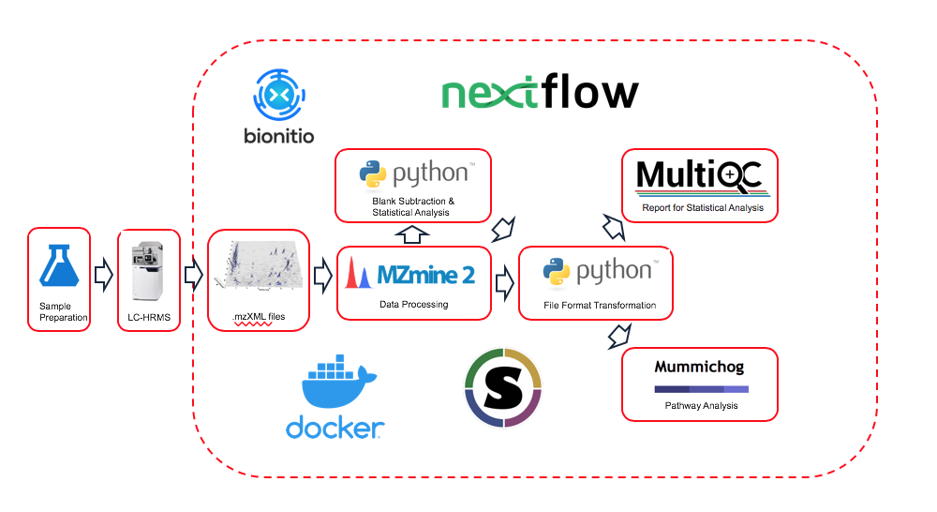
Overview of RUMP Workflow
RUMP Github: https://github.com/lemaslab/RUMP

