Slide 1





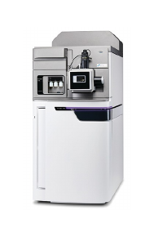

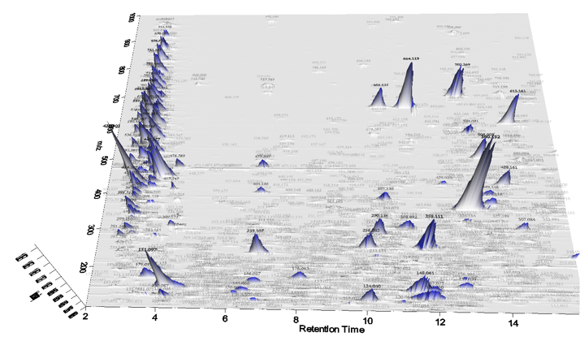


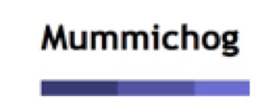

Blank Subtraction & Statistical Analysis
Unidentified Metabolites Search
Sample preparation
LC-HRMS
mzXML files
Data Processing
File Format Transformation
Report Generation
Pathway Analysis

Slide 2
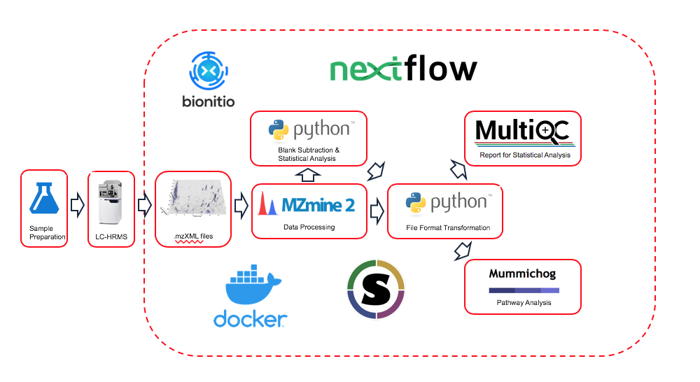
Overview of RUMP Workflow
RUMP Github: https://github.com/lemaslab/RUMP

