Slide 1






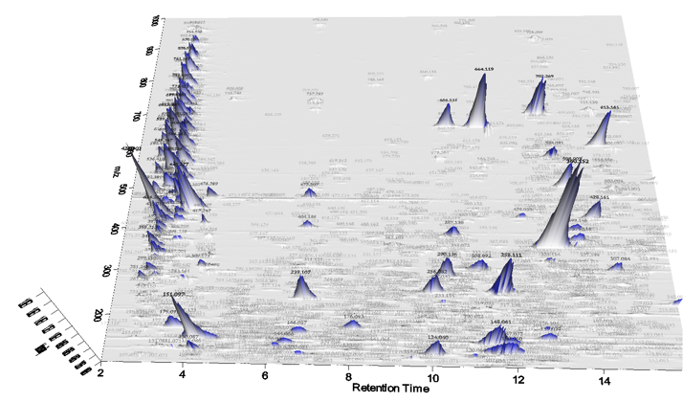


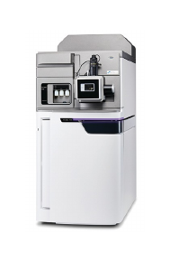

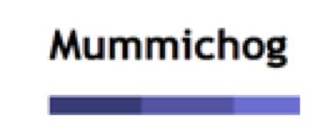

Blank Subtraction & Statistical Analysis
Unidentified Metabolites Search
mzXML files
Data Processing
File Format Transformation
Sample preparation
LC-HRMS
Report Generation
Pathway Analysis

Slide 2







h
i
Blank Subtraction & Statistical Analysis
Unidentified Metabolites Search
a
d
f
Data Deposited to Public Repositories
Data Format Conversion
Converted Files
j
g
File Format Transformation
Data Processing
MODIS Data Quality Qssessment
k
l
Report Generation
Pathway Analysis
b
c
e
Sample Preparation
LC-HRMS

