Slide 1
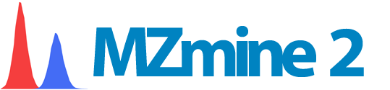
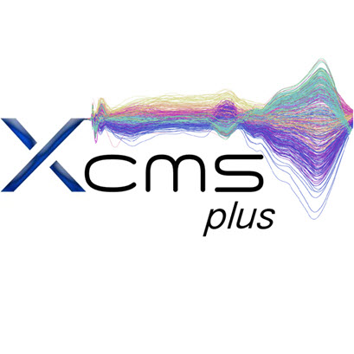


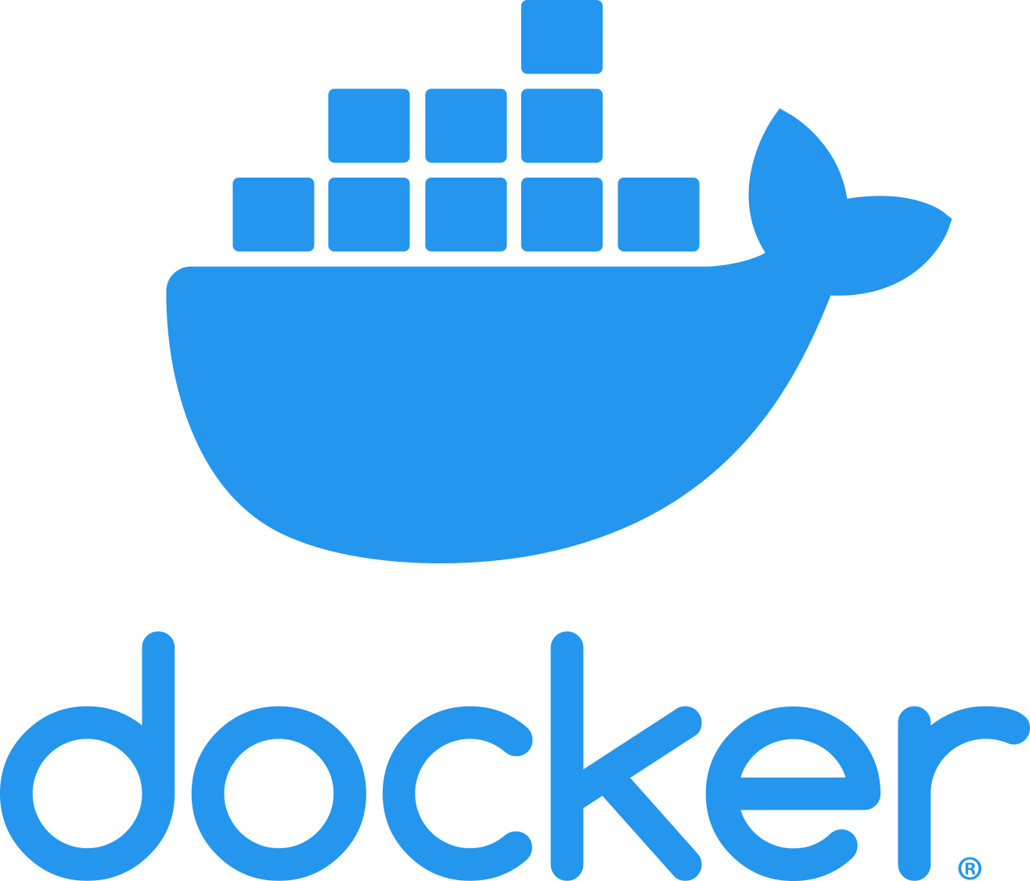


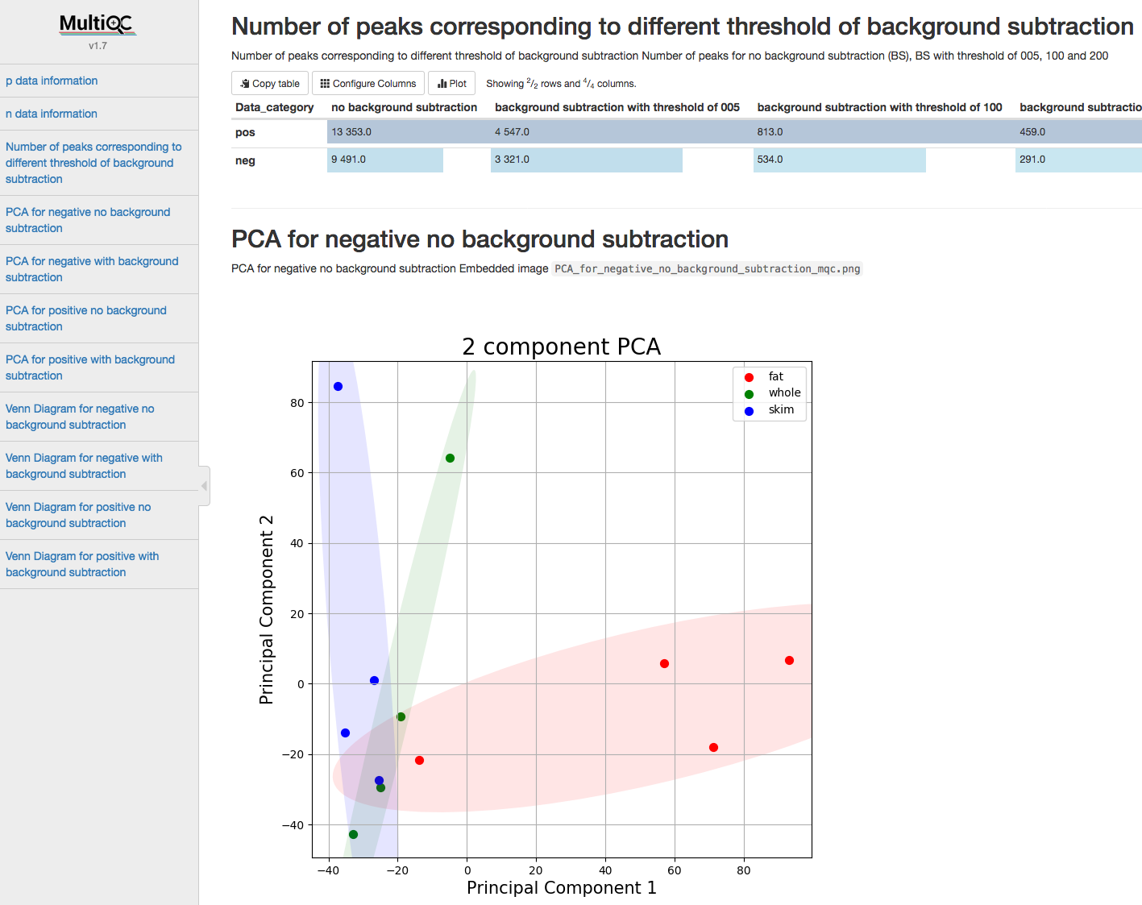
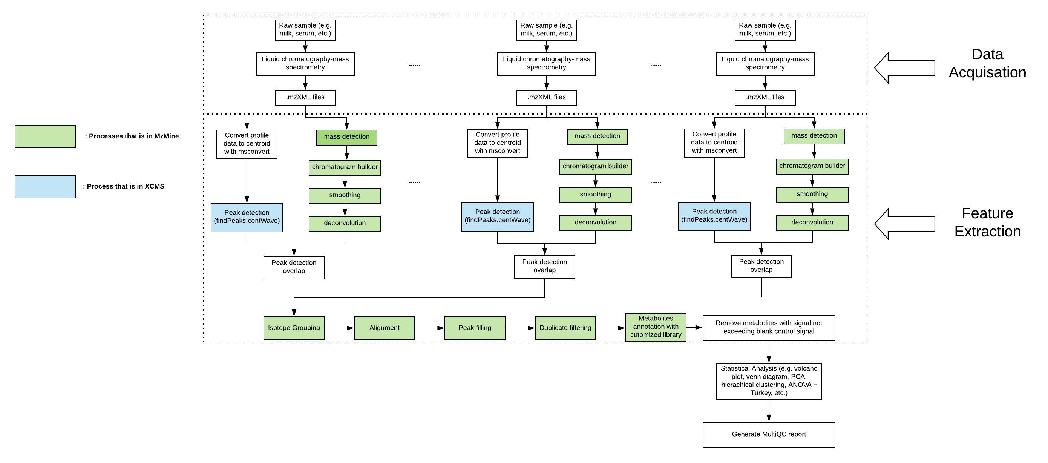
A Reproducible Pipeline for Scalable Untargeted Metabolomics Data Analysis
Xinsong Du, M.S.¹, Luran Manfio¹, Alexander Kirpich, Ph.D.², William R. Hogan, M.D.¹, Timothy J. Garrett, Ph.D.³ & Dominick J. Lemas, Ph.D.¹
Department of Health Outcomes & Biomedical Informatics, College of Medicine, University of Florida¹,
Department of Population Health Sciences, School of Public Health, Georgia State University²,
Department of Pathology, Immunology and Laboratory Medicine, College of Medicine, University of Florida³
Background
Methods
Untargeted metabolomics data is increasingly collected by epidemiological studies to investigate population-level variation in the development of health and disease
XCMS and MzMine are two tools that have been widely used by metabolomics community for untargeted metabolomics research
Reproducibility of metabolomics workflow remains notoriously difficult, metabolomics identification with XCMS can generate very different result from using MzMine.
Recent study shows combining the results of XCMS and MzMine can increase the precision of metabolites identification.
Study shows different software version or even operating system version can lead to different result when running the exact same code.
Nextflow is scalable and reproducible scientific workflow that can implement metabolomics tools using containers on high-performance computers.
Streamline computational steps
Increase precision of metabolites detection
Control versions for software/package/operating system
Beautify Report
Increase scalability
Results
Conclusions
We have developed a container-based platform that has potential to facilitate high-throughput and scalable untargeted metabolomics data analysis with high levels of reproducibility, scalability and transparency.
Workflow
Conclusion
Research was supported by the NIAAA, with co-funding from the NIDA, of the National Institutes of Health under Award Number 5R01AA02069. We also acknowledge generous support from

