Slide 1
A Reproducible Pipeline for Scalable Untargeted Metabolomics Data Analysis
Xinsong Du, M.S.
Ph.D. Student, Graduate Assistant
Department of Health Outcomes and Biomedical Informatics
University of Florida, College of Medicine

Slide 2
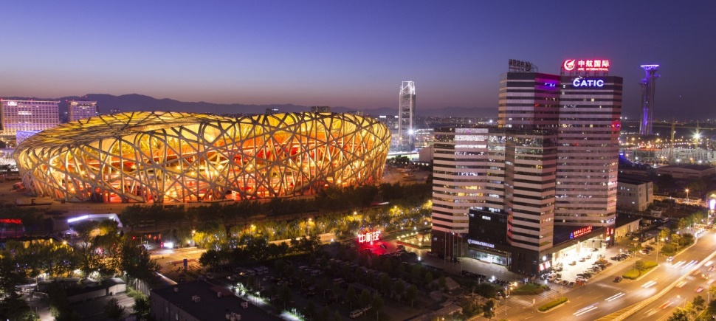

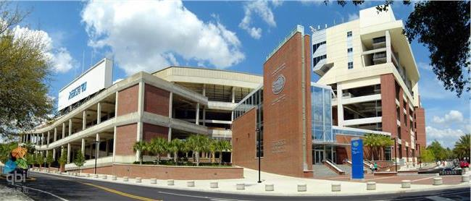

About Me
02/2002 – Present: Live in Beijing, China
05/1993 – 02/2002: Live in Linyi, Shandong Province, China
08/2015 – 05/2017 (M.S., Computer Engineering):
University of Florida, Gainesville, FL, U.S.
08/2017 – Present (Ph.D. student, Biomedical Informatics):
University of Florida, Gainesville, FL, U.S.
09/2011 – 07/2015 (B.S. Electrical Engineering):
Shandong University, Jinan, Shandong Province,
China

Slide 3
Outline
Background & Objectives
Methods & Workflow
Results
Conclusion

Slide 4
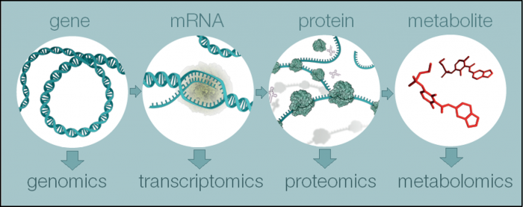
PRESENTATION TITLE
What is Metabolomics?
(Reference: https://www.ebi.ac.uk/training/online/course/introduction-metabolomics/what-metabolomics)
Notes:
Metabolomics is a powerful approach because metabolites and their concentrations, unlike other "omics" measures, directly reflect the underlying biochemical activity and state of cells / tissues. Thus metabolomics best represents the molecular phenotype.

Slide 5
PRESENTATION TITLE
What is Untargeted Analysis?
Targeted:
Quantify some particular metabolites in the material
Untargeted:
Detect what metabolites are contained in the material
Notes:
Metabolomics is a powerful approach because metabolites and their concentrations, unlike other "omics" measures, directly reflect the underlying biochemical activity and state of cells / tissues. Thus metabolomics best represents the molecular phenotype.

Slide 6
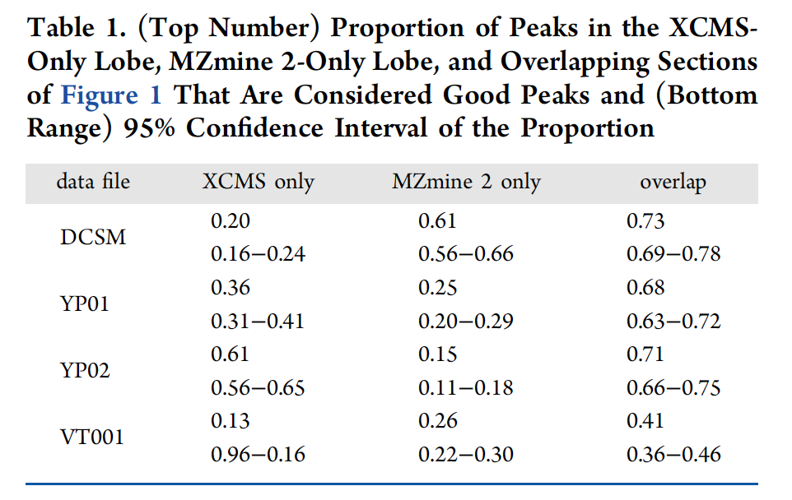
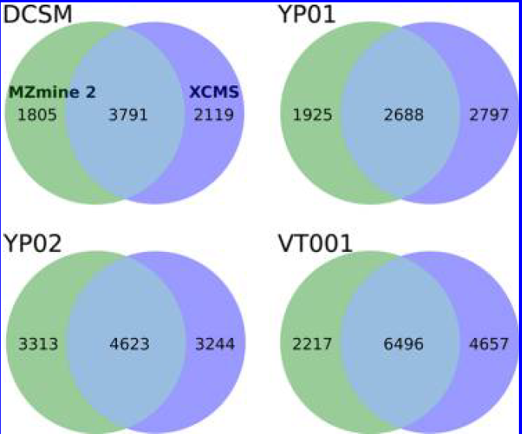
PRESENTATION TITLE
Background
Reference: Myers, O. D., Sumner, S. J., Li, S., Barnes, S. & Du, X. Detailed Investigation and Comparison of the XCMS and MZmine 2 Chromatogram Construction and Chromatographic Peak Detection Methods for Preprocessing Mass Spectrometry Metabolomics Data. Anal. Chem. 89, 8689–8695 (2017).

Slide 7
PRESENTATION TITLE
Background
Study shows different software version or even operating system version can lead to different result when running the exact same code.
Currently, software containers are able to package all codes and dependencies of an application to ensure portability, infrastructure flexibility and reproducibility.
Nextflow is a scalable and reproducible scientific workflow that can implement metabolomics tools using containers on high-performance computers.

Slide 8
PRESENTATION TITLE
Objective
Develop an open-source tool using Nextflow incorporating both MzMine and XCMS to facilitate reproducible and scalable untargeted metabolomic data analysis

Slide 9
Method

Slide 10
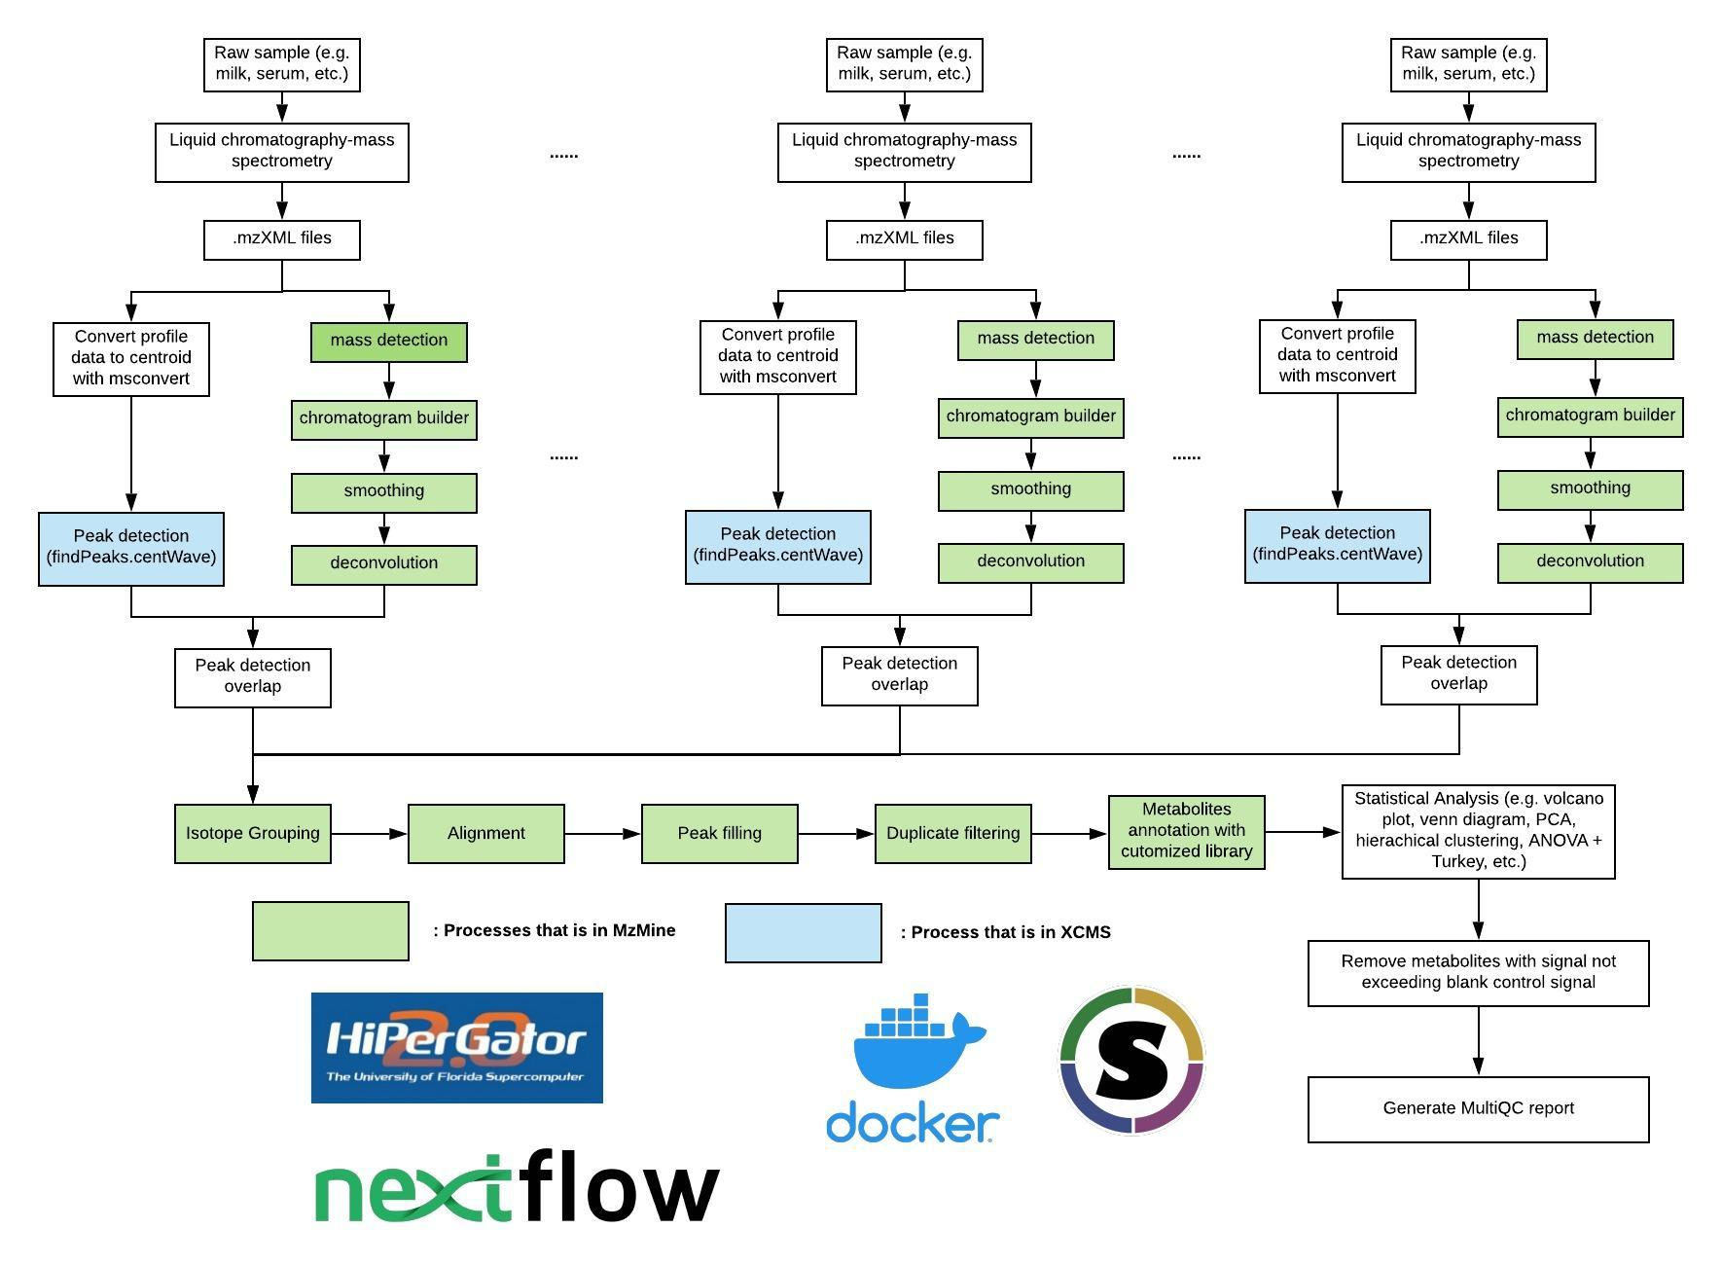
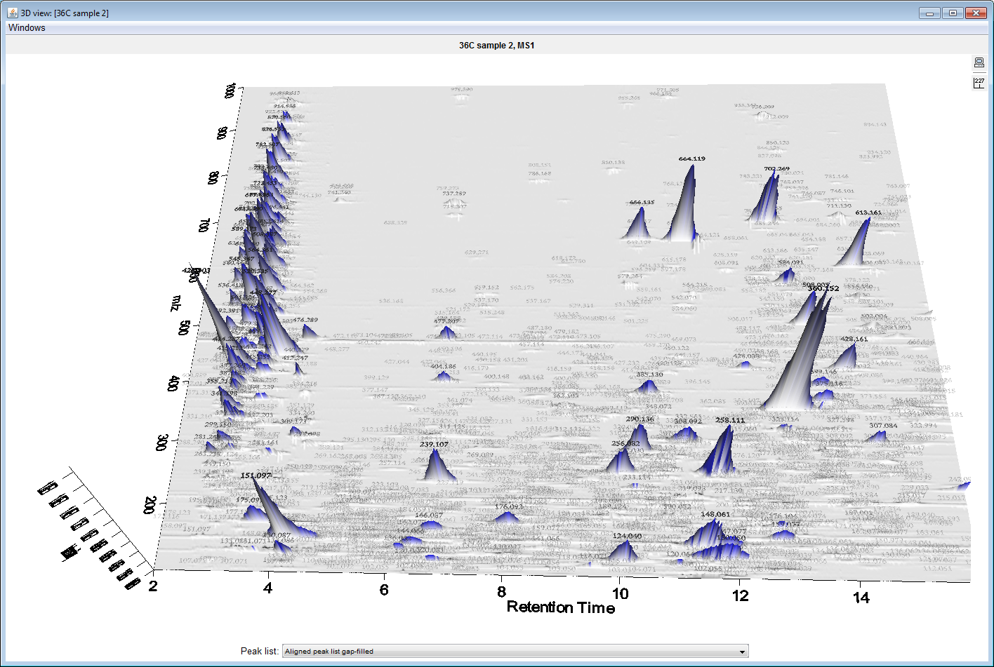

Slide 11
Results

Slide 12
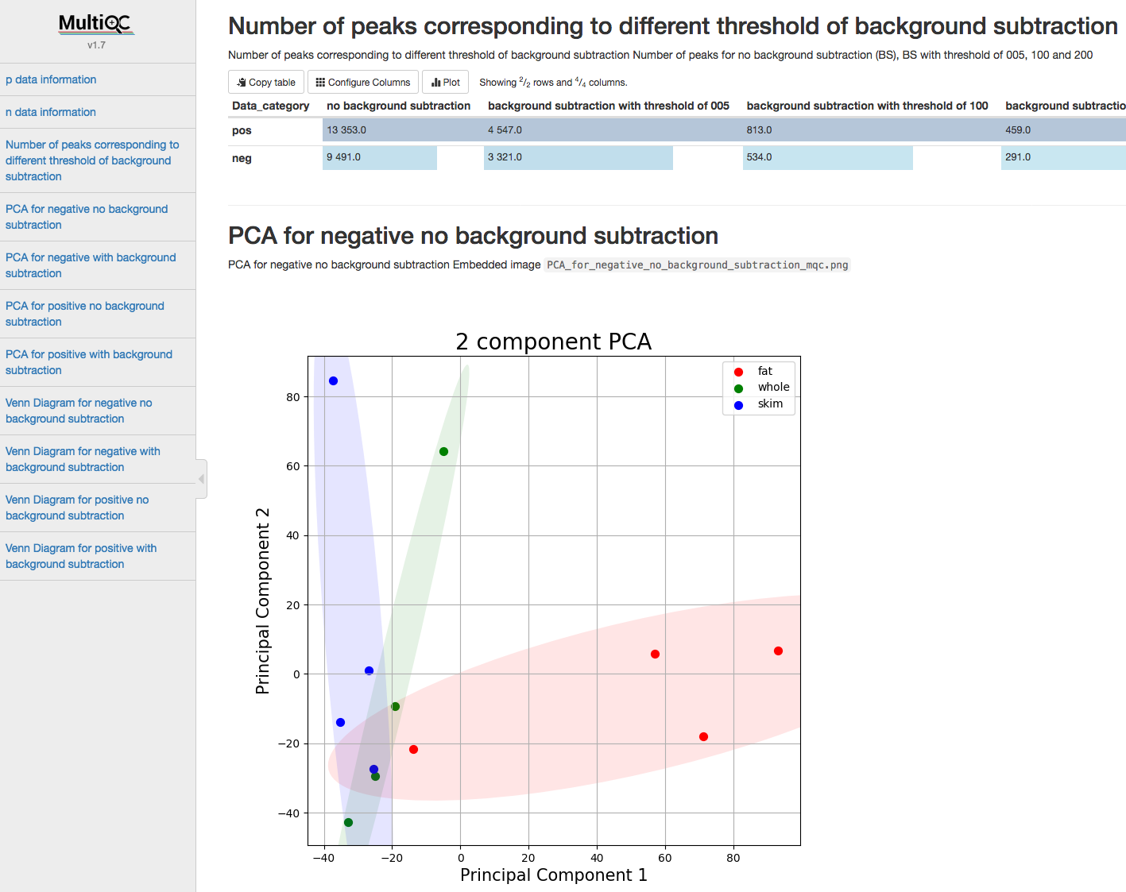
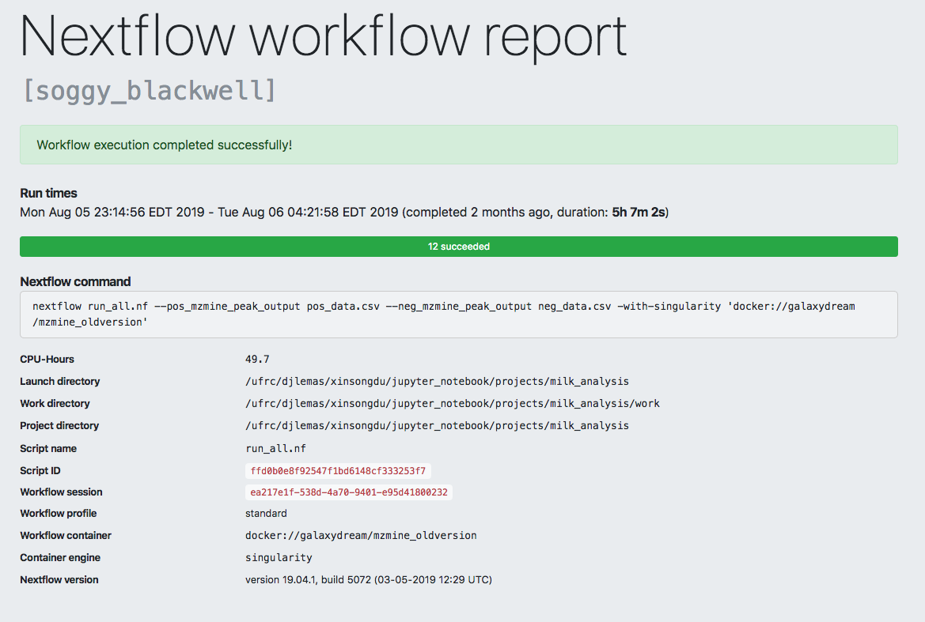
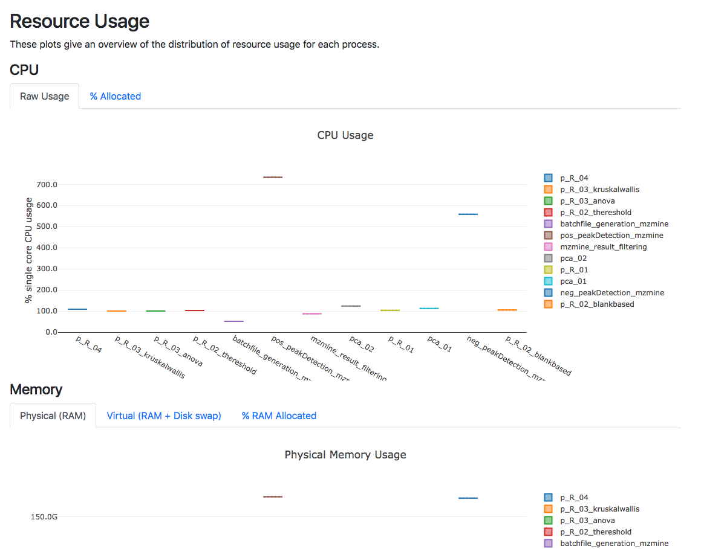

Slide 13
Conclusion
We have developed a container-based platform that has potential to facilitate high-throughput and scalable untargeted metabolomics data analysis with high levels of reproducibility, scalability and transparency.

Slide 14
Acknowledgements
Mentor
Dr. Dominick J. Lemas
Co-authors
Luran Manfio, Alexander Kirpich, William R. Hogan, Timothy J. Garrett, Dominick J. Lemas

Slide 15
Thank you

