Slide 1
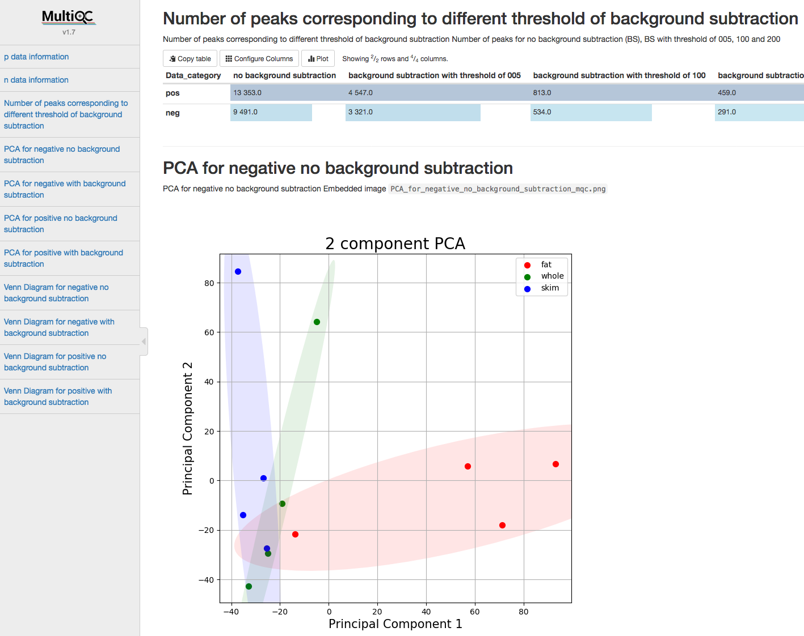
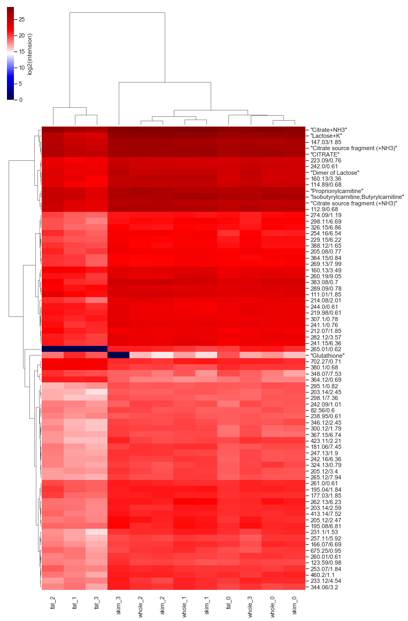

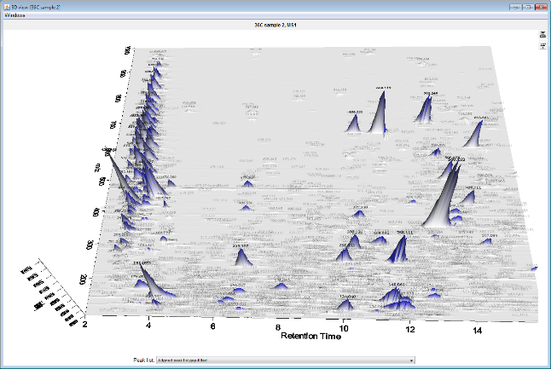
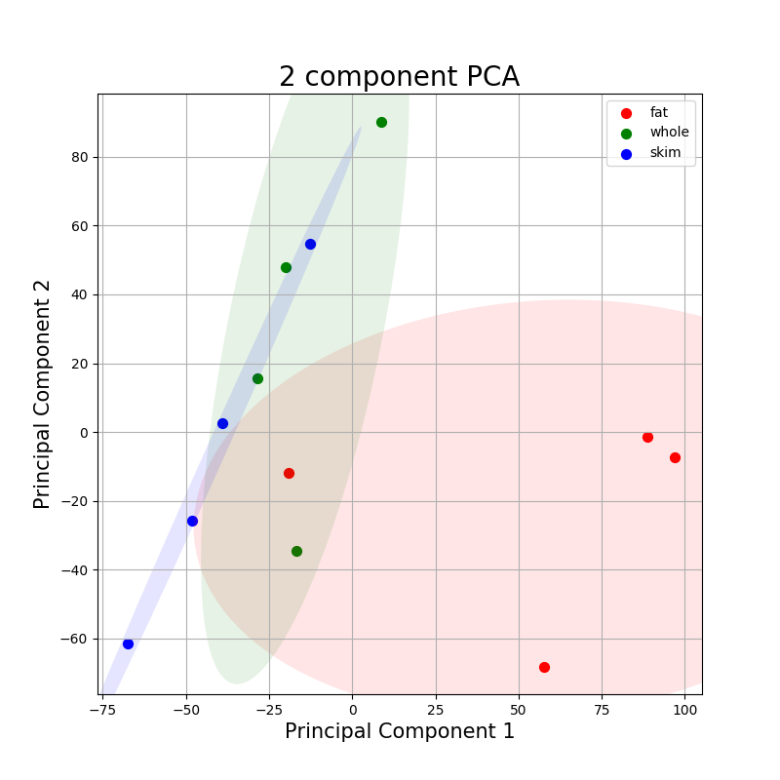
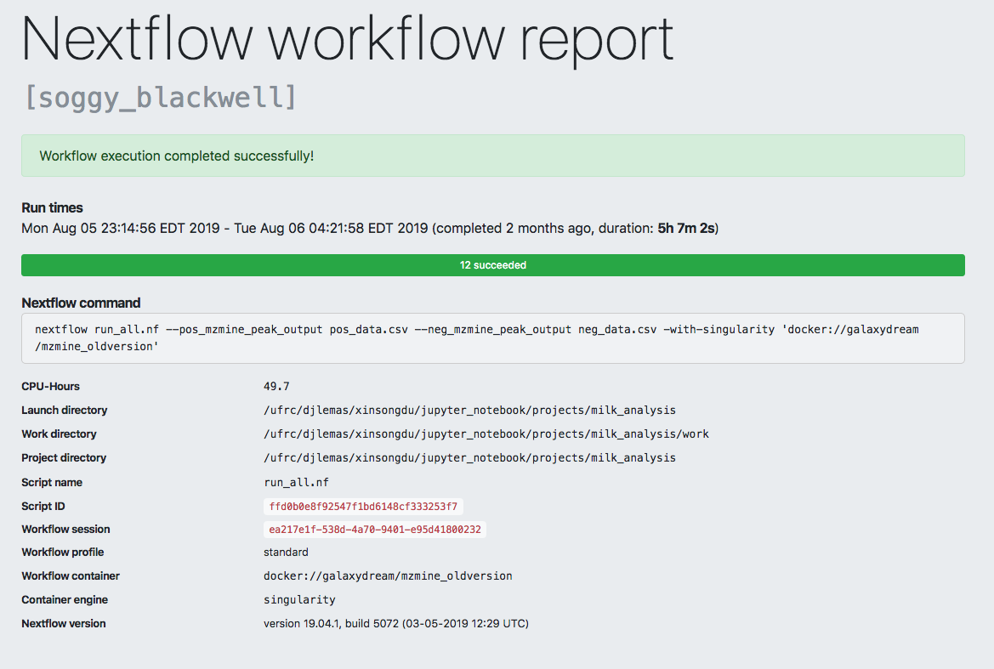
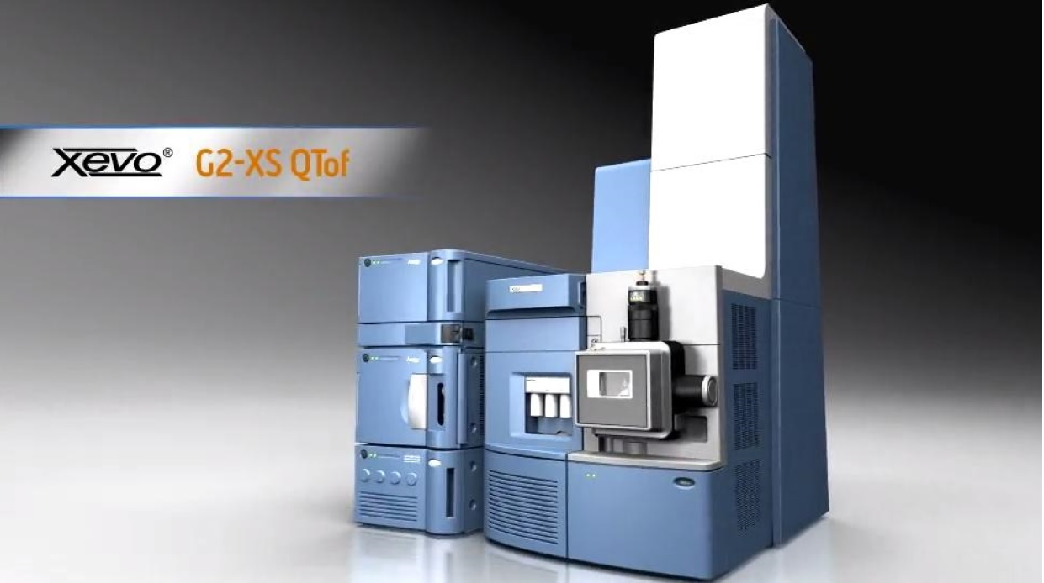
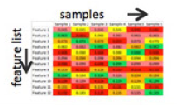
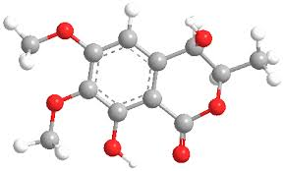
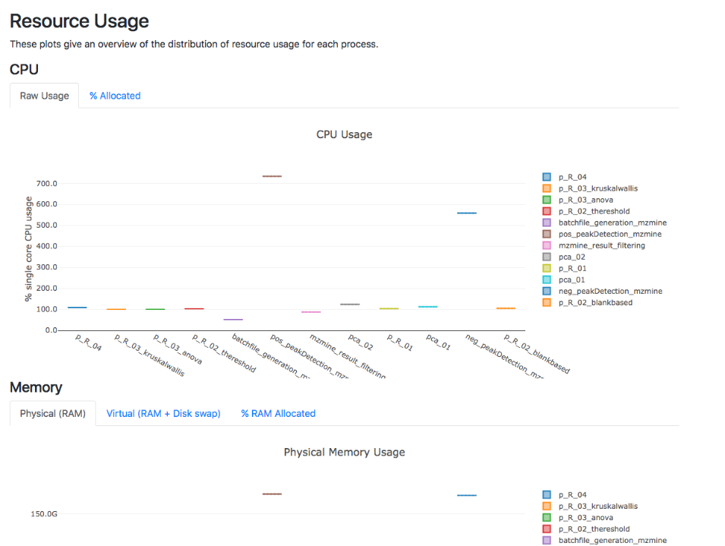


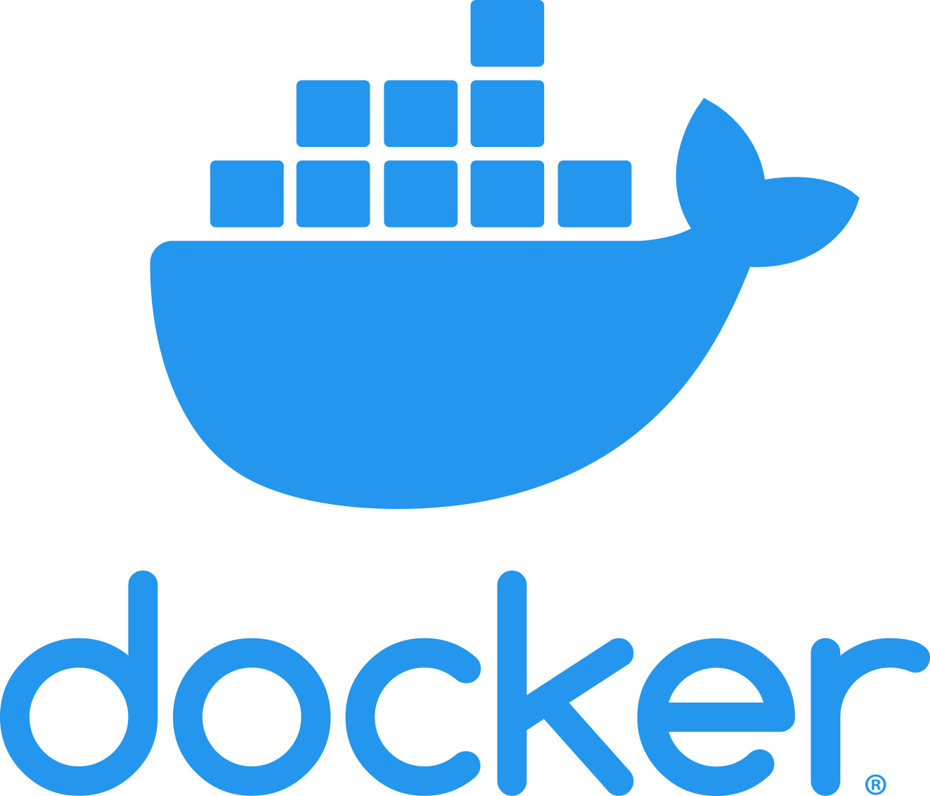
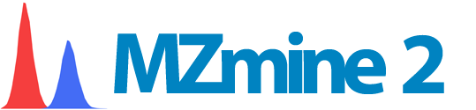
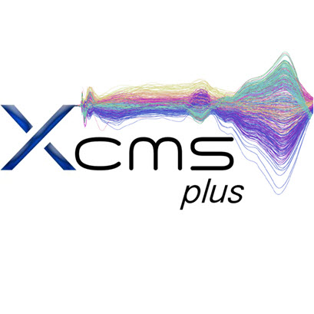

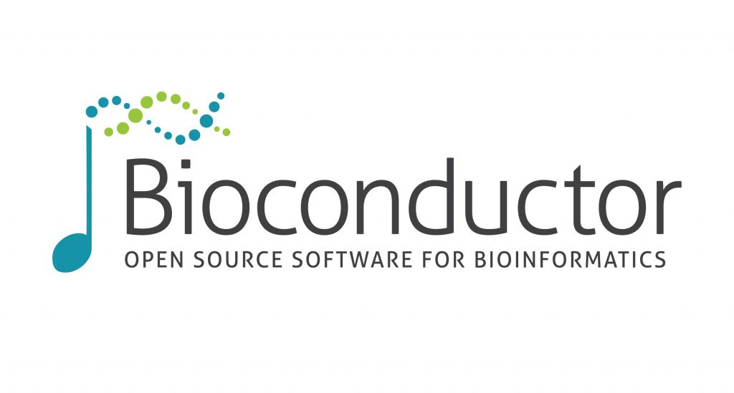

A Reproducible Pipeline for Scalable Untargeted Metabolomics Data Analysis
Xinsong Du, M.S.¹, Luran Manfio¹, Alexander Kirpich, Ph.D.², William R. Hogan, M.D.¹, Timothy J. Garrett, Ph.D.³ & Dominick J. Lemas, Ph.D.¹
Department of Health Outcomes & Biomedical Informatics, College of Medicine, University of Florida¹,
Department of Population Health Sciences, School of Public Health, Georgia State University²,
Department of Pathology, Immunology and Laboratory Medicine, College of Medicine, University of Florida³
Background
Results
MultiQC Report:
Metabolomics is the scientific study of chemical processes involving metabolites, the small molecule substrates, intermediates and products of metabolism.
Metabolomics data processing procedure:
Reproducibility:
Reproducibility is the closeness of the agreement between the results of measurements of the same measured carried out with same methodology described in the corresponding scientific evidence (e.g. a publication in a peer-reviewed journal)
Reproducibility of scientific research has been steadily rising with reports estimating that only 30% of peer-reviewed results can be replicated.
Requirements for reproducibility:
Data Information
Statistical Analysis
Interactive Report
Nextflow Report:
Computational resource information that can guide resource allocation in supercomputers like HiPerGator
Data Acquisition
Feature Extraction
Statistical Analysis
Data processing dilemmas:
multiple data formats
multiple steps
multiple programs
computationally intensive
Reproducibility
Scalability
Metabolites Identification
Conclusions
We built a container-based platform to eliminate variations of operating systems thus increase reproducibility.
We used Nextflow streamline separate steps metabolomics data processing.
We used HiPerGator to increase the scalability of our software, along with Nextflow report to guide setting the parameters for allocating HiPerGator resources.
We combined two widely used metabolomics data processing software (MzMine and XCMS) to increase the precision of metabolites identification.
We employed MultiQC to generate an interactive report easing the results analysis process.
Data
Operating System
Code
Methods
Acknowledgements
Data
Mentor
Dr. Dominick J. Lemas
Co-authors
Luran Manfio, Alexander Kirpich, William R. Hogan, Timothy J. Garrett, Dominick J. Lemas
Funding
K01 DK115632 (NIDDK); SECIM P&F; CTSI Pilot Award; Robin Hood Foundation; NIH Loan Repayment Program
HiPerGator Team
Operating System
Code
Research was supported by the NIAAA, with co-funding from the NIDA, of the National Institutes of Health under Award Number 5R01AA02069. We also acknowledge generous support from

