Slide 1
A Reproducible Pipeline for Scalable Untargeted Metabolomics Data Analysis
Xinsong Du, M.S.
Ph.D. Student, Graduate Assistant
Department of Health Outcomes and Biomedical Informatics
University of Florida, College of Medicine

Slide 2




About Me
02/2002 – Present: Live in Beijing, China
05/1993 – 02/2002: Live in Linyi, Shandong Province, China
08/2015 – 05/2017 (M.S., Computer Engineering):
University of Florida, Gainesville, FL, U.S.
08/2017 – Present (Ph.D. student, Biomedical Informatics):
University of Florida, Gainesville, FL, U.S.
09/2011 – 07/2015 (B.S. Electrical Engineering):
Shandong University, Jinan, Shandong Province,
China

Slide 3
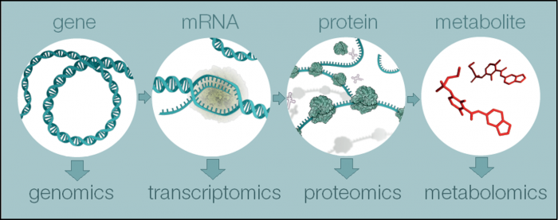
What is Metabolomics?
(Reference: https://www.ebi.ac.uk/training/online/course/introduction-metabolomics/what-metabolomics)
Notes:
Metabolomics is a powerful approach because metabolites and their concentrations, unlike other "omics" measures, directly reflect the underlying biochemical activity and state of cells / tissues. Thus metabolomics best represents the molecular phenotype.
Gene + transcript -> mRNA
mRNA + translate -> protein

Slide 4
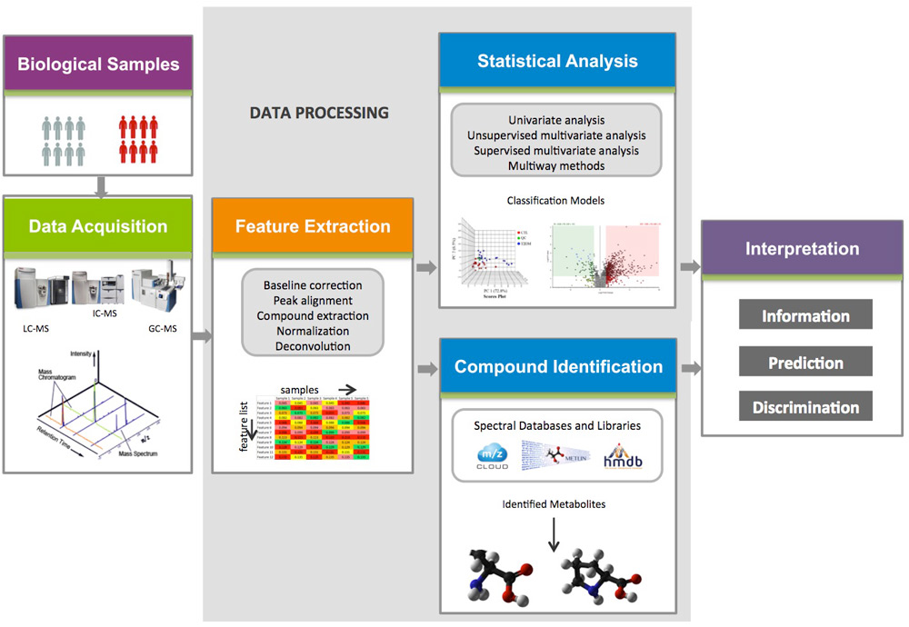
Metabolomics Data Processing
Notes:
Metabolomics is a powerful approach because metabolites and their concentrations, unlike other "omics" measures, directly reflect the underlying biochemical activity and state of cells / tissues. Thus metabolomics best represents the molecular phenotype.

Slide 5
Reproducible Research
Definition: A second researcher might use the same raw data to build the same analysis files and implement the same statistical analysis in an attempt to yield the same results
Concern about the reproducibility of scientific research has been steadily rising recently with reports that the results of experiments in numerous domains of science could not be replicated.
Problems in biomedical research have garnered most of the attention, concerns have touched almost every field in the biological and social sciences and beyond
(Reference: Goodman, S. N., Fanelli, D., & Ioannidis, J. P. A. (2016). What does research reproducibility mean? Science Translational Medicine, 8(341), 341ps12. https://doi.org/10.1126/scitranslmed.aaf5027)
Notes:
Metabolomics is a powerful approach because metabolites and their concentrations, unlike other "omics" measures, directly reflect the underlying biochemical activity and state of cells / tissues. Thus metabolomics best represents the molecular phenotype.

Slide 6
Objective
Developing a open-source tool for reproducible untargeted metabolomic data analysis for the purpose of facilitating collaboration among metabolomics researchers.

Slide 7
Data
Code
Good Reproducibility
Operating System
Computational Steps
Software/Package

Slide 8
Method

Slide 9


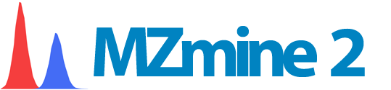


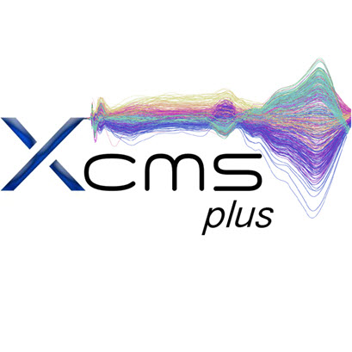
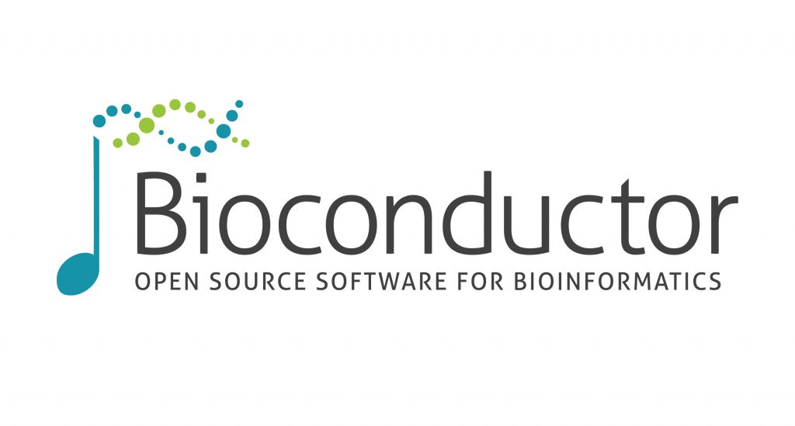

Slide 10
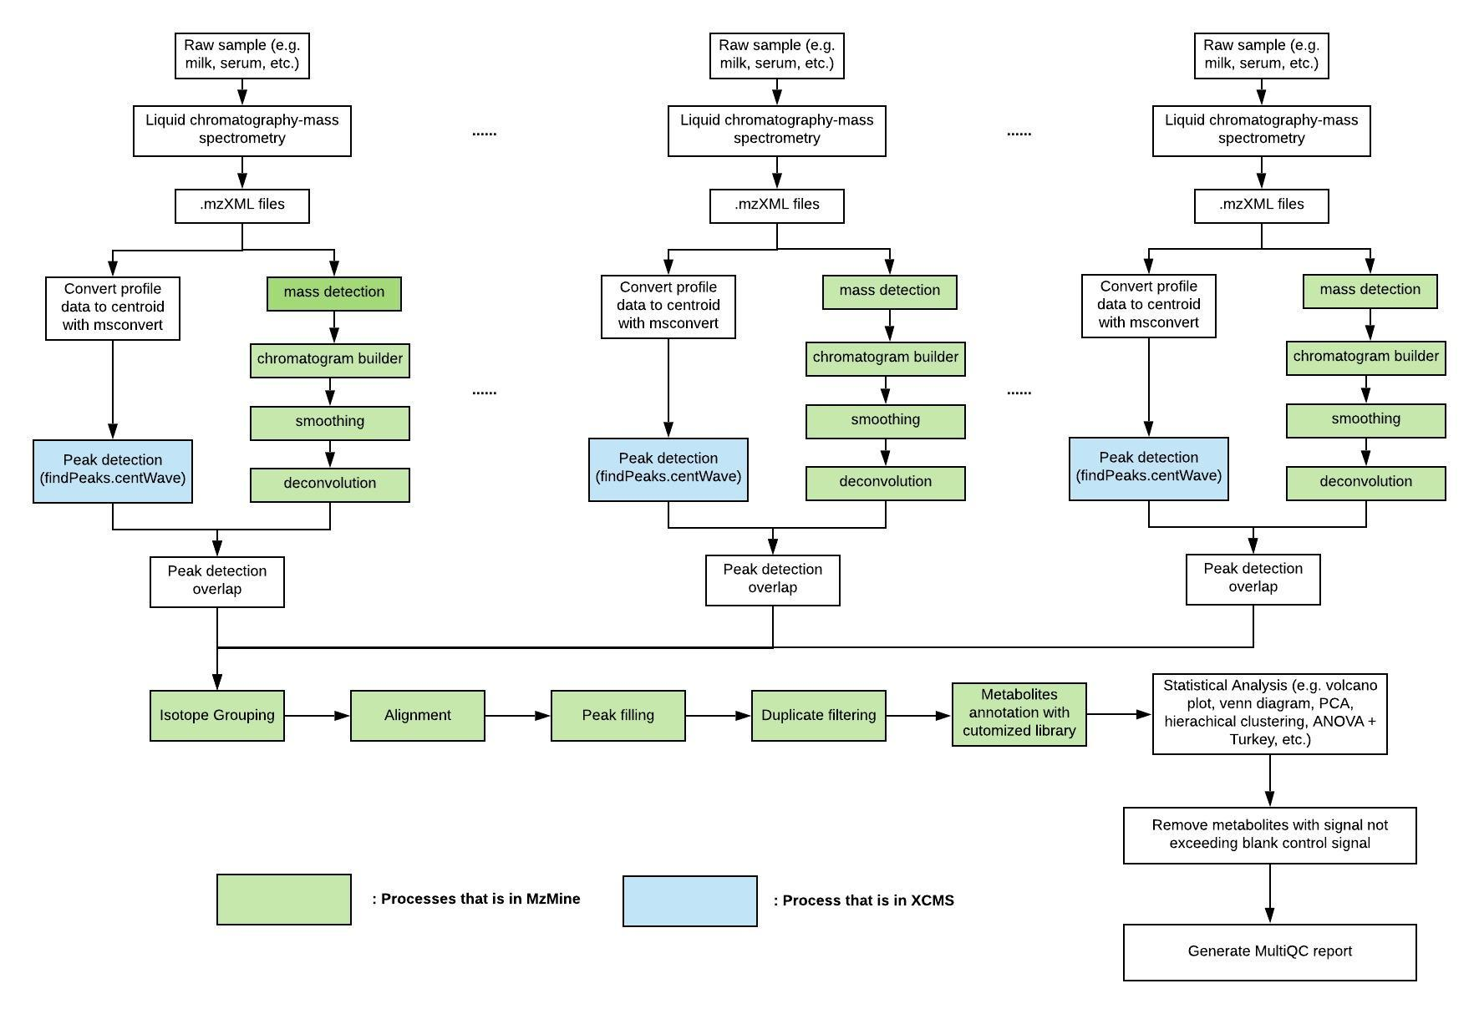
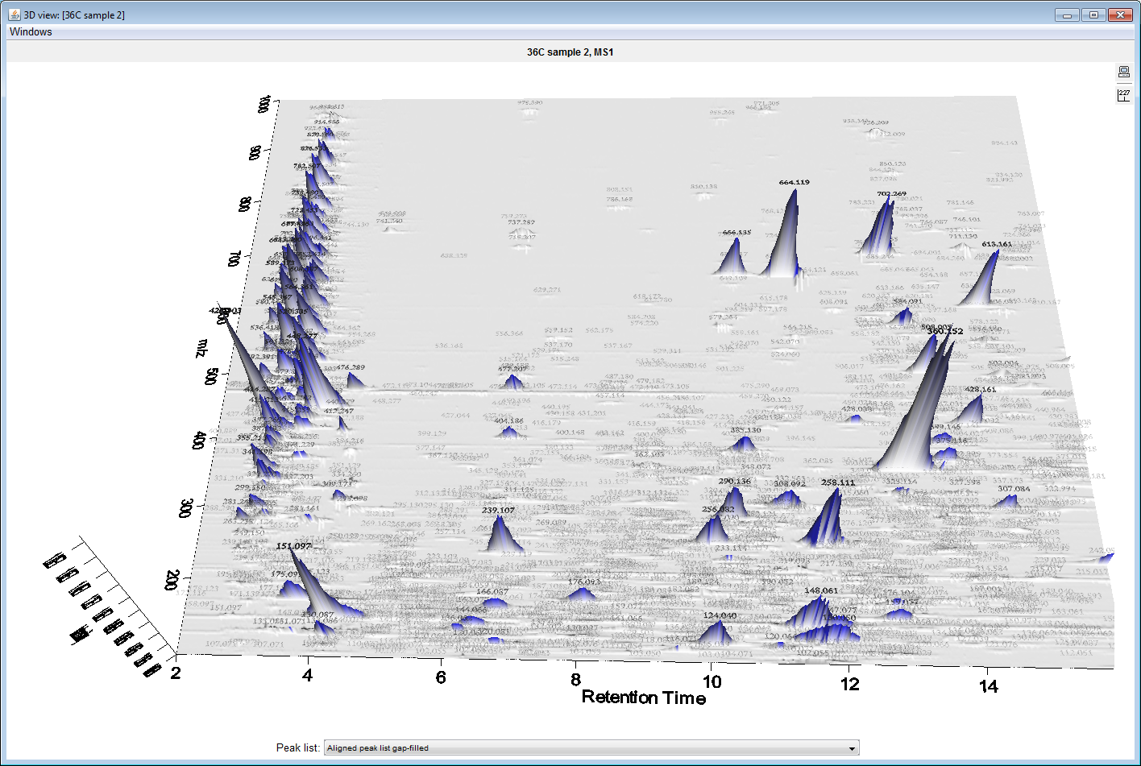
Workflow

Slide 11
Results

Slide 12
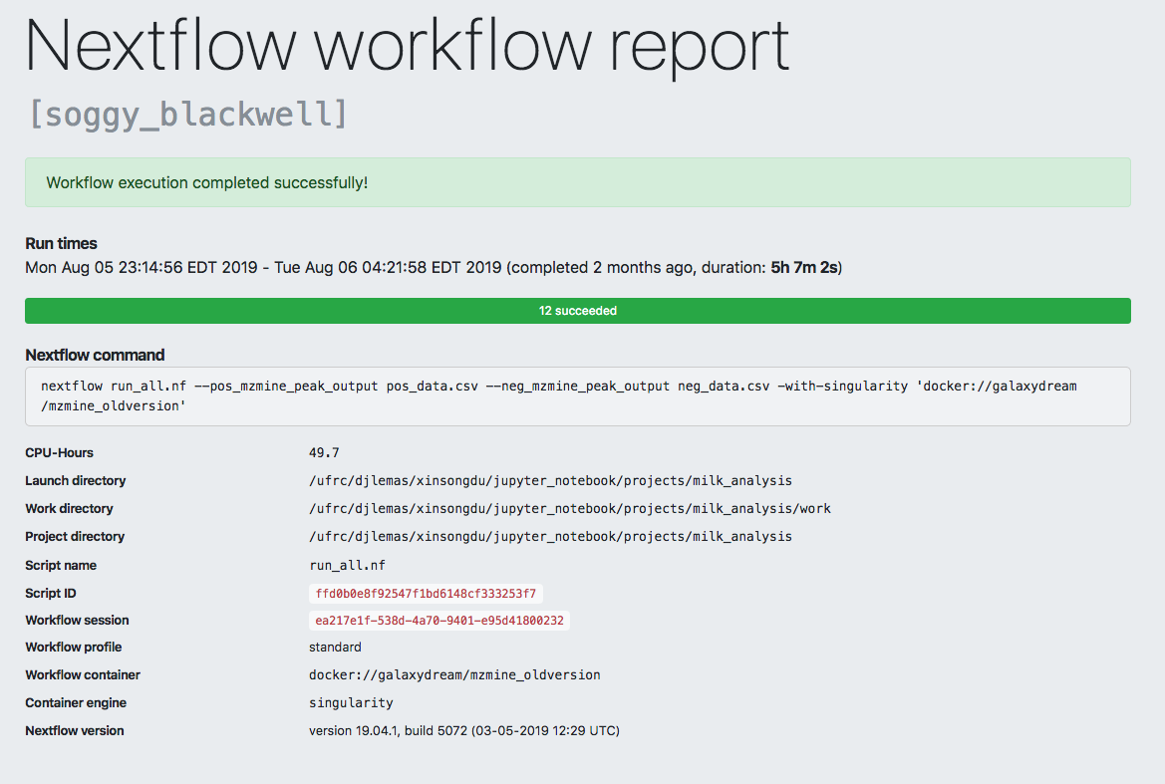
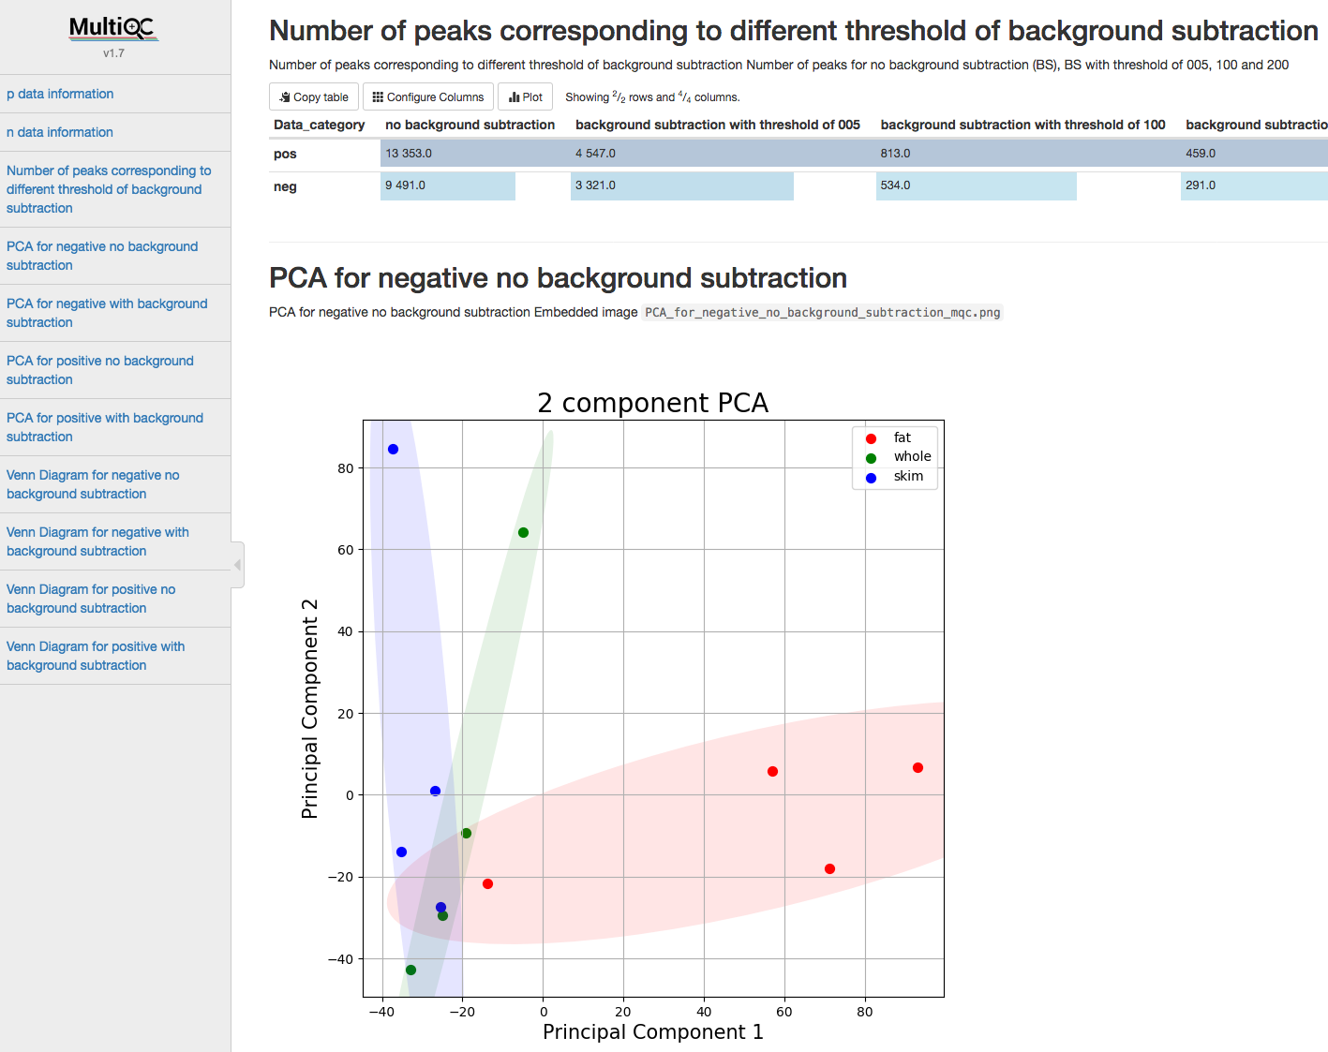
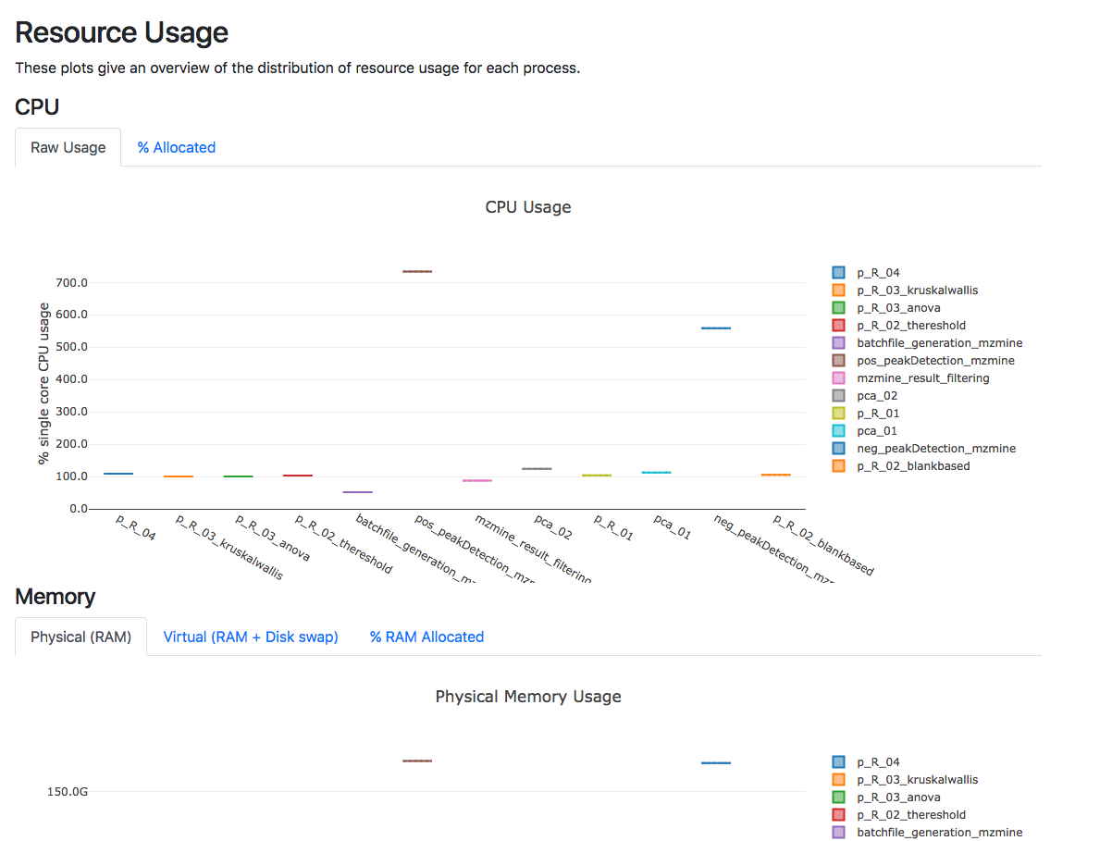
Nextflow Report:
MultiQC Report:

Slide 13
Conclusion
We have developed a container-based platform that has potential to facilitate high-throughput and scalable untargeted metabolomics data analysis with high levels of reproducibility, scalability and transparency.

Slide 14
Acknowledgements
Mentor
Dr. Dominick J. Lemas
Co-authors
Luran Manfio, Alexander Kirpich, William R. Hogan, Timothy J. Garrett, Dominick J. Lemas

Slide 15
Thank you

