Slide 1
A Reproducible Pipeline for Scalable Untargeted Metabolomics Data Analysis
Xinsong Du, M.S.
Ph.D. Student, Graduate Assistant
Department of Health Outcomes and Biomedical Informatics
University of Florida, College of Medicine

Slide 2
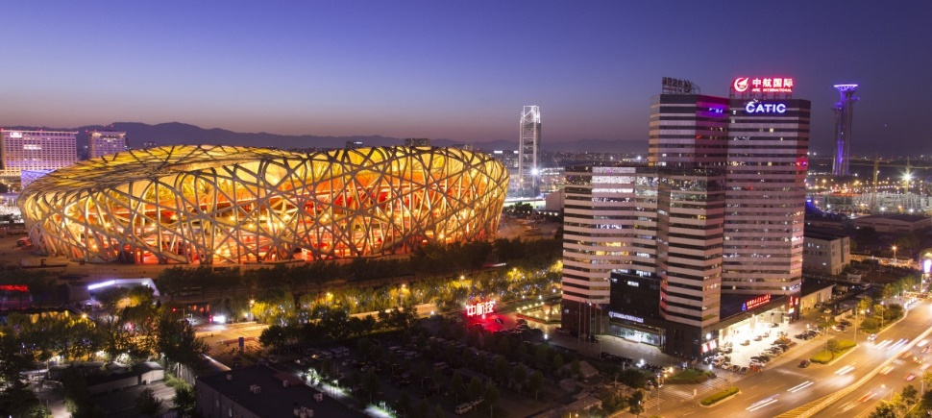

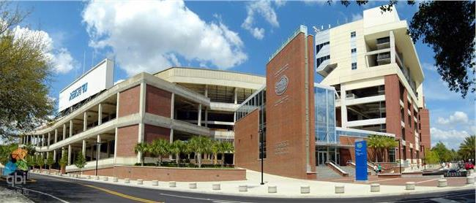

About Me
02/2002 – Present: Live in Beijing, China
05/1993 – 02/2002: Live in Linyi, Shandong Province, China
08/2015 – 05/2017 (M.S., Computer Engineering):
University of Florida, Gainesville, FL, U.S.
08/2017 – Present (Ph.D. student, Biomedical Informatics):
University of Florida, Gainesville, FL, U.S.
09/2011 – 07/2015 (B.S. Electrical Engineering):
Shandong University, Jinan, Shandong Province,
China

Slide 3
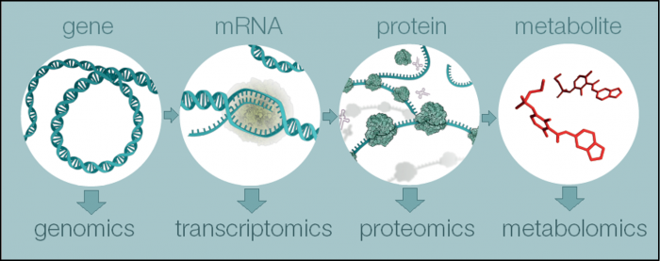
What is Metabolomics?
This needs to answer your question in title: I would come up with a simple definition for this section.
(Reference: https://www.ebi.ac.uk/training/online/course/introduction-metabolomics/what-metabolomics)
Notes:
Metabolomics is a powerful approach because metabolites and their concentrations, unlike other "omics" measures, directly reflect the underlying biochemical activity and state of cells / tissues. Thus metabolomics best represents the molecular phenotype.

Slide 4
Metabolomics Data Processing
Raw data
Data filtering or smoothing to increase signal/noise ratio
Peak filling
Duplicate filtering
Data processing dilemmas:
multiple data formats
multiple steps
multiple programs
computationally intensive
Reproducibility
Scalability
Peak detection
Alignment
Blank Subtraction
Deconvolution
Isotype Grouping
Metabolites Identification
Statistical Analysis
Notes:
Metabolomics is a powerful approach because metabolites and their concentrations, unlike other "omics" measures, directly reflect the underlying biochemical activity and state of cells / tissues. Thus metabolomics best represents the molecular phenotype.

Slide 5
Reproducible Research
Reproducibility: definition
Reproducibility of scientific research has been steadily rising with reports estimating that only X% of peer-reviewed results can be replicated.
Data
Code
Operating System
(Reference: Goodman, S. N., Fanelli, D., & Ioannidis, J. P. A. (2016). What does research reproducibility mean? Science Translational Medicine, 8(341), 341ps12. https://doi.org/10.1126/scitranslmed.aaf5027)
Notes:
Metabolomics is a powerful approach because metabolites and their concentrations, unlike other "omics" measures, directly reflect the underlying biochemical activity and state of cells / tissues. Thus metabolomics best represents the molecular phenotype.

Slide 6
Objective
Developing a open-source tool for reproducible untargeted metabolomic data analysis for the purpose of facilitating collaboration among metabolomics researchers.

Slide 7
Method

Slide 8


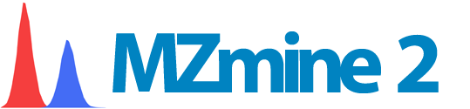


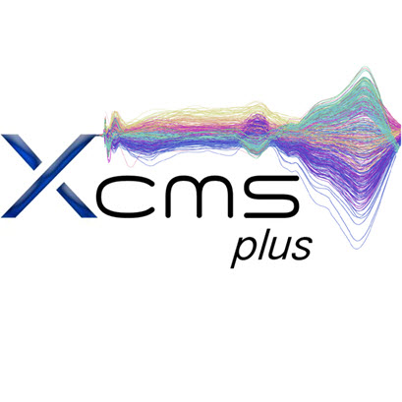

Recreate this as the same triangle in slide 5.
Computing: hipergator/singularity/docker
Code: mzmine, nextflow, xcms, Bioconductor.
Data: picture of testtube/HR-MS

Slide 9
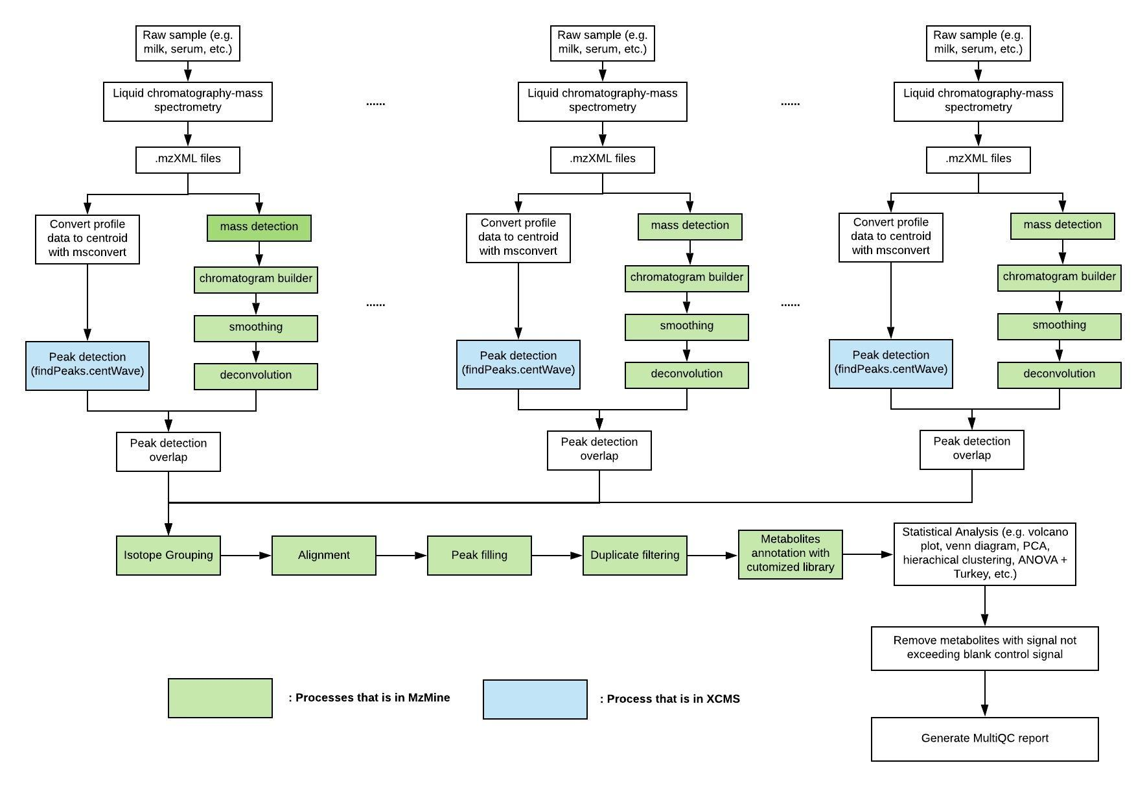
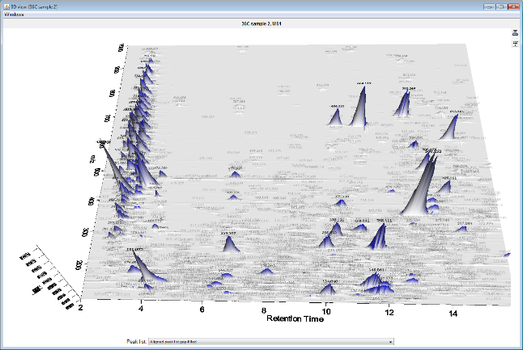
Not sure why you have 3 of the same diagrams for the first part. Limit to only 1 diagram. I like the figure as an overall representation of the pipeline but needs to be simplified.
Workflow

Slide 10
Results

Slide 11
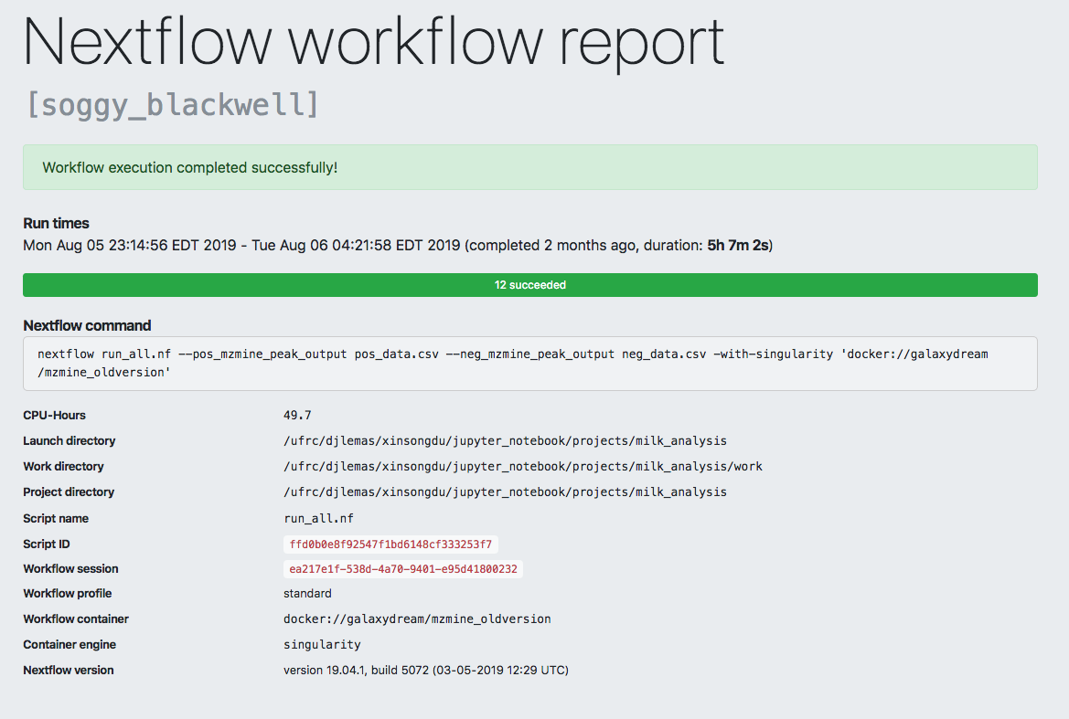
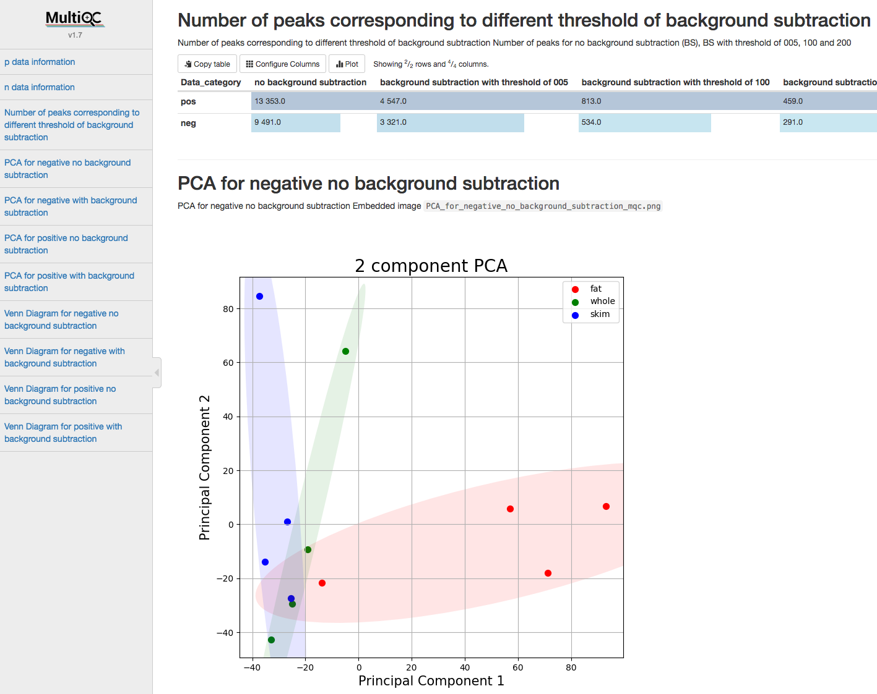
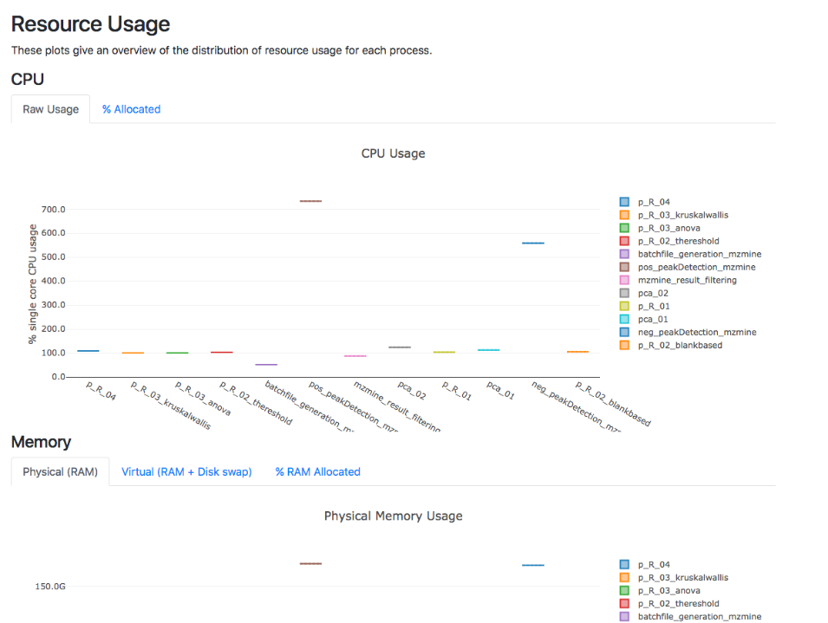
Nextflow Report:
MultiQC Report:
Need bullet points and boxes that outline the things of interest.

Slide 12
Conclusion
We have developed a container-based platform that has potential to facilitate high-throughput and scalable untargeted metabolomics data analysis with high levels of reproducibility, scalability and transparency.
Need 3-4 bullet points to summarize the pipeline.

Slide 13
Acknowledgements
Mentor
Dr. Dominick J. Lemas
Co-authors
Luran Manfio, Alexander Kirpich, William R. Hogan, Timothy J. Garrett, Dominick J. Lemas
Need to aknowledge the super computer people. Funding sources.

Slide 14
Thank you

