Slide 1


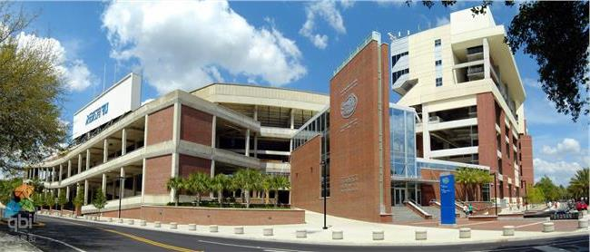

About Me
02/2002 – Present: Live in Beijing, China
05/1993 – 02/2002: Live in Linyi, Shandong Province, China
08/2015 – 05/2017 (M.S., Computer Engineering):
University of Florida, Gainesville, FL, U.S.
08/2017 – Present (Ph.D. student, Biomedical Informatics):
University of Florida, Gainesville, FL, U.S.
09/2011 – 07/2015 (B.S. Electrical Engineering):
Shandong University, Jinan, Shandong Province,
China

Slide 2
A Reproducible Pipeline for Scalable Untargeted Metabolomics Data Analysis
Xinsong Du, M.S.
Ph.D. Student, Graduate Assistant
Department of Health Outcomes and Biomedical Informatics
University of Florida, College of Medicine

Slide 3
What is Metabolomics?
Metabolomics is the scientific study of chemical processes involving metabolites, the small molecule substrates, intermediates and products of metabolism.
Notes:
Metabolomics is a powerful approach because metabolites and their concentrations, unlike other "omics" measures, directly reflect the underlying biochemical activity and state of cells / tissues. Thus metabolomics best represents the molecular phenotype.

Slide 4
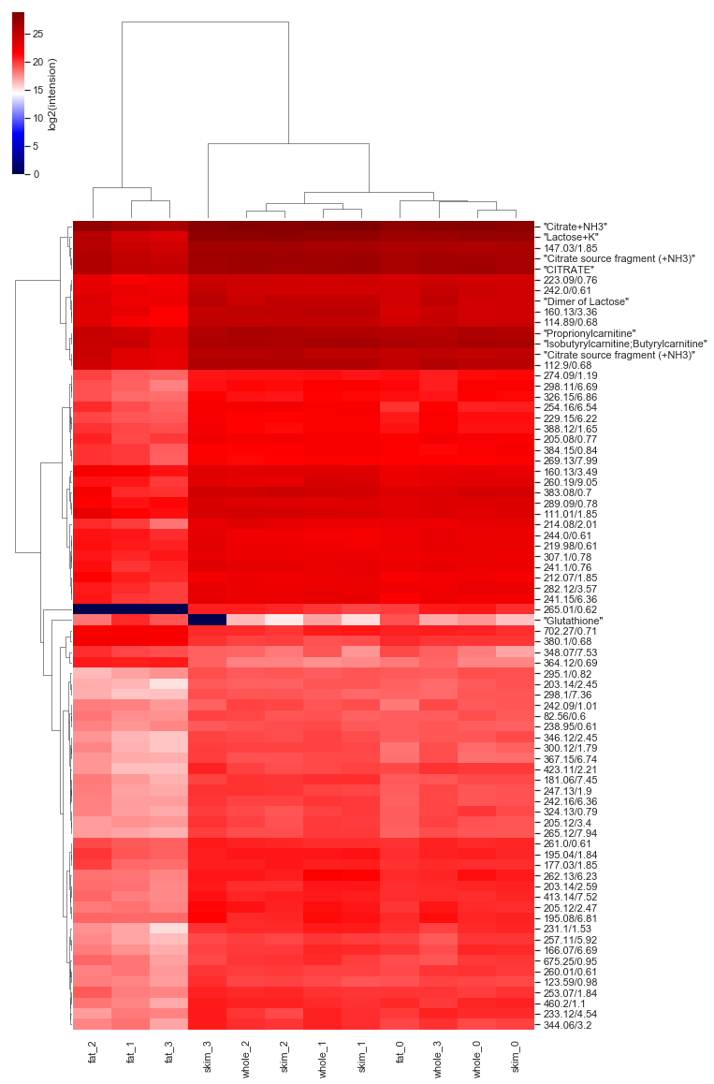
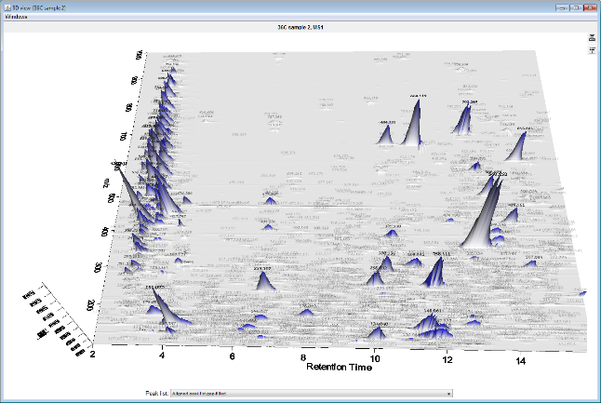

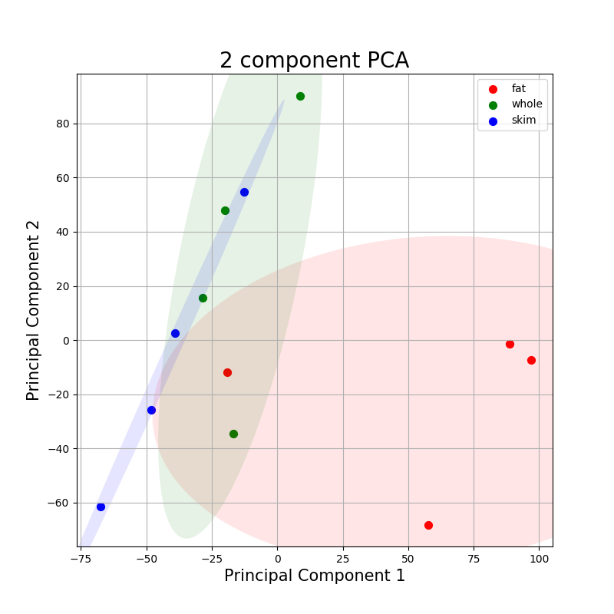
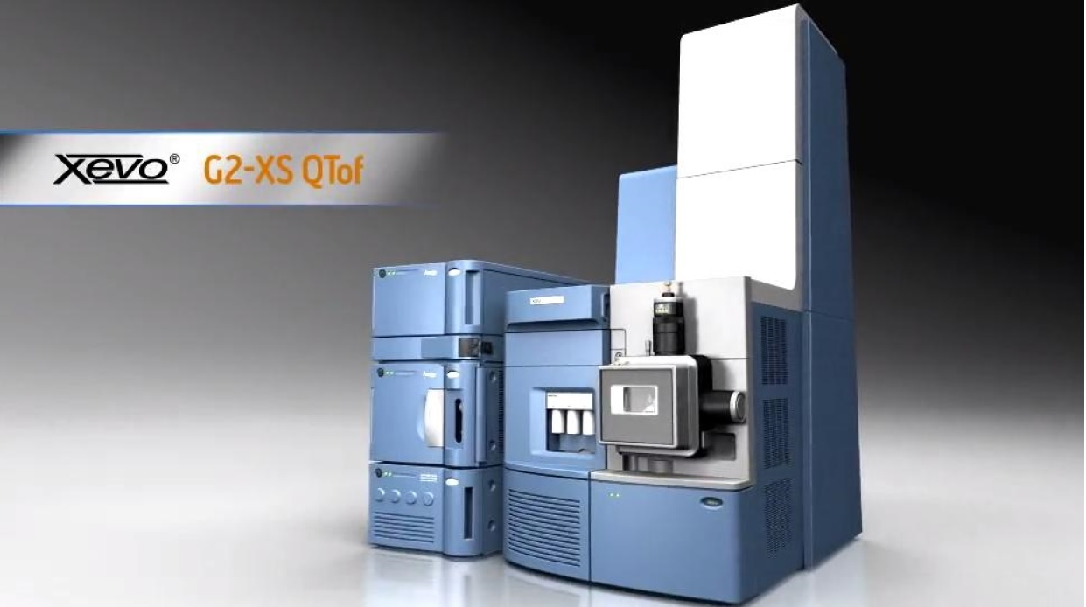
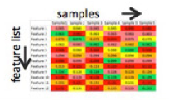
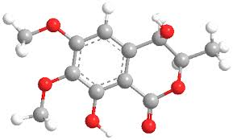
Statistical Analysis
Data Acquisition
Feature Extraction
Data processing dilemmas:
multiple data formats
multiple steps
multiple programs
computationally intensive
Reproducibility
Scalability
Metabolites Identification

Slide 5
Reproducible Research
Reproducibility is the closeness of the agreement between the results of measurements of the same measured carried out with same methodology described in the corresponding scientific evidence (e.g. a publication in a peer-reviewed journal)
Reproducibility of scientific research has been steadily rising with reports estimating that only 30% of peer-reviewed results can be reproduced.
Data
Operating System
Code
(Reference: "Is There a Reproducibility Crisis in Science?". Nature Video, Scientific American. 28 May 2016.)
Notes:
Metabolomics is a powerful approach because metabolites and their concentrations, unlike other "omics" measures, directly reflect the underlying biochemical activity and state of cells / tissues. Thus metabolomics best represents the molecular phenotype.

Slide 6
Objective
Developing an open-source tool for reproducible untargeted metabolomic data analysis for the purpose of facilitating collaboration among metabolomics researchers.

Slide 7
Method

Slide 8



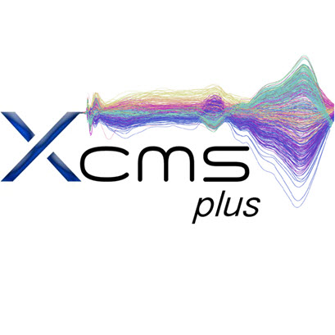
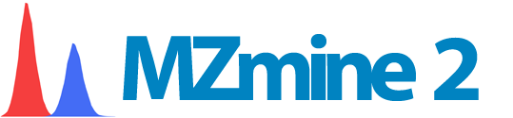

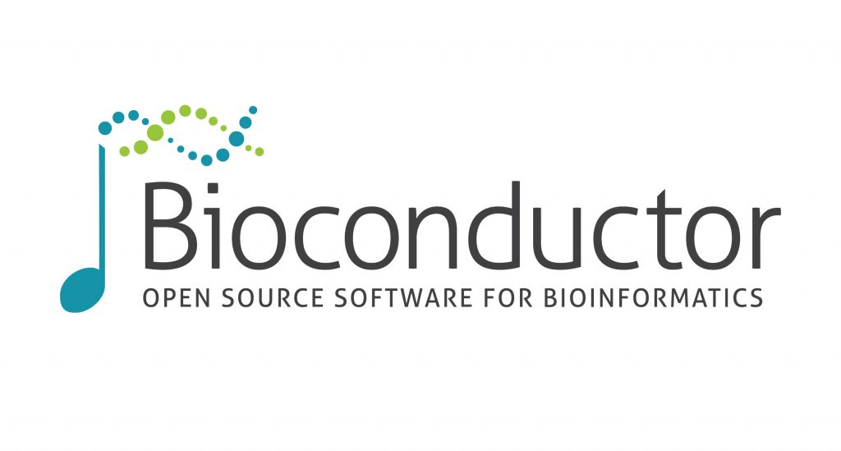

Data
Operating System
Code
Notes:
high-resolution mass spectrometers

Slide 9
Results

Slide 10
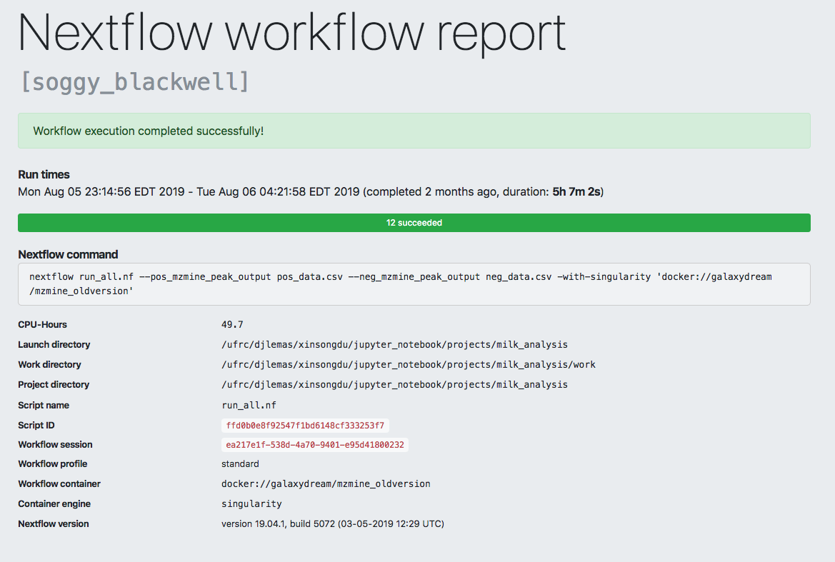
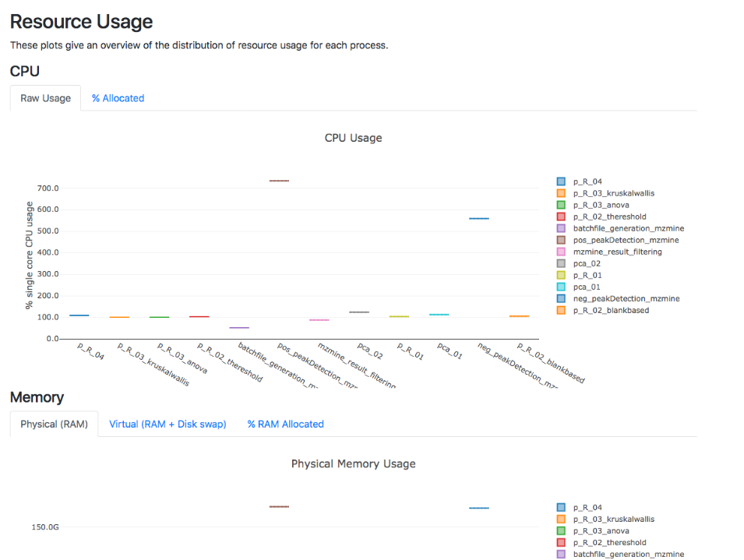
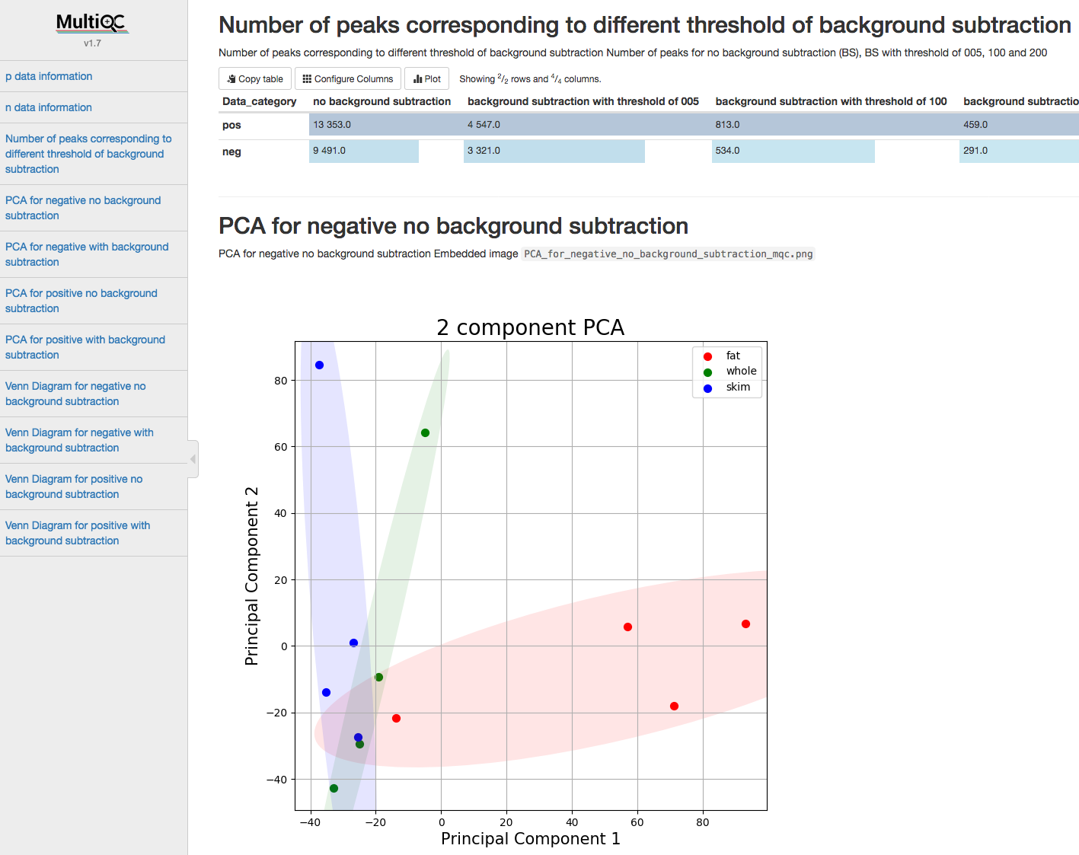
MultiQC Report:
Nextflow Report:
Computational resource information that can guide resource allocation in supercomputers like HiPerGator
Data Information
Statistical Analysis
Interactive Report

Slide 11
Conclusion
We built a container-based platform to eliminate variations of operating systems thus increase reproducibility.
We used Nextflow to streamline separate steps of metabolomics data processing.
We used HiPerGator to increase the scalability of our software, along with Nextflow report to guide setting the parameters for allocating HiPerGator resources.
We combined two widely used metabolomics data processing software (MzMine and XCMS) to increase the precision of metabolites identification.
We employed MultiQC to generate an interactive report easing the results analysis process.

Slide 12
Acknowledgements
Mentor
Dr. Dominick J. Lemas
Co-authors
Luran Manfio, Alexander Kirpich, William R. Hogan, Timothy J. Garrett, Dominick J. Lemas
Funding
K01 DK115632 (NIDDK); SECIM P&F; CTSI Pilot Award; Robin Hood Foundation; NIH Loan Repayment Program
HiPerGator Team

Slide 13
Thank you

