Slide 1
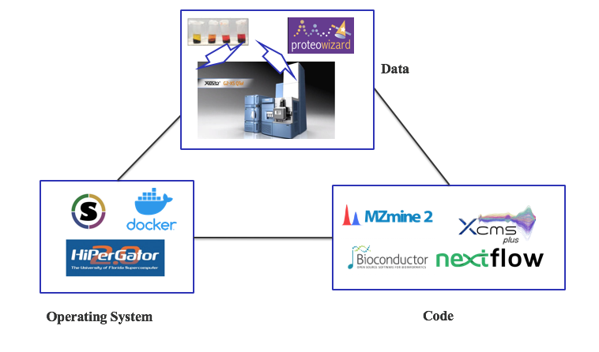
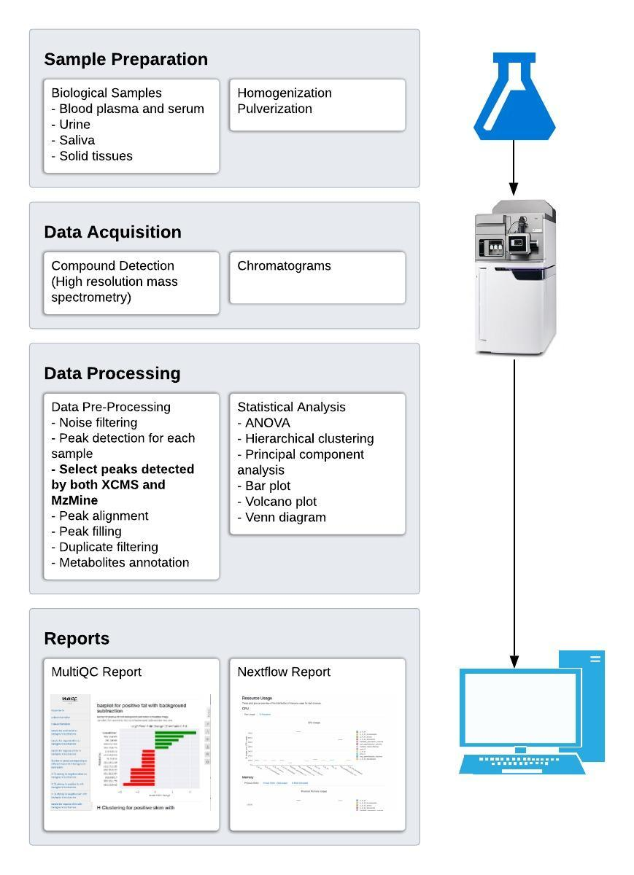
A Reproducible Pipeline for Scalable Untargeted Metabolomics Data Analysis
Xinsong Du, M.S.¹, Luran Manfio¹, Alexander Kirpich, Ph.D.², William R. Hogan, M.D.¹, Timothy J. Garrett, Ph.D.³ & Dominick J. Lemas, Ph.D.¹
Department of Health Outcomes & Biomedical Informatics, College of Medicine, University of Florida¹,
Department of Population Health Sciences, School of Public Health, Georgia State University²,
Department of Pathology, Immunology and Laboratory Medicine, College of Medicine, University of Florida³
Abstract
Untargeted metabolomics data is increasingly collected by epidemiological studies to investigate population-level variation in the development of health and disease. Reproducibility of untargeted metabolomics data analysis remains a challenge. Although an increasing number of open source software packages have been developed to complete untargeted metabolomics analysis, most of these programs were designed for single desktop users and lack high-throughput scalability and reproducibility. Currently, software containers are able to package all codes and dependencies of an application to ensure portability, infrastructure flexibility and reproducibility. Applications running in with the container will depend on the environment pre-built in the container regardless of the environment in the host machine. Nextflow is a pipeline development tool supporting containerization and high performance computing, which improves the scalability and reproducibility of bioinformatics research.
The goal of our project is to develop an open-source tool using Nextflow to facilitate reproducible and scalable untargeted metabolomic data analysis.
The pipeline can be executed on any UNIX-like systems with a specific focus on implementation within large-scale computing environments. We have developed the pipeline to run parallelized common metabolites analysis software packages including MzMine and XCMS for peak detection to enhance precision. Moreover, we used SECIMTools for statistical tests such as ANOVA and student t-test, as well as providing users multiple visualization methods including principle component analysis, volcano plots, hierarchical clustering and others. To facilitate dynamic and transparent data processing, we have included MultiQC reports to visualize the result of data processing and summarize metabolomics output. Furthermore, the relationship between the input file size and the use of corresponding computing resources is monitored within the pipeline. This provides useful suggestions for further computing resource allocation and efficient use.
We have developed a container-based platform that has potential to facilitate high-throughput and scalable untargeted metabolomics data analysis with high levels of reproducibility and transparency.
Background
Untargeted Metabolomics (UM) is focused on identification of unknown metabolites in a given sample. The most popular features of a UM study include data generation using LC-MS as instrument (83%), the mzXML data format (70%), as well as XCMS (70%) and MzMine (26%) as the data processing software.¹ Additionally, combining XCMS and MzMine may improve the precision of untargeted metabolomics data analysis.²
Reproducibility of research is defined as “an independent researcher/lab confirming or redoing that experiment/analysis, potentially in a different environment”, and reproducibility has been a big problem for bioinformatics tools.³
Figure 2. Requirements for good reproducibility
Objective
We developed a Nextflow-based framework for reproducible untargeted metabolomics data processing, in which LC-MS is the data acquisition method, mzXML is the data format, the combination of XCMS and MzMine is the data processing tool.
Conclusion
We proposed a Nextflow-based framework to improve reproducibility for untargeted metabolomics data processing.
The framework combined two widely used metabolomics data processing software (MzMine and XCMS) to increase the precision of untargeted metabolomics data processing.
The framework incorporates supercomputer to increase the scalability of our software, along with Nextflow report to guide setting the parameters for job schedular.
The framework employed MultiQC to generate an interactive report easing the results analysis process.
Future Work
We have got human milk samples and bovine milk samples, will use this workflow to compare the two types of milk in terms of metabolites.
Acknowledgments
Mentor: Dr. Dominick J. Lemas
Funding: K01 DK115632 (NIDDK); SECIM P&F; CTSI Pilot Award; Robin Hood Foundation; NIH Loan Repayment Program
All members of MANA Conference.
Figure 1. Metabolomics data processing workflow
Research was supported by K01 DK115632 (NIDDK); SECIM P&F; CTSI Pilot Award; Robin Hood Foundation; NIH Loan Repayment Program
References: 1. Weber. (2017). Metabolomics 13(2), 12..; 2. Myers (2017). Analytical Chemistry, 89(17), 8689–8695.; 3. Kanwal (2017). BMC Bioinformatics, 18(1), 337.

