Slide 1
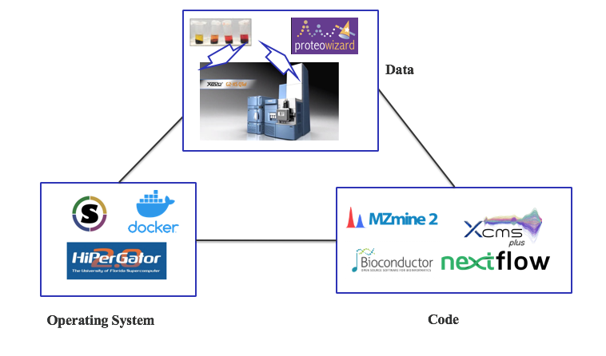
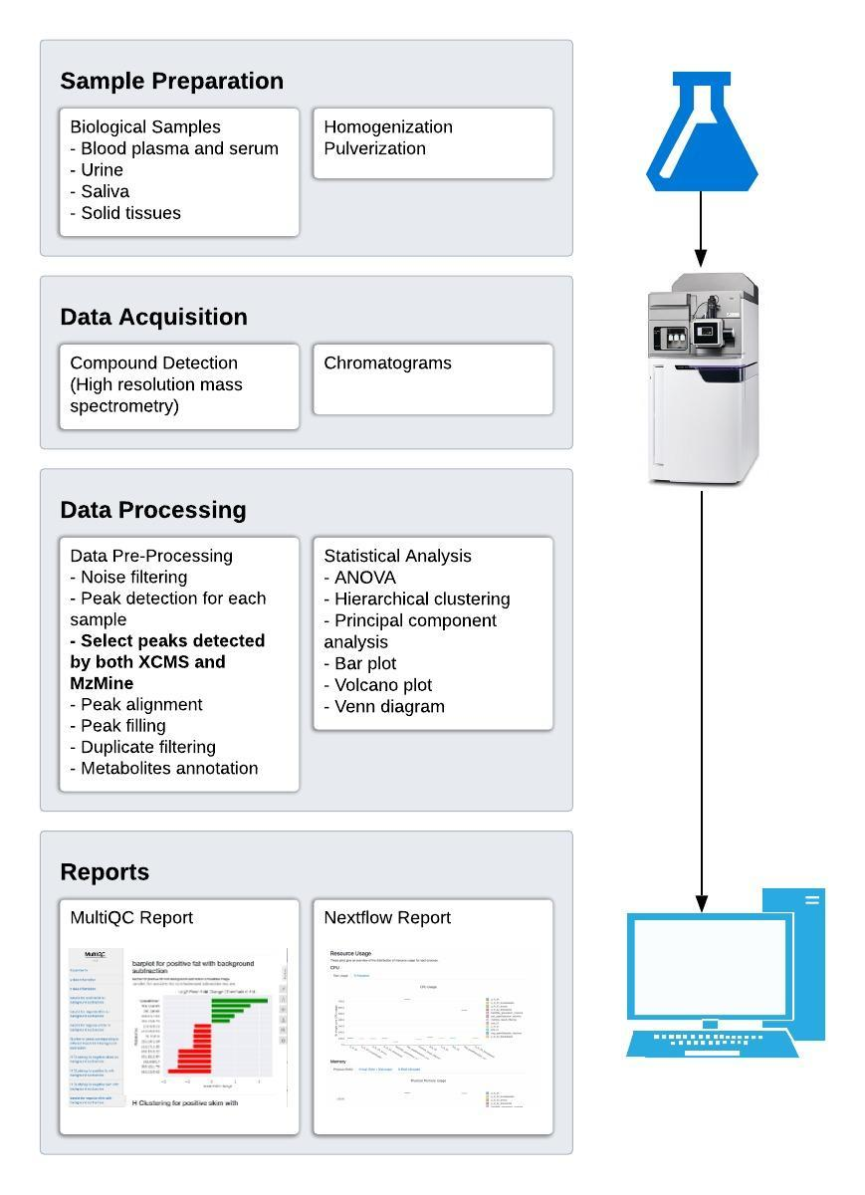
A Reproducible Pipeline for Scalable Untargeted Metabolomics Data Analysis
Xinsong Du, M.S.¹, Luran Manfio¹, Alexander Kirpich, Ph.D.², William R. Hogan, M.D.¹, Timothy J. Garrett, Ph.D.³ & Dominick J. Lemas, Ph.D.¹
Department of Health Outcomes & Biomedical Informatics, College of Medicine, University of Florida¹,
Department of Population Health Sciences, School of Public Health, Georgia State University²,
Department of Pathology, Immunology and Laboratory Medicine, College of Medicine, University of Florida³
Introduction
Untargeted Metabolomics Data Processing
Metabolomics is the scientific study of chemical processes involving metabolites, the small molecule substrates, intermediates and products of metabolism.
Untargeted metabolomics research includes the identification of unknown metabolites and the comparison of metabolites profiles between several materials.
For untargeted metabolomics research, there are several methods for data acquisition, several data formats, and several software/tools for metabolomics data processing.
Survey shows that a majority of researchers use liquid chromatography–mass spectrometry (LC-MS) (83%) for data acquisition, mzXML as data format (70%), XCMS (70%) and MzMine (26%) as data processing software.¹
Study shows combining XCMS and MzMine can improve the precision of untargeted metabolomics data processing results.²
Reproducibility
Reproducible research is defined as “an independent researcher/lab confirmingor redoing that experiment/analysis, potentially in adifferent environment”, and reproducibility has been a big problem for bioinformatics tools.³
Reproducibility of metabolomics data processing can be hurt by using different operating system or software versions.
Software container such as Docker enables software/tools to run upon the exact same dependencies no matter whatever the host machine is.
Nextflow is a workflow development tool that can streamline different data processing steps meanwhile incorporating software container to improve reproducibility.
Objective
We proposed a Nextflow-based framework for reproducible untargeted metabolomics data processing, in which LC-MS is the data acquisition method, mzXML is the data format, the combination of XCMS and MzMine is the data processing tool.
Methods
Sample Preparation:
Blood plasma
Blood serum
Urine
Saliva
Etc.
Data Acquisition:
Liquid Chromatography High Resolution Mass Spectrometry
Data Processing:
Msconvert
MzMine
XCMS (Bioconductor)
Workflow Development:
Nextflow
Environment Control:
Docker
Singularity
Computing Platform:
HiPerGator
Statistical Analysis:
ANOVA:
Hierarchical clustering:
Principal component analysis
Bar plot
Venn diagram
Volcano plot
Reports
Nextflow report
MultiQC report
Figure 1. Requirements for good reproducibility
Fig. 2: Requirements for Good Reproducibility
References
Weber, R. J. M., Lawson, T. N., Salek, R. M., Ebbels, T. M. D., Glen, R. C., Goodacre, R., … Viant, M. R. (2017). Computational tools and workflows in metabolomics: An international survey highlights the opportunity for harmonisation through Galaxy. Metabolomics : Official Journal of the Metabolomic Society, 13(2), 12. https://doi.org/10.1007/s11306-016-1147-x
Myers, O. D., Sumner, S. J., Li, S., Barnes, S., & Du, X. (2017). Detailed Investigation and Comparison of the XCMS and MZmine 2 Chromatogram Construction and Chromatographic Peak Detection Methods for Preprocessing Mass Spectrometry Metabolomics Data. Analytical Chemistry, 89(17), 8689–8695. https://doi.org/10.1021/acs.analchem.7b01069
Kanwal, S., Khan, F. Z., Lonie, A., & Sinnott, R. O. (2017). Investigating reproducibility and tracking provenance – A genomic workflow case study. BMC Bioinformatics, 18(1), 337. https://doi.org/10.1186/s12859-017-1747-0
Conclusion
We proposed a Nextflow-based framework to improve reproducibility for untargeted metabolomics data processing.
The framework combined two widely used metabolomics data processing software (MzMine and XCMS) to increase the precision of untargeted metabolomics data processing.
The framework incorporates supercomputer to increase the scalability of our software, along with Nextflow report to guide setting the parameters for job schedular.
The framework employed MultiQC to generate an interactive report easing the results analysis process.
Acknowledgments
Mentor: Dr. Dominick J. Lemas
Co-authors: Luran Manfio, Alexander Kirpich, William R. Hogan, Timothy J. Garrett, Dominick J. Lemas
Funding: K01 DK115632 (NIDDK); SECIM P&F; CTSI Pilot Award; Robin Hood Foundation; NIH Loan Repayment Program
All members of MANA Conference.
Figure 2. Metabolomics data processing workflow
Research was supported by K01 DK115632 (NIDDK); SECIM P&F; CTSI Pilot Award; Robin Hood Foundation; NIH Loan Repayment Program

Slide 2
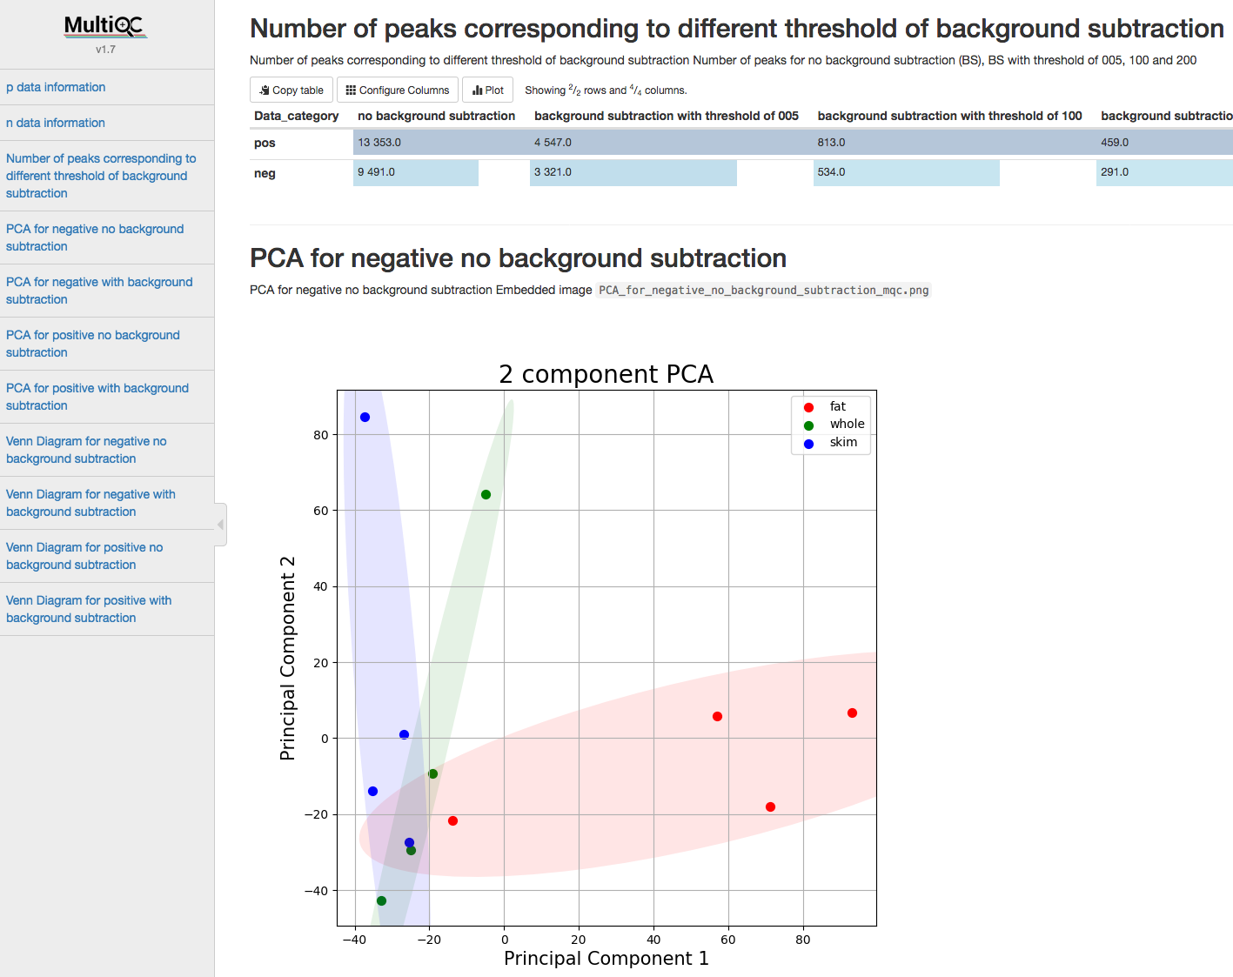
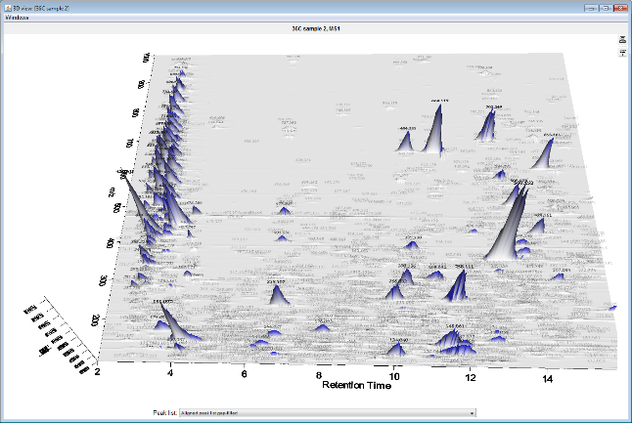
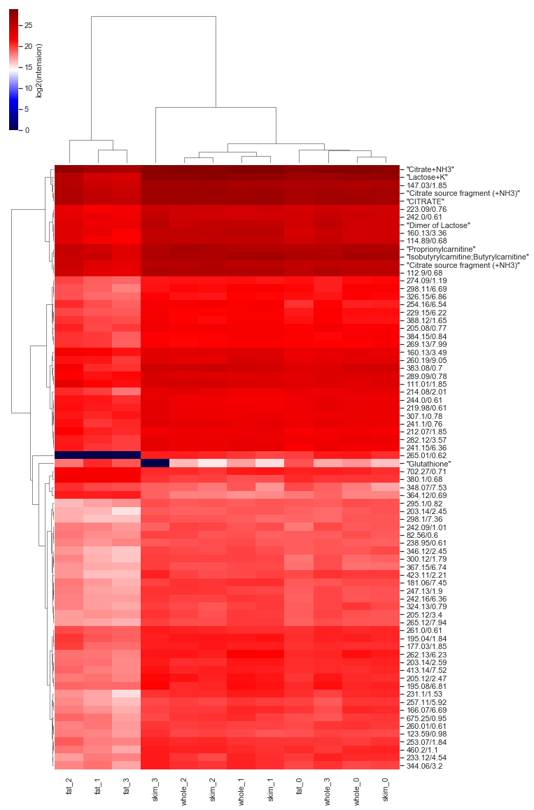
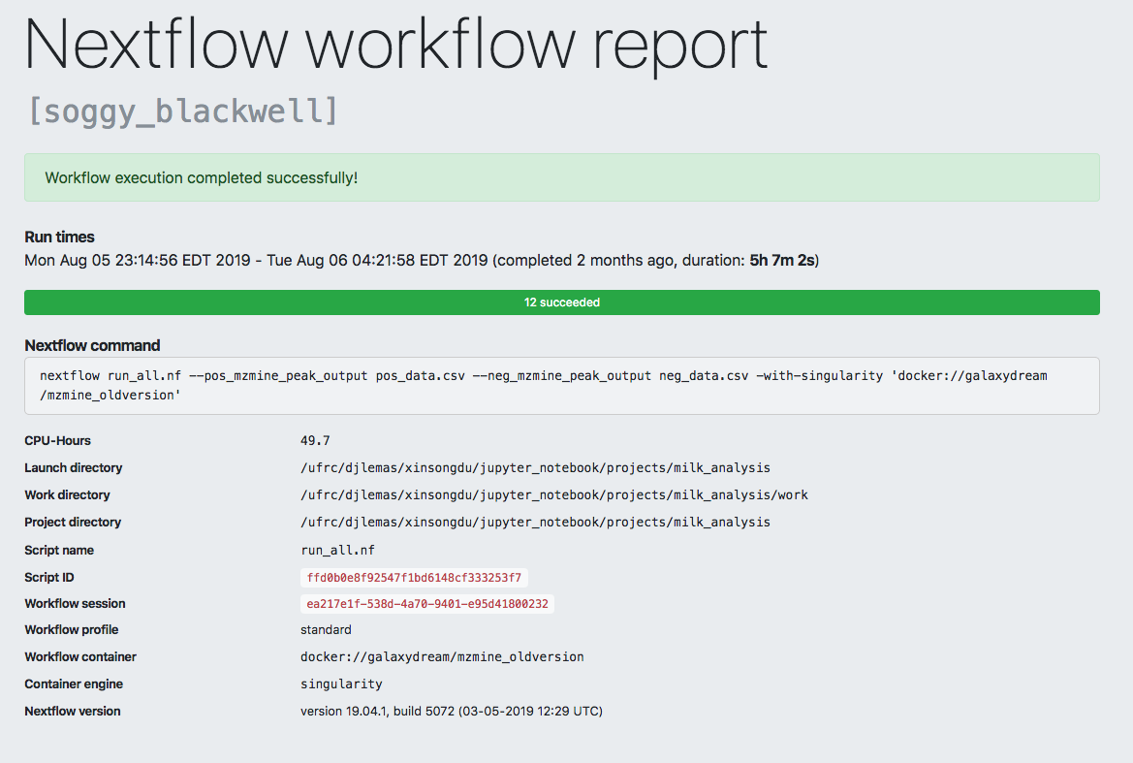

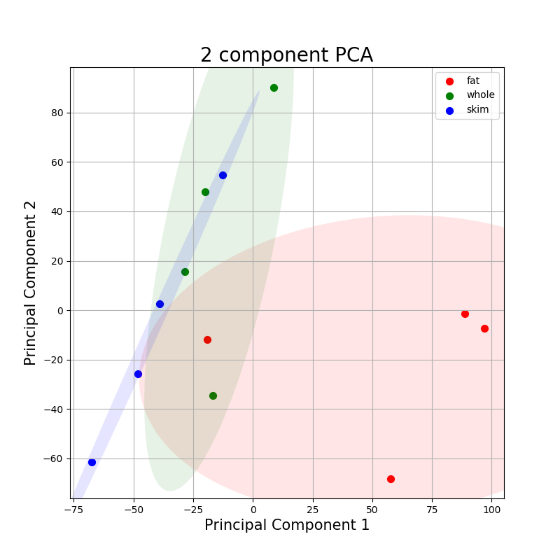
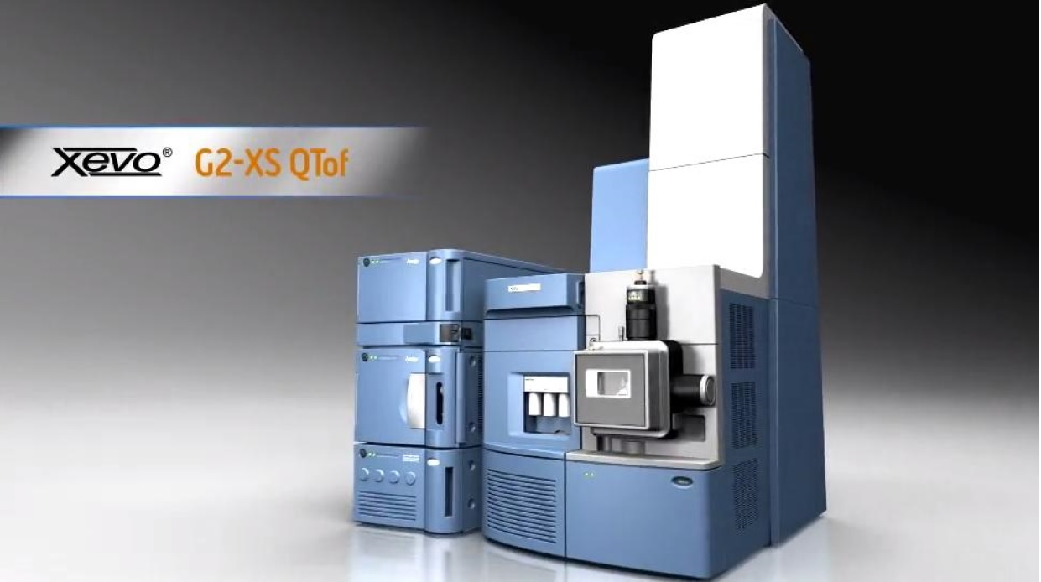
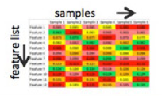
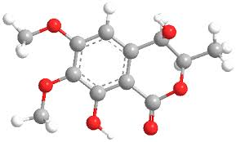
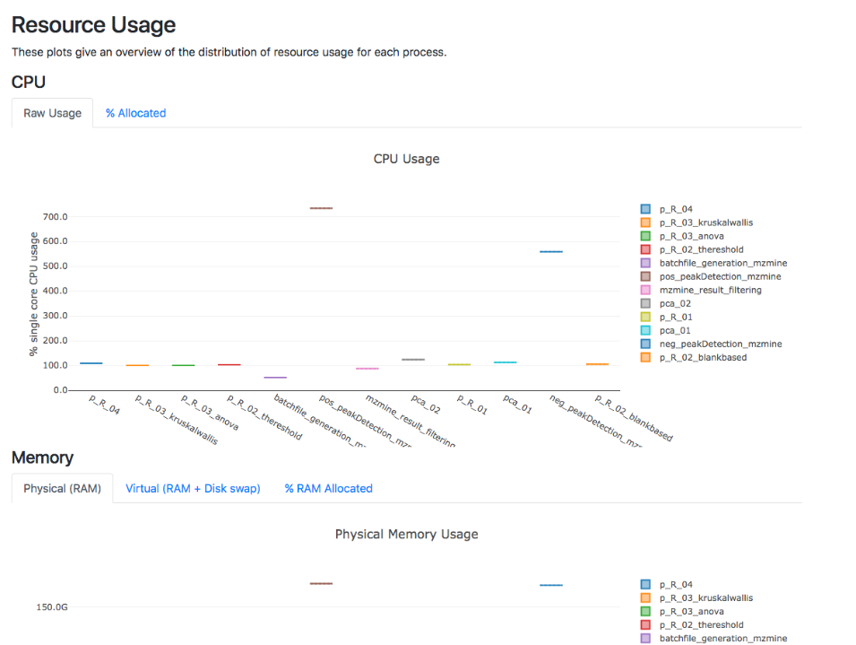


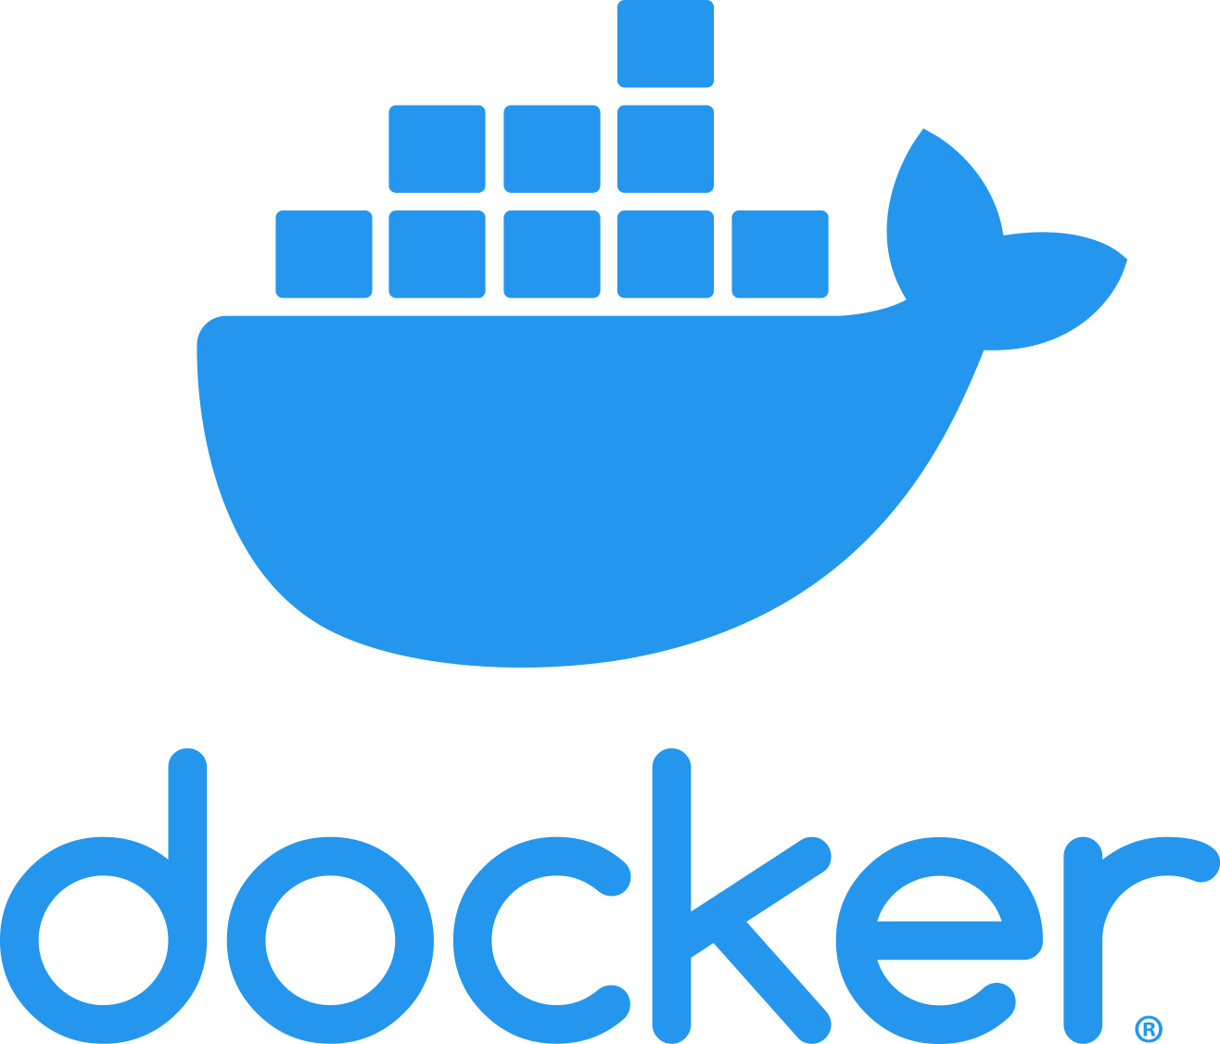
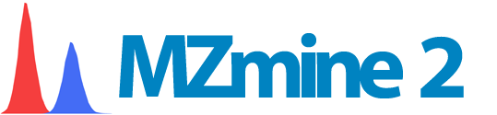
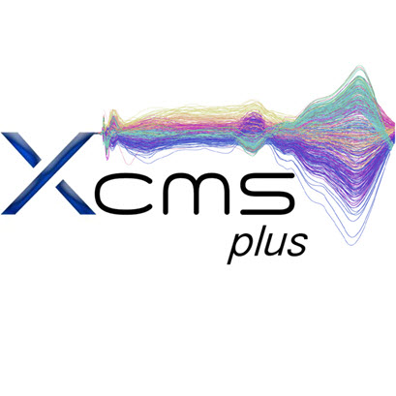

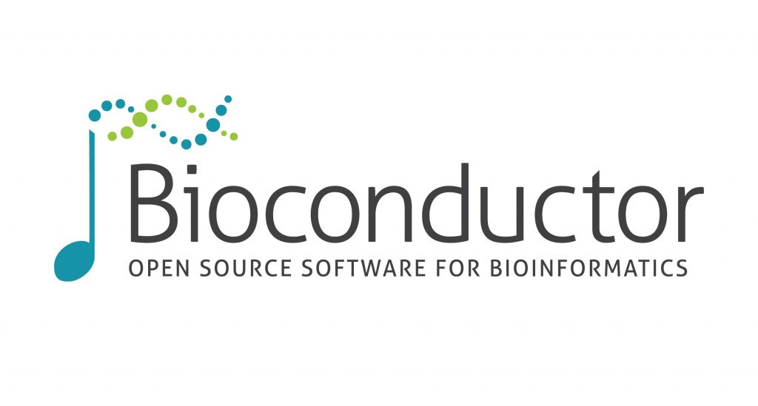

Background
Results
MultiQC Report:
Metabolomics is the scientific study of chemical processes involving metabolites, the small molecule substrates, intermediates and products of metabolism.
Metabolomics data processing procedure:
Reproducibility:
Reproducibility is the closeness of the agreement between the results of measurements of the same measured carried out with same methodology described in the corresponding scientific evidence (e.g. a publication in a peer-reviewed journal)
Reproducibility of scientific research has been steadily rising with reports estimating that only 30% of peer-reviewed results can be replicated.
Requirements for reproducibility:
Nextflow Report:
Computational resource information that can guide resource allocation in supercomputers like HiPerGator
Data Information
Statistical Analysis
Interactive Report
Data Acquisition
Feature Extraction
Statistical Analysis
Data processing dilemmas:
multiple data formats
multiple steps
multiple programs
computationally intensive
Reproducibility
Scalability
Metabolites Identification
Conclusions
We built a container-based platform to eliminate variations of operating systems thus increase reproducibility.
We used Nextflow streamline separate steps metabolomics data processing.
We used HiPerGator to increase the scalability of our software, along with Nextflow report to guide setting the parameters for allocating HiPerGator resources.
We combined two widely used metabolomics data processing software (MzMine and XCMS) to increase the precision of metabolites identification.
We employed MultiQC to generate an interactive report easing the results analysis process.
Data
Operating System
Code
Methods
Acknowledgements
Data
Mentor
Dr. Dominick J. Lemas
Co-authors
Luran Manfio, Alexander Kirpich, William R. Hogan, Timothy J. Garrett, Dominick J. Lemas
Funding
K01 DK115632 (NIDDK); SECIM P&F; CTSI Pilot Award; Robin Hood Foundation; NIH Loan Repayment Program
HiPerGator Team
Operating System
Code

