Slide 1






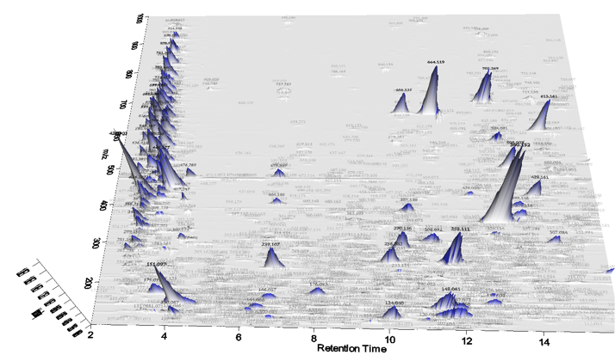


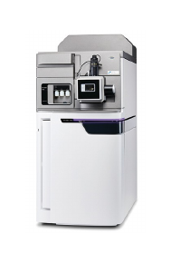

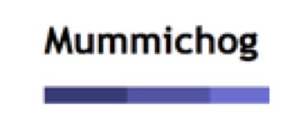

Blank Subtraction & Statistical Analysis
Unidentified Metabolites Search
mzXML files
Data Processing
File Format Transformation
Sample preparation
LC-HRMS
Report Generation
Pathway Analysis

Slide 2






h
i
Blank Subtraction & Statistical Analysis
Unidentified Metabolites Search
a
Data Deposited to Public Repositories
d
f
Data Format Conversion
Converted Files
j
g
File Format Transformation
Data Processing
b
c
Sample Preparation
LC-HRMS
k
l
MODIS Data Quality Qssessment
Report Generation
Pathway Analysis
e

Slide 3


h
Blank Subtraction & Statistical Analysis
a
Data Deposited to Public Repositories
d
f
Data Format Conversion
Converted Files
g
i
Data Processing & Metabolites Annotation
File Format Transformation
b
c
Sample Preparation
LC-HRMS
j
k
MODIS Data Quality Assessment
Report Generation
Pathway Analysis
e

