Slide 1
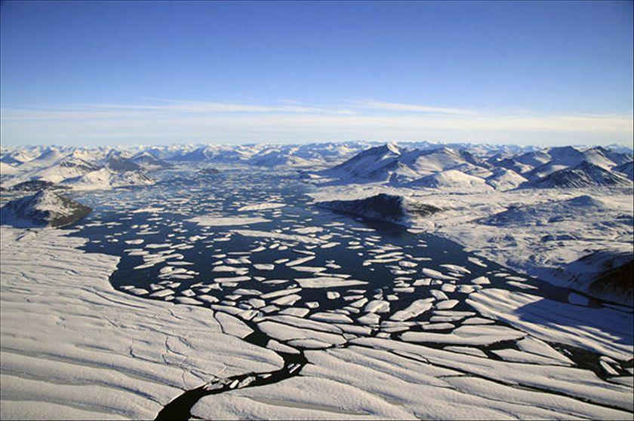
Analysis of the Stefan Problem: A boundary value problem with a phase boundary moving with time
By Max Plomer
For Heat and Mass Transfer class

Slide 2
Contents of Talk
Background
Problem Setup and Properties Used
Classical Stefan Problem 2 Phase
Explicit solution and Pseudo-Steady State Approximation
Matlab code for PSSA Validation
PSSA Newton Cooling at surface x=0
Graph of X(t) for PSS vs. PSS with Newton Cooling
Quadratic approximations
Graph of X(t) for PSS vs. PSS with Quadratic approximation

Slide 3
Background
Joseph Stefan introduced type of problem around 1890 while studying ice formation. In 1889 Stefan had a paper on ice formation in polar seas that drew attention from scientific community.¹
Enthalpy of fusion “The liquid phase has a higher internal energy than the solid phase. This means energy must be supplied to a solid in order to melt it and energy is released from a liquid when it freezes, because the molecules in the liquid experience weaker intermolecular forces and have a larger potential energy.”²

Slide 4
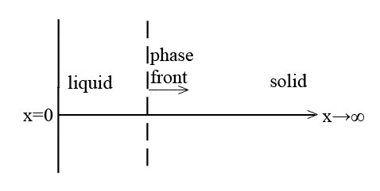
Problem Setup and Properties Used
Semi infinite half plane
Initially solid at point of melting, T_{Solid}=T_{Fusion}
When surface temp raised melting immediately takes place
Properties used: Density (assume constant for both phases, no volume change w/ melting), thermal conductivity and specific heat of phases, latent heat of fusion

Slide 5
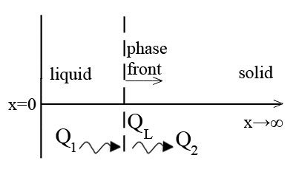
Classical Stefan Problem 2 phase
Conserve Thermal Energy
(using Fouriers Law)

Slide 6
Explicit solution and Pseudo-Steady State Approximation
Explicit Solution³ (Carslaw and Jaeger 1959) slab initially at T_{F}
is the root of the transcendental equation
PSSA⁴ – analytic estimate that assumes movement of boundary slower than rate of diffusion, neglect time partial derivative in diffusion equation Combine and integrate

Slide 7
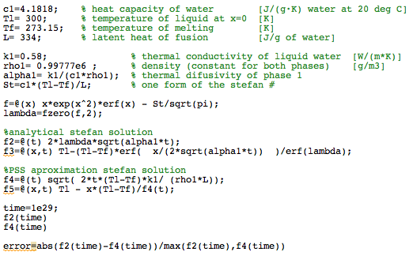
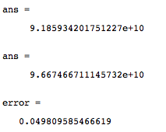
Matlab Code for PSSA Validation
Output:

Slide 8
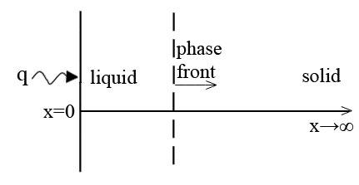
PSSA Newton Cooling at surface x=0
No explicit analytical solution exists
Boundary condition becomes:
Linear temp profile:
From these equations we obtain:

Slide 9
PSSA Newton Cooling at surface x=0 continued
Combine equations and integrate
0
For case of black body radiation, boundary condition becomes:

Slide 10
Graph of X(t) for PSS vs. PSS with Newton Cooling
Time (10⁹seconds)
Distance X(t) (meters)
As expected the affect of Newton cooling causing the phase change front to move more slowly.

Slide 11
Quadratic approximations
Approx solution of the form:
Differentiate wrt t:
Take derivative of quad approx:
From surface condition
Negative root ensures T T_{F}
Megerlin’s Method: Obtain X(t) from Stefan Condition
0

Slide 12
Graph of X(t) for PSS vs. PSS with Quadratic approximation
Distance X(t) (10⁻³meters)
Time (seconds)
As expected the PSS solution is greater than the analytical, the PSS with quadratic approximation has much less error and is slightly less than the analytical solution.

Slide 13
Citations
1. http://ta.twi.tudelft.nl/nw/users/vuik/wi1605/opgave1/stefan.pdf
2. http://en.wikipedia.org/wiki/Enthalpy_of_fusion
3. Phase Transformations. Aifantis, Elias C. ; Gittus, John (1986)
4. One-dimensional Stefan problems: An introduction. Hill, J.M. (1987)

