Slide 1
2020S2C ELEC1601 M18 08 第二次会议
Normal Monday Lab class

Slide 2
Contents
1. Double checked
2. Codeshare

Slide 3
Double checked!
I have checked with lecturer Dr. David
Fast Competition: 小车走完全程用时最短 获得25marks.

Slide 4
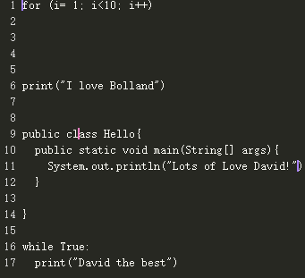
Codeshare (codeshare.io)

