Slide 1
AI9000
Alex Lang
Conor Rogers

Slide 2
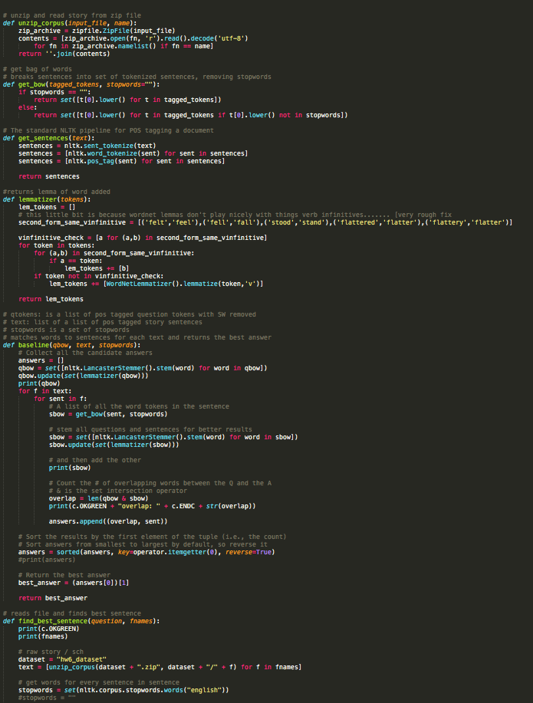
Confusion
55%
We did not understand
Dep. Parsing OR Con. Parsing

Slide 3
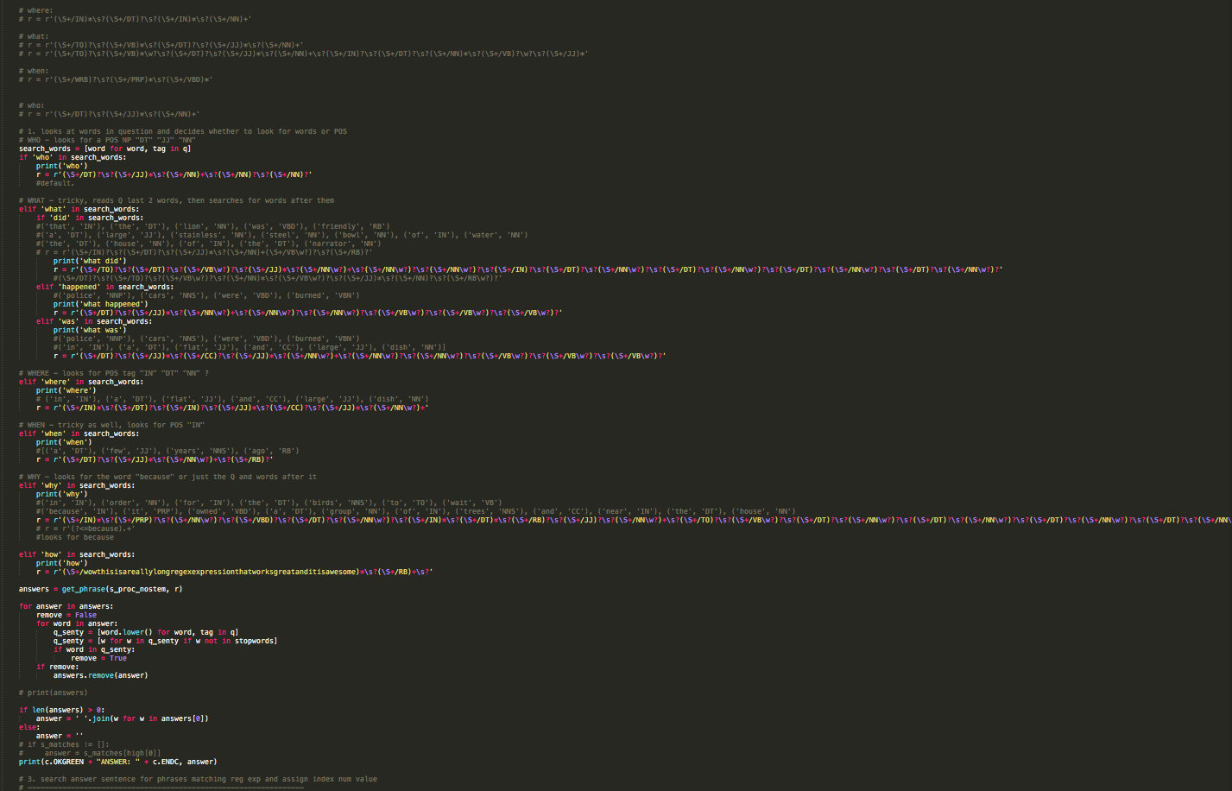
Rejection
58%
We used REGEX
& A dumb Luck Algorithm

Slide 4
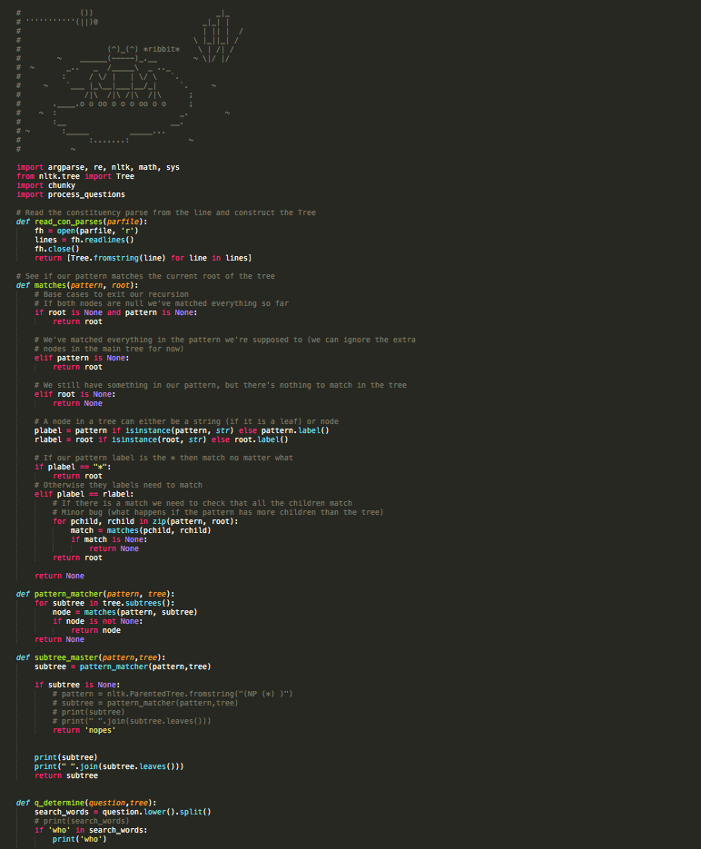
Acceptance
65%
We switched to:
Constituency Parsing

Slide 5

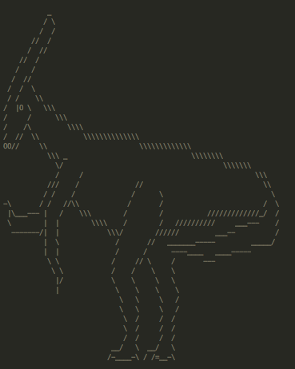
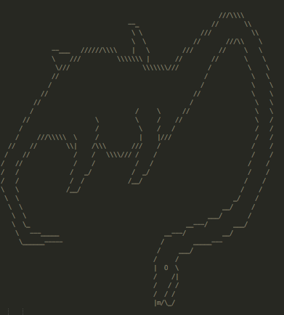
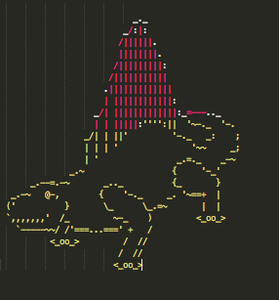
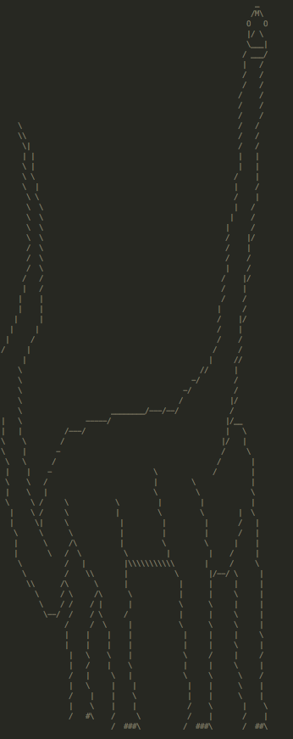
Victory
68%

