Slide 1
AI9000
Alex Lang
Conor Rogers

Slide 2
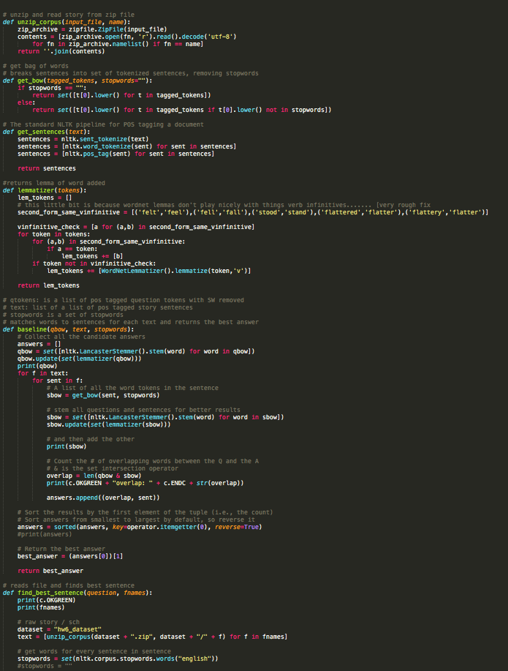
Confusion
55%
We did not understand
Dep. Parsing OR Con. Parsing

Slide 3
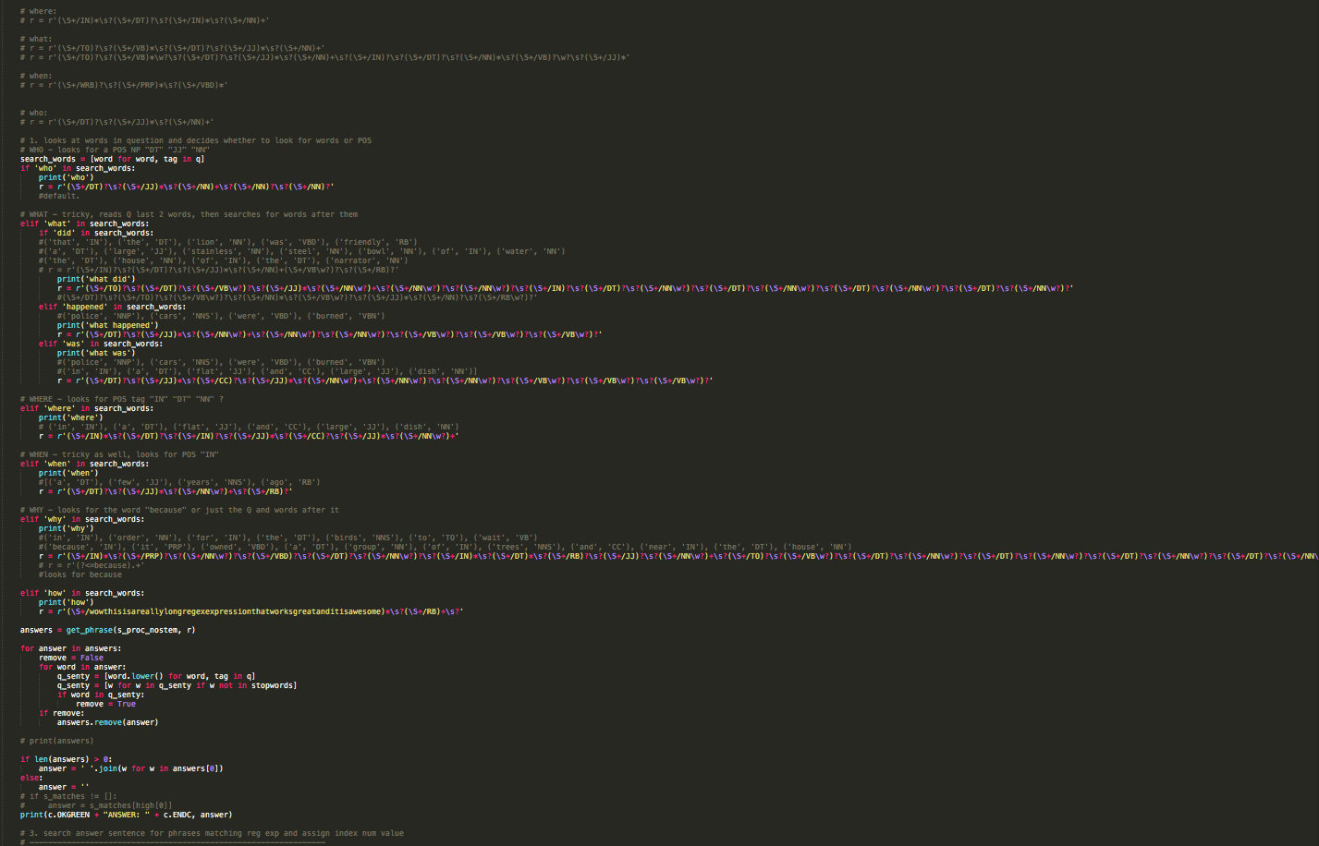
Rejection
58%
We used REGEX
& a Dumb Luck Algorithm

Slide 4
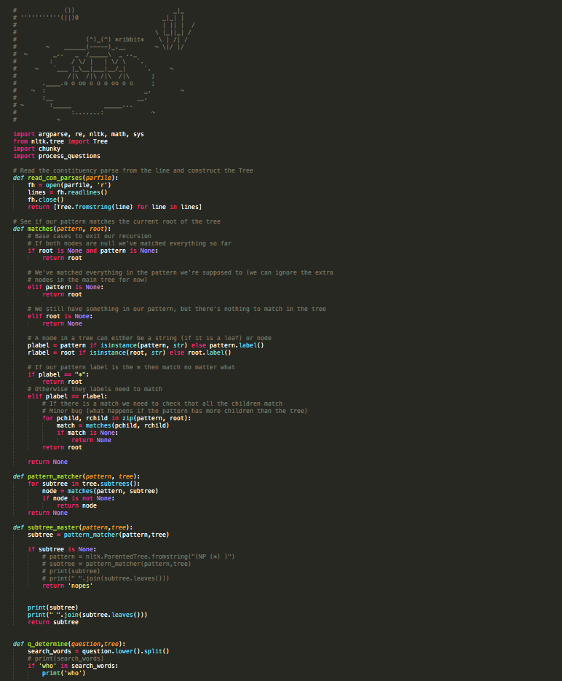
Acceptance
65%
We switched to
Constituency Parsing

Slide 5



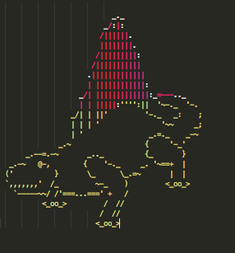

Victory
68%

Slide 6
Held-Out Data
64.4%
63.2%
Recall
Precision
F-score
63.8%

Slide 7
Reflections
Q?
We don’t ‘know’ what the Q is asking
We treat each ‘wh’ Q type accordingly

Slide 8
Observations
Recall
What Q is asking for &
Finding Best Sentence
Precision
Answering Q

