Slide 1






Selenium automates browsers. That's it!
What you do with that power is entirely up to you.
https://www.selenium.dev/
Selenium WebDriver
Selenium Grid

Slide 2
Content
Pruebas distribuidas con Selenium Grid & Docker
Selenium WebDriver & TestNG
Selenium Grid
Docker
Selenium Grid & Docker
Luis Ruiz Caceres ®

Slide 3

Selenium
Selenium es un conjunto de herramientas para automatizar los navegadores web.
Selenium WebDriver
Selenium IDE
Selenium Grid
Selenium WebDriver drives a browser natively, as a real user would, either locally or on remote machines.
Selenium IDE is a Chrome and Firefox extension that makes it easy to record and playback tests in the browser.
Selenium Grid takes WebDriver to another level by running tests on many machines at the same time, cutting down on the time it takes to test on multiple browsers and operating systems.
Luis Ruiz Caceres ®

Slide 4
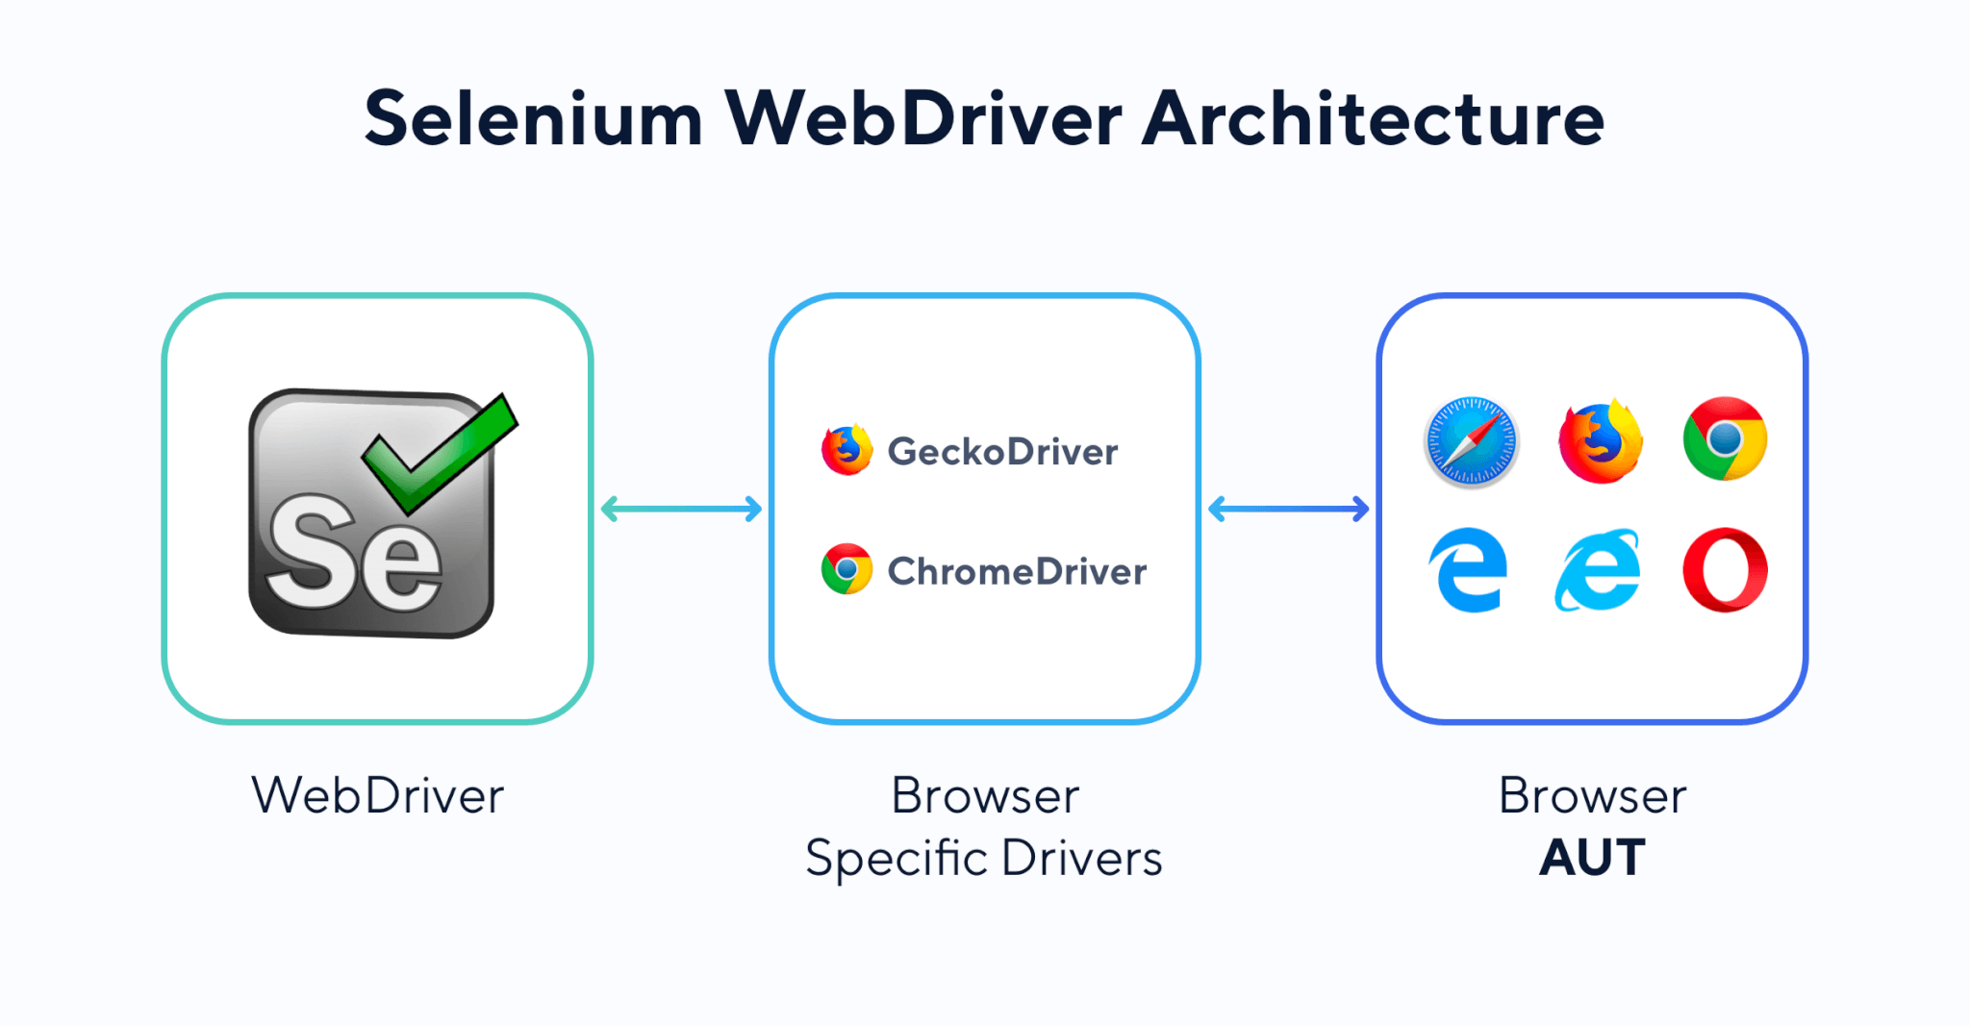
Selenium
Selenium WebDriver
Selenium es una herramienta que permite desarrollar pruebas de UI que pueden ejecutarse en Chrome, Firefox, Opera, IE and Edge.
Permite crea pruebas y conjuntos robustos de automatización de regresión ​en diferentes navegadores, escalar y distribuir scripts en muchos entornos.
Luis Ruiz Caceres ®

Slide 5
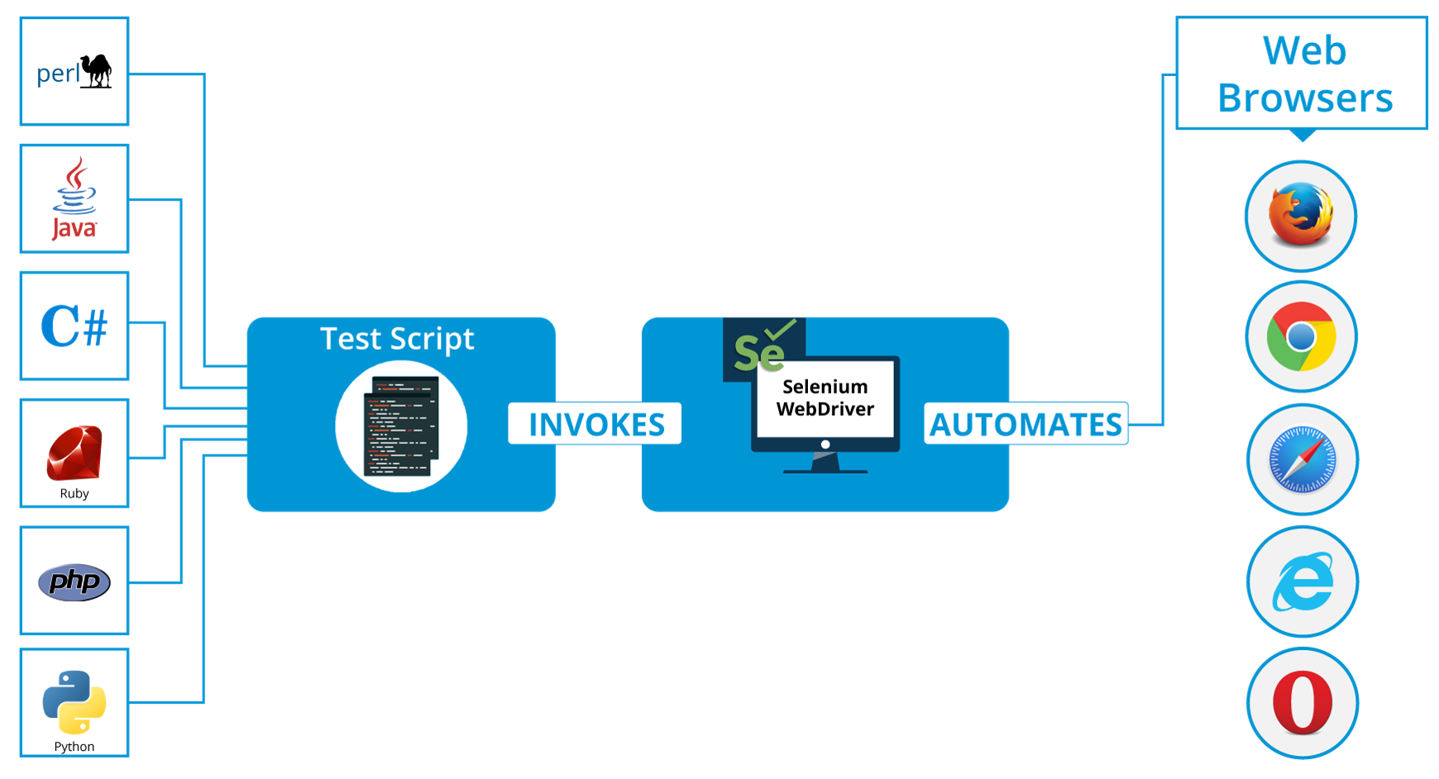
Selenium
Selenium WebDriver
Luis Ruiz Caceres ®

Slide 6

Selenium
Selenium WebDriver
<test name="Test On Opera">
<parameter name="BrowserName" value="opera"></parameter>
<classes>
<class name="pe.edu.galaxy.doLogin_v2" />
</classes>
</test>
<test name="Test On Chrome">
<parameter name="BrowserName" value="chrome"></parameter>
<classes>
<class name="pe.edu.galaxy.doLogin_v2" />
</classes>
</test>
<test name="Test On Firefox">
<parameter name="BrowserName" value="firefox"></parameter>
<classes>
<class name="pe.edu.galaxy.doLogin_v2" />
</classes>
</test>
public void setUp(String BrowserName) {
if (BrowserName.equalsIgnoreCase("FIREFOX")) {
driver = new FirefoxDriver();
} else if (BrowserName.equalsIgnoreCase("chrome")){
driver = new ChromeDriver();
} else if (BrowserName.equalsIgnoreCase("ie")) {
driver = new InternetExplorerDriver();
} else if (BrowserName.equalsIgnoreCase("operA")) {
driver = new OperaDriver();
}
}
Luis Ruiz Caceres ®

Slide 7
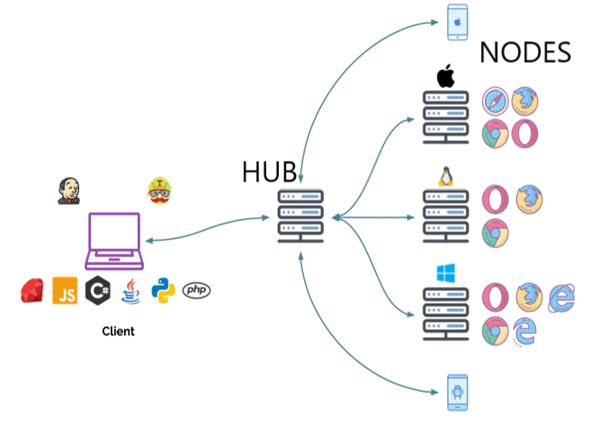
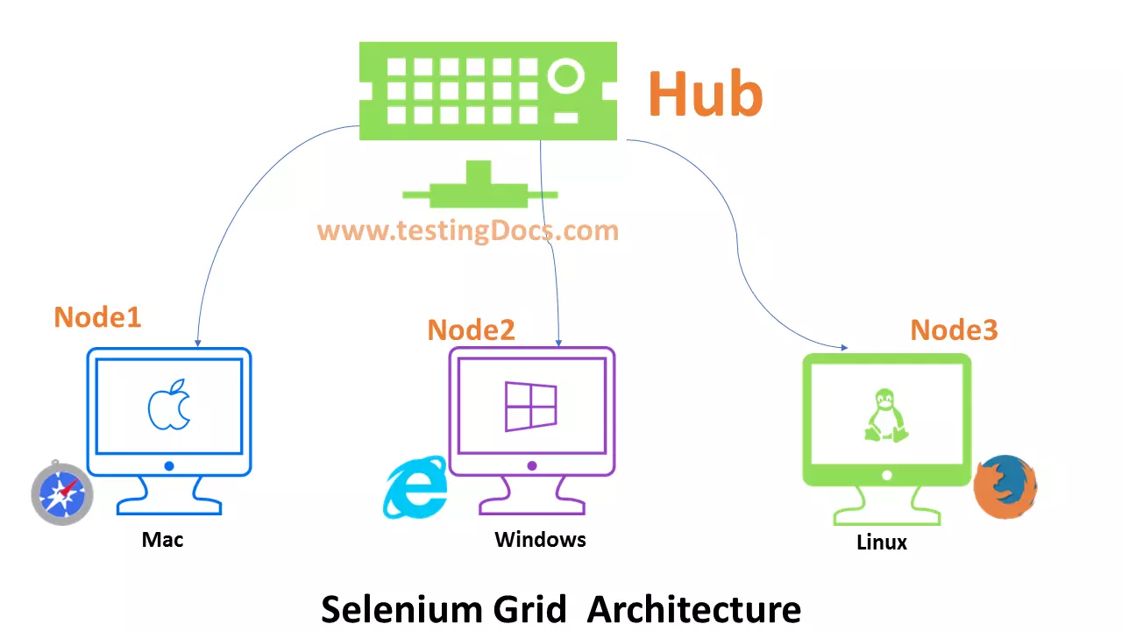
Selenium
Selenium Grid
se utiliza para ejecutar la ejecución de pruebas en diferentes máquinas, diferentes sistemas operativos y múltiples navegadores al mismo tiempo.
Luis Ruiz Caceres ®

Slide 8
Selenium
<test name="Chrome Test">
<parameter name="platformName" value="LINUX" />
<parameter name="browserVersion" value="87.0.4280.66" />
<parameter name="browserName" value="chrome" />
<classes>
<class name="pe.edu.galaxy.SeleniumGrid2" />
</classes>
</test>
<test name="Firefox Test">
<parameter name="platformName" value="LINUX" />
<parameter name="browserVersion" value="83.0" />
<parameter name="browserName" value="firefox" />
<classes>
<class name="pe.edu.galaxy.SeleniumGrid2" />
</classes>
</test>
<test name="Opera Test">
<parameter name="platformName" value="LINUX" />
<parameter name="browserVersion" value="72.0.3815.378" />
<parameter name="browserName" value="opera" /><classes>
<class name="pe.edu.galaxy.SeleniumGrid2" />
</classes>
</test>
Selenium Grid
//setup platformName
if (platformName.equalsIgnoreCase("Windows")) {
caps.setPlatform(Platform.WINDOWS);
}else if(platformName.equalsIgnoreCase("MAC")) {
caps.setPlatform(Platform.MAC);
}else if(platformName.equalsIgnoreCase("LINUX")) {
caps.setPlatform(Platform.LINUX);
}
//setup browserName
if (browserName.equalsIgnoreCase("chrome")) {
caps = DesiredCapabilities.chrome();
}else if (browserName.equalsIgnoreCase("firefox")) {
caps = DesiredCapabilities.firefox();
}else if(browserName.equalsIgnoreCase("opera")){
caps = DesiredCapabilities.opera();
}
//version browser
caps.setVersion(browserVersion);
Luis Ruiz Caceres ®

Slide 9

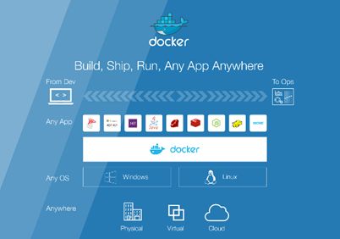
Docker
Plataforma abierta para desarrolladores y administradores de sistemas que desarrollen, envíen y ejecuten aplicaciones distribuidas, ya sea en computadoras portátiles, maquinas virtuales de centros de datos o en la nube.
Luis Ruiz Caceres ®

Slide 10
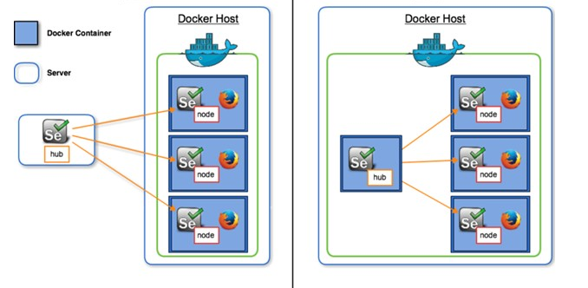
Docker
Selenium Grid sin Docker
Selenium Grid con Docker
Luis Ruiz Caceres ®

Slide 11
Docker
Docker Images
docker pull selenium/hub
docker pull selenium/node-chrome-debug
docker pull selenium/node-firefox-debug
docker pull selenium/node-opera-debug
Start Docker
docker-compose -f docker-compose-full.yml up
Tear Down
docker-compose -f docker-compose-full.yml down
<test name="Chrome Test">
<parameter name="platformName" value="LINUX" />
<parameter name="browserVersion" value="87.0.4280.66" />
<parameter name="browserName" value="chrome" />
<classes>
<class name="pe.edu.galaxy.SeleniumGrid2" />
</classes>
</test>
<test name="Firefox Test">
<parameter name="platformName" value="LINUX" />
<parameter name="browserVersion" value="83.0" />
<parameter name="browserName" value="firefox" />
<classes>
<class name="pe.edu.galaxy.SeleniumGrid2" />
</classes>
</test>
<test name="Opera Test">
<parameter name="platformName" value="LINUX" />
<parameter name="browserVersion" value="72.0.3815.378" />
<parameter name="browserName" value="opera" />
<classes>
<class name="pe.edu.galaxy.SeleniumGrid2" />
</classes>
</test>
Luis Ruiz Caceres ®

Slide 12
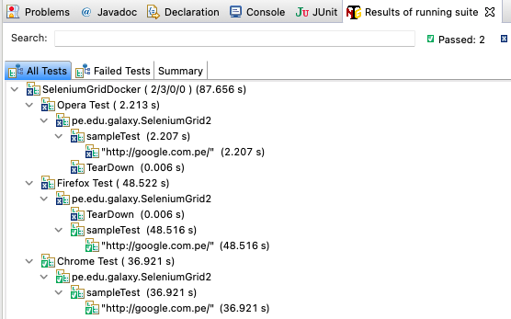
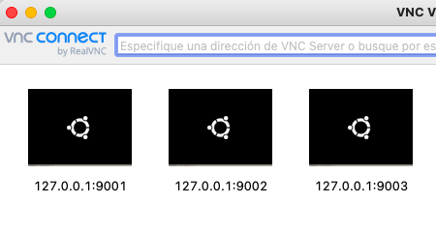
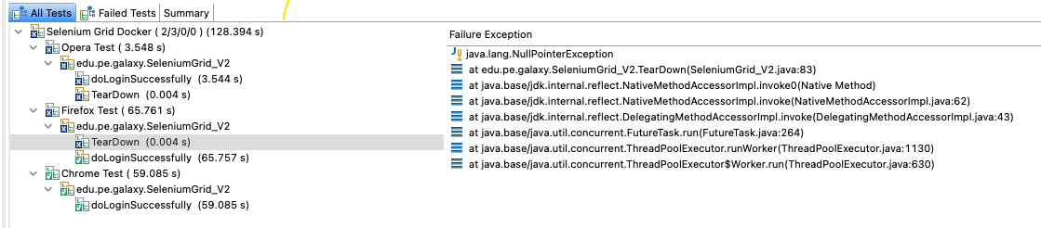
Docker
Luis Ruiz Caceres ®

Slide 13





Luis Ruiz Caceres ®

