Slide 1


Example
1
2
3
4
5
6
7
8
9
10
11
12
Text

Slide 2
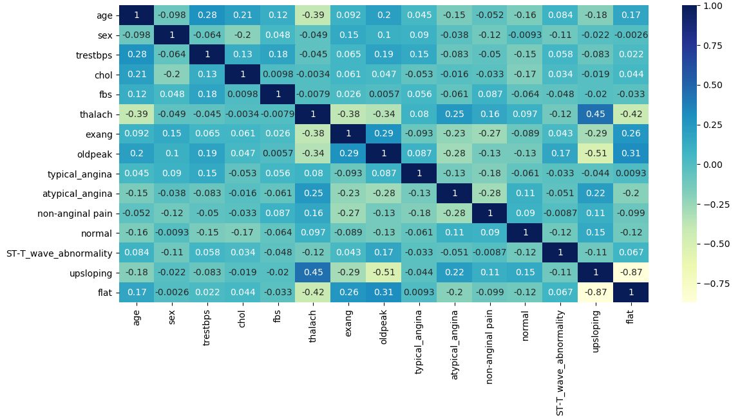
Example
1
2
3
4
5
6
7
8
9
10
11
12

Slide 3
Cluster 0 Persona
1
2
3
4
5
6
7
8
9
10
11
12
Low Blood Sugar Not Exercise
(LBSNE Patient)
The patient has a fasting blood sugar below 120 mg/dl with no exercise induced angina, and an upsloping peak exercise ST segment.

Slide 4








Assignment 1: Iris Dataset
Advanced Data Analytics
1
2
3
4
5
6
7
8
9
10
11
12
Author: Garrett Powell & Gale Proulx
PART I: Project Scope
PART II: Observations
PART III: Data Preprocessing
PART IV: Next Steps

Slide 5
Assignment 1: Iris Dataset
Advanced Data Analytics
1
2
3
4
5
6
7
8
9
10
11
12
Author: Garrett Powell & Gale Proulx
PART I: Project Scope
PART II: Observations
PART III: Data Preprocessing
PART IV: Next Steps

Slide 6
Goal
1
2
3
4
5
6
7
8
9
10
11
12
Text

Slide 7
Audience
1
2
3
4
5
6
7
8
9
10
11
12
Text

Slide 8
Social Impact
1
2
3
4
5
6
7
8
9
10
11
12
Text

Slide 9
Assignment 1: Iris Dataset
Advanced Data Analytics
1
2
3
4
5
6
7
8
9
10
11
12
Author: Garrett Powell & Gale Proulx
PART I: Project Scope
PART II: Observations
PART III: Data Preprocessing
PART IV: Next Steps

Slide 10
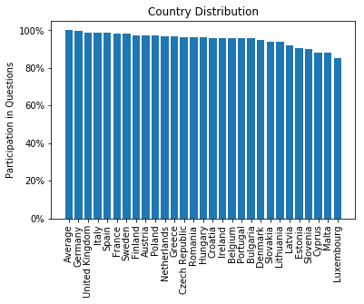
Country Distribution
1
2
3
4
5
6
7
8
9
10
11
12

Slide 11
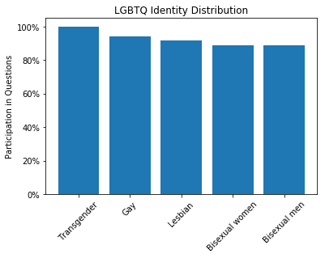
Identity Distribution
1
2
3
4
5
6
7
8
9
10
11
12

Slide 12
Assignment 1: Iris Dataset
Advanced Data Analytics
1
2
3
4
5
6
7
8
9
10
11
12
Author: Garrett Powell & Gale Proulx
PART I: Project Scope
PART II: Observations
PART III: Data Preprocessing
PART IV: Next Steps

Slide 13
Example
1
2
3
4
5
6
7
8
9
10
11
12
# Checking to see if columns have null values...
print(df_master.isnull().any())
CountryCode | False
subset | False
… | …
percentage | False
notes | True

Slide 14
Example
1
2
3
4
5
6
7
8
9
10
11
12
# Double check to see if any code values overlap.
File 1 Survey Question Code Unique: 52
File 2 Survey Question Code Unique: 32
File 3 Survey Question Code Unique: 10
File 4 Survey Question Code Unique: 23
File 5 Survey Question Code Unique: 47
Total Unique Codes: 164

Slide 15
Assignment 1: Iris Dataset
Advanced Data Analytics
1
2
3
4
5
6
7
8
9
10
11
12
Author: Garrett Powell & Gale Proulx
PART I: Project Scope
PART II: Observations
PART III: Data Preprocessing
PART IV: Next Steps

Slide 16
Next Steps
1
2
3
4
5
6
7
8
9
10
11
12
Determine what we want to cluster.
Determine how we want to use NMF.
Properly encode columns to accommodate each algorithm.

Slide 17
Assignment 1: Iris Dataset
Advanced Data Analytics
1
2
3
4
5
6
7
8
9
10
11
12
Author: Garrett Powell & Gale Proulx
PART I: Project Scope
PART II: Observations
PART III: Data Preprocessing
PART IV: Next Steps

Slide 18
Sources
1
2
3
4
5
6
7
8
9
10
11
12
EU LGBT Survey Kaggle Dataset published by def me(x)

