Slide 1


Example
1
2
3
4
5
6
7
8
9
10
11
12
Text

Slide 2
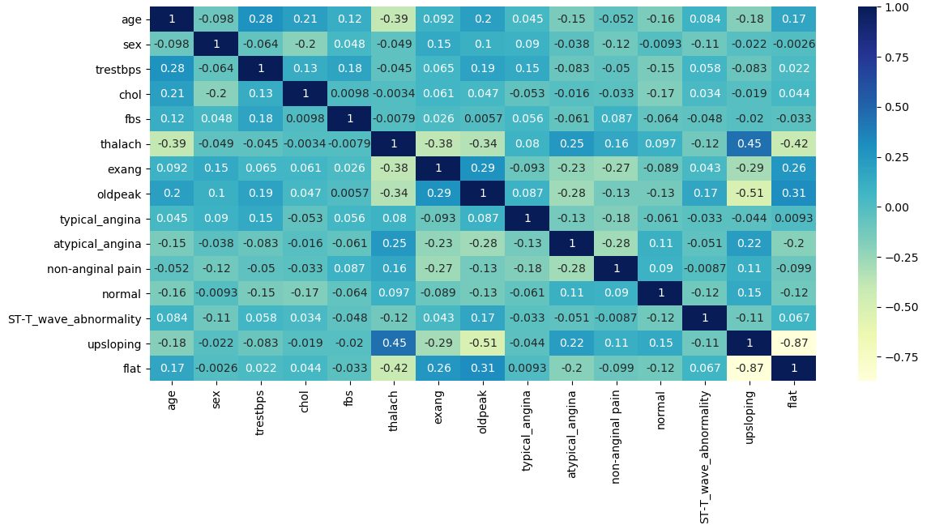
Example
1
2
3
4
5
6
7
8
9
10
11
12

Slide 3
Cluster 0 Persona
1
2
3
4
5
6
7
8
9
10
11
12
Low Blood Sugar Not Exercise
(LBSNE Patient)
The patient has a fasting blood sugar below 120 mg/dl with no exercise induced angina, and an upsloping peak exercise ST segment.

Slide 4








Assignment 1: Iris Dataset
Advanced Data Analytics
1
2
3
4
5
6
7
8
9
10
11
12
Author: Garrett Powell & Gale Proulx
PART I: Project Scope
PART II: Research Questions
PART III: Data Preprocessing
PART IV: Next Steps

Slide 5
Assignment 1: Iris Dataset
Advanced Data Analytics
1
2
3
4
5
6
7
8
9
10
11
12
Author: Garrett Powell & Gale Proulx
PART I: Project Scope
PART II: Research Questions
PART III: Data Preprocessing
PART IV: Next Steps

Slide 6
Example
1
2
3
4
5
6
7
8
9
10
11
12
Text

Slide 7
Assignment 1: Iris Dataset
Advanced Data Analytics
1
2
3
4
5
6
7
8
9
10
11
12
Author: Garrett Powell & Gale Proulx
PART I: Project Scope
PART II: Research Questions
PART III: Data Preprocessing
PART IV: Next Steps

Slide 8
Assignment 1: Iris Dataset
Advanced Data Analytics
1
2
3
4
5
6
7
8
9
10
11
12
Author: Garrett Powell & Gale Proulx
PART I: Project Scope
PART II: Research Questions
PART III: Data Preprocessing
PART IV: Next Steps

Slide 9
Assignment 1: Iris Dataset
Advanced Data Analytics
1
2
3
4
5
6
7
8
9
10
11
12
Author: Garrett Powell & Gale Proulx
PART I: Project Scope
PART II: Research Questions
PART III: Data Preprocessing
PART IV: Next Steps

Slide 10
Assignment 1: Iris Dataset
Advanced Data Analytics
1
2
3
4
5
6
7
8
9
10
11
12
Author: Garrett Powell & Gale Proulx
PART I: Project Scope
PART II: Research Questions
PART III: Data Preprocessing
PART IV: Next Steps

