Slide 1
3 Card Guts
Demo
Rules
3 cards
Simultaneously declare
If In and win then take the pot
If In and loss then pay the pot
Best poker hand wins
So, what should your strategy be?

Slide 2
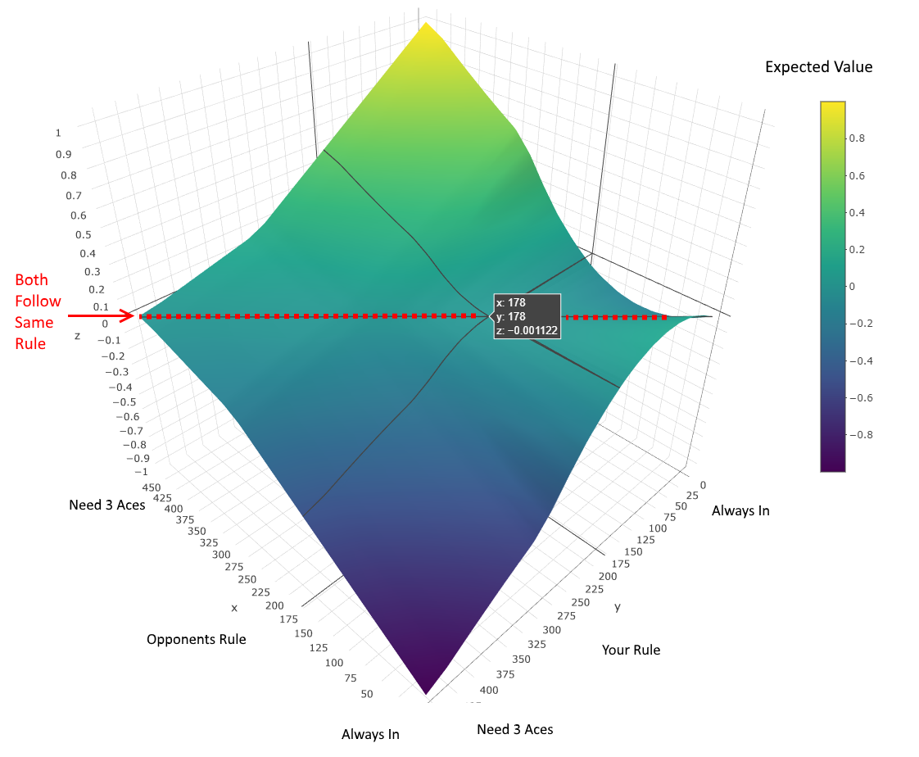
Both Follow Same Strategy

Slide 3
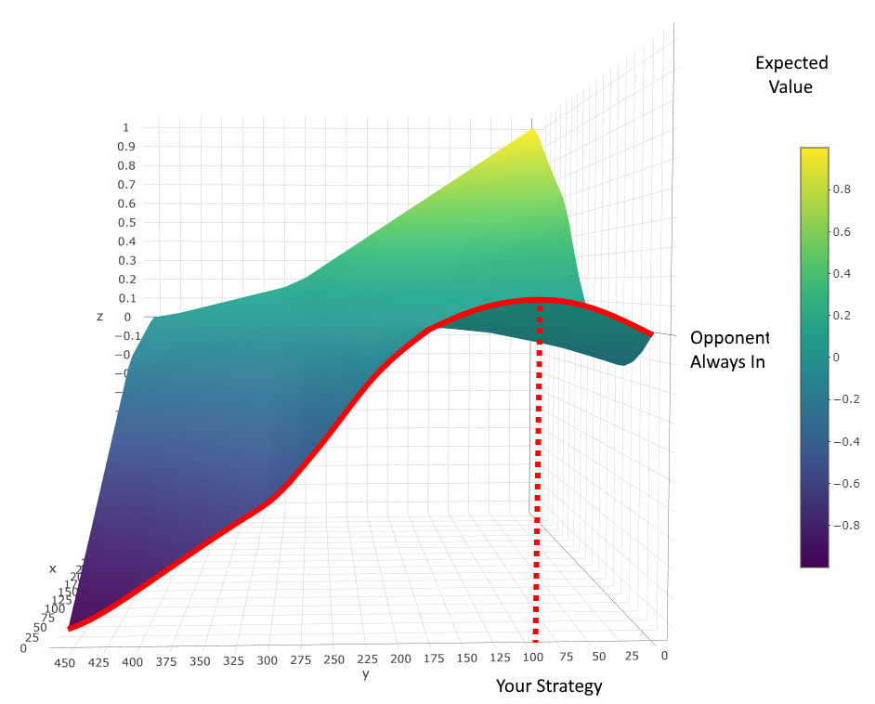
Opponent Always In

Slide 4
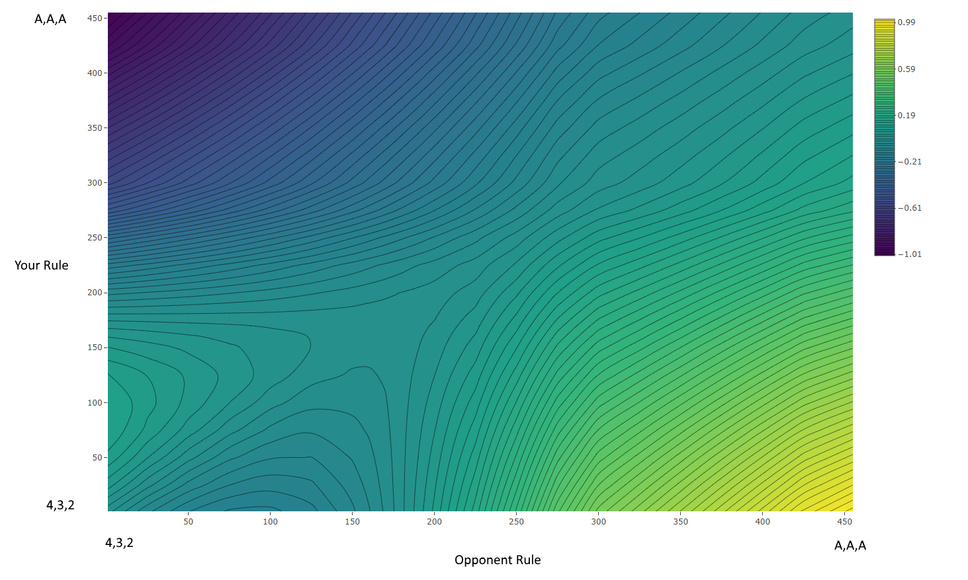
Contour Plot

Slide 5
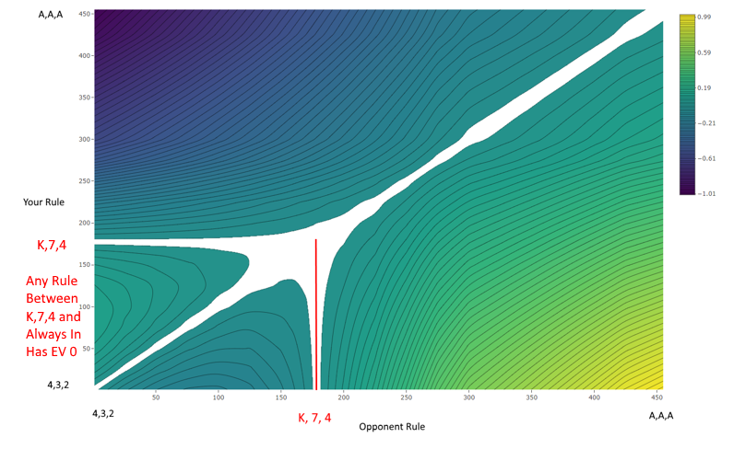
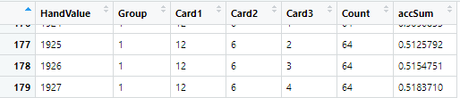
Zero Expected Value Contour

Slide 6
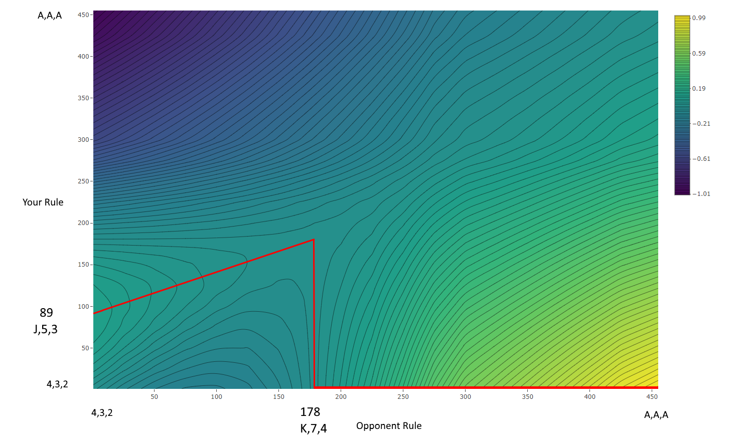
Your Best Strategy Given Opponents Rule

Slide 7
Guts Rules
If your rule is K, 7,4 or higher then your opponent can always go in and your expected value is zero.
If your rule is K, 7,4 or higher and your opponent is more conservative then your expected value will be greater than zero.
If your opponent is more conservative and will only go in on hands greater than K, 7, 4 then you should always go in.
If your opponent is more gutsy then you could adjust your strategy to go in on hands half way between theirs and K, 7, 4.

Slide 8
Guts Ideas
What about more than two players?
What about multiple players with differing strategies?
What about sequentially declaring In or Out?
What about players adjusting their strategies given prior game history?
What about other types of Guts games?
Can we figure out mathematically?
Maybe redefine the game to getting a random number from 0 to 1.

Slide 9
Guts Sequential Declare
3 Card Guts
If you are In and win then you take the pot.
If you are In and loss then you pay the pot.
If you are the only person In, you need to beat the deck.
Sequential declare if you are in or out.
Did this 25 years ago with Excel Macros.
Simulated 100,000,000 hands (let run for 24 hours).
Used algorithm similar to how Linier Regression solved.
Started each player scenario with default rule (in on an Ace high).
Adjusted each player’s rule slightly up or down to see if better strategy.
Rerun adjustment process until zeroed in on over optimal strategy for all.

Slide 10
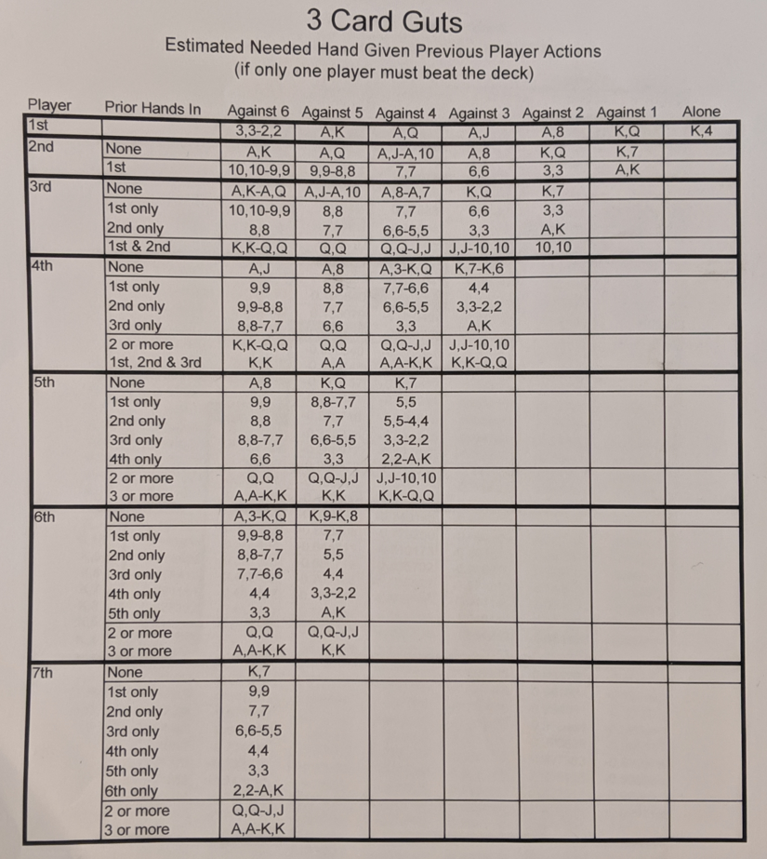
Guts Sequential Declare Results
NOTES:
Convex Outcome so…
used Gradient Descent algorithm
Could create new game where random number between 0-1 generated and highest wins.
Could then calculate exact rules.
Could also take many games and calculate ranks (0-1).

