Slide 1
Axis and Allies Odds Calculations
Exact Outcomes and
Simulate Battle Outcomes

Slide 2
Slides
Axis and Allies Battle Board
Example of a Battle
Dice Roll Hit Distribution
One Round Outcomes Explained
Exact Outcome Code
Exact Outcome Animation (Full Battle)
Simulated Outcome Animation
Simulation Outcome Code

Slide 3



Axis & Allies Battle Board
Defender
Die Role
Needed
For Hit
<= 1
<= 2
<= 3
<= 4
Attacker

Slide 4





Axis & Allies Units
Defender
8
Total
Units
Die Role
Needed
For Hit
<= 1
<= 2
<= 3
<= 4
10
Total
Units
Attacker

Slide 5
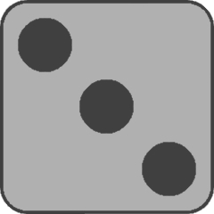
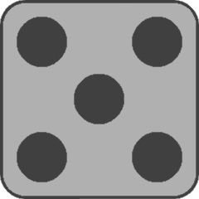
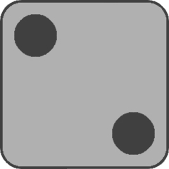
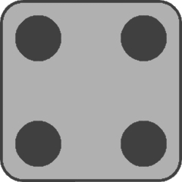


Axis & Allies Unit Rolls
Defender
8
Total
Units
Die Role
Needed
For Hit
<= 1
<= 2
<= 3
<= 4
10
Total
Units
Attacker

Slide 6
Axis & Allies Unit Roll Results
Defender
8
Total
Units
4
Total
Hits
Die Role
Needed
For Hit
<= 1
<= 2
<= 3
<= 4
10
Total
Units
5
Total
Hits
Attacker

Slide 7

Axis & Allies Round One Results
Defender
3
Units
Left
4
Total
Hits
Die Role
Needed
For Hit
<= 1
<= 2
<= 3
<= 4
6
Units
Left
5
Total
Hits
Attacker

Slide 8
Hit Probability Distribution
Example: Number of Hits probability distribution for Defender having 2 Fighters, 1 Tank and 3 Infantry. Unit hit powers (4, 4, 3, 2, 2, 2).

Slide 9
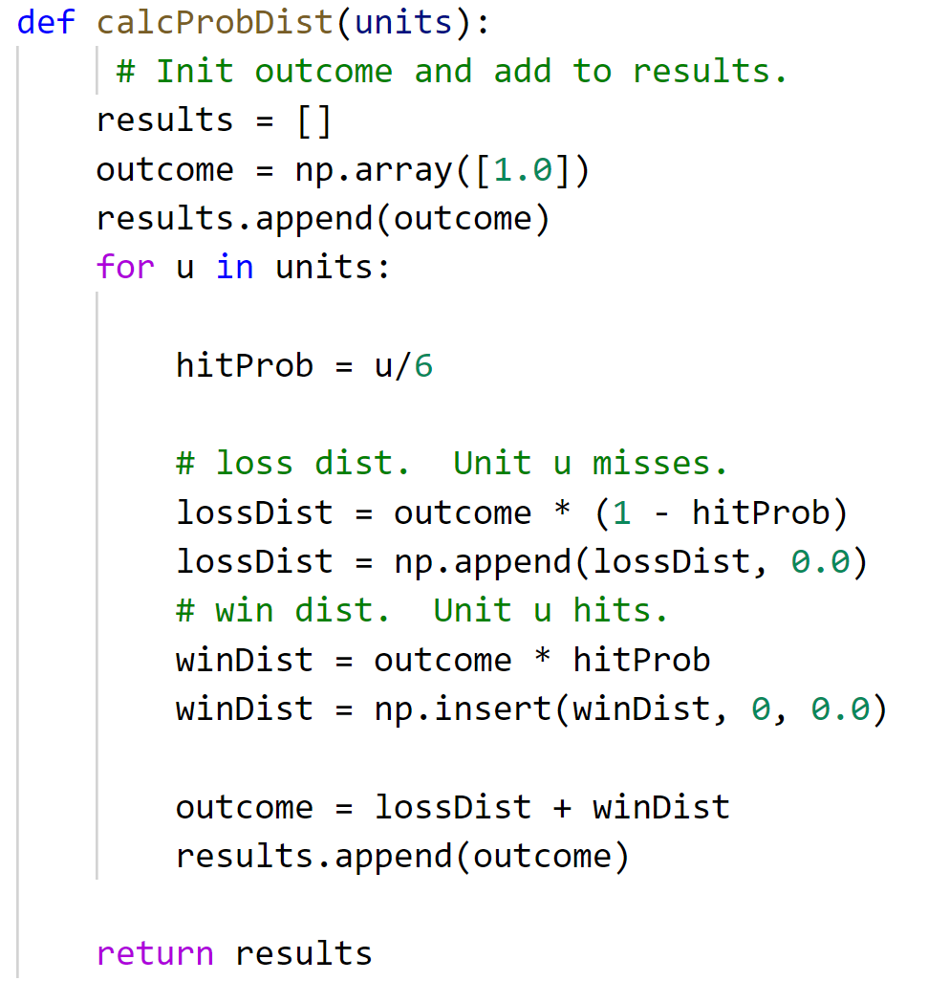
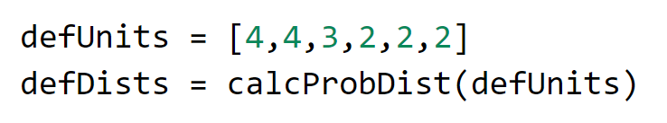
Hit Probability Distribution Code
defDists:
[array([1.]),
array([0.33333333, 0.66666667]),
array([0.11111111, 0.44444444, 0.44444444]),
array([0.05555556, 0.27777778, 0.44444444, 0.22222222]),
array([0.03703704, 0.2037037 , 0.38888889, 0.2962963 , 0.07407407]),
array([0.02469136, 0.14814815, 0.32716049, 0.32716049, 0.14814815, 0.02469136]),
array([0.01646091, 0.10699588, 0.26748971, 0.32716049, 0.20781893, 0.06584362, 0.00823045])]

Slide 10
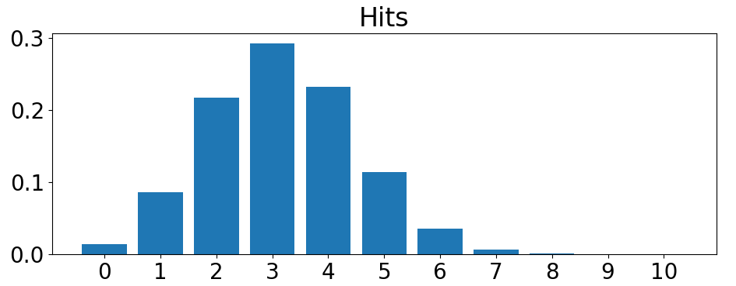
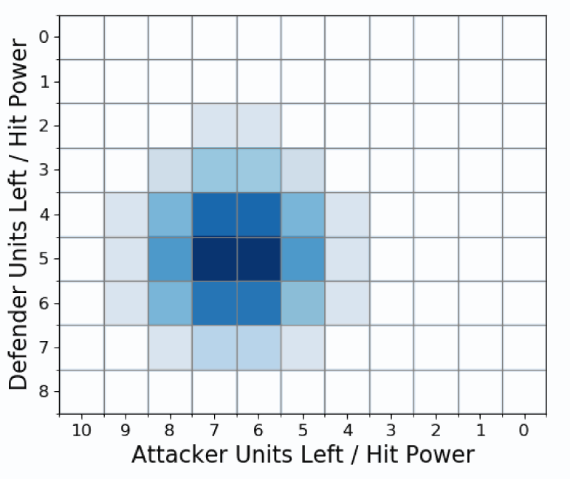

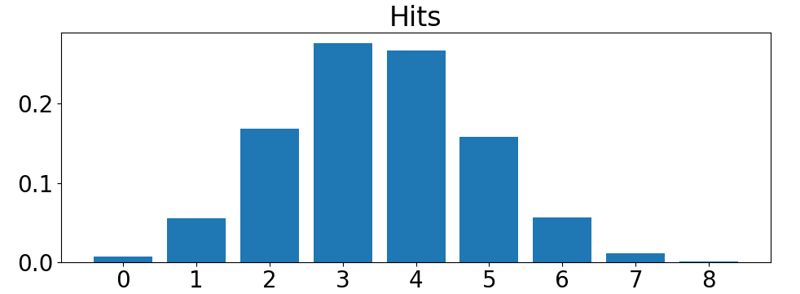
one round distribution
Apply Attacker total Hits. Decreases Defender units remaining.
Apply Defender total Hits. Decreases Attacker units remaining.

Slide 11
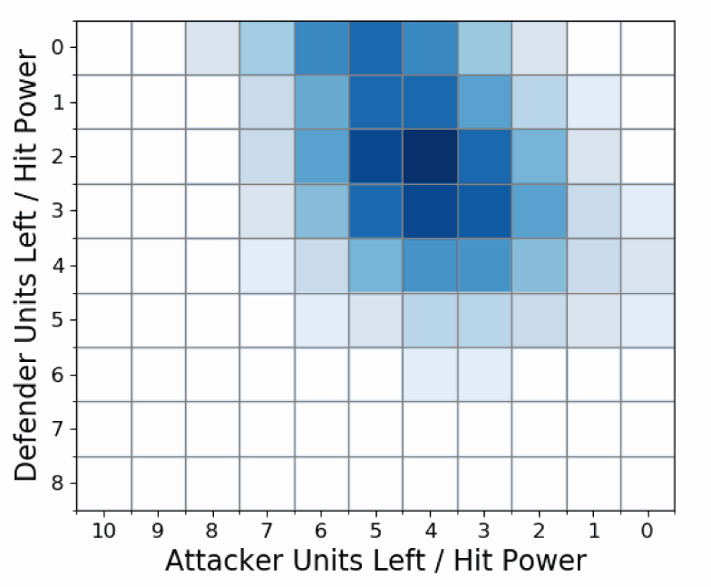
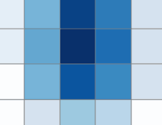
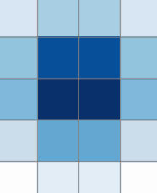

Second round distribution
For every cell in round one’s probability distribution grid, calculate outcomes and add to cumulative round two’s distribution.

Slide 12
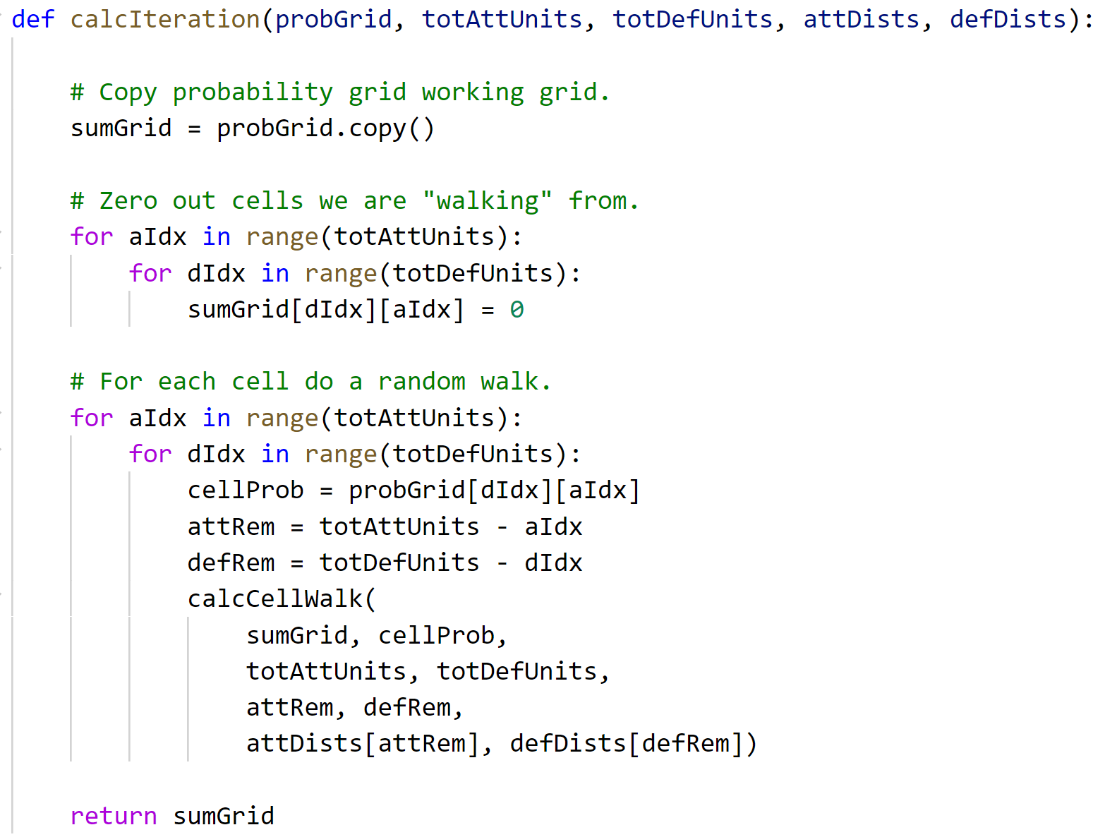
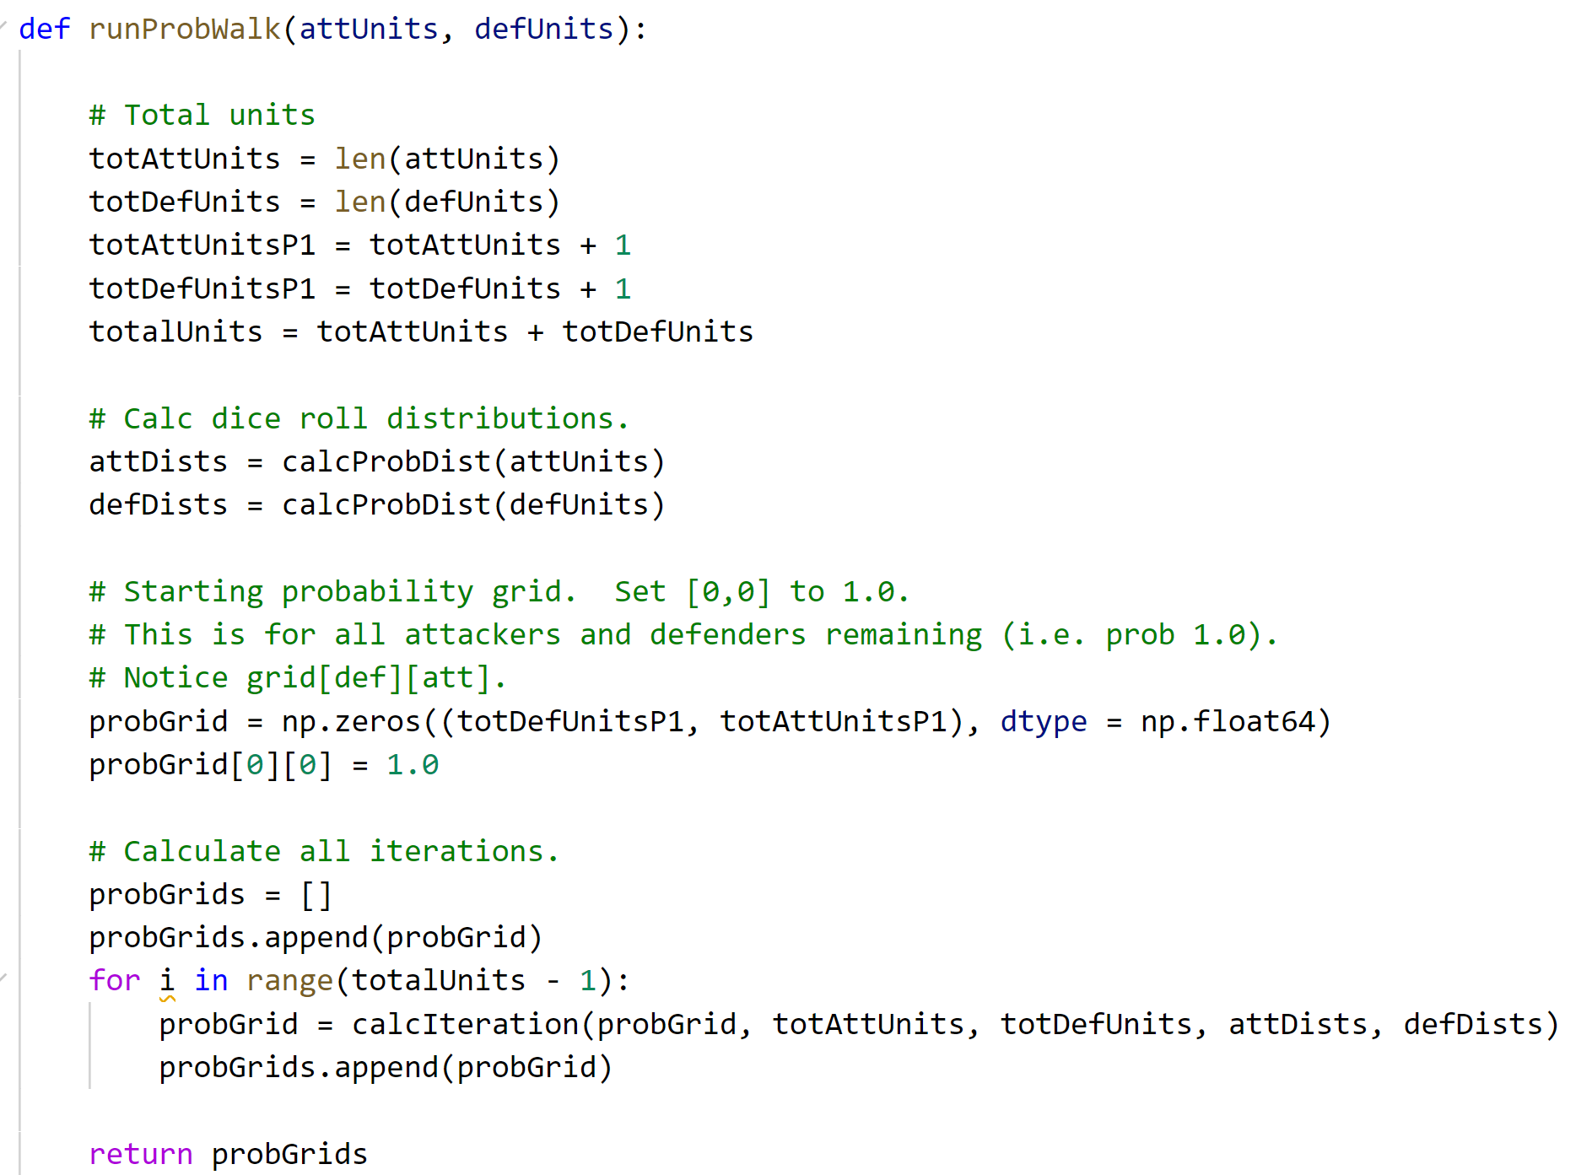
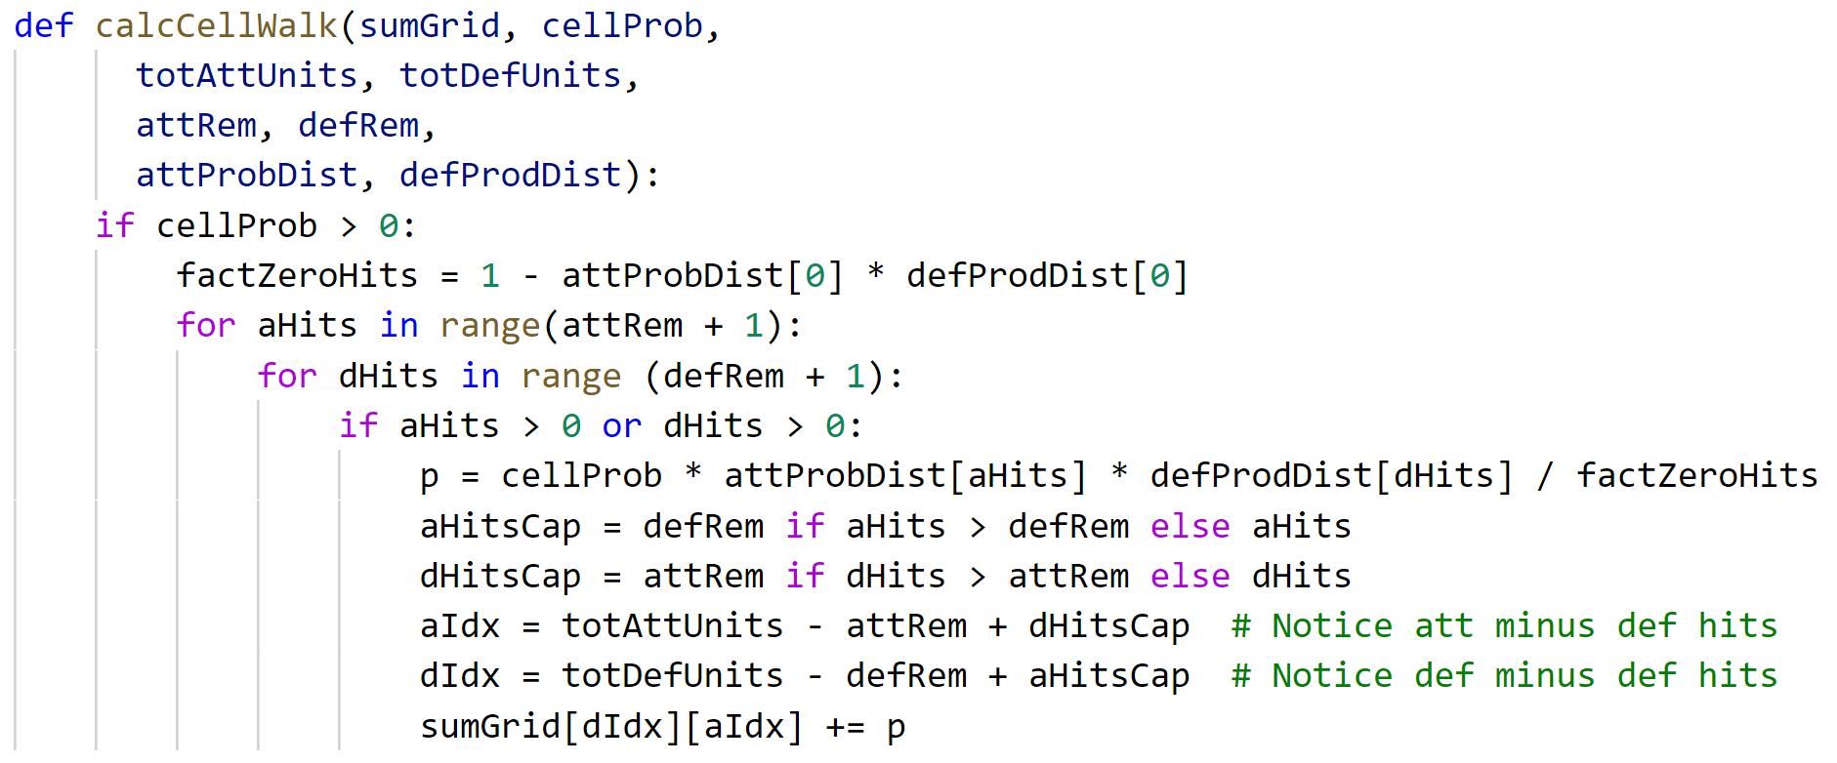
Exact outcomes calculation code
Iterate over battle rounds until done.
For each outcome in grid calculated next outcomes and sum.
For given cell calculate outcomes.

Slide 13
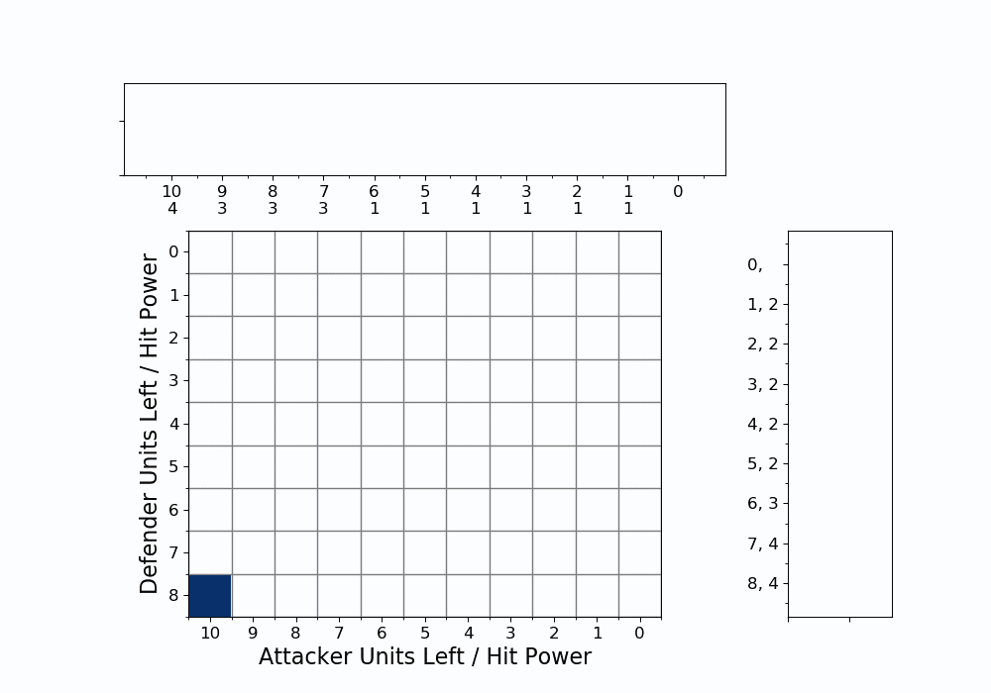
exact outcomes

Slide 14
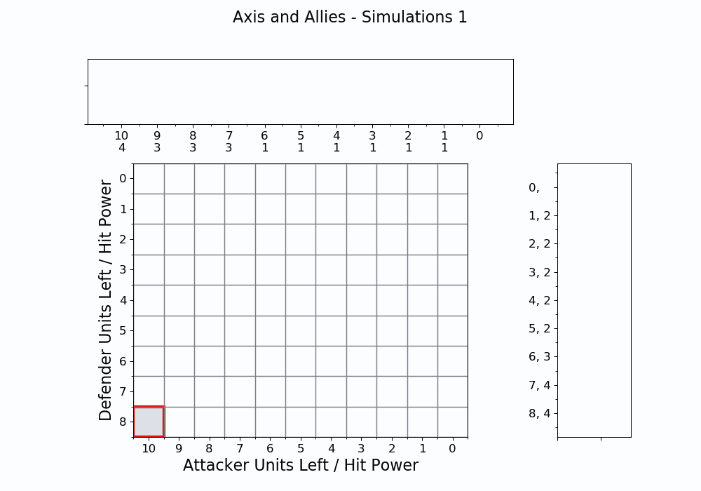
Simulated outcomes (10,000,000)

Slide 15
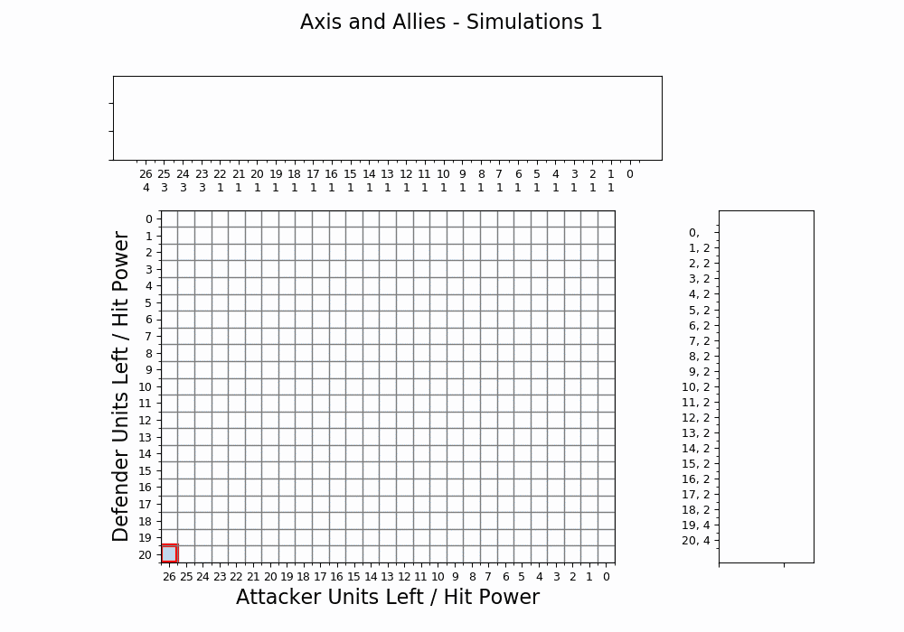
Large Battle - Simulated & Exact

