Slide 1
Slide
Cryptarithmetic Puzzles
Risk Battle Odds

Slide 2
Cryptarithmetic Puzzles
A cryptarithmetic puzzle is a mathematical exercise where the digits of some numbers are represented by letters (or symbols). Each letter represents a unique digit. The goal is to find the digits such that a given mathematical equation is verified:
SEND
+ MORE
-------
= MONEY
How many lines or logical steps of code to solve this in R?

Slide 3
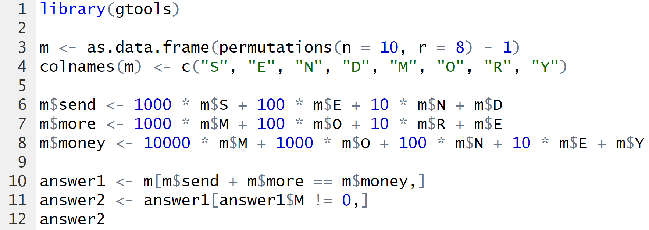
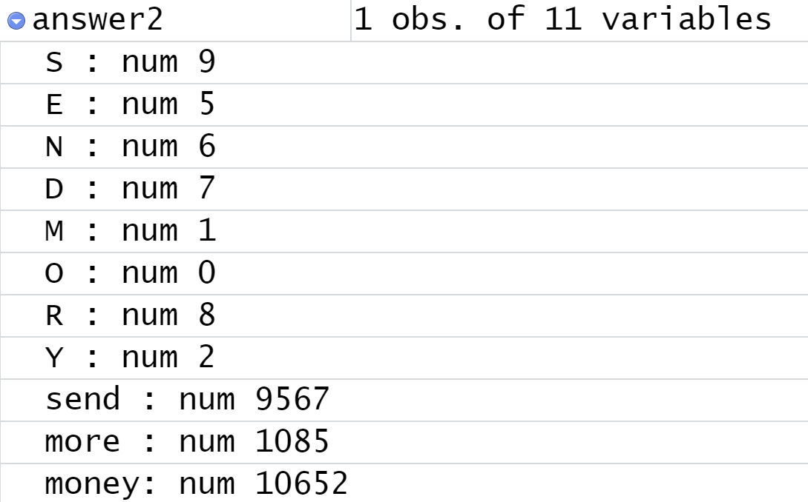
Answer
1
2
3
9567
+ 1085
-------
= 10652

Slide 4
Game of Risk Odds
What are the possible outcomes of a battle?
What is the expected value of a battle?
How many lines of code to solve this in R?
What about multiple battles (random walk)?

Slide 5



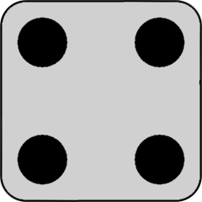
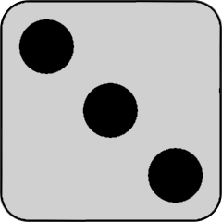
Game of Risk Battles
In the Game of Risk ® battle are resolved as follows:
Attacker roles 3 dice and arranges highest to lowest:
Defender roles 2 dice and arranges highest to lowest:
Align dice to determine outcome. Ties go the defender so the outcome of this battle is:
Attacker wins
Defender
losses 1
army
Defender wins
Attacker
losses 1
army

Slide 6
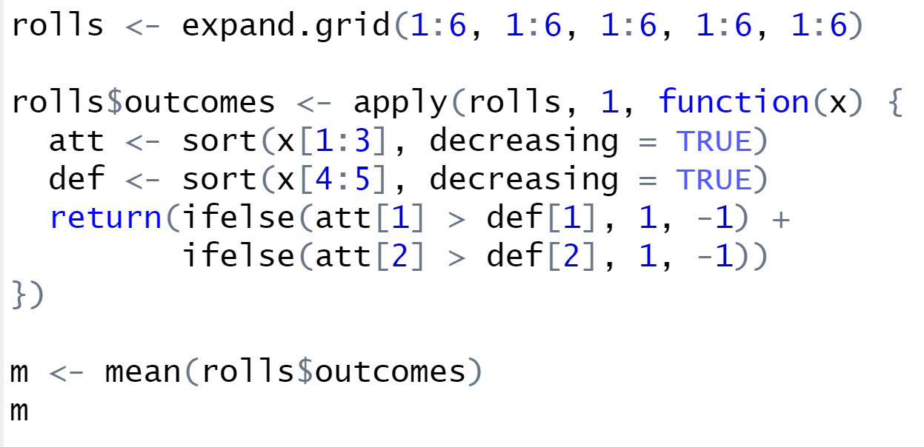
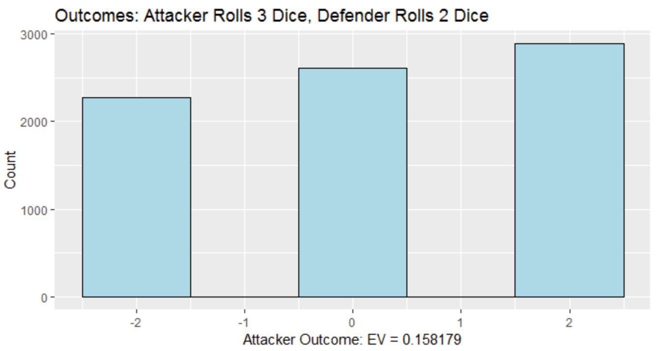

Game of Risk Result
1
2
I would consider this 5 lines (logical steps).
3
4
5

Slide 7
Game of Risk Result
Generate 7,776 records 6*6*6*6*6,
each outcome. The 1st 3 columns can be the attacker outcomes and the last 2 columns the defender.
Apply inline function to each row, generating results in new “outcomes” column.
Given row, sort first 3 columns from highest to lowest (attacker). Sort last 2 columns (defender).
Determine attacker result for given row and store in “outcomes” column.
Tie goes to defender.
Outcomes +2, 0, -2.
Calculate the expected value for the Attacker (mean).

