Slide 1
Krótkie wprowadzenie do metody FDTD (cz. 2(2D))

Slide 2

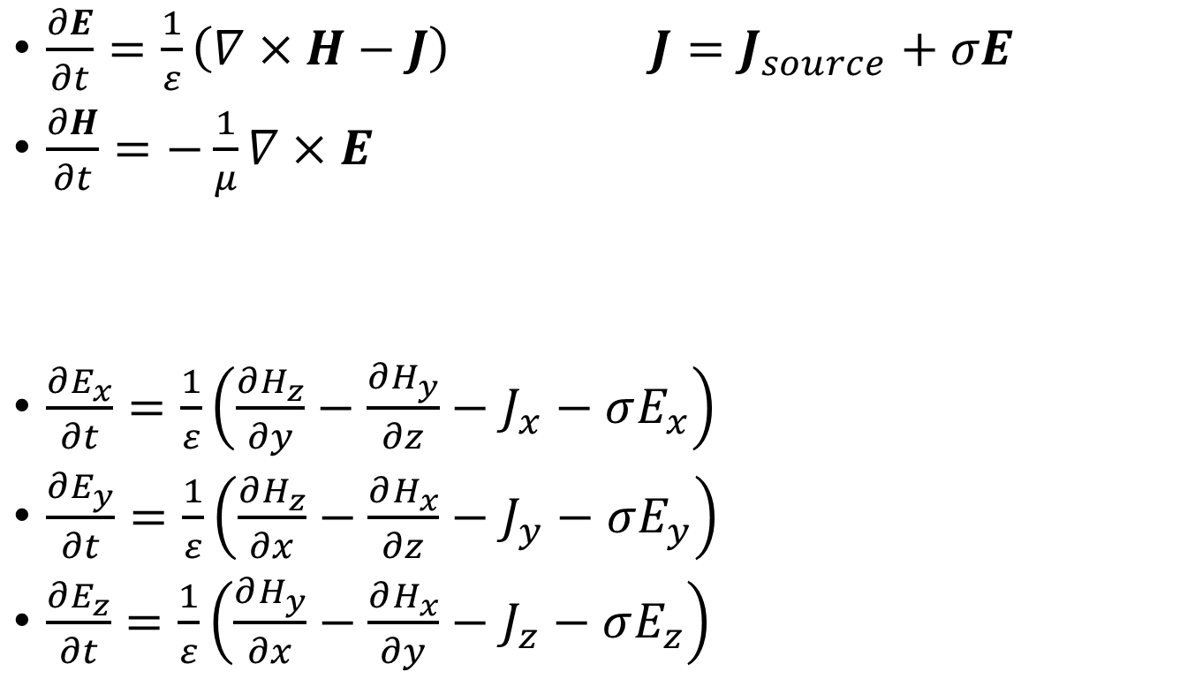
Równania Maxwella
$\frac{∂E}{∂t}=\frac{1}{ε}\left(∇×H−J\right)$ $J=J_{source}+σE$
$\frac{∂H}{∂t}=−\frac{1}{μ}∇×E$
$\frac{∂E_{x}}{∂t}=\frac{1}{ε}\left(\frac{∂H_{z}}{∂y}−\frac{∂H_{y}}{∂z}−J_{x}−σE_{x}\right)$
$\frac{∂E_{y}}{∂t}=\frac{1}{ε}\left(\frac{∂H_{z}}{∂x}−\frac{∂H_{x}}{∂z}−J_{y}−σE_{y}\right)$
$\frac{∂E_{z}}{∂t}=\frac{1}{ε}\left(\frac{∂H_{y}}{∂x}−\frac{∂H_{x}}{∂y}−J_{z}−σE_{z}\right)$
Mikroskopowe prawo Ohma
Źródło prądu
$\frac{∂H_{x}}{∂t}=\frac{1}{μ}\left(\frac{∂E_{y}}{∂z}−\frac{∂E_{z}}{∂y}\right)$
$\frac{∂H_{y}}{∂t}=\frac{1}{μ}\left(\frac{∂E_{x}}{∂z}−\frac{∂E_{z}}{∂x}\right)$
$\frac{∂H_{z}}{∂t}=\frac{1}{μ}\left(\frac{∂E_{x}}{∂y}−\frac{∂E_{y}}{∂x}\right)$

Slide 3
Równania Maxwella – ograniczenie do 2D
Zakładamy niezmienniczość ze względu na translację wzdłuż osi $z$ (pole EM nie zmienia się w kierunku z)
$\frac{∂E}{∂t}=\frac{1}{ε}\left(∇×H−J\right)$ $J=J_{source}+σE$
$\frac{∂H}{∂t}=−\frac{1}{μ}∇×E$
$\frac{∂E_{x}}{∂t}=\frac{1}{ε}\left(\frac{∂H_{z}}{∂y}−\frac{∂H_{y}}{∂z}−J_{x}−σE_{x}\right)$
$\frac{∂E_{y}}{∂t}=\frac{1}{ε}\left(\frac{∂H_{z}}{∂x}−\frac{∂H_{x}}{∂z}−J_{y}−σE_{y}\right)$
$\frac{∂E_{z}}{∂t}=\frac{1}{ε}\left(\frac{∂H_{y}}{∂x}−\frac{∂H_{x}}{∂y}−J_{z}−σE_{z}\right)$
Mikroskopowe prawo Ohma
Źródło prądu
$\frac{∂H_{x}}{∂t}=\frac{1}{μ}\left(\frac{∂E_{y}}{∂z}−\frac{∂E_{z}}{∂y}\right)$
$\frac{∂H_{y}}{∂t}=\frac{1}{μ}\left(\frac{∂E_{x}}{∂z}−\frac{∂E_{z}}{∂x}\right)$
$\frac{∂H_{z}}{∂t}=\frac{1}{μ}\left(\frac{∂E_{x}}{∂y}−\frac{∂E_{y}}{∂x}\right)$

Slide 4
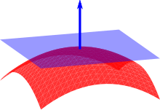
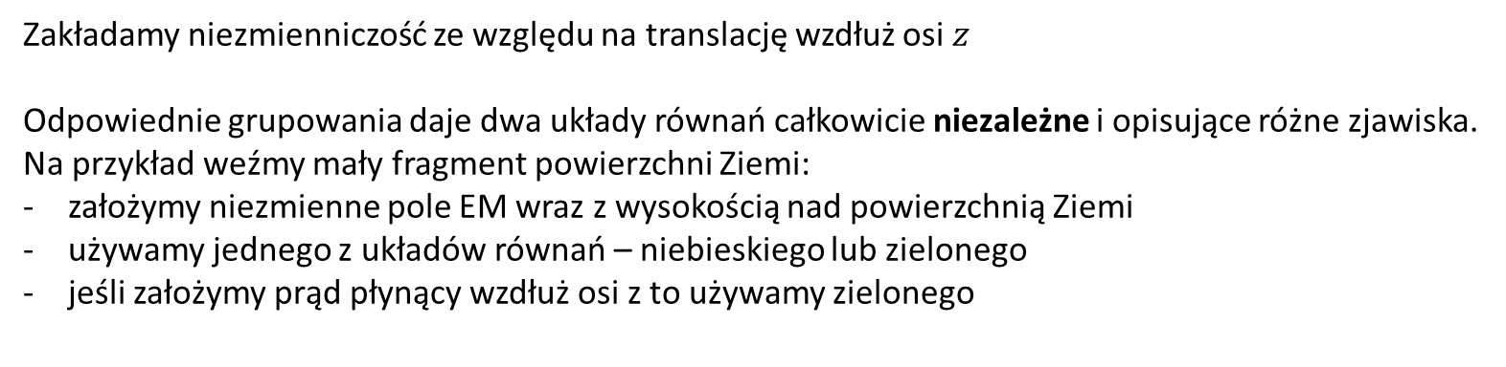
Równania Maxwella – ograniczenie do 2D
Zakładamy niezmienniczość ze względu na translację wzdłuż osi $z$
Odpowiednie grupowania daje dwa układy równań całkowicie niezależne i opisujące różne zjawiska.
Na przykład weźmy mały fragment powierzchni Ziemi:
założymy niezmienne pole EM wraz z wysokością nad powierzchnią Ziemi
używamy jednego z układów równań – niebieskiego lub zielonego
jeśli założymy prąd płynący wzdłuż osi z to używamy zielonego
$\frac{∂E}{∂t}=\frac{1}{ε}\left(∇×H−J\right)$ $J=J_{source}+σE$
$\frac{∂H}{∂t}=−\frac{1}{μ}∇×E$
$\frac{∂E_{x}}{∂t}=\frac{1}{ε}\left(\frac{∂H_{z}}{∂y}−\frac{∂H_{y}}{∂z}−J_{x}−σE_{x}\right)$
$\frac{∂E_{y}}{∂t}=\frac{1}{ε}\left(\frac{∂H_{z}}{∂x}−\frac{∂H_{x}}{∂z}−J_{y}−σE_{y}\right)$
$\frac{∂E_{z}}{∂t}=\frac{1}{ε}\left(\frac{∂H_{y}}{∂x}−\frac{∂H_{x}}{∂y}−J_{z}−σE_{z}\right)$
Mikroskopowe prawo Ohma
Źródło prądu
$\frac{∂H_{x}}{∂t}=\frac{1}{μ}\left(\frac{∂E_{y}}{∂z}−\frac{∂E_{z}}{∂y}\right)$
$\frac{∂H_{y}}{∂t}=\frac{1}{μ}\left(\frac{∂E_{x}}{∂z}−\frac{∂E_{z}}{∂x}\right)$
$\frac{∂H_{z}}{∂t}=\frac{1}{μ}\left(\frac{∂E_{x}}{∂y}−\frac{∂E_{y}}{∂x}\right)$

Slide 5
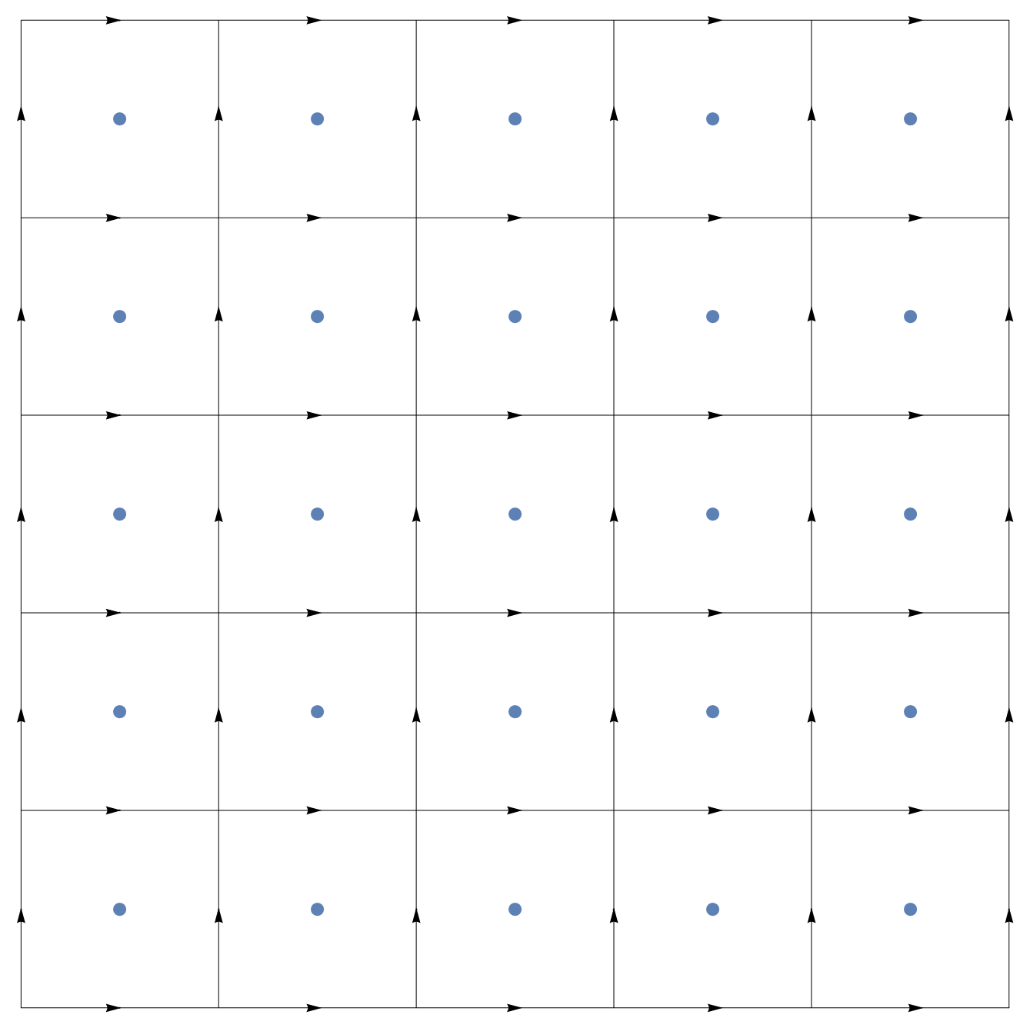





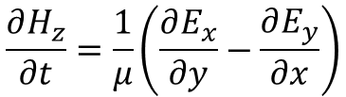

$${E_{x}}_{i+1/2,j+1}^{}$$
$${E_{y}}_{i,j+1/2}^{}$$
$${H_{z}}_{i+1/2,j+1/2}^{}$$
$${E_{y}}_{i+1,j+1/2}^{}$$
$$\frac{∂H_{z}}{∂t}=\frac{1}{μ}\left(\frac{∂E_{x}}{∂y}−\frac{∂E_{y}}{∂x}\right)$$
$${E_{x}}_{i+1/2,j}^{}$$
$$\frac{{H_{z}}_{i+1/2,j+1/2}^{n+1}−{H_{z}}_{i+1/2,j+1/2}^{n}}{Δt} =\frac{1}{μ}\left(\frac{{E_{x}}_{i+1/2,j+1}^{n+1/2}−{E_{x}}_{i+1/2,j}^{n+1/2}}{Δy}−\frac{{E_{y}}_{i+1,j+1/2}^{n+1/2}−{E_{y}}_{i,j+1/2}^{n+1/2}}{Δx}\right)$$

Slide 6
$${E_{x}}_{i+1/2,j+1}^{}$$
$${E_{y}}_{i,j+1/2}^{}$$
$${H_{z}}_{i+1/2,j+1/2}^{}$$
$${E_{y}}_{i+1,j+1/2}^{}$$
$$\frac{∂H_{z}}{∂t}=\frac{1}{μ}\left(\frac{∂E_{x}}{∂y}−\frac{∂E_{y}}{∂x}\right)$$
$${E_{x}}_{i+1/2,j}^{}$$
$${H_{z}}_{i+1/2,j+1/2}^{n+1}={H_{z}}_{i+1/2,j+1/2}^{n}+\frac{Δt}{μ}\left(\frac{{E_{x}}_{i+1/2,j+1}^{n+1/2}−{E_{x}}_{i+1/2,j}^{n+1/2}}{Δy}−\frac{{E_{y}}_{i+1,j+1/2}^{n+1/2}−{E_{y}}_{i,j+1/2}^{n+1/2}}{Δx}\right)$$

Slide 7


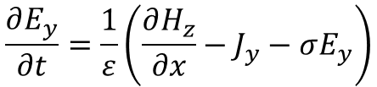

$${H_{z}}_{i−1/2,j+1/2}^{}$$
$${E_{y}}_{i,j+1/2}^{}$$
$${H_{z}}_{i+1/2,j+1/2}^{}$$
$$\frac{∂E_{y}}{∂t}=\frac{1}{ε}\left(\frac{∂H_{z}}{∂x}−J_{y}−σE_{y}\right)$$
$$\frac{{E_{y}}_{i,j+1/2}^{n+1/2}−{E_{y}}_{i,j+1/2}^{n−1/2}}{Δt} =$$
$$\frac{1}{ε}\left(\frac{{H_{z}}_{i+1/2,j+1/2}^{n}−{H_{z}}_{i−1/2,j+1/2}^{n}}{Δy}−J_{y}−σ_{i,j+1/2}{E_{y}}_{i,j+1/2}^{n}\right)$$

Slide 8

$${H_{z}}_{i−1/2,j+1/2}^{}$$
$${E_{y}}_{i,j+1/2}^{}$$
$${H_{z}}_{i+1/2,j+1/2}^{}$$
$$\frac{∂E_{y}}{∂t}=\frac{1}{ε}\left(\frac{∂H_{z}}{∂x}−J_{y}−σE_{y}\right)$$
$$\frac{{E_{y}}_{i,j+1/2}^{n+1/2}−{E_{y}}_{i,j+1/2}^{n−1/2}}{Δt} =$$
$$\frac{1}{ε}\left(\frac{{H_{z}}_{i+1/2,j+1/2}^{n}−{H_{z}}_{i−1/2,j+1/2}^{n}}{Δy}−J_{y}−σ_{i,j+1/2}\frac{{E_{y}}_{i,j+1/2}^{n+1/2}+{E_{y}}_{i,j+1/2}^{n−1/2}}{2}\right)$$

Slide 9

$${H_{z}}_{i−1/2,j+1/2}^{}$$
$${E_{y}}_{i,j+1/2}^{}$$
$${H_{z}}_{i+1/2,j+1/2}^{}$$
$$\frac{∂E_{y}}{∂t}=\frac{1}{ε}\left(\frac{∂H_{z}}{∂x}−J_{y}−σE_{y}\right)$$
$${E_{y}}_{i,j+1/2}^{n+1/2} ={E_{y}}_{i,j+1/2}^{n−1/2}$$
$$\frac{Δt}{ε}\left(\frac{{H_{z}}_{i+1/2,j+1/2}^{n}−{H_{z}}_{i−1/2,j+1/2}^{n}}{Δy}−J_{y}−σ_{i,j+1/2}\frac{{E_{y}}_{i,j+1/2}^{n+1/2}+{E_{y}}_{i,j+1/2}^{n−1/2}}{2}\right)$$

Slide 10

$${H_{z}}_{i−1/2,j+1/2}^{}$$
$${E_{y}}_{i,j+1/2}^{}$$
$${H_{z}}_{i+1/2,j+1/2}^{}$$
$$\frac{∂E_{y}}{∂t}=\frac{1}{ε}\left(\frac{∂H_{z}}{∂x}−J_{y}−σE_{y}\right)$$
$${E_{y}}_{i,j+1/2}^{n+1/2} \left(1+\frac{Δtσ_{i,j+1/2}}{2ε}\right)=$$
$${E_{y}}_{i,j+1/2}^{n−1/2}\left(1−\frac{Δtσ_{i,j+1/2}}{2ε}\right)+\frac{Δt}{ε}\left(\frac{{H_{z}}_{i+1/2,j+1/2}^{n}−{H_{z}}_{i−1/2,j+1/2}^{n}}{Δx}−J_{y}\right)$$

Slide 11


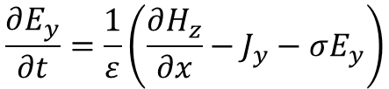



$$\frac{∂E_{y}}{∂t}=\frac{1}{ε}\left(\frac{∂H_{z}}{∂x}−J_{y}−σE_{y}\right)$$
$${H_{z}}_{i+1/2,j+1/2}^{}$$
$${E_{x}}_{i+1/2,j}^{n+1/2} \left(1+\frac{Δtσ_{i,j+1/2}}{2ε}\right)=$$
$${E_{x}}_{i+1/2,j}^{n−1/2}\left(1−\frac{Δtσ_{i,j+1/2}}{2ε}\right)$$
$$+\frac{Δt}{ε}\left(\frac{{H_{z}}_{i+1/2,j+1/2}^{n}−{H_{z}}_{i+1/2,j−1/2}^{n}}{Δy}−J_{x}\right)$$
$${E_{y}}_{i+1/2,j}^{}$$
$${H_{z}}_{i+1/2,j−1/2}^{}$$

Slide 12
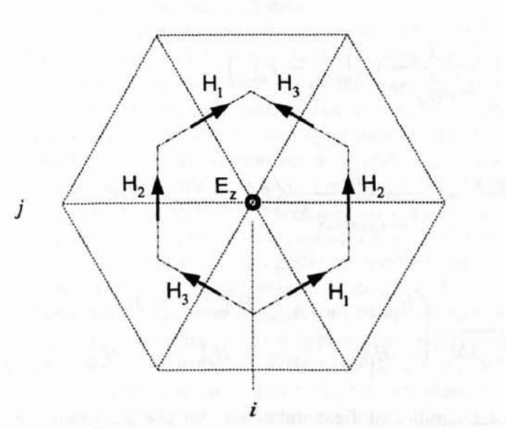
A co dla siatek skomplikowanych?
źr: Allen Taflove, Susan C. Hagness, Computational electrodynamics – FDTD method

Slide 13

Równania Maxwella
$ε_{0}\frac{∂E}{∂t}=∇×H−J$ $J=J_{source}+σE$
$μ_{0}\frac{∂H}{∂t}=−∇×E$
$ε_{0}\frac{∂}{∂t}\int_{S}{E⋅ds}=\int_{C}{H⋅dl}−I I=\int_{S}{J⋅ds}$
$μ_{0}\frac{∂}{∂t}\int_{S}{H⋅ds}=−\int_{C}{E⋅dl}$
Mikroskopowe prawo Ohma
Źródło prądu

Slide 14

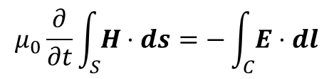

$${E_{x}}_{i+1/2,j+1}^{}$$
$${E_{y}}_{i,j+1/2}^{}$$
$${H_{z}}_{i+1/2,j+1/2}^{}$$
$${E_{y}}_{i+1,j+1/2}^{}$$
$$μ_{0}\frac{∂}{∂t}\int_{S}{H⋅ds}=−\int_{C}{E⋅dl}$$
$${E_{x}}_{i+1/2,j}^{}$$
$$\frac{∂}{∂t}\int{{H_{z}}_{i+1/2,j+1/2}^{n+1/2}}ds=−\frac{1}{μ}\int{E_{i+1/2,j+1/2}^{n_{ }+1/2}dl}$$

Slide 15

$${E_{x}}_{i+1/2,j+1}^{}$$
$${E_{y}}_{i,j+1/2}^{}$$
$${H_{z}}_{i+1/2,j+1/2}^{}$$
$${E_{y}}_{i+1,j+1/2}^{}$$
$${E_{x}}_{i+1/2,j}^{}$$
$$\frac{∂}{∂t}ΔxΔy{H_{z}}_{i+1/2,j+1/2}^{n+1/2}=\frac{1}{μ}\left(Δx\left({E_{x}}_{i+1/2,j+1}^{n+1/2}−{E_{x}}_{i+1/2,j}^{n+1/2}\right) +Δy\left({E_{y}}_{i+1,j+1/2}^{n+1/2}−{E_{y}}_{i,j+1/2}^{n+1/2}\right)\right)$$

Slide 16

$${E_{x}}_{i+1/2,j+1}^{}$$
$${E_{y}}_{i,j+1/2}^{}$$
$${H_{z}}_{i+1/2,j+1/2}^{}$$
$${E_{y}}_{i+1,j+1/2}^{}$$
$${E_{x}}_{i+1/2,j}^{}$$
$$ΔxΔy\frac{∂}{∂t}{H_{z}}_{i+1/2,j+1/2}^{n+1/2}=\frac{1}{μ}\left(Δx\left({E_{x}}_{i+1/2,j+1}^{n+1/2}−{E_{x}}_{i+1/2,j}^{n+1/2}\right) +Δy\left({E_{y}}_{i+1,j+1/2}^{n+1/2}−{E_{y}}_{i,j+1/2}^{n+1/2}\right)\right)$$

Slide 17


$${E_{x}}_{i+1/2,j+1}^{}$$
$${E_{y}}_{i,j+1/2}^{}$$
$${H_{z}}_{i+1/2,j+1/2}^{}$$
$${E_{y}}_{i+1,j+1/2}^{}$$
$${E_{x}}_{i+1/2,j}^{}$$
$$ΔxΔy\frac{{H_{z}}_{i+1/2,j+1/2}^{n+1}−{H_{z}}_{i+1/2,j+1/2}^{n}}{Δt}$$
$$=\frac{1}{μ}\left(Δx\left({E_{x}}_{i+1/2,j+1}^{n+1/2}−{E_{x}}_{i+1/2,j}^{n+1/2}\right) +Δy\left({E_{y}}_{i+1,j+1/2}^{n+1/2}−{E_{y}}_{i,j+1/2}^{n+1/2}\right)\right)$$

Slide 18
$${E_{x}}_{i+1/2,j+1}^{}$$
$${E_{y}}_{i,j+1/2}^{}$$
$${H_{z}}_{i+1/2,j+1/2}^{}$$
$${E_{y}}_{i+1,j+1/2}^{}$$
$${E_{x}}_{i+1/2,j}^{}$$
$$\frac{{H_{z}}_{i+1/2,j+1/2}^{n+1}−{H_{z}}_{i+1/2,j+1/2}^{n}}{Δt} =\frac{1}{μ}\left(\frac{{E_{x}}_{i+1/2,j+1}^{n+1/2}−{E_{x}}_{i+1/2,j}^{n+1/2}}{Δy}+\frac{{E_{y}}_{i+1,j+1/2}^{n+1/2}−{E_{y}}_{i,j+1/2}^{n+1/2}}{Δx}\right)$$

