Slide 1

256 px
128 px
256 px
128 px

Slide 2
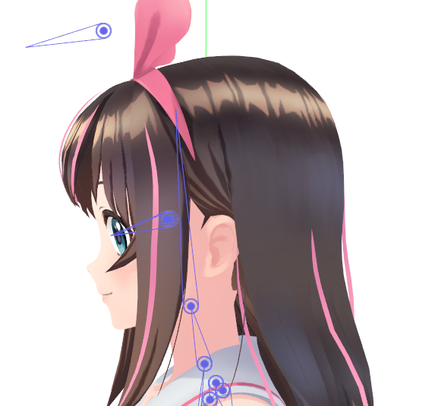



$$y$$
$$z$$
$$x$$
neck tip
neck root

Slide 3
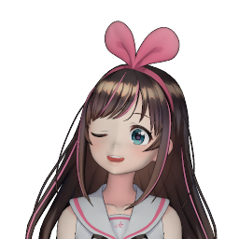
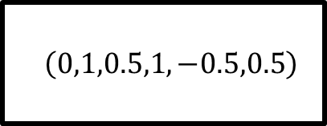
System
Character in rest pose
$$\left(0,1,0.5,1,−0.5,0.5\right)$$
Character posed as specified
Pose

Slide 4







$$p(x)$$
$$0.85$$
$$0.15$$
$$−1$$
$$0$$
$$1$$
$$x$$

Slide 5


System
Face Morpher
Face
Rotator
In rest pose
With facial expression
Fully posed
$$\left(0,1,0.5,…,0.5\right)$$
Pose

Slide 6


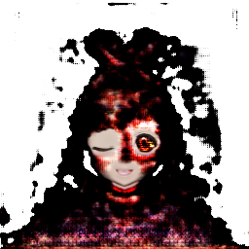

Face Morpher [Pumarola et al. 2018]
Sigmoid
Conv
In rest pose
Encoder-decoder network
Alpha mask
Alpha blending
$$\left(0,1,0.5,…,0.5\right)$$
With facial
expression
Tanh
Conv
Pose
Change

Slide 7
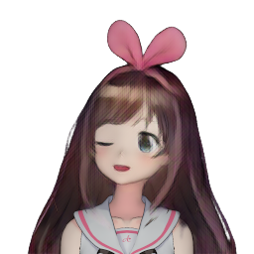
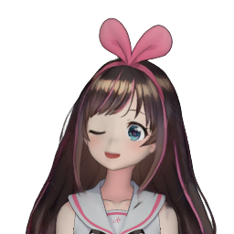
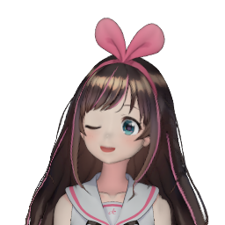



Pose
$$\left(0,1,0.5,…,0.5\right)$$
With facial
Expression
In rest pose
Face Morpher
[Pumarola et al. 2018]
Pose
$$\left(0,1,0.5,…,0.5\right)$$
[Pumarola et al. 2018]
Final output
Two-Algo
Face Rotator
Face rotated #1
[Zhou et al. 2016]
Combiner
Face rotated #2
$$\left(0,1,0.5,…,0.5\right)$$
Pose
Face Rotater

Slide 8
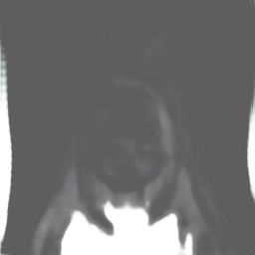

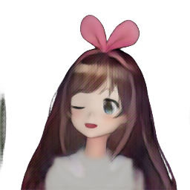
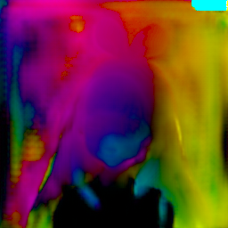
Pumarola et al. 2018
Sigmoid
Conv
Alpha mask
Alpha blending
Encoder-decoder network
Tanh
Face rotated #1
With facial
expression
Conv
$$\left(0,1,0.5,…,0.5\right)$$
Change
Pose
Conv
Pixel
sampling
Appearance flow
Face rotated #2
Zhou et al. 2016

Slide 9
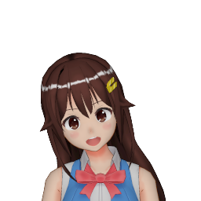

Slide 10
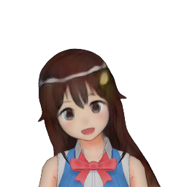

Slide 11
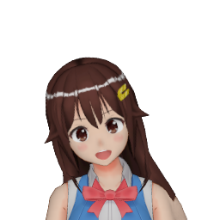

Slide 12


Slide 13
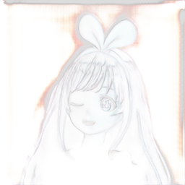

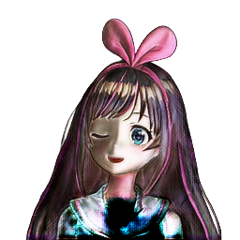
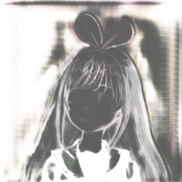
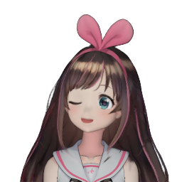

Pose
Sigmoid
Conv
$$\left(0,1,0.5,…,0.5\right)$$
Alpha mask #2
Alpha blending
Face rotated #1
Tanh
Final output
U-Net
Conv
Change
Face rotated #2
Sigmoid
Alpha
blending
Conv
Alpha mask #1
Combined

