Slide 1


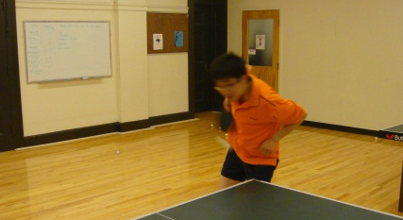
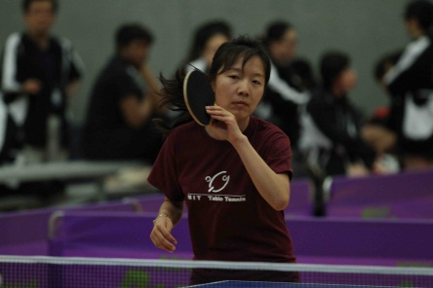
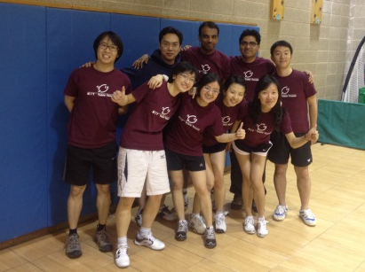
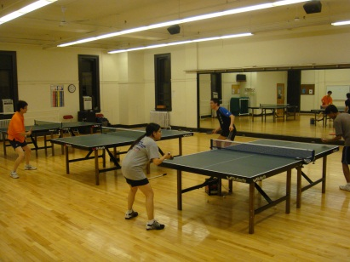
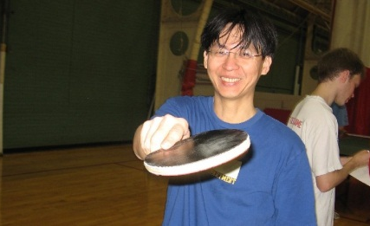
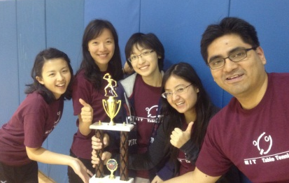
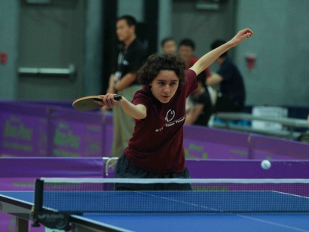
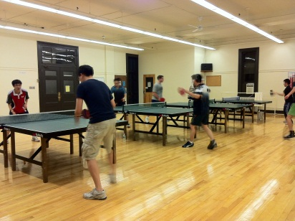
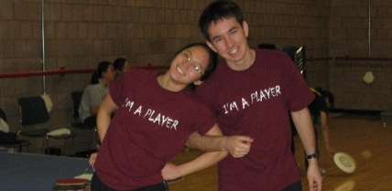
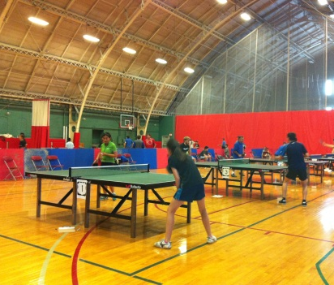
Come play with us!
For club hours and more information,
visit our website at
http://web.mit.edu/tabletennis/
And follow us on Facebook:
www.facebook.com/MITTableTennisClub

Slide 2
Come play with us!
For club hours and more information,
visit our website at
http://web.mit.edu/tabletennis/
And follow us on Facebook:
www.facebook.com/MITTableTennisClub

Slide 3
Come play with us!
For club hours and more information,
visit our website at
http://web.mit.edu/tabletennis/
And follow us on Facebook:
www.facebook.com/MITTableTennisClub

Slide 4
Come play with us!
For club hours and more information,
visit our website at
http://web.mit.edu/tabletennis/
And follow us on Facebook:
www.facebook.com/MITTableTennisClub

