Slide 1
City Power Consumption Prediction Using Machine Learning
A Machine Learning Approach to Forecast Energy Usage Based on Environmental Parameters
Presented by : G Siva Sai
Date: 12 July 2025
Batch : LB_DSC+5thjuly_WKDY_EV_24

Slide 2
Problem Statement
To accurately predict power consumption in a city using environmental features such as temperature, humidity, wind speed, and cloudiness.
Enables efficient load balancing and energy distribution.
Supports smart grid infrastructure and reduces wastage.

Slide 3
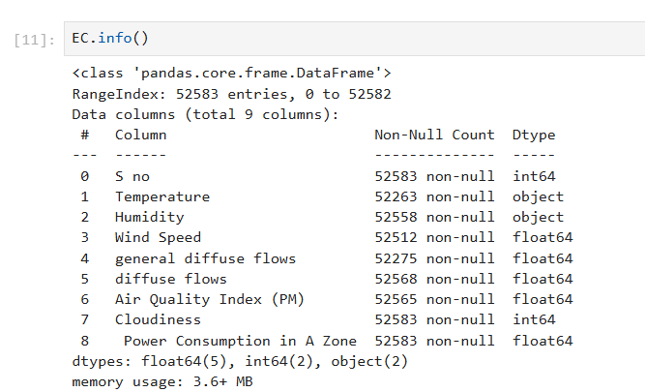
Dataset Overview
Rows: 52,583 | Columns: 9 (including target).
Key features: Temperature, Humidity, Wind Speed, Cloudiness, etc.
Target: Power Consumption in A Zone.

Slide 4
Data Preprocessing
Handled missing values and converted object columns to float.
Scaled features using Standard Scaler.
Split into features (X) and target (y).

Slide 5
Exploratory Data Analysis
Visuals used: Boxplot, Pair plot, Distribution Plot, Correlation Heatmap.
Cloudiness shows significant impact on power consumption.
Moderate correlations observed among features.

Slide 6
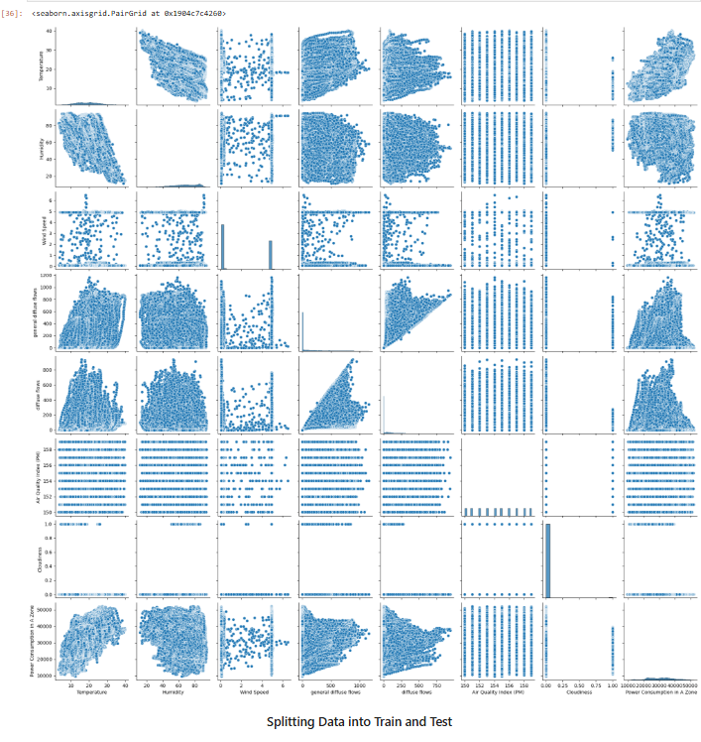
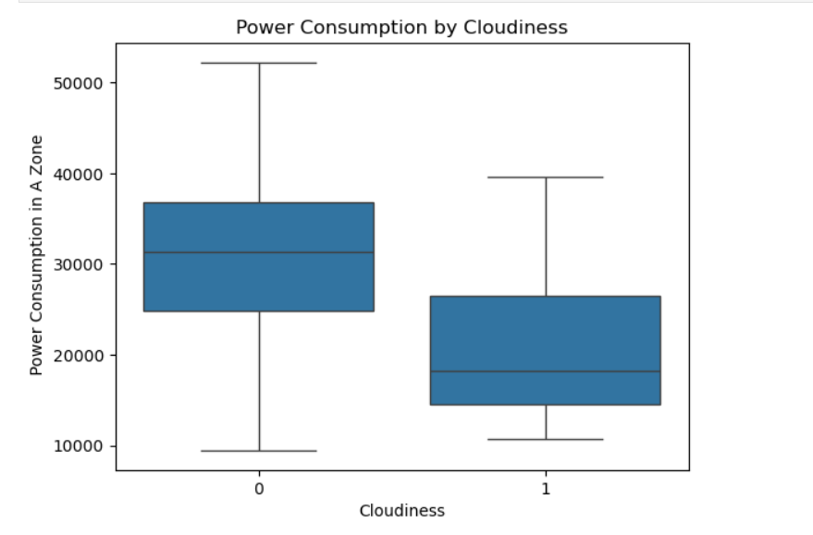
Box Plot and Distribution Plot

Slide 7
Feature Engineering
Used XGBoost to assess feature importance.
Most influential: Temperature, Cloudiness, Humidity.
Dropped irrelevant features and outliers.

Slide 8
Model Building
Split data: 75% training, 25% testing
Models used:
Decision Tree
Linear Regression
Gradient Descent
XGBoost
Random Forest
Hyperparameter Tuning using:
Max_depth
Min_samples_split
GridSearchCV for optimization

Slide 9
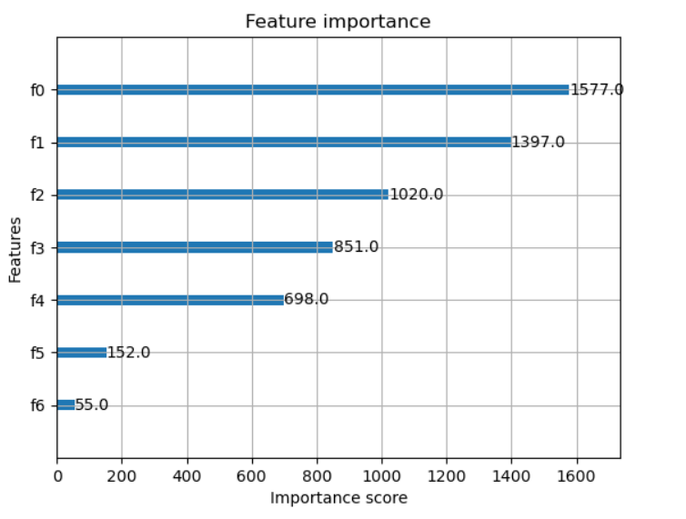
Feature importance
Temperature Got the highest importance with score 1577.o
Humidity stands in the second position
Air Quality Index and Cloudiness contributed least to the model

Slide 10
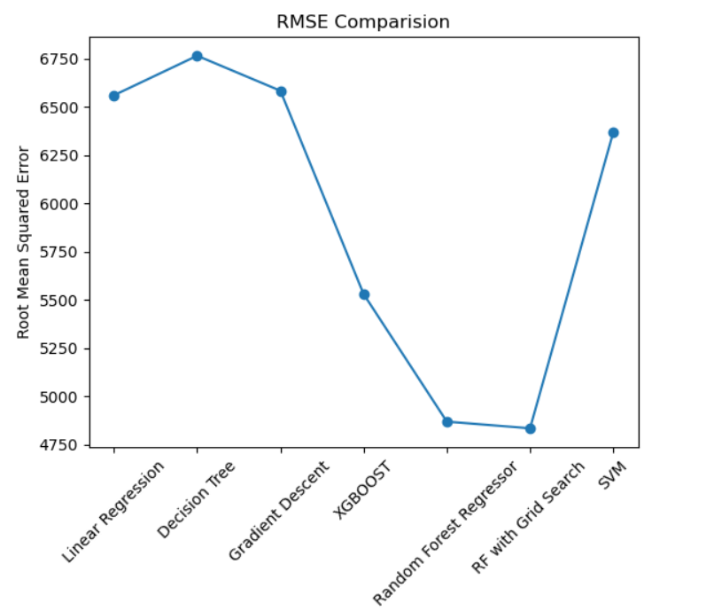
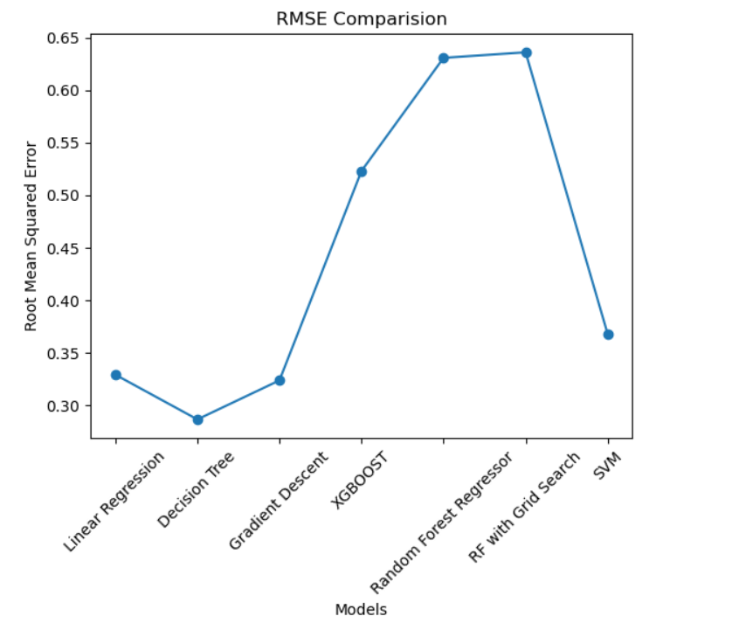
Model Evaluation
Best Model: Random Forest Regressor(Grid Search).
Mean RMSE: 4833.332997123141 | R² Score: 0.6359292949020146.
Line plot compared RMSE across models.

Slide 11
Conclusion & Insights
Random Forest Regression using Grid Search performed best among all models.
Cloudiness and Temperature are strongest predictors.
RMSE around 4833.332997123141 indicates reasonable accuracy.

