Slide 1

Dating Application (LOVOO) ML Project

Slide 2
Background - LOVOO
Lovoo app was gathered to try to answer the following questions:
What makes a successful profile?
Who will have more matches?
What are attractive qualities of a profile?
Using Machine Learning models we can learn what constitutes a popular profile and try to predict how many views a profile will receive based on the available data of a user. The views is represented by column ‘profileVisits’.
Disclaimers about the data:
Mabilama collected 2015 data, while the Lovoo was expanding in European countries.
The metrics of the Lovoo include social media like features such as ‘count kisses’, ‘count fans’, that mirror likes and followers. Also, the ‘profileVisits’ column is usually difficult to obtain.
The data gathered by browsing through profiles and searches recommended by Lovoo's algorithm for 2 profiles created for this purpose a male, open to friends & chats & dates. That is why there are only female users in the dataset.
The recommendation algorithm’s output produced the same set of user profiles which could mean that it was relying on location (to recommend more people nearby than people in different places or countries). This lowered the number of different user profiles that would be presented and included in the dataset.

Slide 3
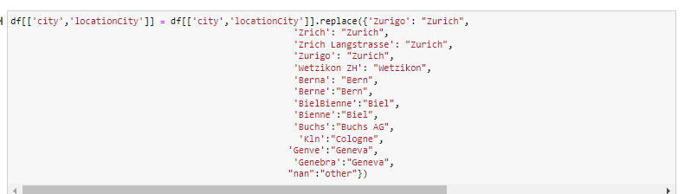
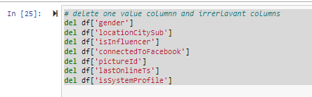
Data Preparation
There were two csv files: users_api_results and user instances. Upon exploring, there are a number of columns that are duplicates and have different names, mostly boolean values:
location= locationCity
isFlirtstar=flirtstar
isHighlighted = highlighted
isMobile= mobile
isOnline= online
birthd= hasBirthday
LastOnlineDate= LastOnline
LastOnlineTime = lastOnlineTs
isNew = Freshman
isVip=isVIP
IsVerified = verified

Slide 4
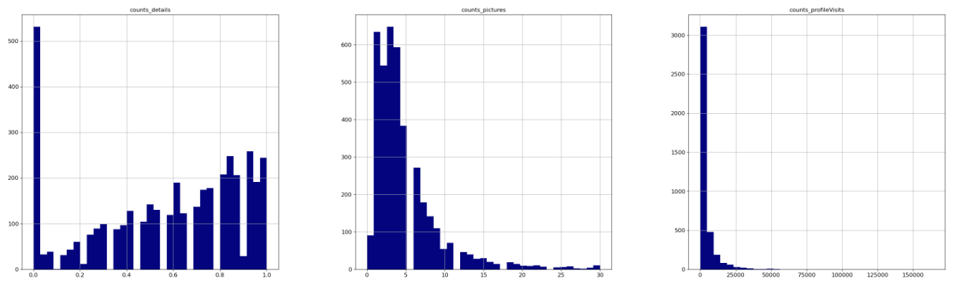
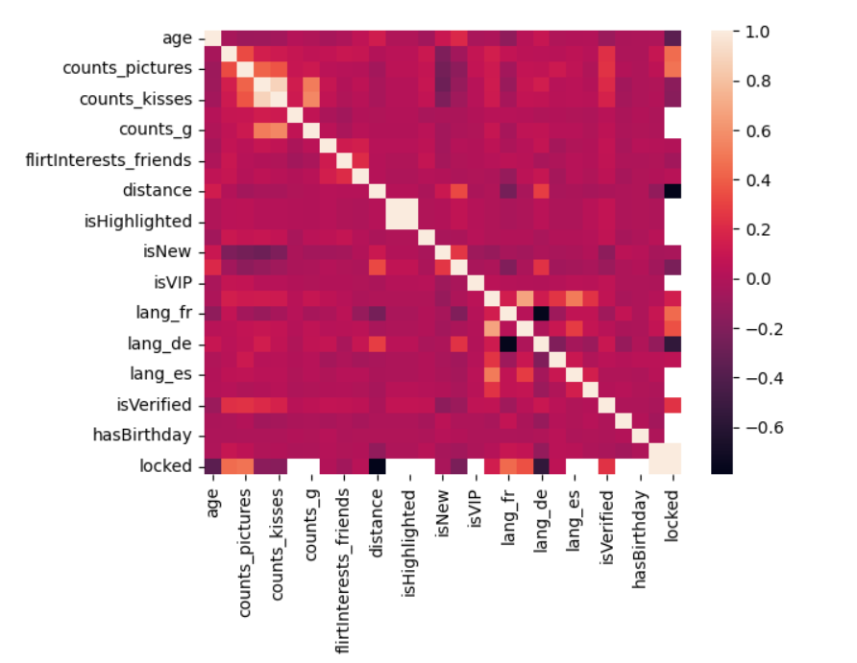
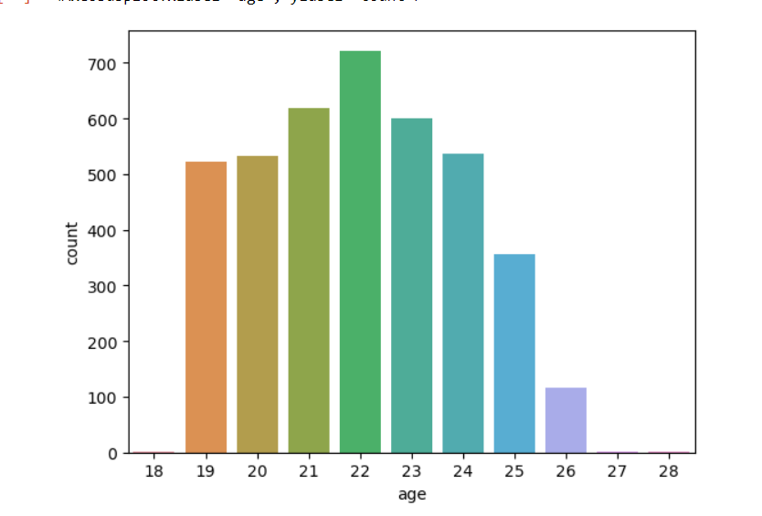
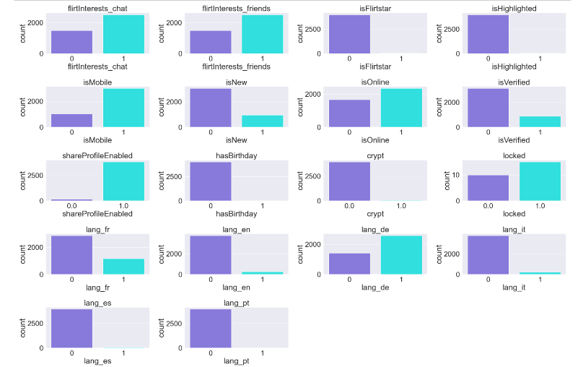
Explanatory Data Analysis:

Slide 5
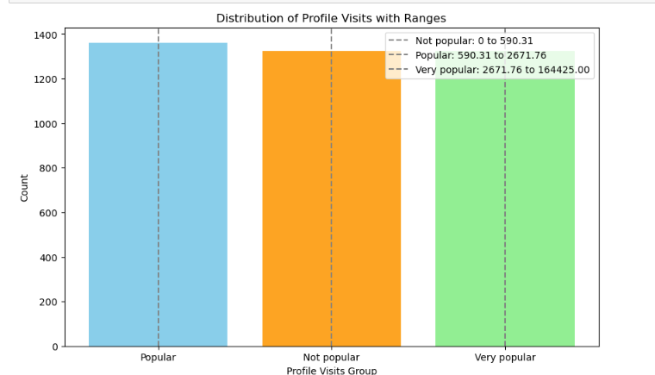

Slide 6
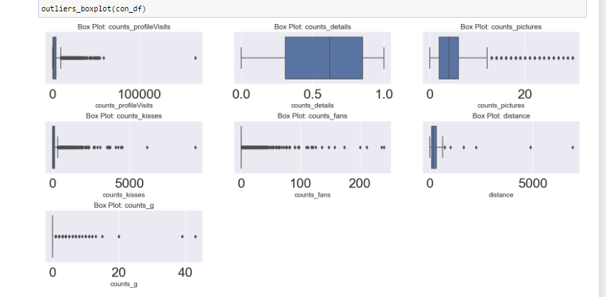
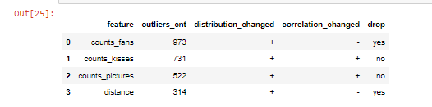
Cleansing Outliers
After the outliers is column 'distance’ has been removed. KNN was used for imputation

Slide 7
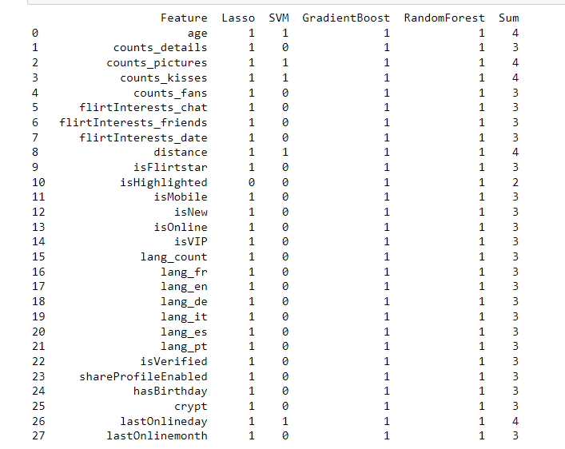
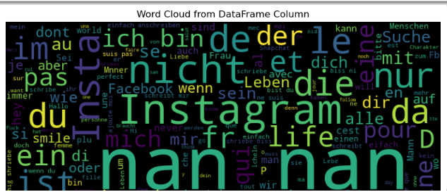
Feature Engineering and Feature Selection:
‘userId’ is set as the index
Splitting the date to into month and day, since the year is the same in all value
Creating word cloud of the column ‘whazzup’
Feature selection with Lasso, SVM, GradientBoost, Random Forest

Slide 8
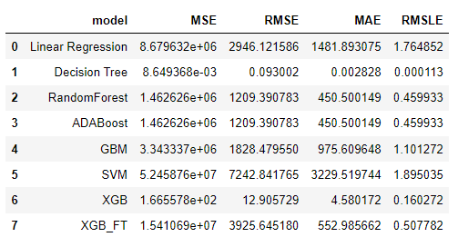
Model Selection and Fine-Tuning
The Decision Tree model shows extremely low errors, which might indicate overfitting to the training data.
XGBoost performs with low error metrics. It is one of the better-performing models, especially considering the relatively low RMSLE.
Random Forest and ADABoost shows a solid performance with reasonable errors, but it is much less accurate than XGBoost.
Best Performers: Decision Tree and XGBoost (XGB) stand out as the most effective models. While the Decision Tree may be overfitting, XGBoost provides a strong balance of accuracy and generalization.

Slide 9
Model Selection and Fine-Tuning
The Model XGBoost was chosen:
Splitting the data for train and test
GridSearch for hyperparameter fine-tuning
Best Parameters: enable_categorical=True, max_depth=20, colsample_bytree=1.0, min_child_weight=4, gamma=0, n_estimators=5
Model Performance
Mean Absolute Error: 1416.7915

Slide 10
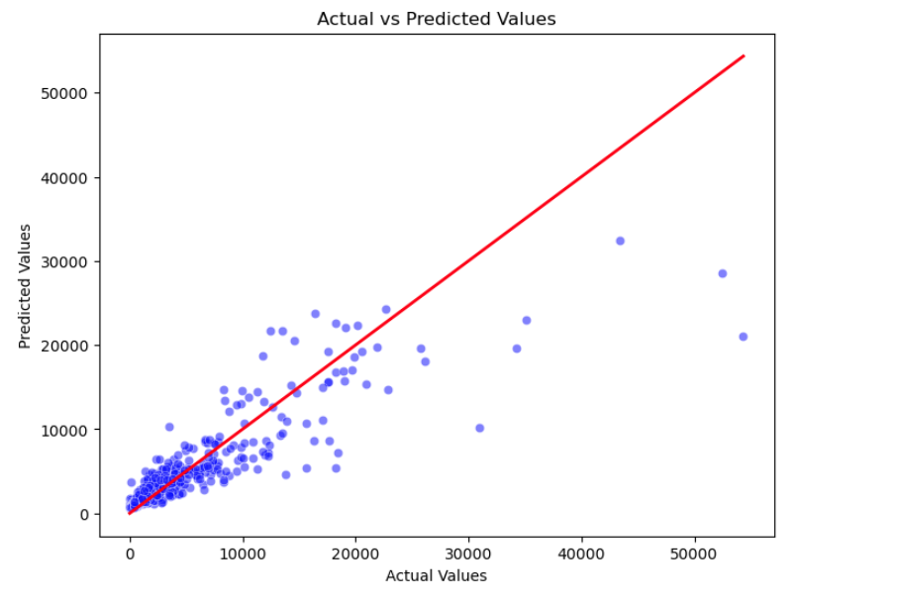
Conclusion
When comparing the actual and predicted values of ‘counts_profileVisits’ are close.

Slide 11
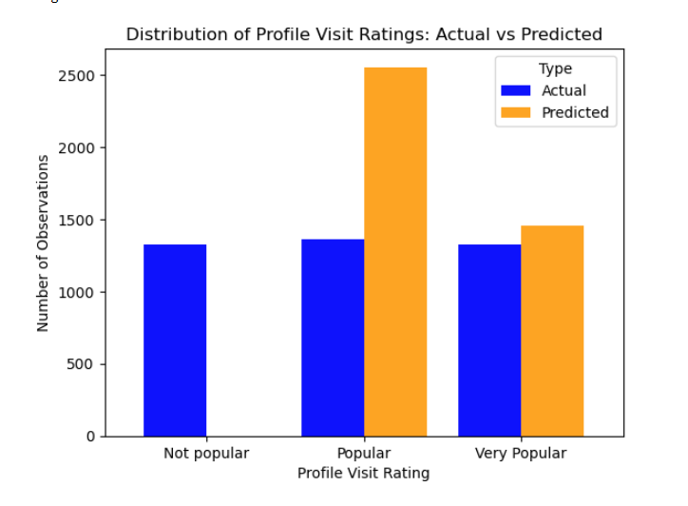
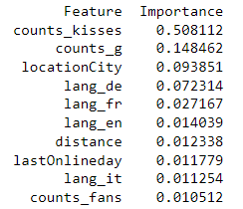
Conclusion
Top contributing features:
The model predicted very popular profiles with the closest range as opposed to the inaccurate predictions of unpopular profiles and popular profiles.

