Slide 1
Machine Learning
Introduction to Human Brain Mechanism
and
Machine Learning
Lecture # 1
Leading University (LU)
* This lecture is prepared from the Prof. Thorsteinn (Denni) Rögnvaldsson’s, Department of CSc. Orebro University, Machine Learning course’s lecture # 1

Slide 2
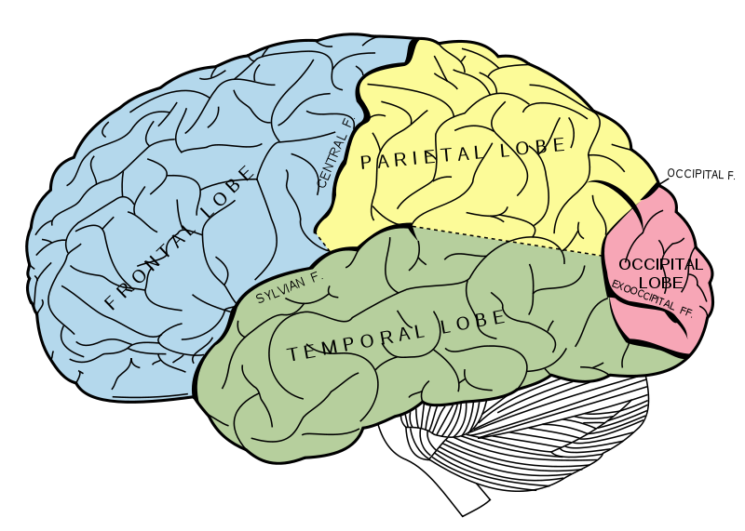
The Human Brain

Slide 3

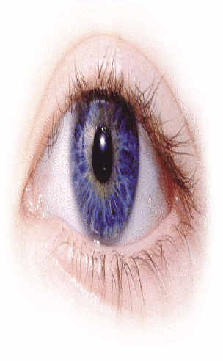
Digression: The brain’s computing power?
• Canon EOS 4000D
• 18 Mpixels
• Canon DIGIC 4+ processor
~74000 MIPS
• ~12 images/sec
• The eye
• 1 Mpixels (1 Mneurons)
• Handles ~10 images/sec
⇒ Approx. 1000 MIPS
• 10¹¹ neurons in the brain
→ ~100 000 times the eye
100 000 000 MIPS

Slide 4
The brain’s memory capacity?
• Million instructions per second (MIPS)
• 10¹¹ neurons in the brain & 10¹²⁻¹³ synapses.
• If one synapse can hold 1 byte → 10⁶⁻⁷ Mbyte.

Slide 5
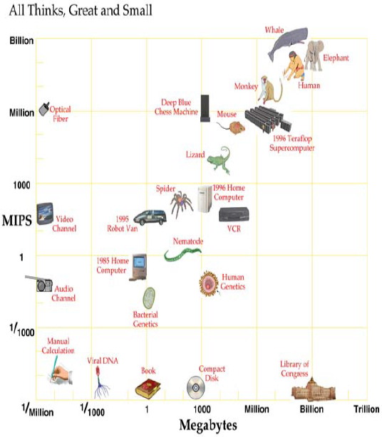
Computing speed
Children Video Game
Memory capacity
Image from Moravec

Slide 6
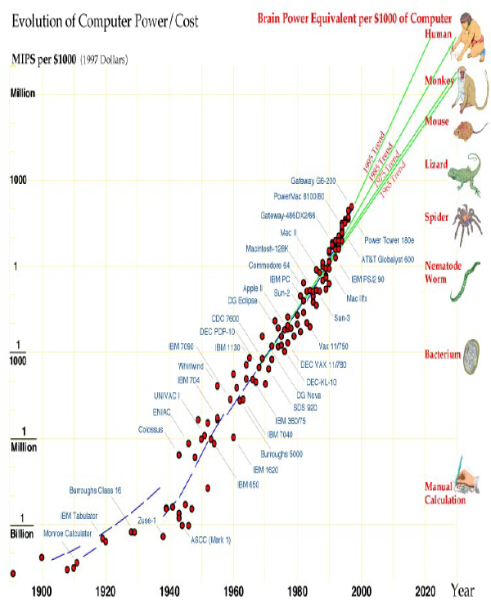
Computers get better and cheaper
Chips double their
capacity in
18 months
A ”MIPS” gets
1,000,000 times
cheaper in
~40 years.
Half the price
in 1 year.
Price for computer memory halves semiannually.

Slide 7
Fuzzy Logic
Neural Network
Genetic Algorithms
…..
Machine Learning

Slide 8
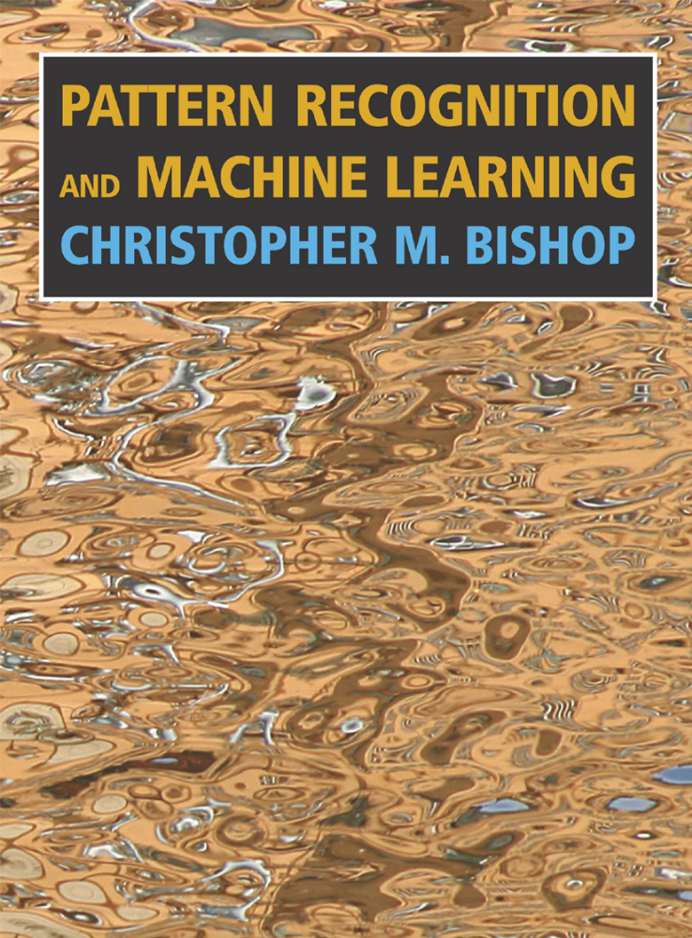
Book (suggested)

Slide 9
Machine Learning (ML) Pattern recognition and model fitting

Slide 10
Why machine learning?
• Some tasks can easily be described by
example, but difficult to write down the rules
for.
• There may be new information in data (i.e. the
expert might not know all the information
available in the data).
• On-line tuning (knowledge increases, too
difficult to update by hand).
Machine learning is very close to statistics.

Slide 11
Task of Machine learning algorithms
  Problems attacked with learning systems
    classification
    regression
  What are the Issues in learning?
    Bias
    over-learning
    generalization

Slide 12
Typical tasks for ML
Build systems with the purpose of
• Classify observations
– Good/bad, Healthy/sick, red/green/blue, A/B/C,...
• Estimate some value for observations
– How good/bad is it?, how healthy is the patient?,
how many points will I gain?, how likely is it that I
win if I do this or that?, what risk do I take if I do
this or that?, what is a reasonable price for this
house?, etc.
The latter is called “regression” in statistics…or
“curve fitting”

Slide 13
What you should learn
• How to approach a machine learning classification or a regression problem
• Basic knowledge of the common linear machine learning algorithms
• Basic knowledge of some nonlinear machine learning algorithms
• Practical use of a few machine learning algorithms with MATLAB
?

Slide 14
Some “machine learning” methods
• Artificial neural networks (ANN)
– Models inspired by the structure of the neural system
• Fuzzy Logic
– Fuzzy set theory, which can thought of as a generalization of classical set theory.
• Genetic Algorithms
– The Primary purpose of using this algorithm is optimization through evaluation or fitness function.

Slide 15
Some “machine learning” methods
• Support Vector Machines (SVM)
– Models designed from statistical learning theory
• Decision trees
– Similar to “expert systems”, produces rules
• Bayesian networks
– Reasoning under uncertainty

Slide 16
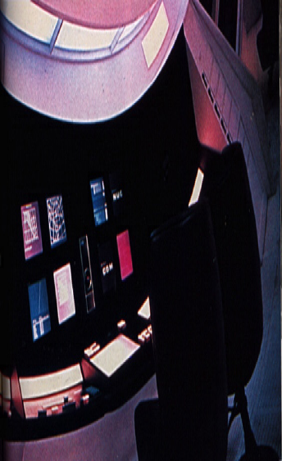
Game playing
Chess
• Search
• Evaluation function
There are 10¹²⁰
possible game paths
in chess.
Backgammon
• Pattern recognition

Slide 17

IBM deep blue
• Deep Blue is computational power and search and evaluation.
• Deep Blue evaluates about 200×106 positions per second.
• Deep Blue is a 32-node IBM RS/6000 SP with P2SC processors. Each node of the SP employs a single micro-channel card containing 8 dedicated VLSI chess processors, for a total of 256 processors working in tandem.
Deep Blue is “brute force” in the spirit of traditional expert systems, symbolic AI. Humans (probably) play chess differently...

Slide 18
But – any predicting is hard
• AI researchers in 1958 predicted that an AI chess program would beat the world chess champion within 10 years.
• It didn’t happen until 1996...

