Slide 1
Machine Learning
Mean Normalization, Feature Engineering & Polynomial Regression
Lecture # 6
Leading University (LU)
* This lecture is prepared from the 2nd week lecture of Andrew Ng “Machine Learning” course.

Slide 2
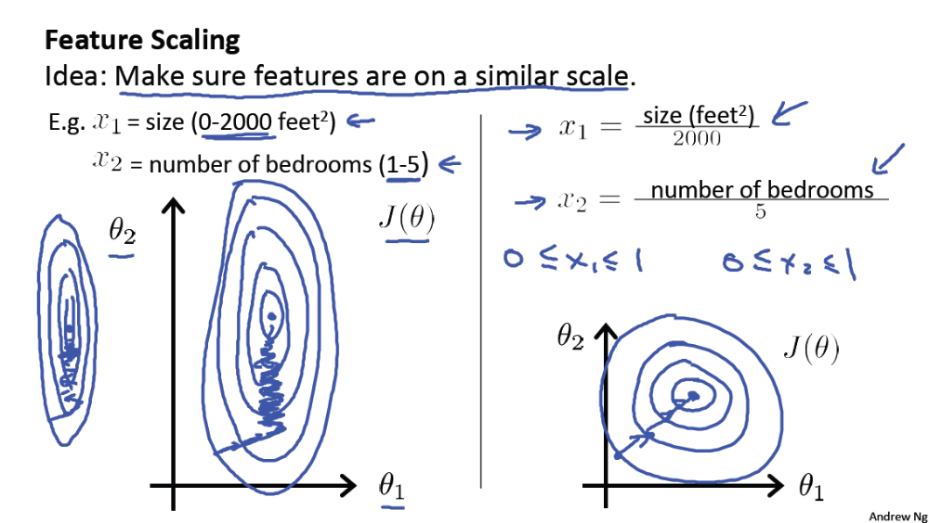
Multiple Features (Variables) Repeated again

Slide 3
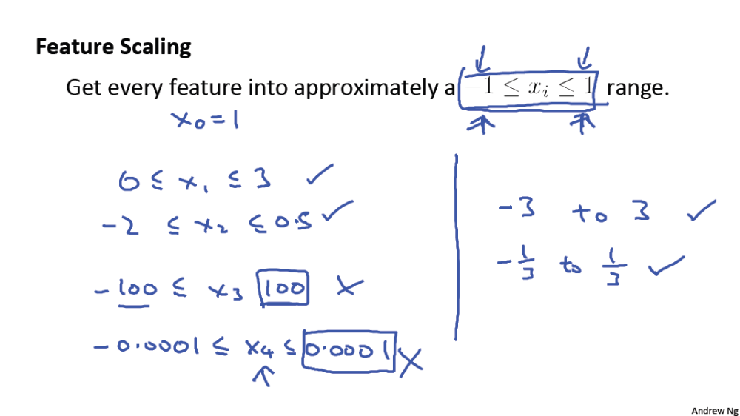
Multiple Features (Variables) Repeated again

Slide 4
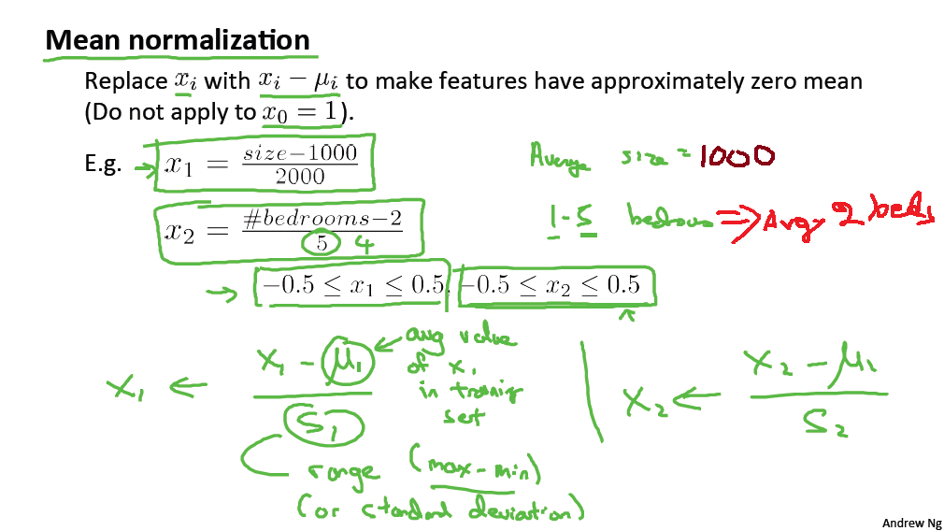
Multiple Features (Variables)

Slide 5
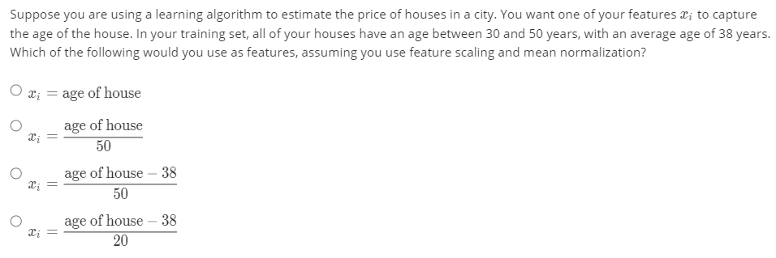
Multiple Features (Variables)

Slide 6
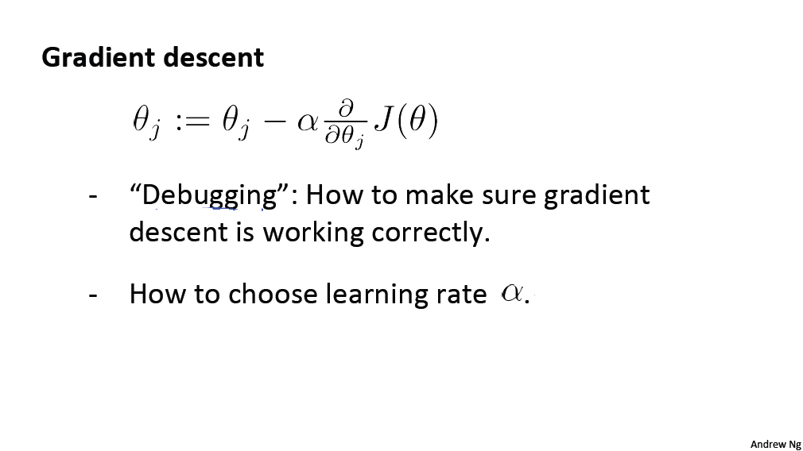
Multiple Features (Variables)

Slide 7
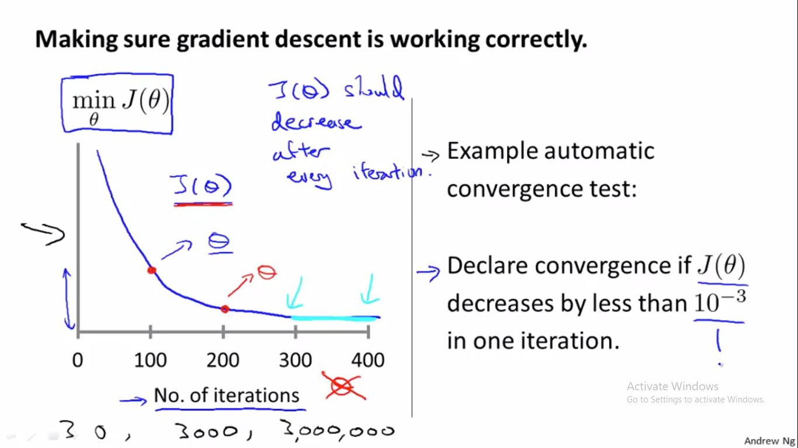
Multiple Features (Variables)

Slide 8
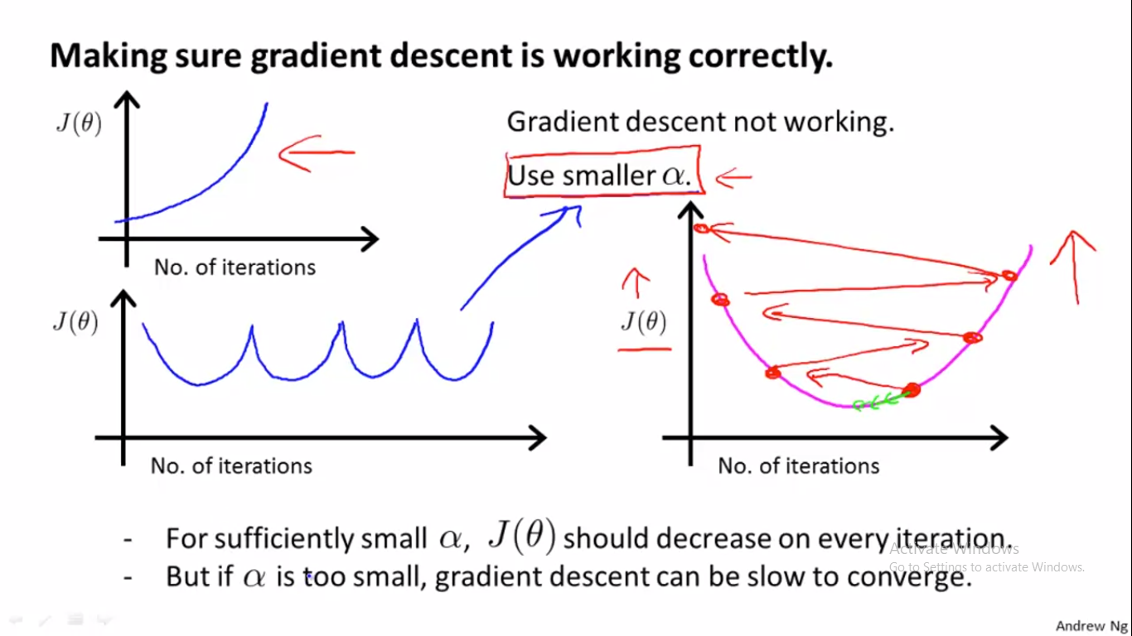
Multiple Features (Variables)

Slide 9
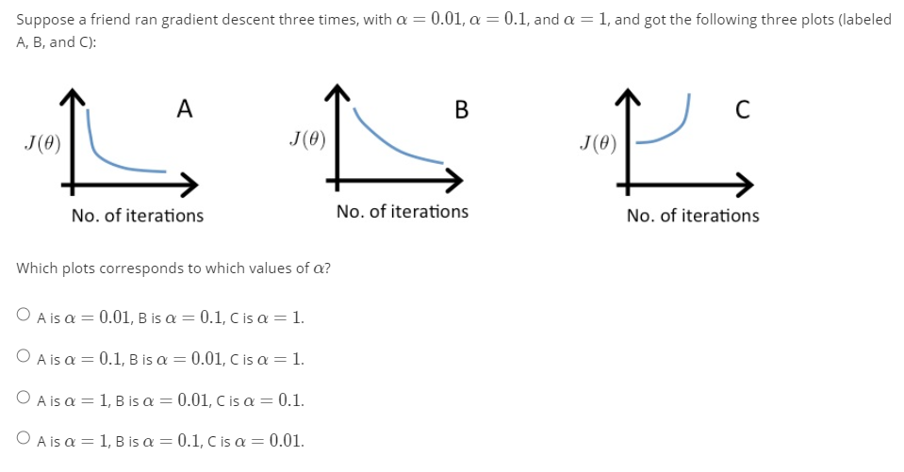
Multiple Features (Variables)

Slide 10
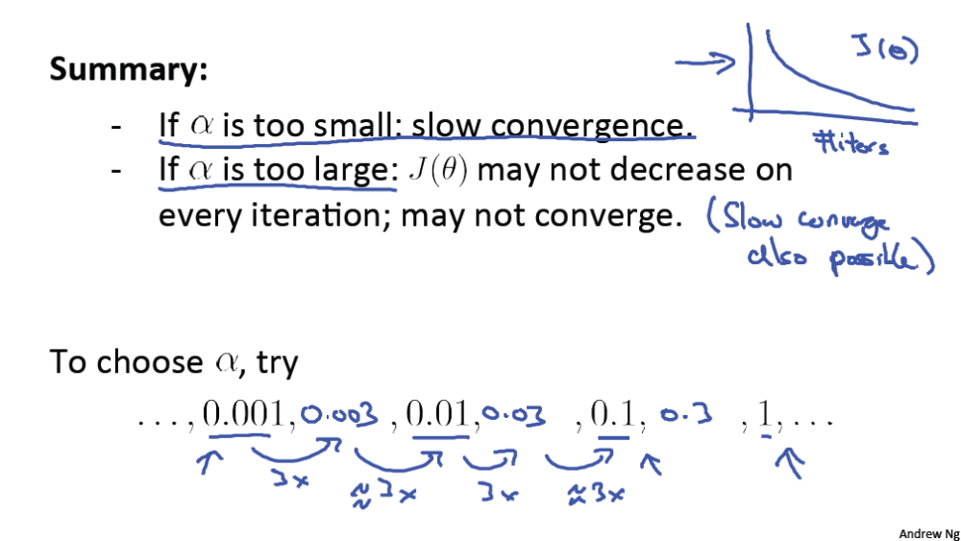
Multiple Features (Variables)

Slide 11
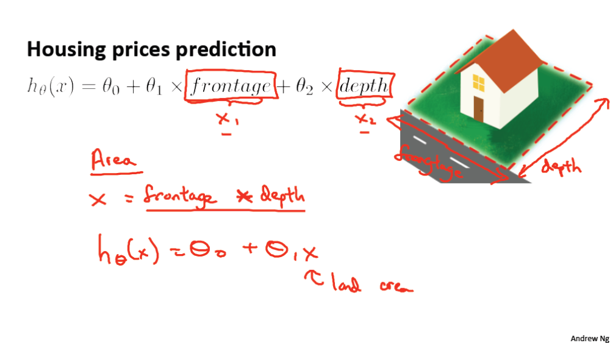
Multiple Features (Variables)

Slide 12
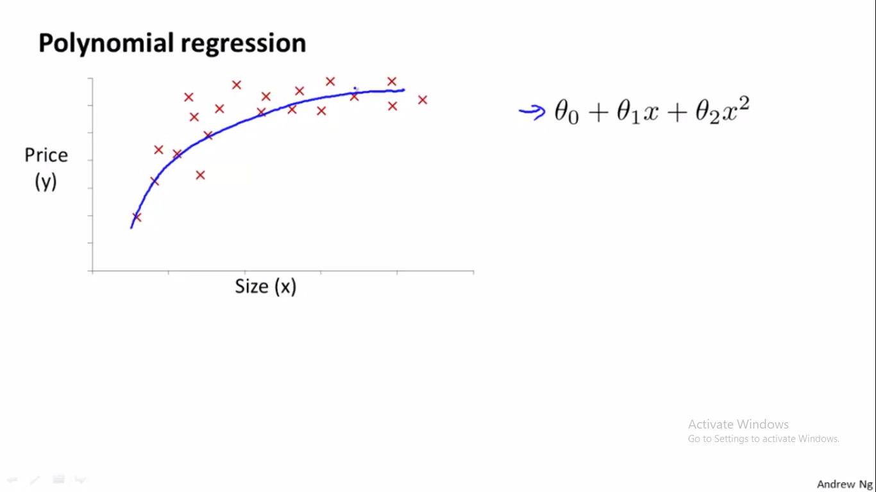
Multiple Features (Variables)

Slide 13
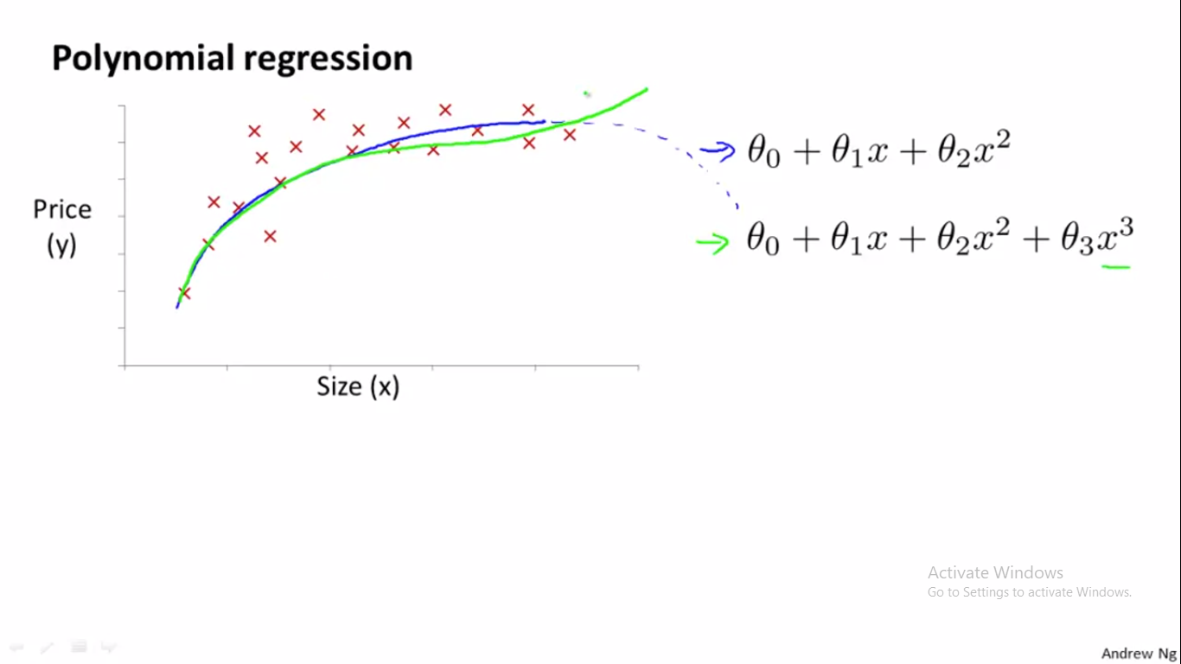
Multiple Features (Variables)

Slide 14
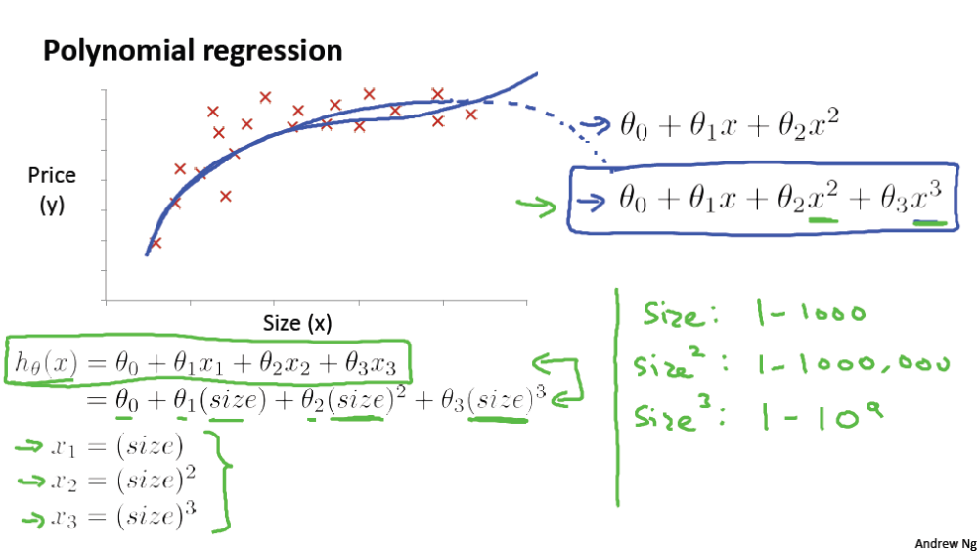
Multiple Features (Variables)

Slide 15
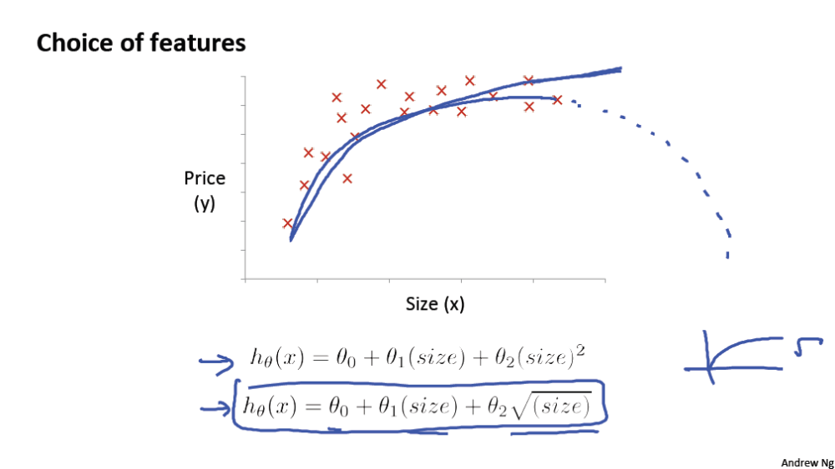
Multiple Features (Variables)

Slide 16
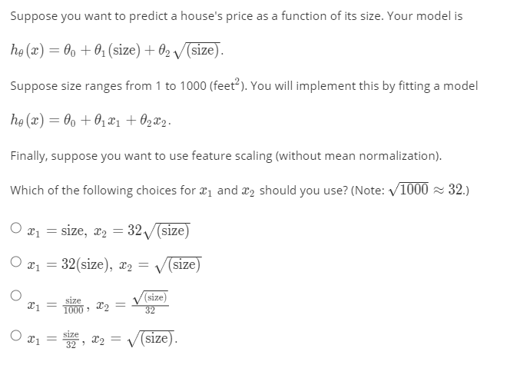
Multiple Features (Variables)

