Slide 1
Handwritten Digit Recognition System
Name: Galib Asfak Tanzir
ID: 0562210005101018
7th Semester, Section : B
Department of Computer Science & Engineering
CSE-460 (Deep Learning Lab)

Slide 2
Project Overview
Goal: Recognize handwritten digits (0–9) using machine learning.
Tools: Python, OpenCV, scikit-learn, joblib, matplotlib
Method: Image capture → Preprocessing → Dataset creation → Model training → Prediction

Slide 3



Image Collection
Used pyscreenshot to capture images from screen.
Captured 100 images per digit (0-9).
Example code:
im = ImageGrab.grab(bbox=(60,170,400,550))

Slide 4
Dataset Creation
Convert RGB to grayscale
Apply Gaussian blur
Resize to 28x28
Binarize pixel values:
0–100 → 0 (black), 101–255 → 1 (white)
Save as dataset.csv

Slide 5
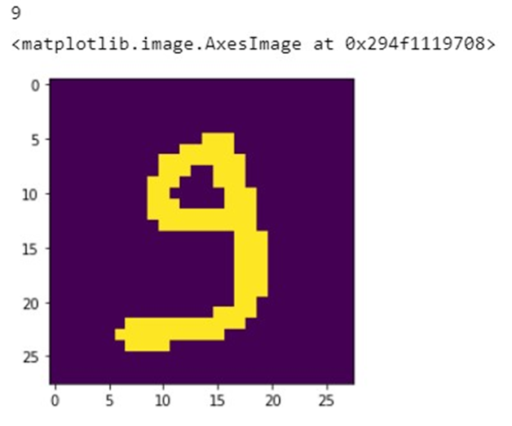
Dataset Preview
Used pandas to load dataset.
Shuffled data using:
data = shuffle(data)

Slide 6
Model Training
Used SVM (Support Vector Machine) from scikit-learn.
Train-test split: 80% training, 20% testing.
Fit model:
classifier = SVC(kernel="linear")
classifier.fit(train_x, train_y)

Slide 7
Model Accuracy
Evaluated using metrics.accuracy_score
Accuracy: Around 94%
Meaning: Correctly predicted 94 out of 100 digits
Code:
from sklearn import metrics prediction=classifier.predict(test_x)
print("Accuracy= ",metrics.accuracy_score(prediction, test_y))

Slide 8
Live Digit Prediction
Real-time digit capture from Paint using loop
Converted to 28x28 binary format
Prediction displayed with:
model.predict([X])

Slide 9
Challenges
Screen coordinate tuning (bbox)
Delay in breaking the loop using cv2.waitKey
Manual effort in data collection and labeling

Slide 10
Conclusion
Successfully built a digit recognition system using SVM.
Learned data preprocessing, model training, and real-time prediction.
Future scope: Use CNN for better accuracy.

Slide 11
Thank You
Questions? Feedback?

