Slide 1
The impact of molecular profiling of gliomas on treatment and prognosis
Galina Glousker
CAS ADS M2
081024

Slide 2
Molecular biomarkers in glioma

Slide 3

Goal of the project
analyze genomic data from a large cohort of adult patients with glioma
identify genomic alterations associated with clinical behavior and therapy outcome
use machine learning methods to be able to predict glioma outcomes in adult patients depending on their tumor molecular profile

Slide 4
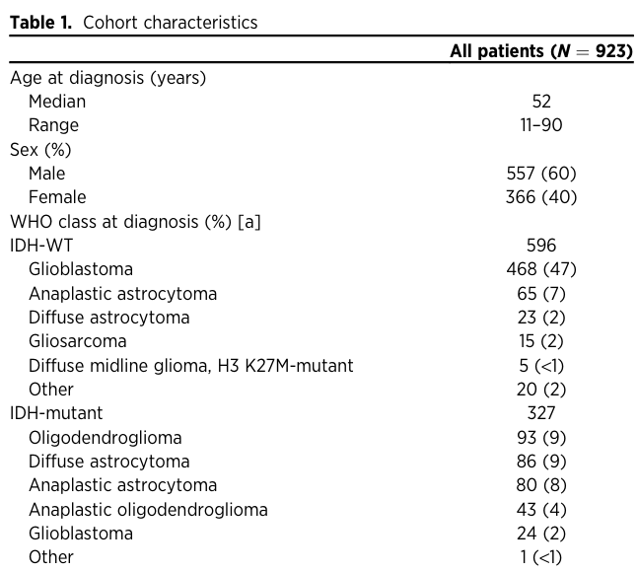
Patient cohort
Number of IDH mutant patients: 312 Number of IDH WT patients: 529
Clin Cancer Res. 2019 doi: 10.1158/1078-0432.CCR-19-0032

Slide 5
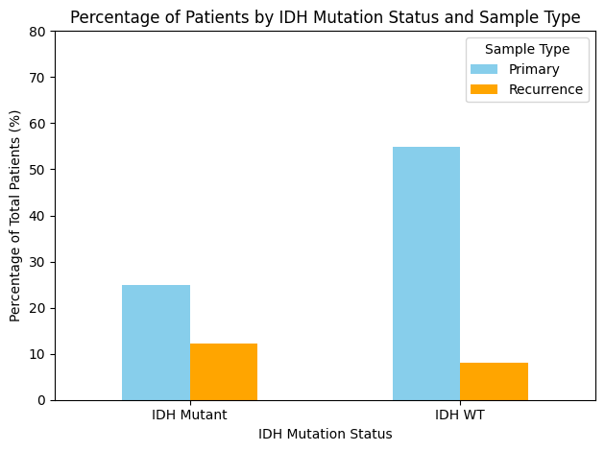
IDH status affects prognosis
Mann-Whitney U test
P-values:
{'Primary': 1.659953987802262e-147, 'Recurrence': 7.581727399256121e-39}

Slide 6
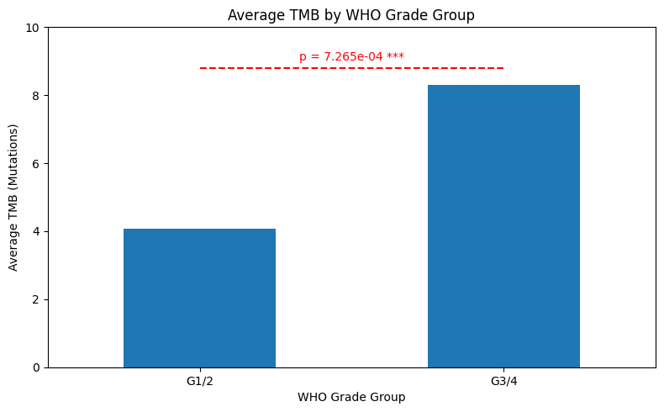
More advanced tumors have higher TMB
Notes:
Mann Whitney

Slide 7
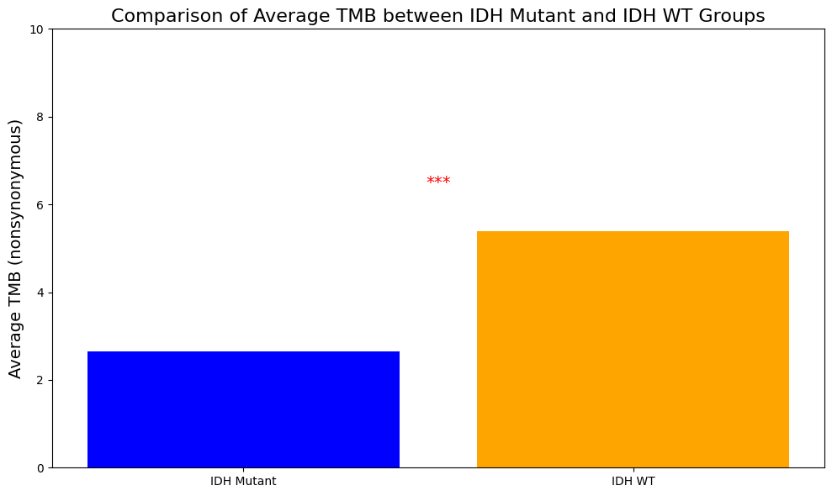
IDH mutant tumor have higher TMB
Notes:
Mann Whitney

Slide 8
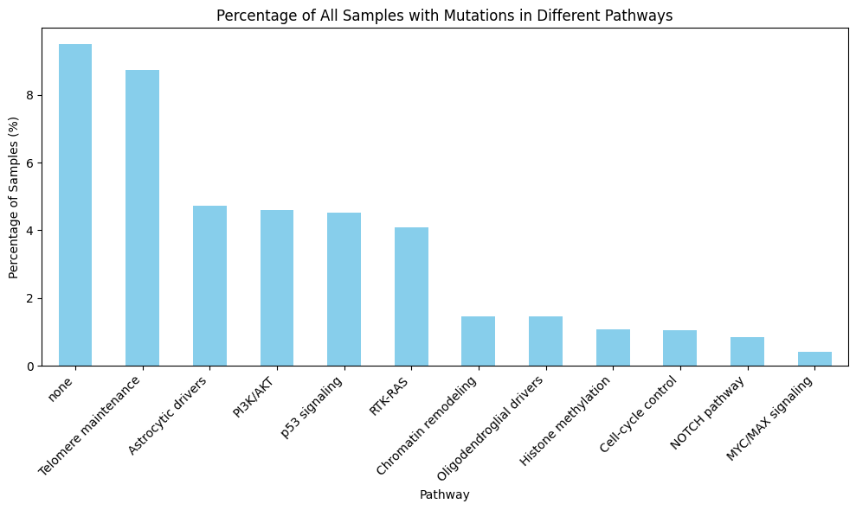
Pathways mutated in the cohort

Slide 9
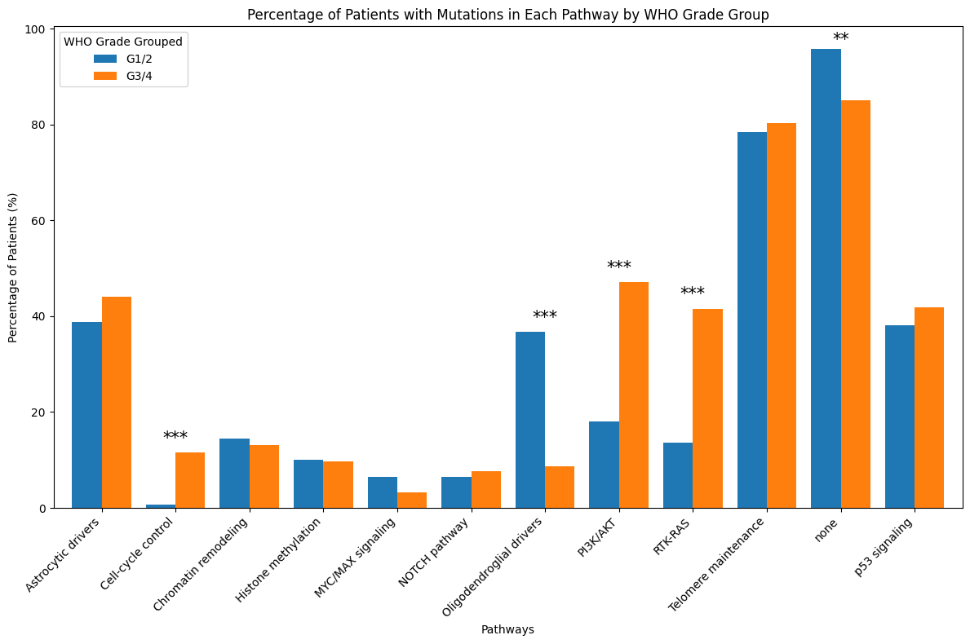
Pathways mutated in the cohort depending on tumor grade
Notes:
Chi square

Slide 10
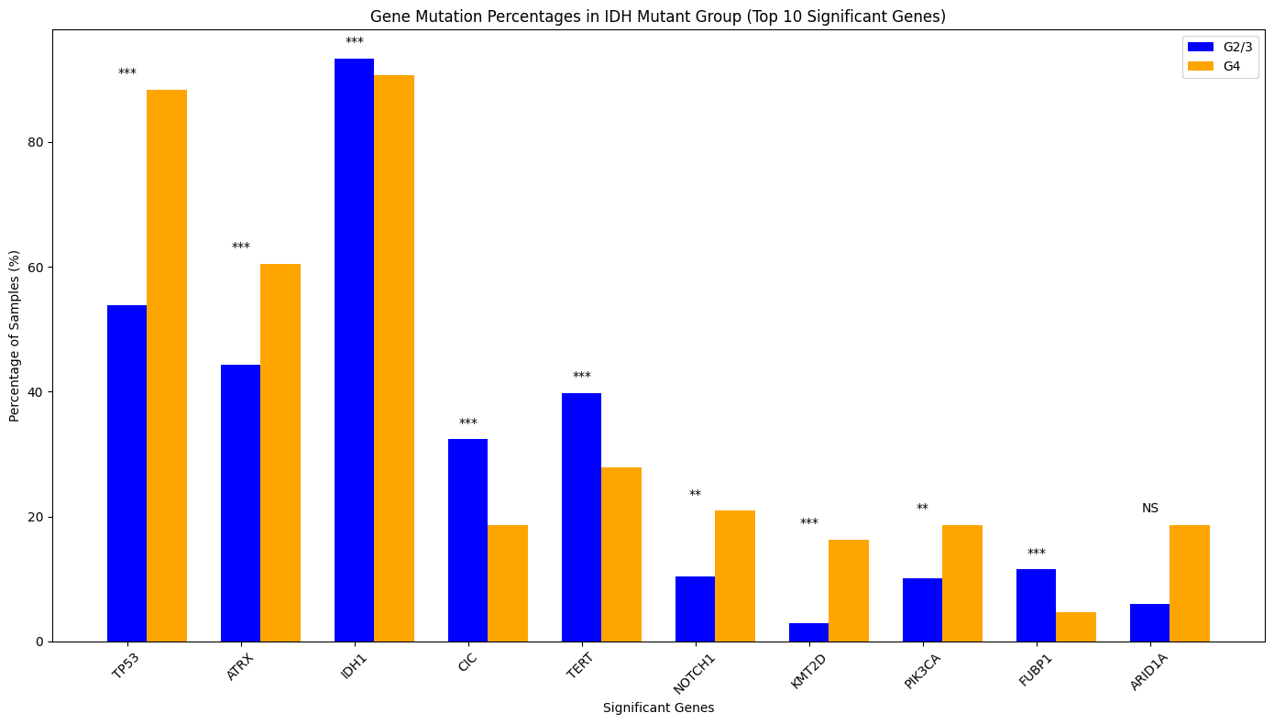
Pathways mutated in the cohort depending on IDH status
Notes:
Chi square

Slide 11
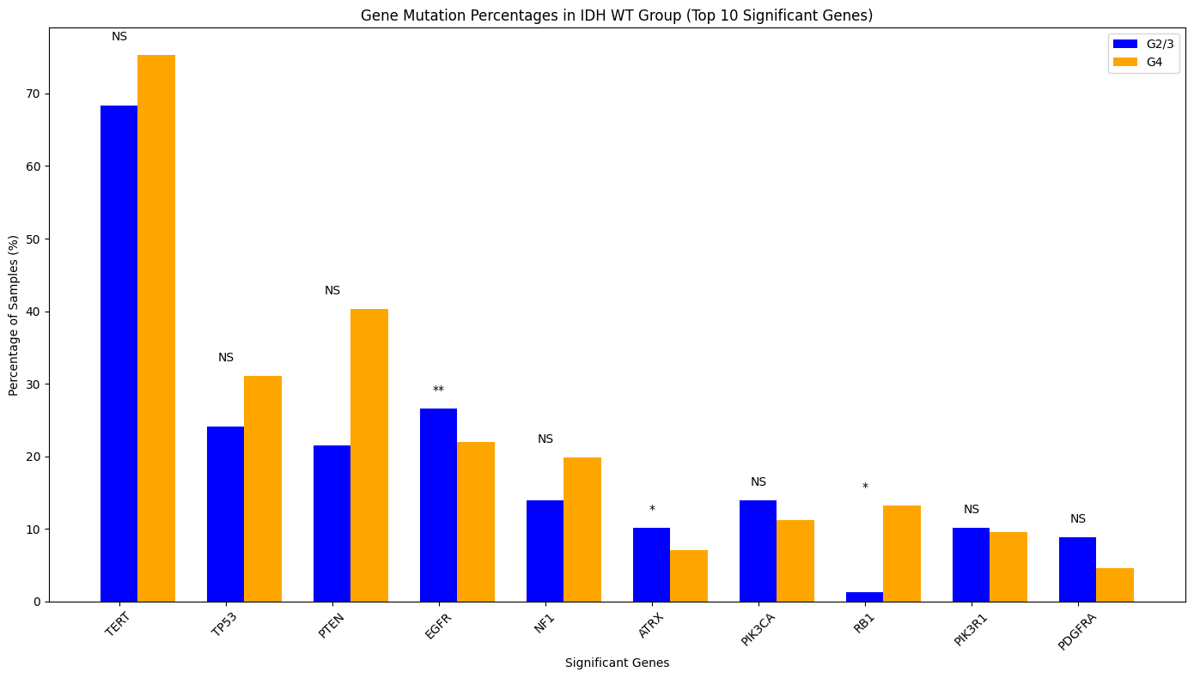
Pathways mutated in the cohort depending on IDH status
Notes:
Fiacher exact test

Slide 12
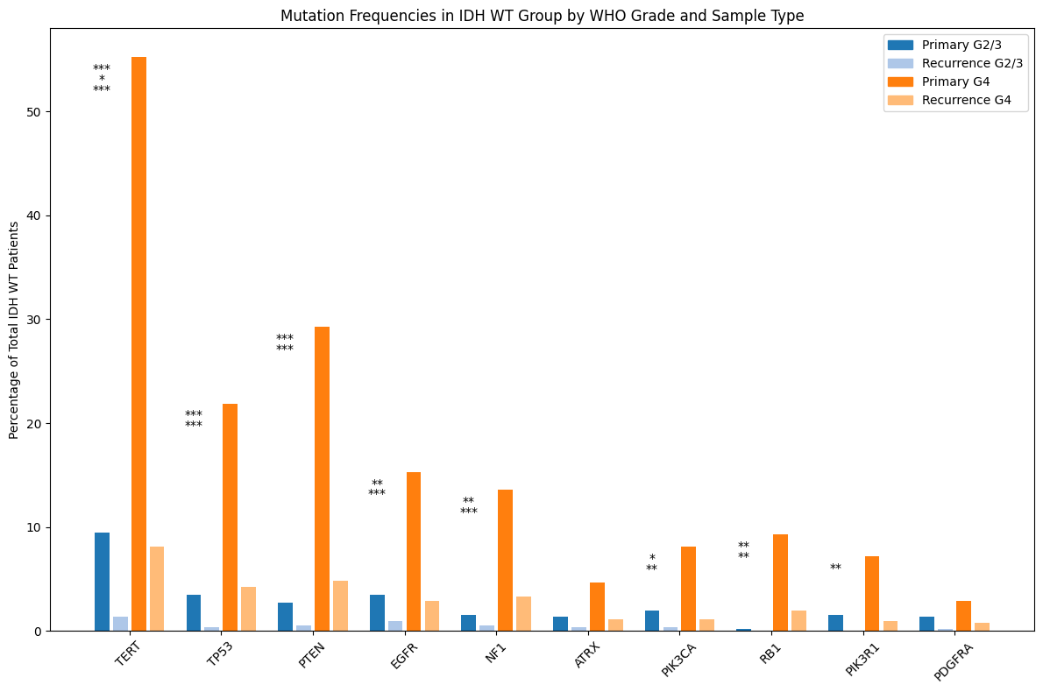
Pathways mutated in IDH WT patients

Slide 13
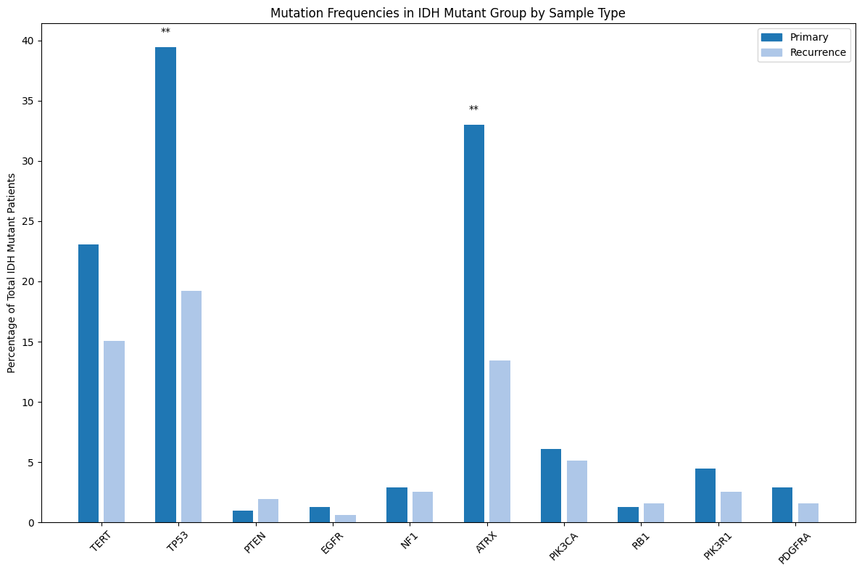
Pathways mutated in IDH mutant patients

Slide 14
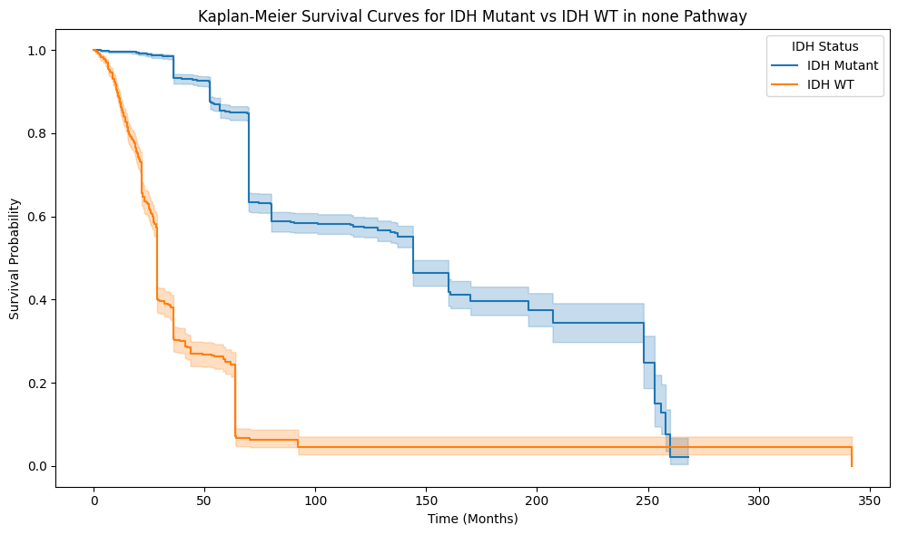
Survival curves depending on IDH status

Slide 15
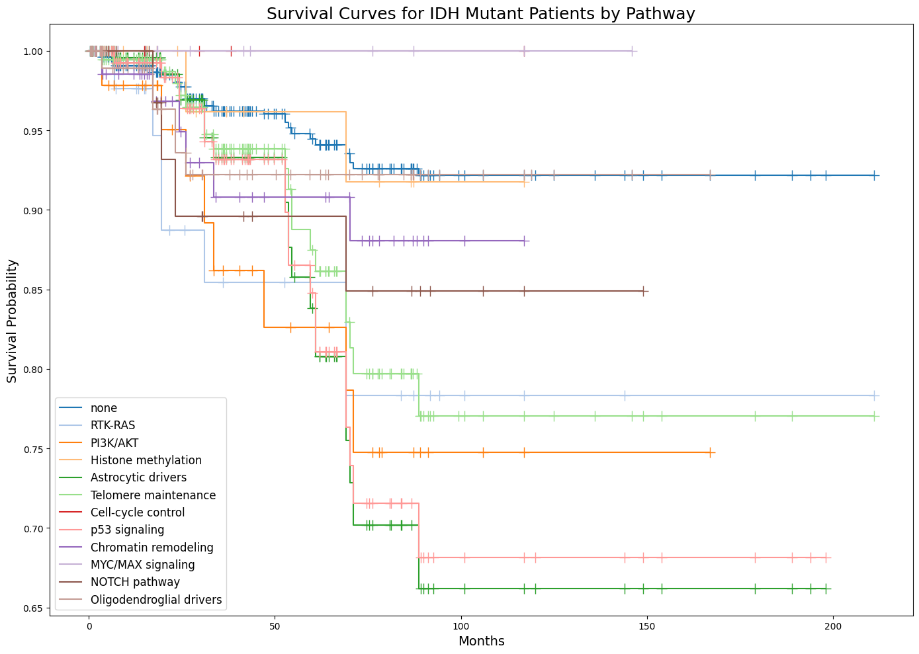
Survival curves in IDH mutant group depending on pathways

Slide 16
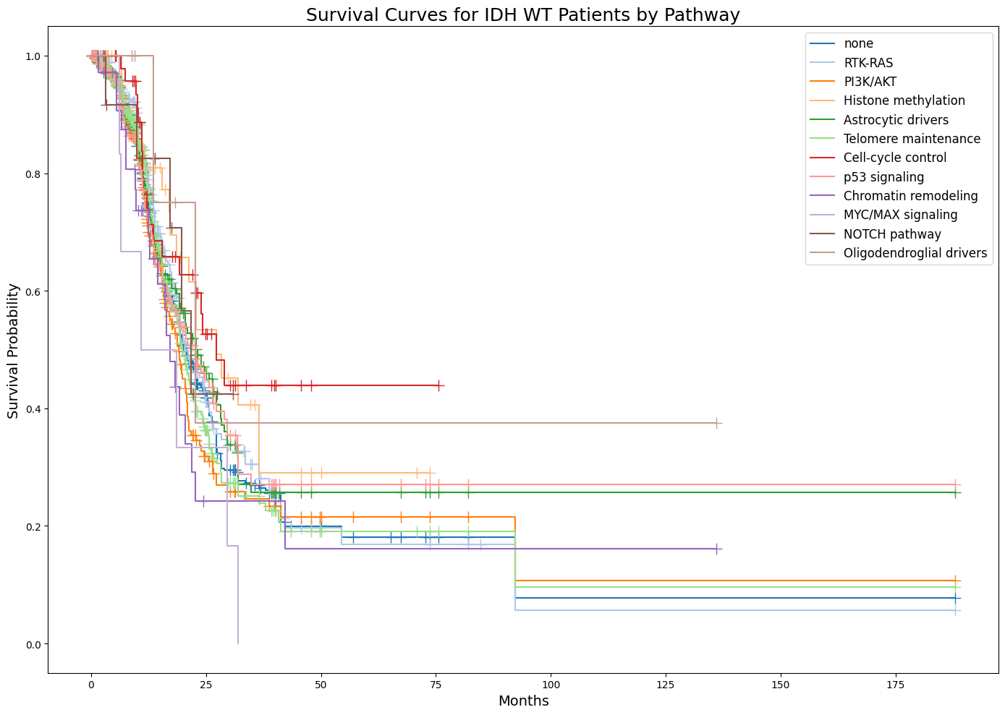
Survival curves in IDH WT group depending on pathways
Notes:
Log-Rank Test between none and RTK-RAS in IDH Mutant: p-value = 0.0028 Log-Rank Test between none and PI3K/AKT in IDH Mutant: p-value = 0.0004 Log-Rank Test between none and Astrocytic drivers in IDH Mutant: p-value = 0.0000 Log-Rank Test between none and Telomere maintenance in IDH Mutant: p-value = 0.0004 Log-Rank Test between none and p53 signaling in IDH Mutant: p-value = 0.0000 Log-Rank Test between RTK-RAS and none in IDH Mutant: p-value = 0.0028 Log-Rank Test between PI3K/AKT and none in IDH Mutant: p-value = 0.0004 Log-Rank Test between Histone methylation and Astrocytic drivers in IDH Mutant: p-value = 0.0290 Log-Rank Test between Histone methylation and p53 signaling in IDH Mutant: p-value = 0.0440 Log-Rank Test between Astrocytic drivers and none in IDH Mutant: p-value = 0.0000 Log-Rank Test between Astrocytic drivers and Histone methylation in IDH Mutant: p-value = 0.0290 Log-Rank Test between Astrocytic drivers and Oligodendroglial drivers in IDH Mutant: p-value = 0.0182 Log-Rank Test between Telomere maintenance and none in IDH Mutant: p-value = 0.0004 Log-Rank Test between p53 signaling and none in IDH Mutant: p-value = 0.0000 Log-Rank Test between p53 signaling and Histone methylation in IDH Mutant: p-value = 0.0440 Log-Rank Test between p53 signaling and Oligodendroglial drivers in IDH Mutant: p-value = 0.0392 Log-Rank Test between Oligodendroglial drivers and Astrocytic drivers in IDH Mutant: p-value = 0.0182 Log-Rank Test between Oligodendroglial drivers and p53 signaling in IDH Mutant: p-value = 0.0392 Log-Rank Test between PI3K/AKT and Cell-cycle control in IDH WT: p-value = 0.0270 Log-Rank Test between Histone methylation and MYC/MAX signaling in IDH WT: p-value = 0.0345 Log-Rank Test between Telomere maintenance and Cell-cycle control in IDH WT: p-value = 0.0491 Log-Rank Test between Cell-cycle control and PI3K/AKT in IDH WT: p-value = 0.0270 Log-Rank Test between Cell-cycle control and Telomere maintenance in IDH WT: p-value = 0.0491 Log-Rank Test between Cell-cycle control and Chromatin remodeling in IDH WT: p-value = 0.0330 Log-Rank Test between Cell-cycle control and MYC/MAX signaling in IDH WT: p-value = 0.0299 Log-Rank Test between Chromatin remodeling and Cell-cycle control in IDH WT: p-value = 0.0330 Log-Rank Test between MYC/MAX signaling and Histone methylation in IDH WT: p-value = 0.0345 Log-Rank Test between MYC/MAX signaling and Cell-cycle control in IDH WT: p-value = 0.0299

Slide 17
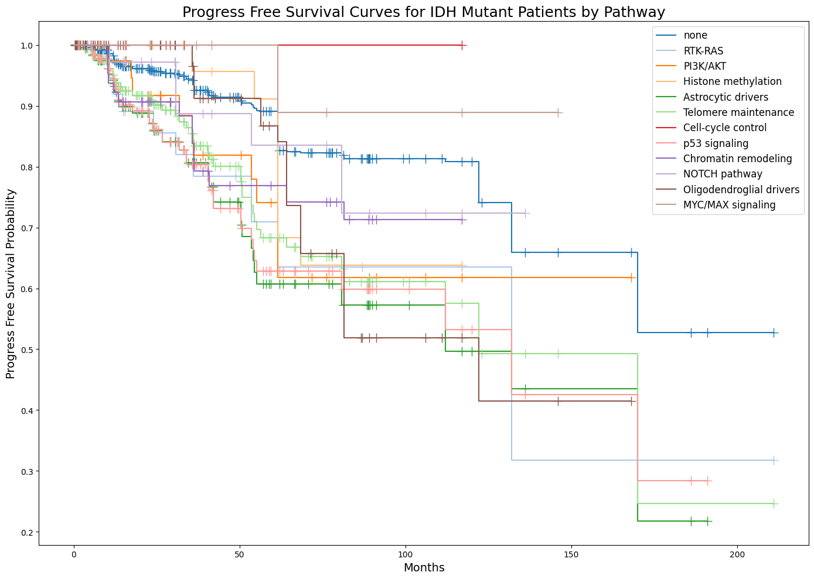
Progress free curves in IDH mutant group depending on pathways

Slide 18
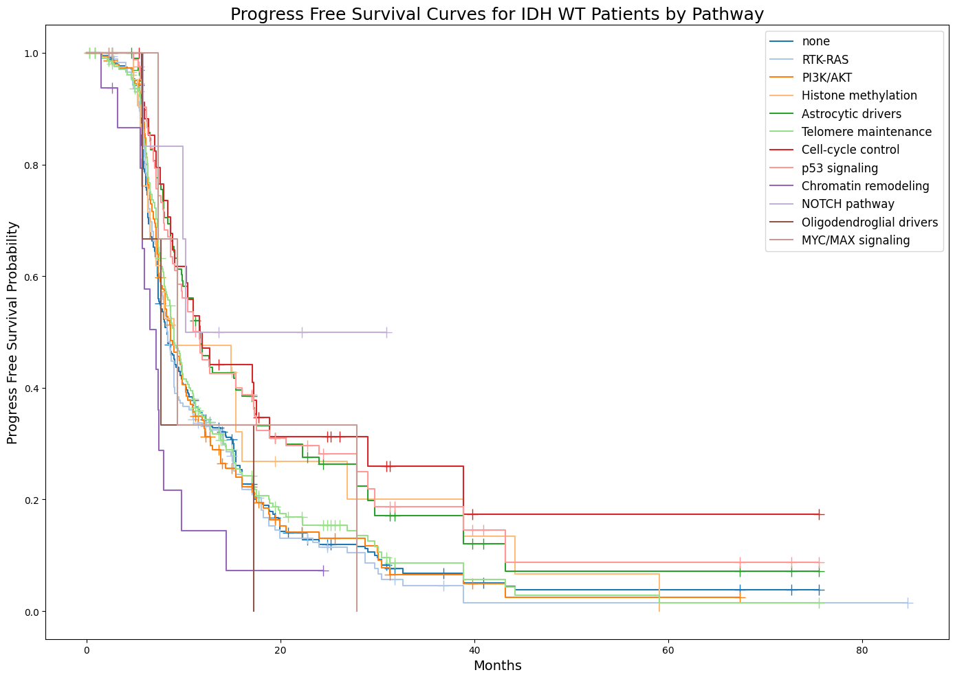
Progress free curves in IDH WT group depending on pathways
Notes:
Log-Rank Test between none and RTK-RAS in IDH Mutant: p-value = 0.0063 Log-Rank Test between none and PI3K/AKT in IDH Mutant: p-value = 0.0118 Log-Rank Test between none and Astrocytic drivers in IDH Mutant: p-value = 0.0000 Log-Rank Test between none and Telomere maintenance in IDH Mutant: p-value = 0.0000 Log-Rank Test between none and p53 signaling in IDH Mutant: p-value = 0.0000 Log-Rank Test between none and Chromatin remodeling in IDH Mutant: p-value = 0.0334 Log-Rank Test between none and Oligodendroglial drivers in IDH Mutant: p-value = 0.0048 Log-Rank Test between RTK-RAS and none in IDH Mutant: p-value = 0.0063 Log-Rank Test between PI3K/AKT and none in IDH Mutant: p-value = 0.0118 Log-Rank Test between Astrocytic drivers and none in IDH Mutant: p-value = 0.0000 Log-Rank Test between Astrocytic drivers and MYC/MAX signaling in IDH Mutant: p-value = 0.0261 Log-Rank Test between Telomere maintenance and none in IDH Mutant: p-value = 0.0000 Log-Rank Test between p53 signaling and none in IDH Mutant: p-value = 0.0000 Log-Rank Test between p53 signaling and MYC/MAX signaling in IDH Mutant: p-value = 0.0355 Log-Rank Test between Chromatin remodeling and none in IDH Mutant: p-value = 0.0334 Log-Rank Test between Oligodendroglial drivers and none in IDH Mutant: p-value = 0.0048 Log-Rank Test between MYC/MAX signaling and Astrocytic drivers in IDH Mutant: p-value = 0.0261 Log-Rank Test between MYC/MAX signaling and p53 signaling in IDH Mutant: p-value = 0.0355 Log-Rank Test between none and Astrocytic drivers in IDH WT: p-value = 0.0005 Log-Rank Test between none and Cell-cycle control in IDH WT: p-value = 0.0054 Log-Rank Test between none and p53 signaling in IDH WT: p-value = 0.0008 Log-Rank Test between none and Chromatin remodeling in IDH WT: p-value = 0.0457 Log-Rank Test between RTK-RAS and Astrocytic drivers in IDH WT: p-value = 0.0002 Log-Rank Test between RTK-RAS and Cell-cycle control in IDH WT: p-value = 0.0030 Log-Rank Test between RTK-RAS and p53 signaling in IDH WT: p-value = 0.0004 Log-Rank Test between RTK-RAS and Chromatin remodeling in IDH WT: p-value = 0.0493 Log-Rank Test between PI3K/AKT and Astrocytic drivers in IDH WT: p-value = 0.0026 Log-Rank Test between PI3K/AKT and Cell-cycle control in IDH WT: p-value = 0.0109 Log-Rank Test between PI3K/AKT and p53 signaling in IDH WT: p-value = 0.0043 Log-Rank Test between PI3K/AKT and Chromatin remodeling in IDH WT: p-value = 0.0322 Log-Rank Test between Histone methylation and Chromatin remodeling in IDH WT: p-value = 0.0450 Log-Rank Test between Astrocytic drivers and none in IDH WT: p-value = 0.0005 Log-Rank Test between Astrocytic drivers and RTK-RAS in IDH WT: p-value = 0.0002 Log-Rank Test between Astrocytic drivers and PI3K/AKT in IDH WT: p-value = 0.0026 Log-Rank Test between Astrocytic drivers and Telomere maintenance in IDH WT: p-value = 0.0048 Log-Rank Test between Astrocytic drivers and Chromatin remodeling in IDH WT: p-value = 0.0002 Log-Rank Test between Telomere maintenance and Astrocytic drivers in IDH WT: p-value = 0.0048 Log-Rank Test between Telomere maintenance and Cell-cycle control in IDH WT: p-value = 0.0165 Log-Rank Test between Telomere maintenance and p53 signaling in IDH WT: p-value = 0.0072 Log-Rank Test between Telomere maintenance and Chromatin remodeling in IDH WT: p-value = 0.0151 Log-Rank Test between Cell-cycle control and none in IDH WT: p-value = 0.0054 Log-Rank Test between Cell-cycle control and RTK-RAS in IDH WT: p-value = 0.0030 Log-Rank Test between Cell-cycle control and PI3K/AKT in IDH WT: p-value = 0.0109 Log-Rank Test between Cell-cycle control and Telomere maintenance in IDH WT: p-value = 0.0165 Log-Rank Test between Cell-cycle control and Chromatin remodeling in IDH WT: p-value = 0.0011 Log-Rank Test between p53 signaling and none in IDH WT: p-value = 0.0008 Log-Rank Test between p53 signaling and RTK-RAS in IDH WT: p-value = 0.0004 Log-Rank Test between p53 signaling and PI3K/AKT in IDH WT: p-value = 0.0043 Log-Rank Test between p53 signaling and Telomere maintenance in IDH WT: p-value = 0.0072 Log-Rank Test between p53 signaling and Chromatin remodeling in IDH WT: p-value = 0.0004 Log-Rank Test between Chromatin remodeling and none in IDH WT: p-value = 0.0457 Log-Rank Test between Chromatin remodeling and RTK-RAS in IDH WT: p-value = 0.0493 Log-Rank Test between Chromatin remodeling and PI3K/AKT in IDH WT: p-value = 0.0322 Log-Rank Test between Chromatin remodeling and Histone methylation in IDH WT: p-value = 0.0450 Log-Rank Test between Chromatin remodeling and Astrocytic drivers in IDH WT: p-value = 0.0002 Log-Rank Test between Chromatin remodeling and Telomere maintenance in IDH WT: p-value = 0.0151 Log-Rank Test between Chromatin remodeling and Cell-cycle control in IDH WT: p-value = 0.0011 Log-Rank Test between Chromatin remodeling and p53 signaling in IDH WT: p-value = 0.0004 Log-Rank Test between Chromatin remodeling and NOTCH pathway in IDH WT: p-value = 0.0258 Log-Rank Test between NOTCH pathway and Chromatin remodeling in IDH WT: p-value = 0.0258

Slide 19
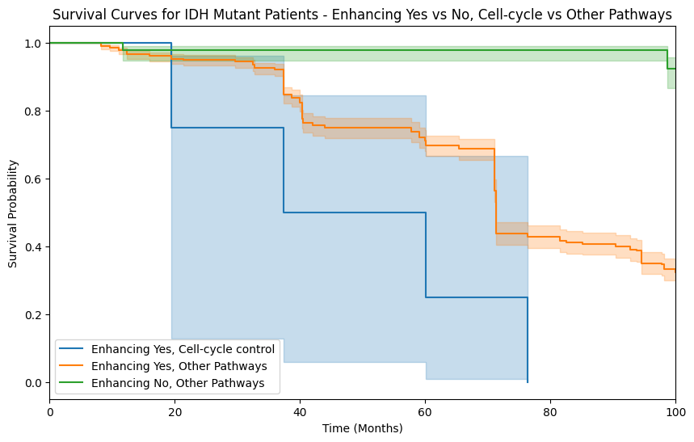
Survival curves in IDH mutant group depending on pathways
Notes:
Multivariate log-rank test p-value = 3.205779148640615e-60

Slide 20
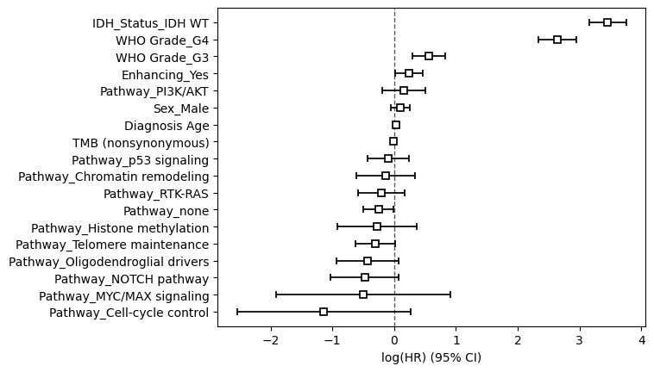
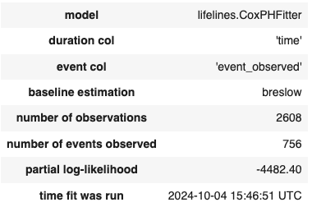
Cox proportional hazards model

Slide 21
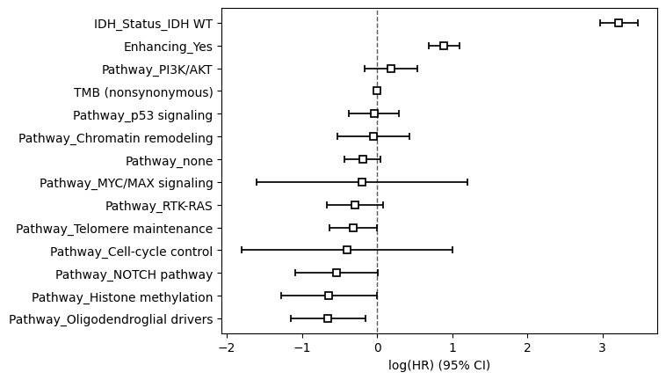
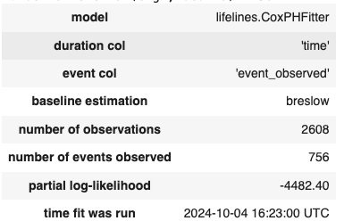
Cox proportional hazards model

Slide 22
Conclusions
Sample size is not big enogh too ensure narrower confidence intervals.
IDH Status_IDH WT: Significantly increases hazard (worse survival).
WHO Grade_G4: Significantly increases hazard (worse survival).
WHO Grade_G3: Likely increases hazard (worse survival).
Enhancing_Yes: Significantly increases hazard (worse survival).
Pathway_PI3K/AKT: Likely increases hazard (worse survival).
Pathway_Cell-cycle control: Significantly increases hazard (worse survival).
Pathway_MYCN/MAX signaling: Significantly increases hazard (but note the wide CI indicating variability).
Non-significant variables (CI crosses 0):
Variables such as TMB (nonsynonymous), and several pathways (e.g., Pathway_NOTCH pathway, Pathway_RT-RAS) appear to have confidence intervals crossing 0, indicating no significant association with survival.

