Slide 1

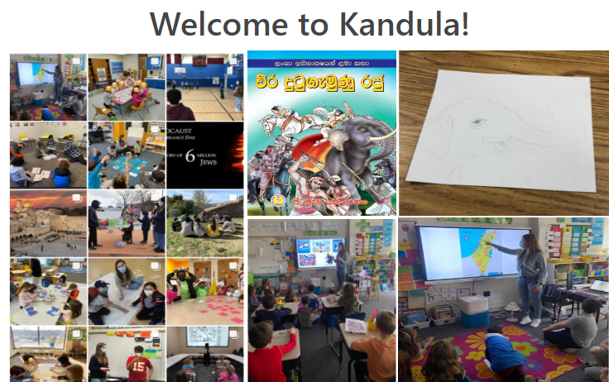

Per aspera ad astra (cloud)
Galit Udovik
Hands-on course #8
Kandula final project
04/08/2022

Slide 2

Who am I
3 factors of Authentication

Slide 3



Something I am
Personal
  49-year-old
  32 years Israel citizen (Alia 1990)
  Happy and free Divorces
  4 years (cancer runner)
  Mom to 19-year great daughter
Professional
  One women show more that 10 years with full responsibility on all R&D processes and infrastructure
  DevOps Architect & Sr. Software Engineer at CMT
  Mentor and development evangelist
  C++ speaker ☺

Slide 4
Something I have
Personal
  Cat
  Daughter
  Sister
  Love
Professional
  28-year development experience from bottom to top (Development, Architecture, Design…)
  Some theoretical knowledge about Cloud technology
  Near 0 experienced knowledge of Cloud technology

Slide 5
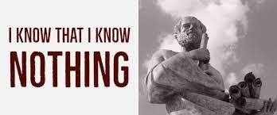
Something I know
Personal
  I know that I know NOTHING
  Hobbies : Abseiling, Hiking, sewing
  Each day that we not smile and not cause to someone smile is wasted day
Professional
  Few ☺ software languages
    C, C++, C#, Java, Perl, TCl, PHP, Python
  There are many technology to learn

Slide 6
What was my target of Course
Personal
  Develop my self again (I do it each 5-7 years)
  Meet new interesting people from the Hitech industry
  Meet personal challenge and compete according my self “yesterday” only
Professional
  Learn and “fill” cloud infrastructure near as possible to real usage

Slide 7
Let’s start

Slide 8
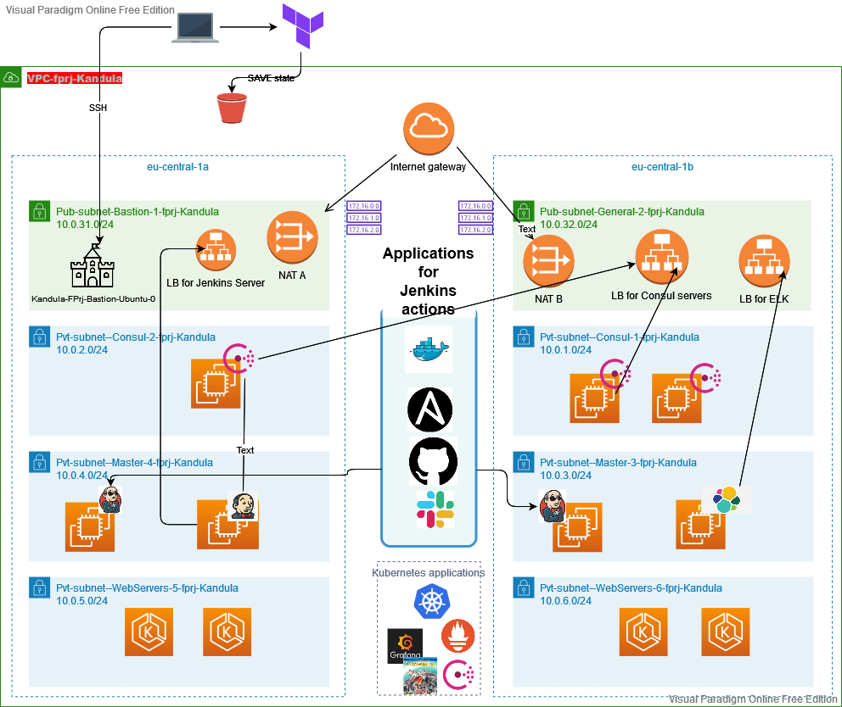
AWS infrastructure diagram

Slide 9
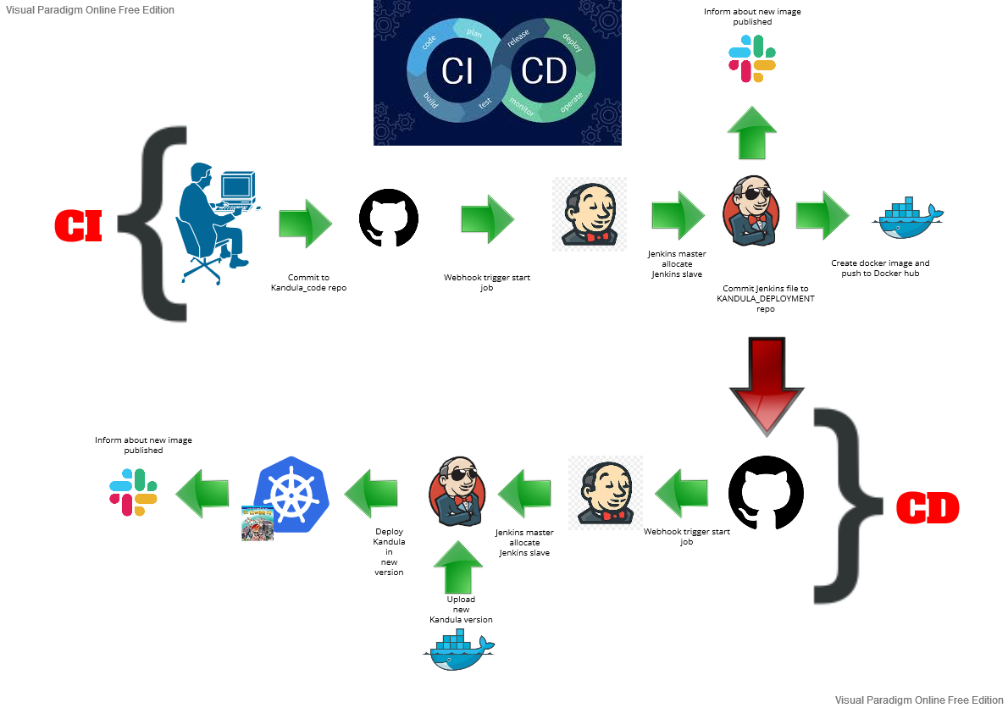
CI-CD flow

Slide 10
Different tools and decisions
Terraform
  Creates all VPC/EC2/KUBERNETEST/… infrastructure for first create an environment
  Use modules for create more modulated environment
Ansible
  Used from Jenkins job any time at Terraform build for first time and any time when user want update environment from Jenkins job Used for install manually
    Consul servers and agents on EC2
    Node Exporter
    Filebeat
Git
  As Source control system

Slide 11
Different tools and decisions
Shell
  Used for create an environment
  Used inside user data
  Used in TF remote-exec provisioning via bastion
Jenkins server was created from saved ami each time
Jenkins slaves/Consul server/ELK server
  Installed from TF user data and remote-exec provisional and user data
HELM used for install on Kubernetes
  Prometheus
  Grafana
  Consul

Slide 12
Different tools and decisions
Python
  Used for Kandula itself code
  Used for CLI tool for Kandula
  Used for internal scripts
Secrets
  Jenkins server secret system used for keep all git, docker hub, private keys secrets
  Kubernetes secrets used for keep AWS secrets for start kandula application
Slack
  Used for notification system of Jenkins jobs
Separated TF environment
  For save time and easy create part of environment was decided to use relevant TF code for Logical parts of project
  There exist 1 shell script which execute full create AWS environment

Slide 13
Different tools and decisions
Jenkins slaves are “self registered machines” via Jenkins CLI
3 Ansible Jenkins job executed at end of create TF environment
All deployment to Kubernetes are executed via TF at beginning or yaml file via Jenkins job any time
Kubernetes Ingress used for
  Grafana inside KUBE
  Kandula inside KUBE
  Prometheus inside KUBE
Load balancers for private EC2 machines
  Decided to use 1 per server and not 1 for all with different targets and ports
I purchased Domain for use its name for all AWS environment UI
TLS termination
  Used a public AWS certificate for all web UI of all applications

Slide 14
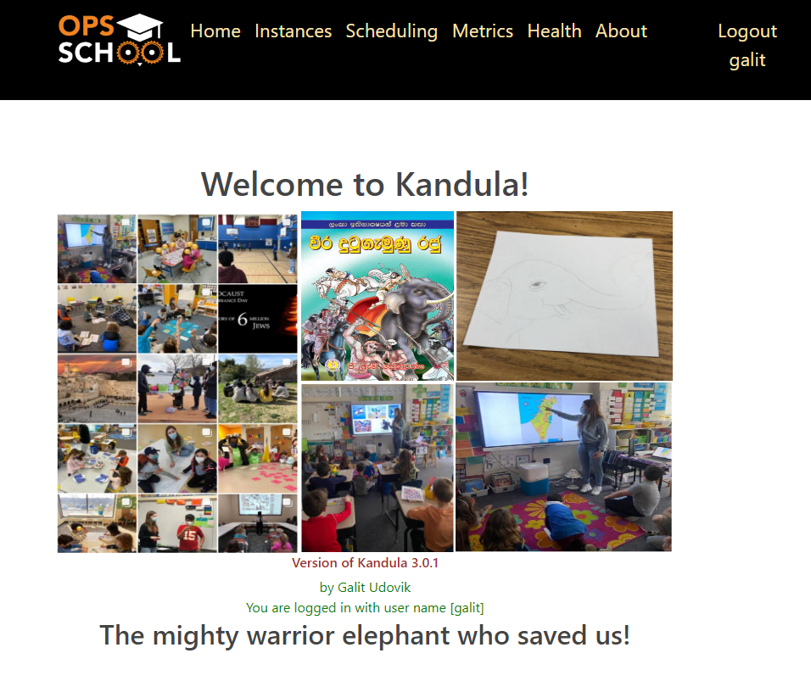
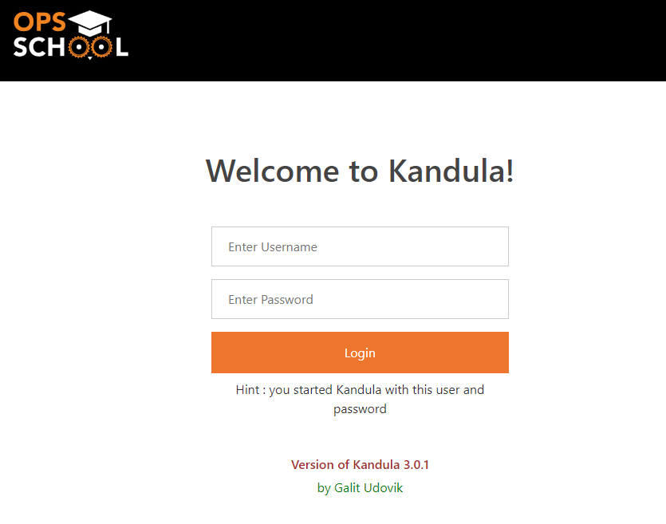
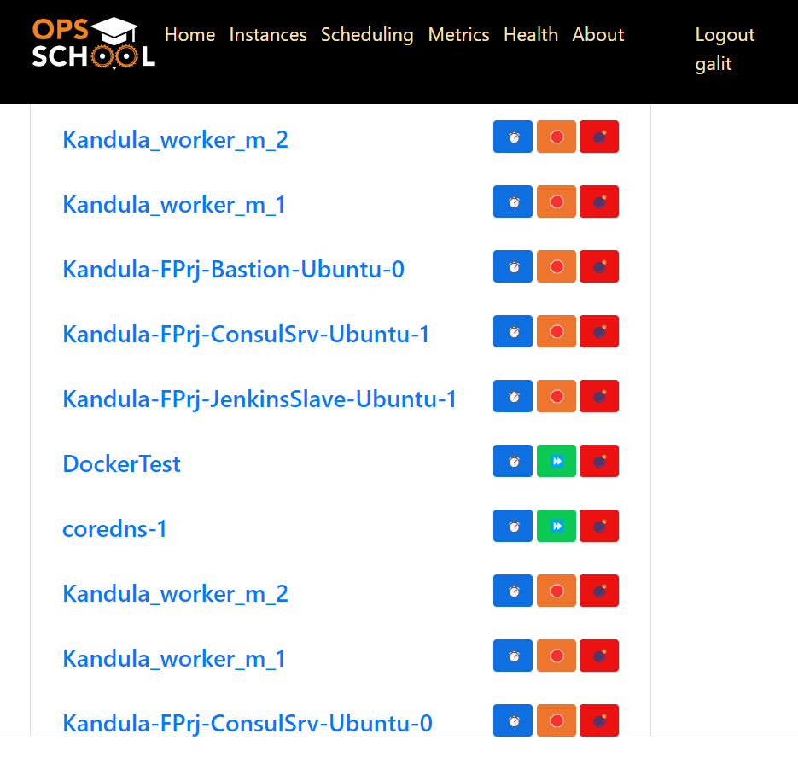
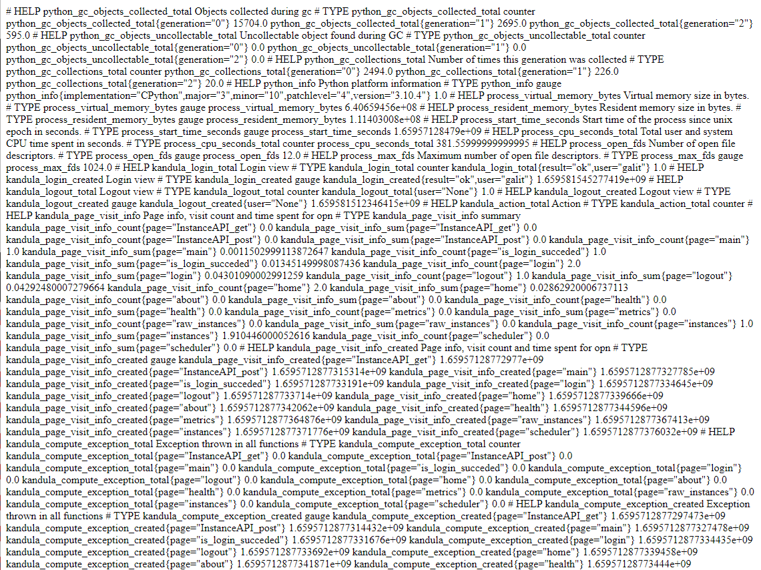
https://kandula.galitu.site
Kandula application

Slide 15
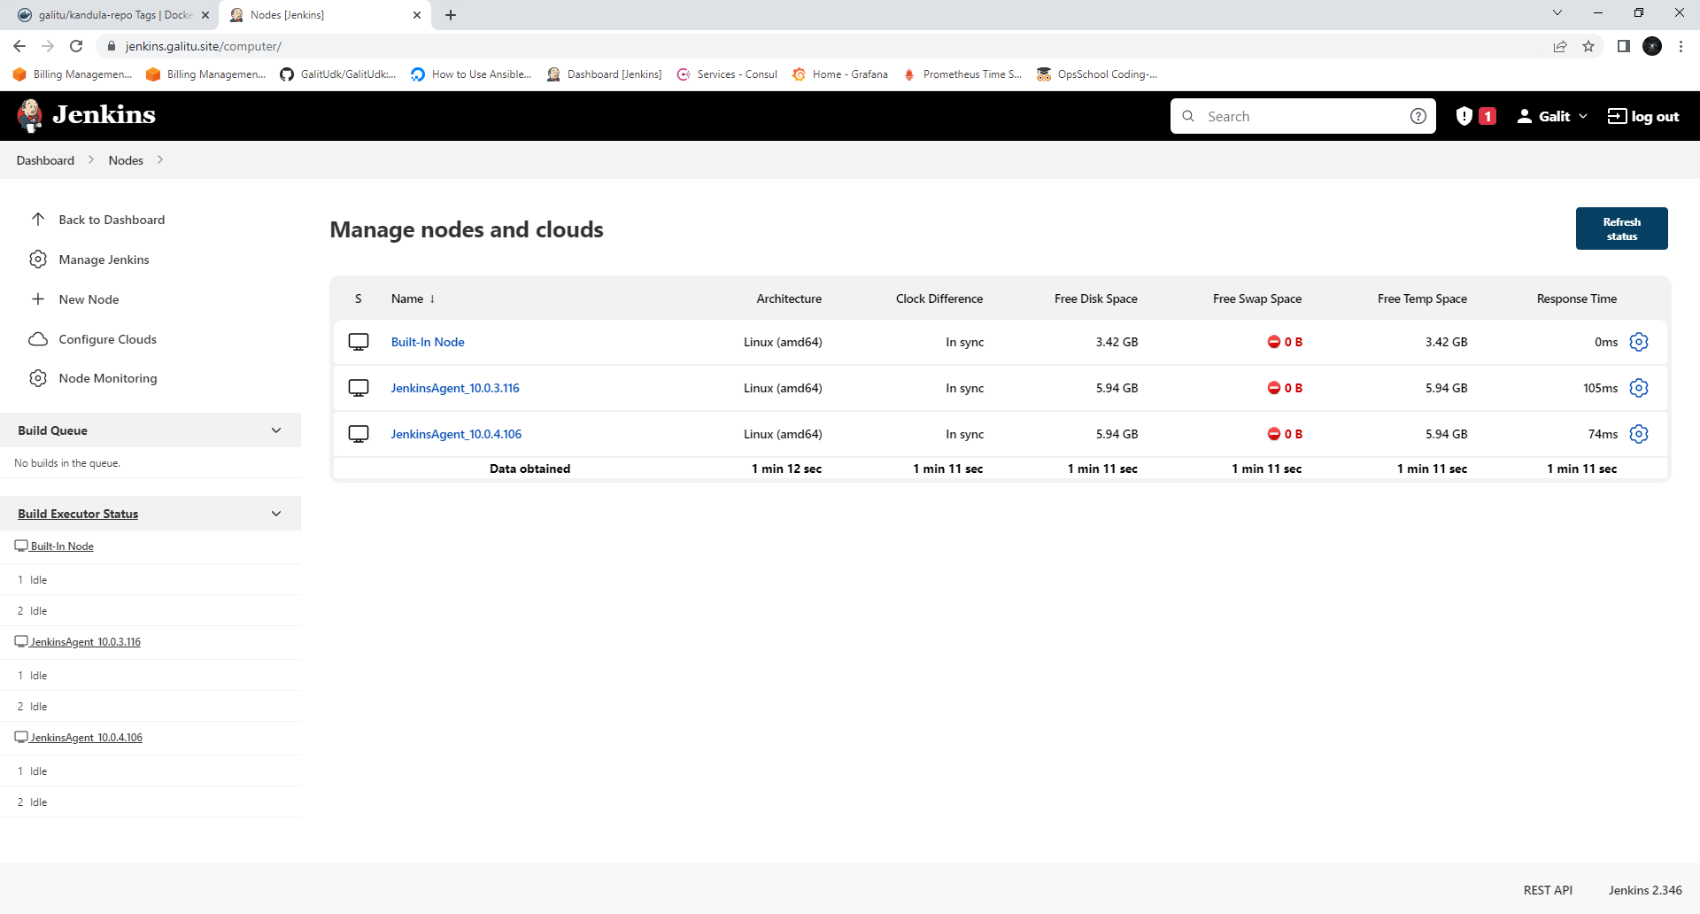
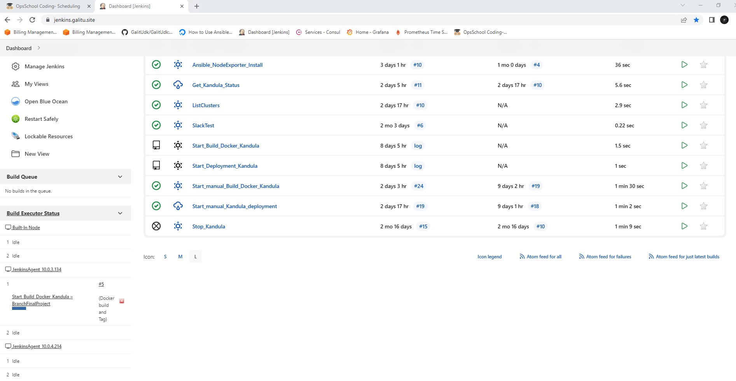
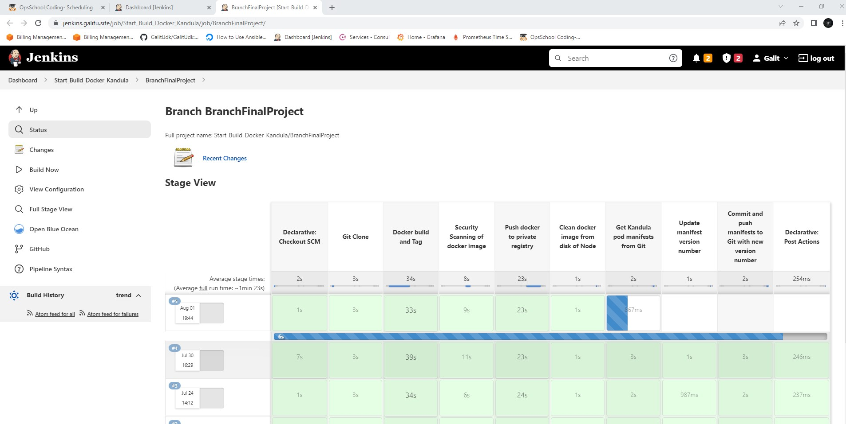
Jenkins infrastructure Docker build process

Slide 16
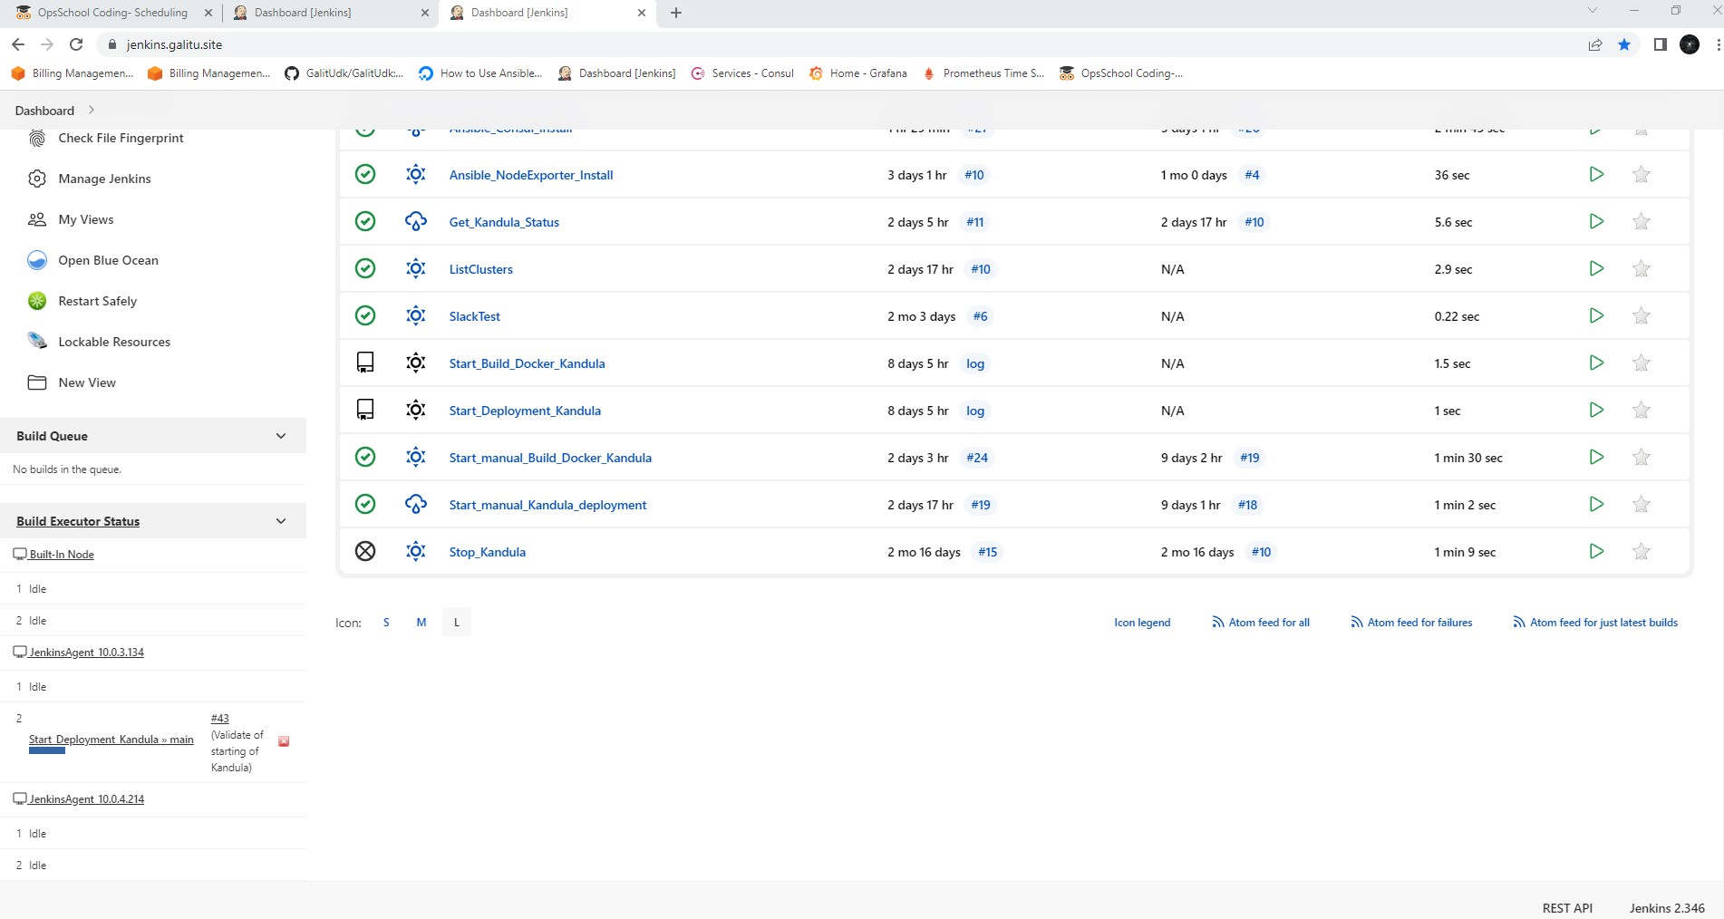
Jenkins infrastructure Deployment

Slide 17
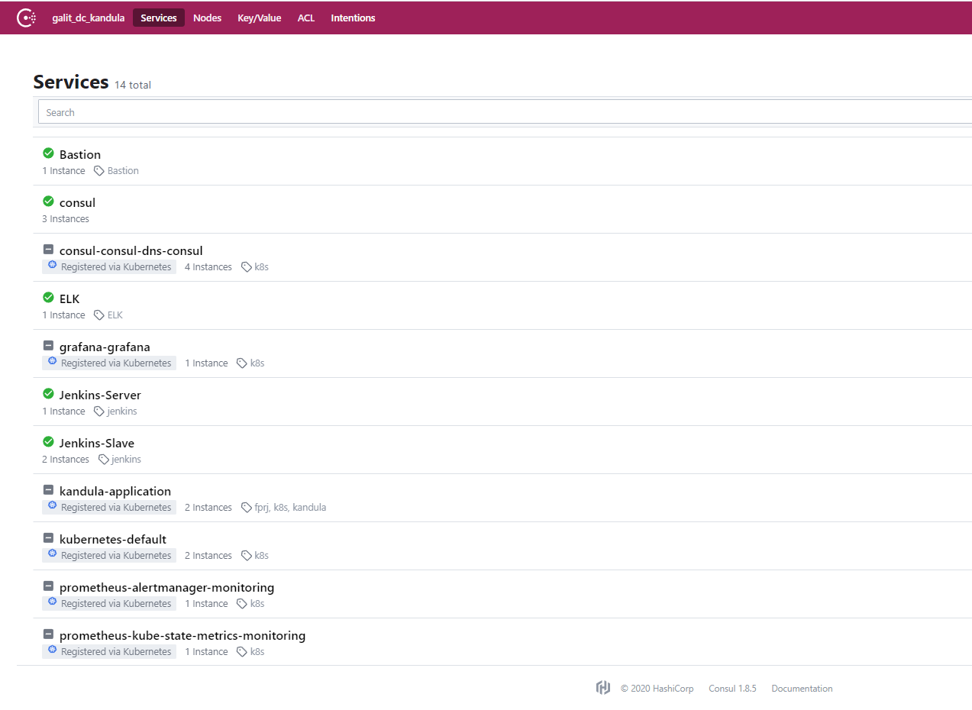
Consul servers

Slide 18
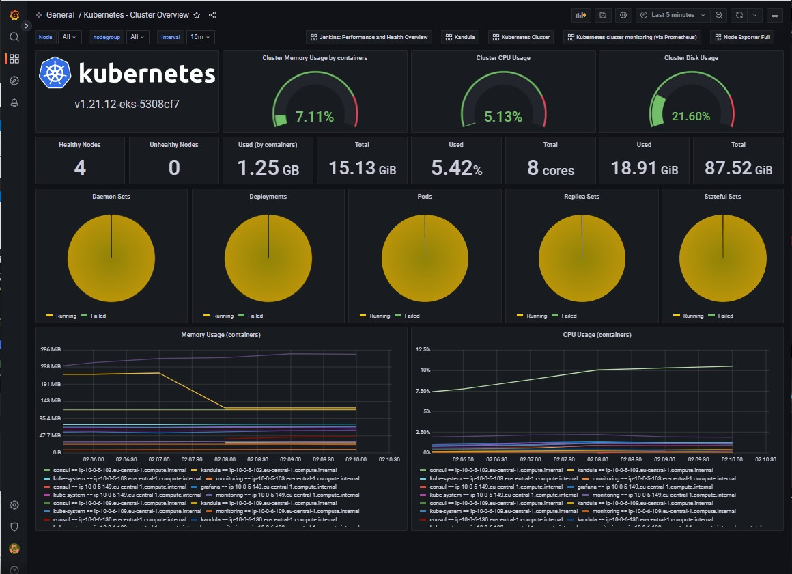
Grafana dashboards … Kubernetes

Slide 19
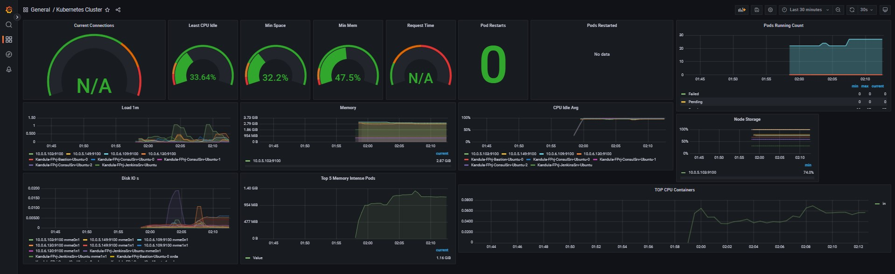
Grafana dashboards … Kubernetes

Slide 20
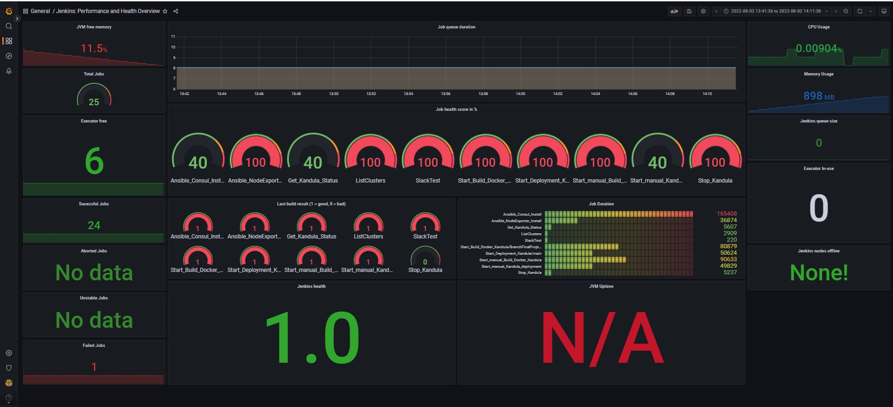
Grafana dashboards … Jenkins

Slide 21
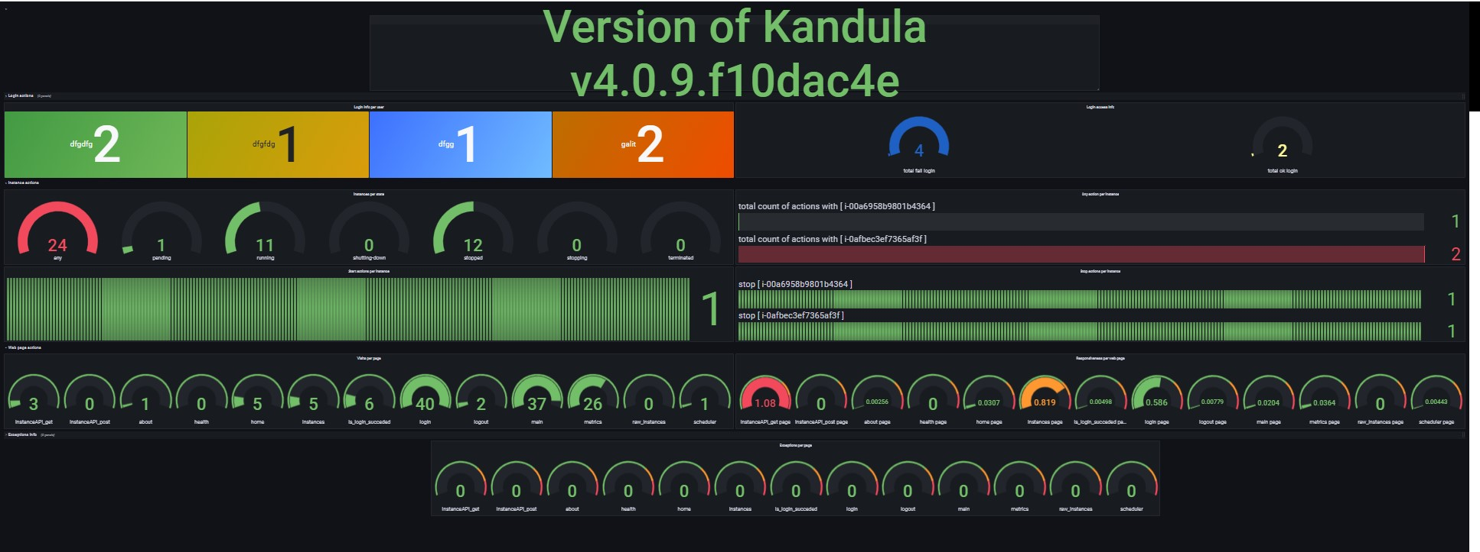
Grafana dashboards …Kandula

Slide 22
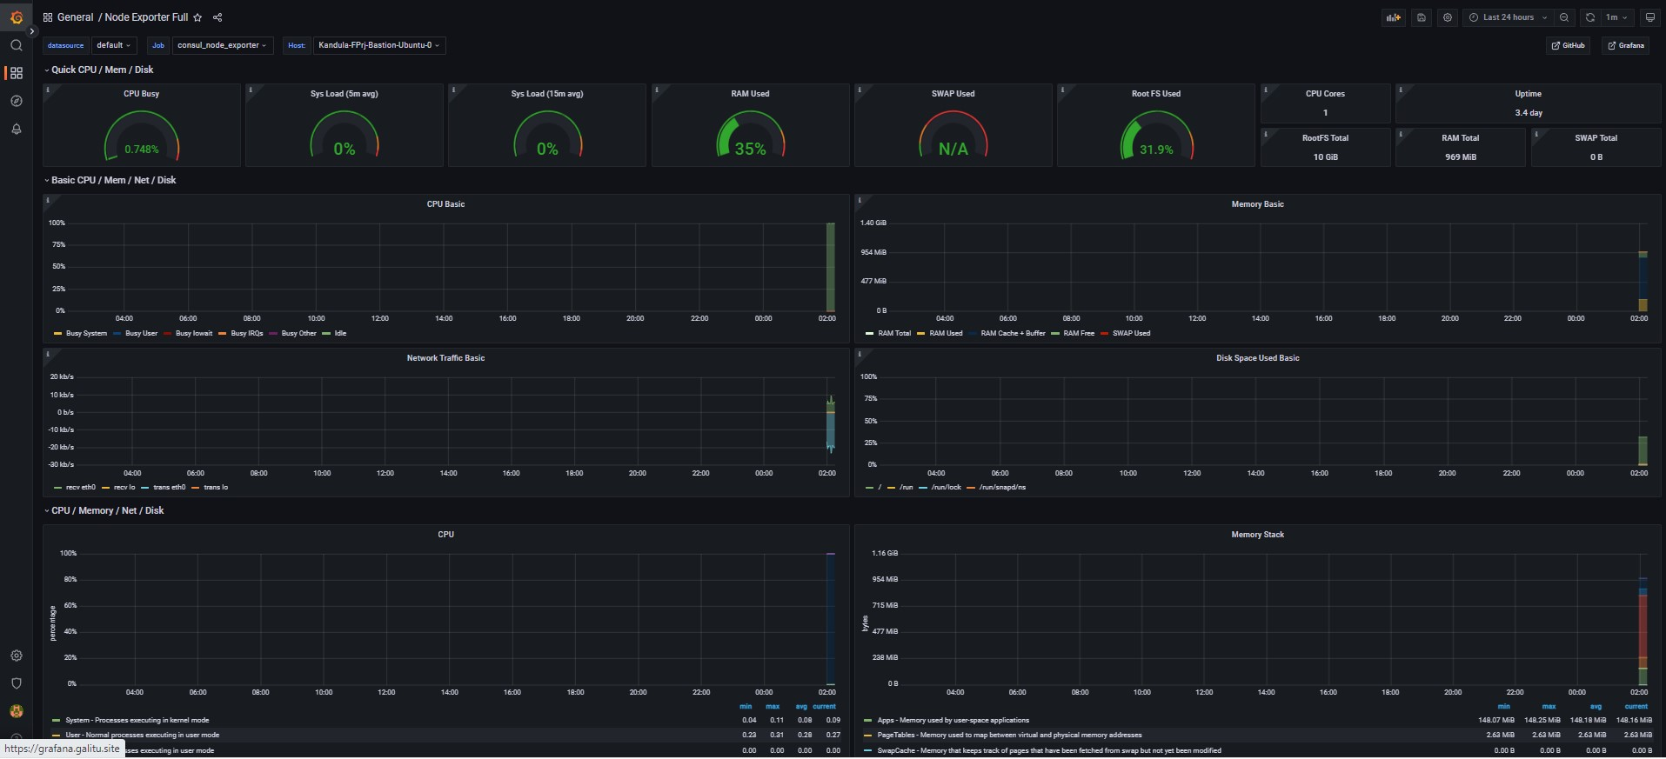
Grafana dashboards …Node Exporter

Slide 23
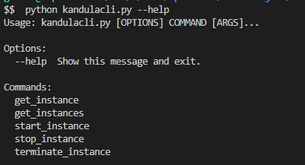
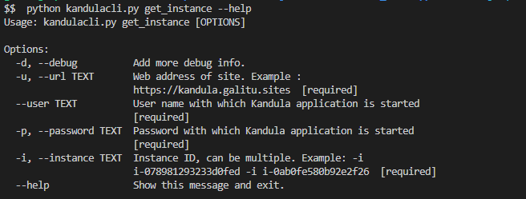
Kandula CLI

Slide 24
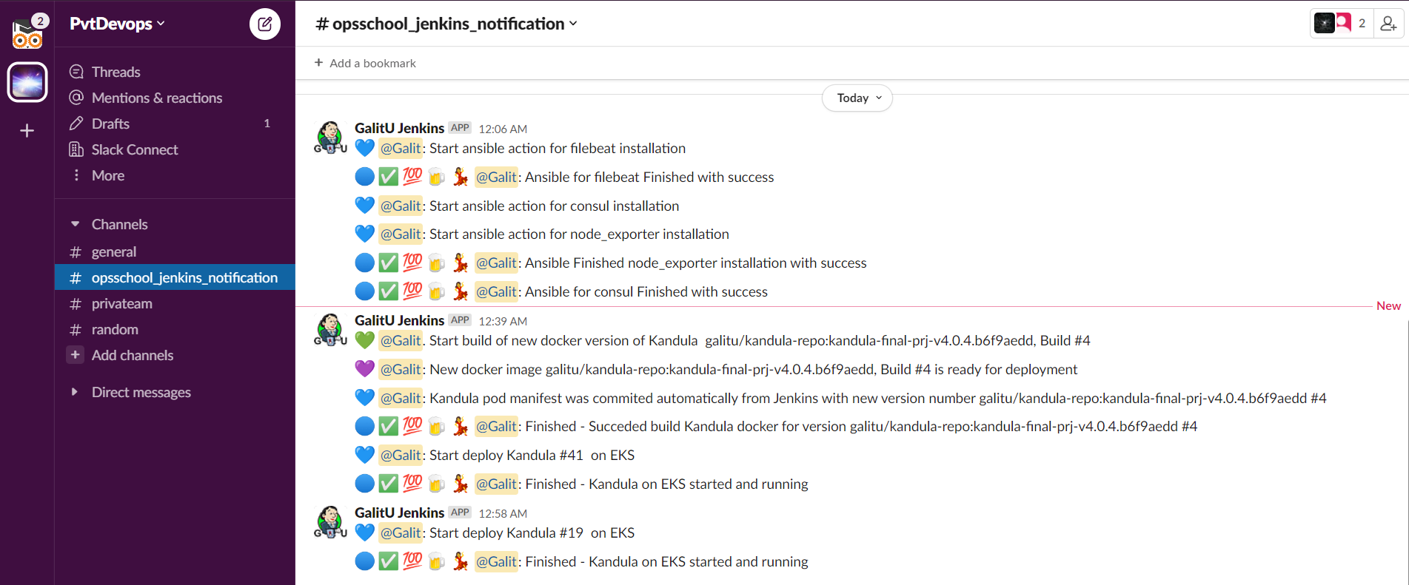
Slack notification system

Slide 25
Links to relevant git repo
https://github.com/GalitU/Kandula_project
https://github.com/GalitU/Kandula_deployment
https://github.com/GalitU/Kandula_code
https://github.com/GalitU/Ansible_for_jenkins

Slide 26
Work conditions and problems
I had 0 experience of cloud technology, so all what I learned was from scratch and took a time.
I work full week at my office, and I am one women show, so there was a homework time between 21:00 – 05:00
My regular working environment is Windows, “romance” with Unix is new for me and took to me some time at start
There was many times that something what worked fine before just stopped to work, like Jenkins webhook, installation of ansible of consul… and I found my self make 1 step forward and 4 backward

Slide 27
What I decided not implement
RDS + scheduler – I wrote many times software which used a DB including build a scheme and more. I have a proved experience with next list of DBs, so I decided to use a time for something new which I don’t know
  MySql
  Posgress
  LocalDB
  SqlLite
ELK – I started to implement if near the deadline and just not have a time to finish
VPN – is a bonus, so decided not to implement
Grafana alerts – I understood the idea, but it is taken an important time before end of project and decided not implement
Pytest – I prepare unitests for many languages including python on my daily base at work so this is not new for me, even more I responsible for explain and teach developers at my work to do it, so not implemented because I have an experience at this

Slide 28
Decisions after a course
All “not implemented” issues will be finished after the course
I learned a lot and want to thank each of you and all for the opportunity to “touch” the sky (cloud)
After the course I will implement at my work 2/5 of learned stuff which will be allowed by company security :☺
Again ☺, there are a lot of things to learn, and now I have a base to start it

Slide 29


Thank You
Galit Udovik
galitu@gmail.com
http://galitu.site
https://www.linkedin.com/in/galitudovik/?originalSubdomain=il
This presentation is at http://galitu.site/FinalOpsSchoolPresentation.pdf

