Slide 1

ML
A Tool for Managing the Machine Learning Lifecycle

Slide 2
contents
What is MLflow?
MLflow Components
Do We Need a Database?
Integrations
Architecture
Benefits vs Challenges
Real-World Usage
When Not To Use
Demo Video

Slide 3
How do we currently track experiments?
Introduction
Goal: Can MLflow improve our workflow?

Slide 4
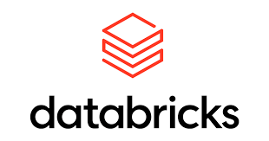
What is MLflow?
Open-source platform for managing ML lifecycle.
Created by Databricks.
Supports Python, R, Java.

Slide 5
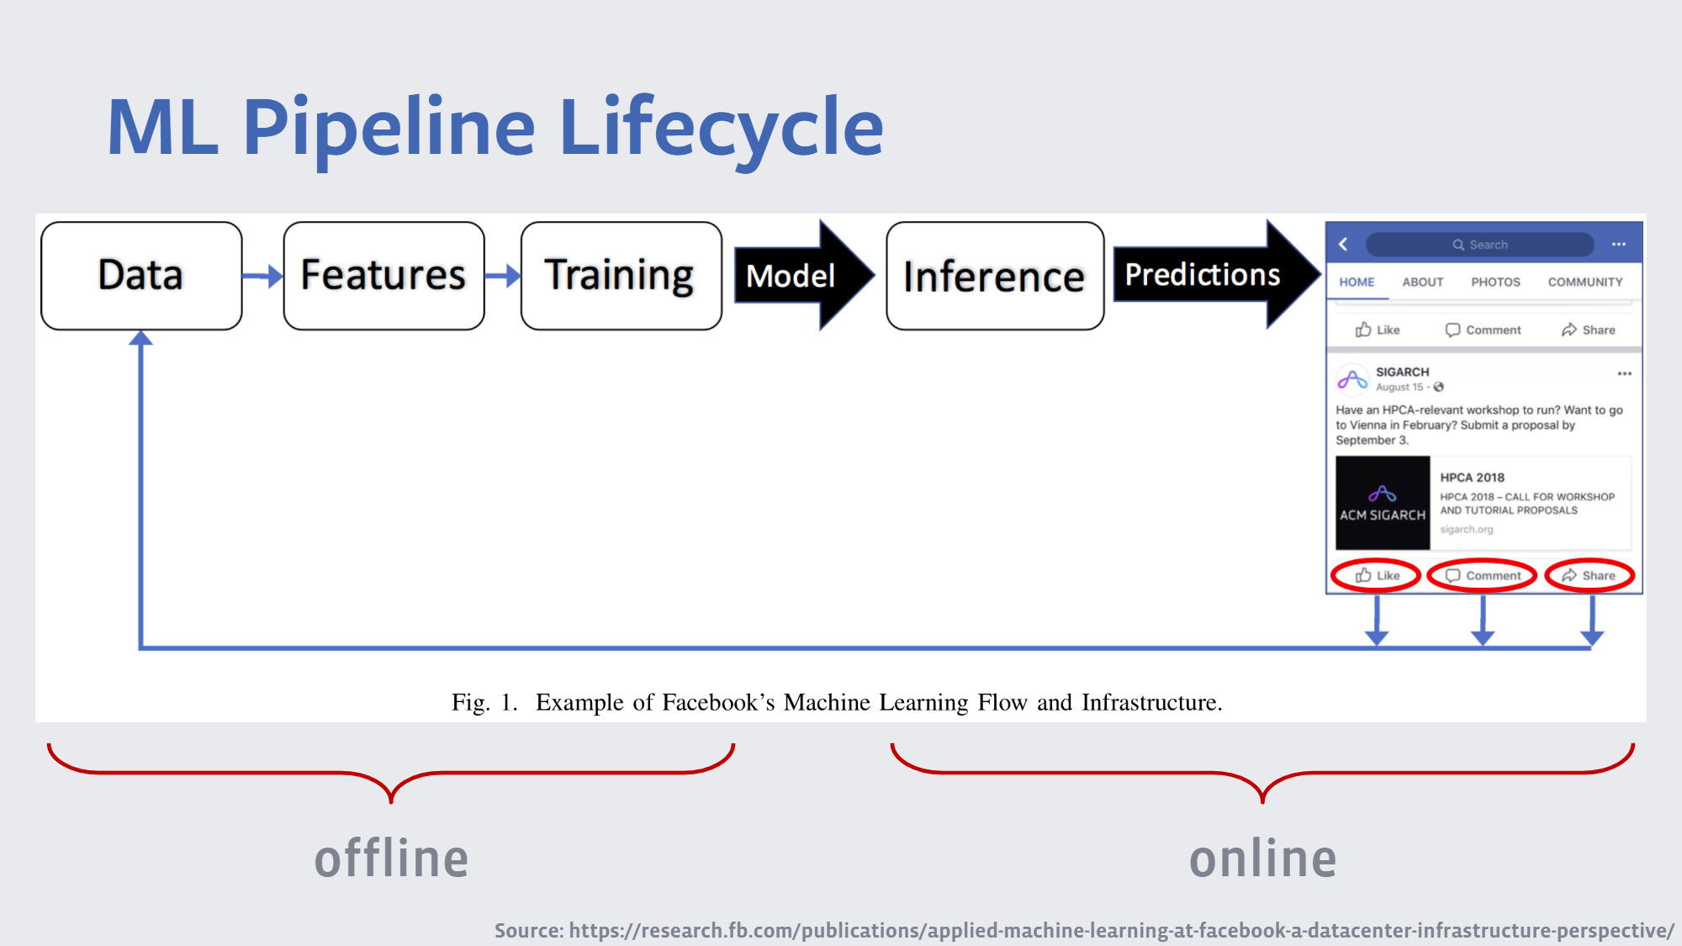

Slide 6
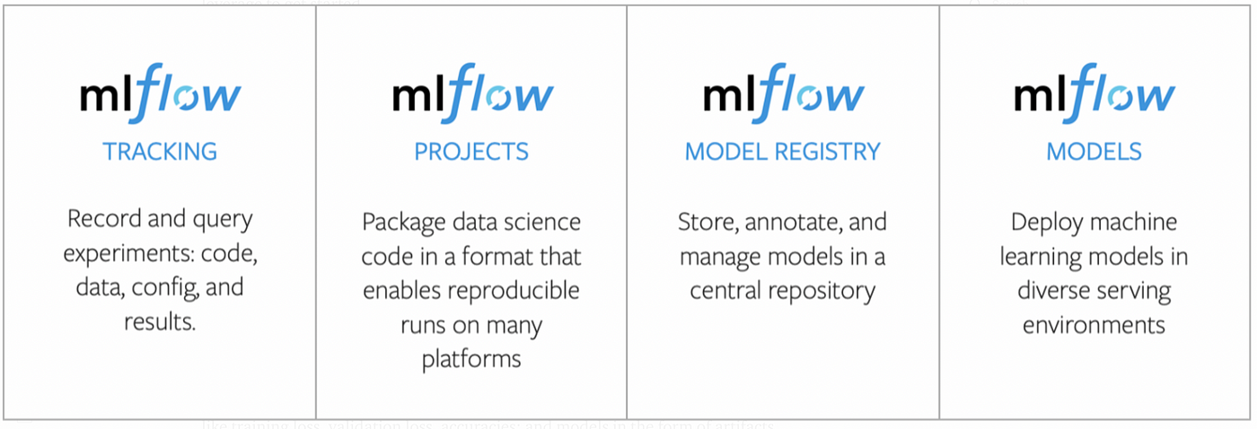
MLflow Components
Foundation

Slide 7
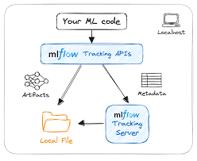
MLflow Tracking
Log parameters, metrics, artifacts, models.
UI for comparing experiments.
REST API, CLI, Python SDK.

Slide 8
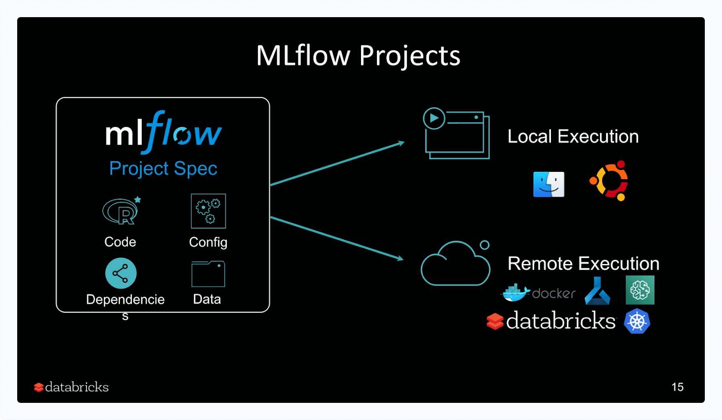
MLflow Projects
Standardized packaging of ML code.
Uses MLproject file.
Supports Conda and Docker environments.

Slide 9
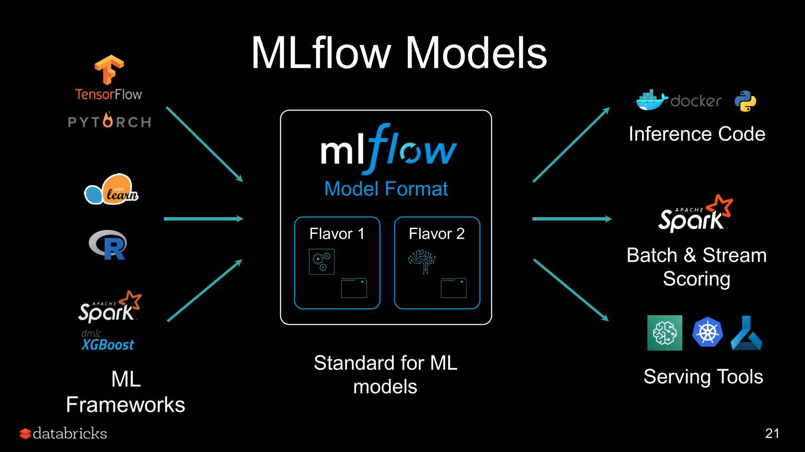
MLflow Models
Format abstraction for deployment.
Supports many ML libraries.
'Package once – deploy anywhere'.

Slide 10
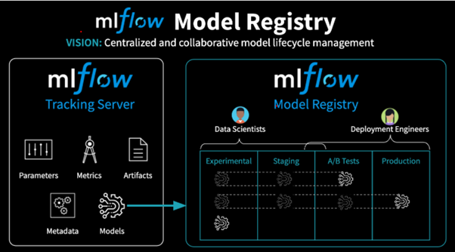
MLflow Model Registry
Central store for models.
Model versioning, approval stages, CI/CD integration

Slide 11
Does MLflow Require a Database?
MLflow can use a database—but it's not strictly required for basic use. By default, MLflow uses a local file system to store experiment metadata and artifacts. However, for team collaboration, centralized tracking, and scalability, integrating a backend database like MySQL, PostgreSQL, or SQLite is strongly recommended. This allows multiple users to track experiments, share results, and manage models in a consistent way across environments.

Slide 12
Integrations
ML Libraries & Frameworks:
Scikit-learn, TensorFlow,
PyTorch, XGBoost, and more.
Data & Storage:
Amazon S3, Azure Blob Storage,
Google Cloud Storage, or local file systems.
CI/CD Workflow Tools:
GitHub Actions, Jenkins, Airflow, and Kubeflow
Model Serving & Deployment:
Docker, Kubernetes, Azure ML, SageMaker, and Databrick,
Rest API
Visualization & Monitoring:
TensorBoard, Prometheus,
and Grafana

Slide 13
Architecture
Tracking Server – Logs and queries experiments.
UI – Web interface to visualize runs and metrics.
Artifact Store – Stores models, datasets, and output files (e.g., S3, GCS, local).
Backend Store – Stores metadata (e.g., SQLite, MySQL, PostgreSQL).
Can be self-hosted or used via managed platforms (e.g., Databricks, Azure ML).

Slide 14
With or Without
Without MLflow | With MLflow
Manual tracking with notebooks/files. | Centralized and automatic tracking.
Hard to reproduce. | Easier debugging and comparison.
Difficult collaboration. | Improved collaboration.
With MLflow: Organized, Reproducible, Scalable
Without it: Chaos in Experiments.

Slide 15
Benefits vs Challenges
Reproducibility | Hosting infrastructure
Comparison of experiments | Learning curve
Integration with CI/CD | Not a full MLOps solution alone

Slide 16
Real-World Usage
Used by:
Databricks - Creators of MLflow; use it as a core part of their ML platform.
Airbnb - Uses MLflow to standardize model tracking across teams
Microsoft - Integrates MLflow with Azure Machine Learning to provide flexible experiment tracking and model deployment.
Facebook - Applies MLflow in internal workflows to streamline model development and deployment
Example – Finance: Used to manage experiments for fraud detection, credit scoring, and algorithmic trading.

Slide 17
When NOT to Use
Small projects
Simple experimentation
No need for reproducibility

Slide 18
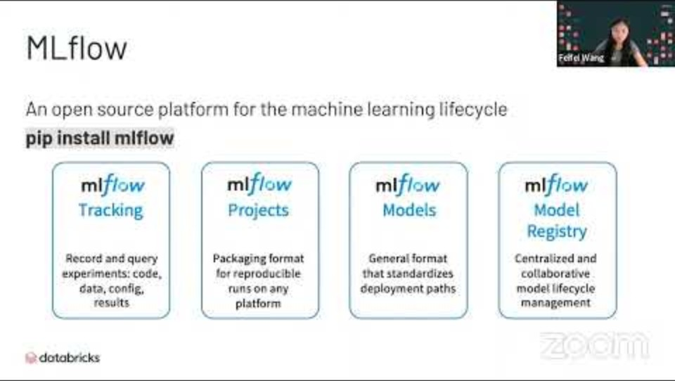
Resources

Slide 19
Resources
• https://mlflow.org
• GitHub: https://github.com/mlflow/mlflow
• Docs, tutorials, examples

Slide 20
THANK YOU

