Slide 1
ROUTING AN EXPRESS APP

Slide 2




Team Members
PRADEEPKUMAR THEEGALA | RAGHAVENDAR REDDY MADDELAVEDU | NIKITHA LAKMARAPU | BHAVANI PATHURI

Slide 3
Table Of Contents
Overview
Flow of data and things
Defining Routing
Route parameters
Routing in middle ware

Slide 4
Overview
On the top of Node we use Express app which is web framework.
Routing refers to how an application responds for client request to particular resource.
Notes:
https://expressjs.com/en/starter/basic-routing.html

Slide 5
Routing
Express router is a class which helps us to create router handlers.
By router handlers we can provide routing to our application
Routing can also extend this routing to handle validation, handle 404, or other errors etc.

Slide 6
Controllers to route requests
Routes to forward the supported requests to appropriate controller functions.
Controller functions to get the requested data from the models.
Views used by the controllers to render the data

Slide 7
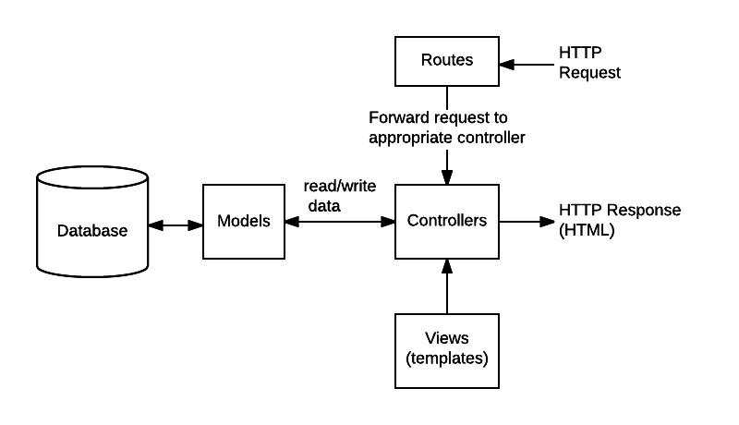
Flow of data and things
https://developer.mozilla.org/en-US/docs/Learn/Server-side/Express_Nodejs/routes
Notes:
https://developer.mozilla.org/en-US/docs/Learn/Server-side/Express_Nodejs/routes

Slide 8
Syntax for routing
Routing contains HTTP verb (GET, POST, PUT, DELETE..) and a function that is handle the pattern.
app.Method(PATH, HANDLER)
app is an instance of express.
Method is an HTTP request method
PATH is a path on the server
HANDLER is a callback function which is executed when specified routes are matched.

Slide 9
HTTP Verbs
A route is a section of express code that associates an HTTP verb
app.get(): This method is to respond to HTTP Get request with a certain path.
Other mostly used route methods:
app.put()
app.post()
app.delete()

Slide 10
Route paths
Route path defines the endpoint where requests are made.
Paths can also string patterns

Slide 11
Defining Separate route modules
const express = require('express')
const app = express()
app.get('/', (req, res) => {
res.send('hello world’)
})
// About page route.
router.get('/about', function (req, res) {
res.send('About this wiki');
})
Notes:
https://expressjs.com/en/guide/routing.html

Slide 12
Callback Functions
The callback function has three parameters
HTTP Request Object
HTTP Response
Next function

Slide 13
Route parameters
Route parameters are named URL segments used to capture values specified in URL.
The named segments are prefixed with a colon followed by name
E.g /:parameterName/
Captured values are stored in req.params object
E.g req.params.parameterName

Slide 14
Routing parameter example
app.get('/user/:id', (req, res) =>{
res.send(req.params.id )
})
app.get(‘/user/:year/:id’, (req,res) =>{
res.send(req.params)
})
app.listen(3000, function () { console.log('Example app listening on port 3000!') })

Slide 15
Citation
https://developer.mozilla.org/en-US/docs/Learn/Server-side/Express_Nodejs/routes
https://expressjs.com/en/guide/routing.html

Slide 16
Thank You

