Slide 1
SHU ASE Group 12 2025
Haris Mahmood, Laurence Layland, Alex SURNAME, Theo SURNAME

Slide 2
Introduction
Team member introductions
Product goal

Slide 3
Project planning and management
Project organisation
Formative feedback

Slide 4
Requirements and design
UCD
ERD
SD
C4
Technology stack
Early development

Slide 5
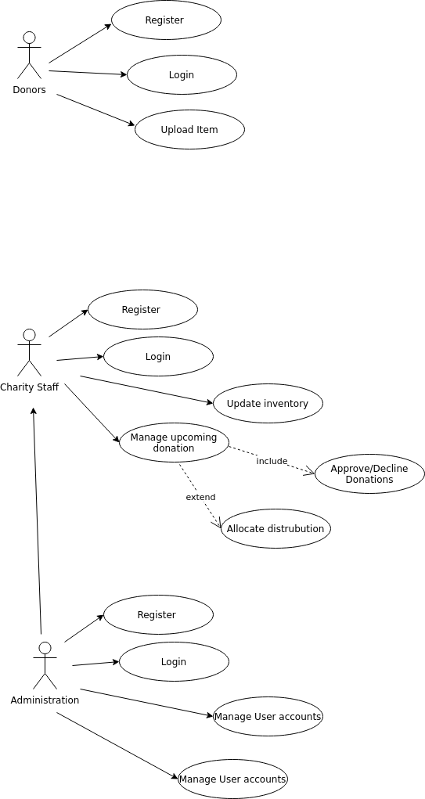
Requirements and design - UCD

Slide 6
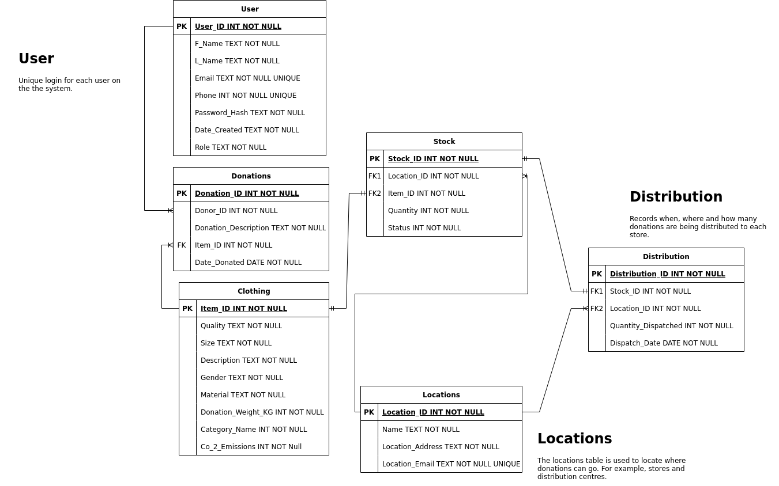
Requirements and design - ERD

Slide 7
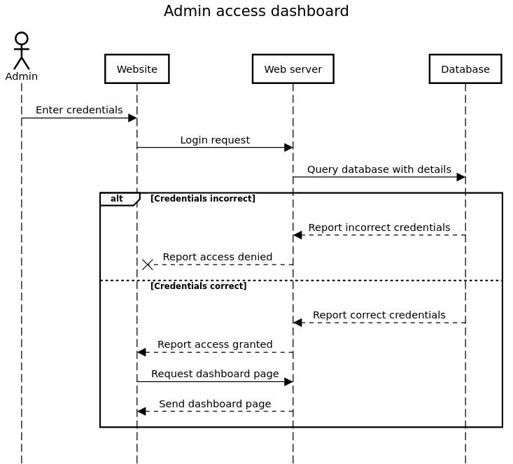
Requirements and design - SD

Slide 8
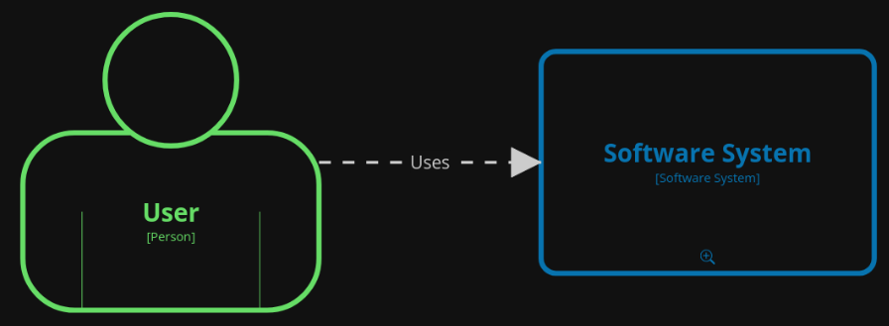
Requirements and design - C4

Slide 9
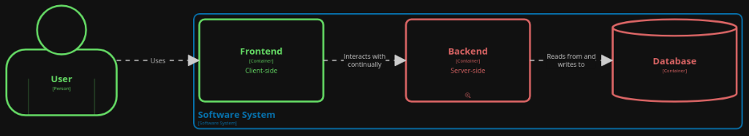
Requirements and design - C4

Slide 10
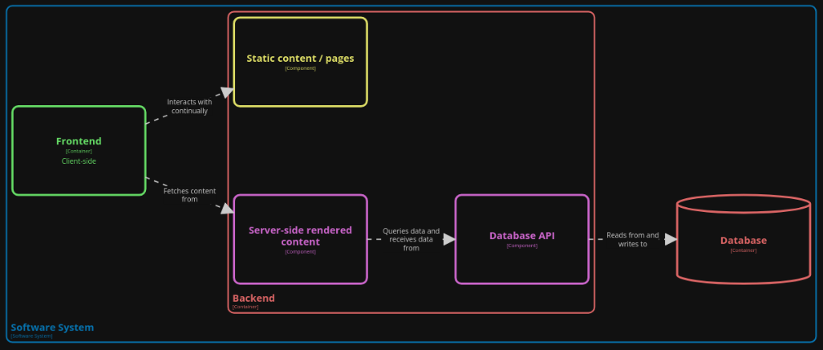
Requirements and design - C4

Slide 11
Requirements and design
UCD
ERD
SD
C4
Technology stack
Early development

Slide 12
Prototype demonstration

Slide 13
Testing
Testing process and methods

Slide 14
Reflections on LSEPI

Slide 15
Group reflection and collaboration

