Slide 1


STUDENT-MANIA
Discord for Students
By
Jack Haugh G00359747
Kevin Flanagan G00228079
Stephen Gallagher G00314689

Slide 2

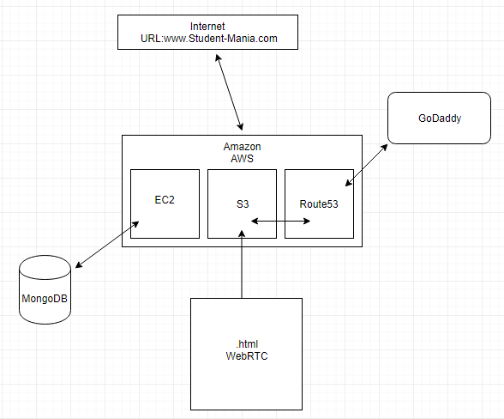







AWS CLOUD WEB SERVICES
EC2
VIRTUAL MACHINE
S3
BUCKET STORING WEBSITE
ROUTE - 53

Slide 3

ARCHITECTURE
CREATE A CLUSTER

Slide 4
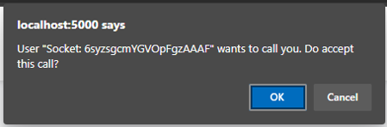
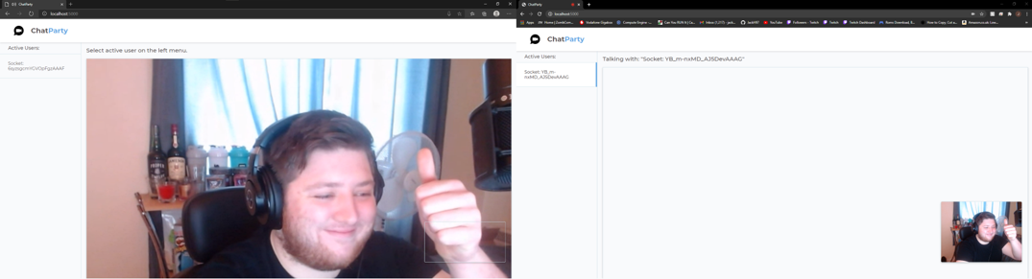
Video and audio – Web RTC

Slide 5
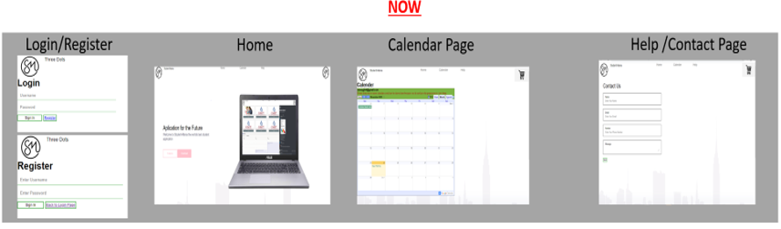
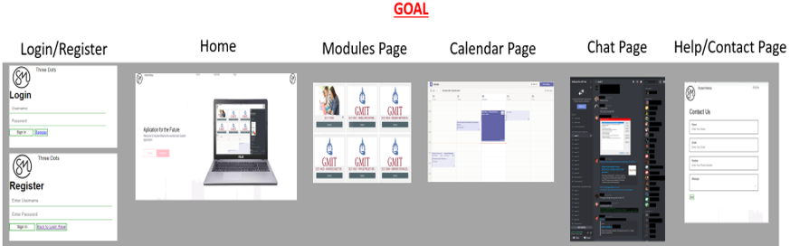
Semester 2 /Future Goals
Login – functioning login
Modules for student – students having there own section for each of there modules
Chatbox – Getting communication between users in real time
Video- allowing users to be able to Video call one another
Link to Website: http://www.student-mania.com/

