Slide 1


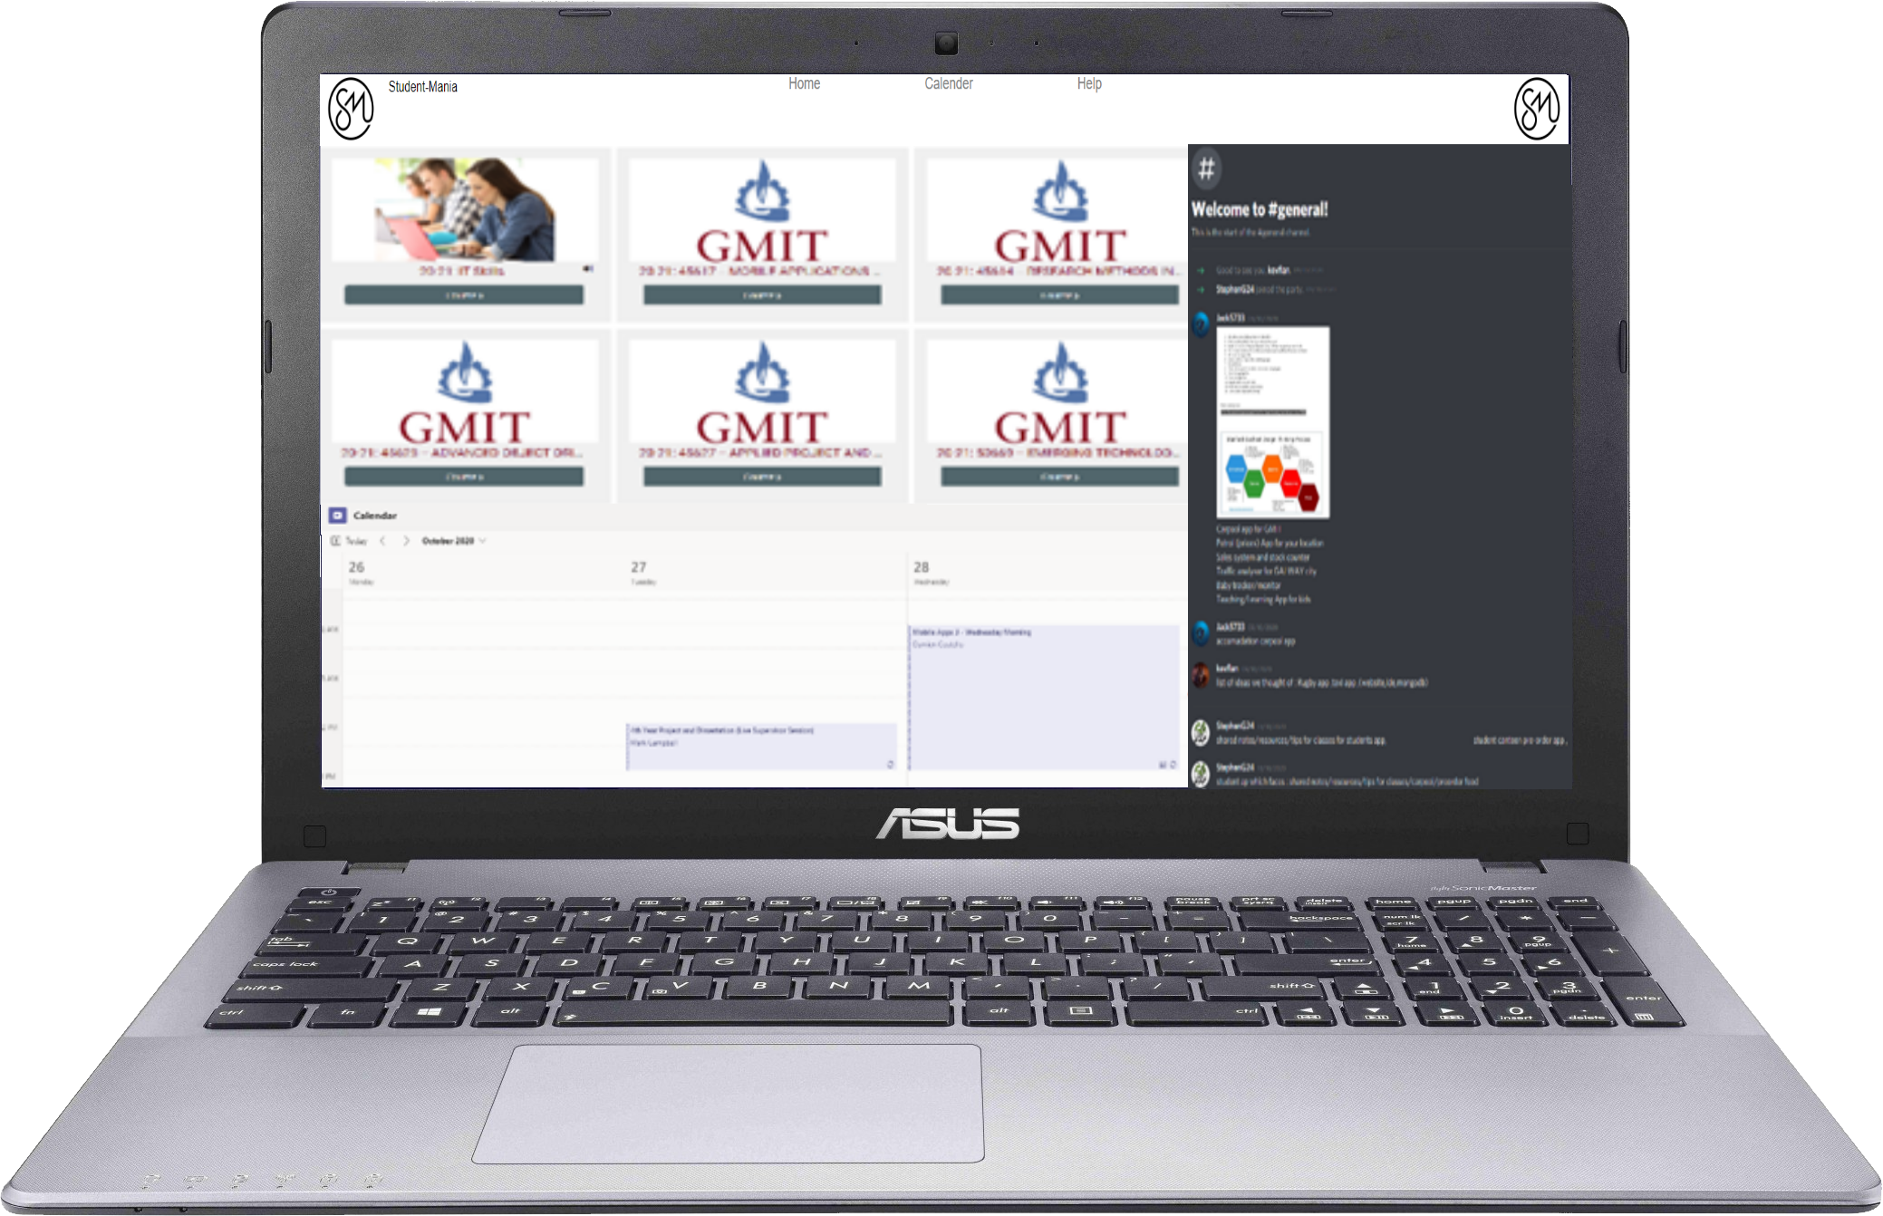
STUDENT-MANIA
Discord for Students
By
Jack Haugh G00359747
Kevin Flanagan G00228079
Stephen Gallagher G00314689

Slide 2

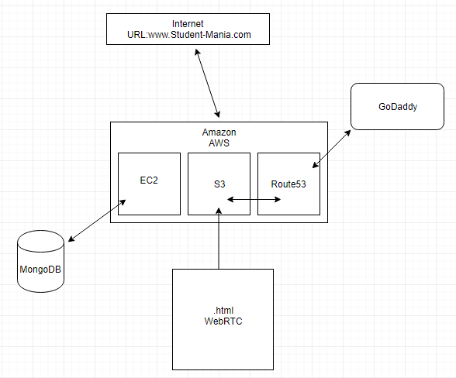







AWS CLOUD WEB SERVICES
EC2
VIRTUAL MACHINE
S3
BUCKET STORING WEBSITE
ROUTE - 53

Slide 3




MongoDB
MongoDB
Scalability & Performance
Strong Consistency
Flexibility
Lyft
Twitter
Stack

Slide 4
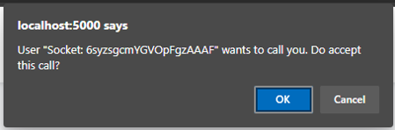

Video and audio – Web RTC

Slide 5
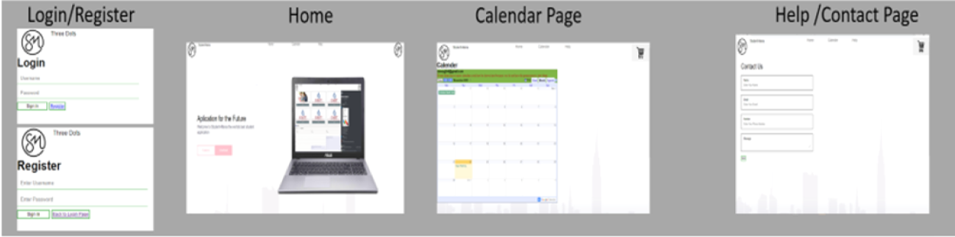
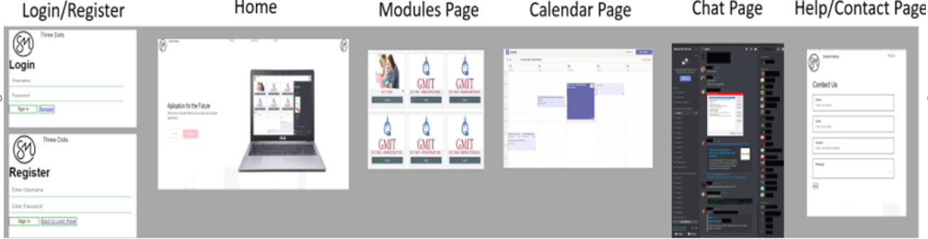
Semester 2 /Future Goals
Link to Website: http://www.student-mania.com/
NOW :
GOALS :

