Slide 1
CSC741 Digital Image Processing Presentation 5
Jessica Gallo & Alex Liew

Slide 2
Assignment
Part 1
Generate and add 4 different nosie (including Gaussian, salt and pepper(impulse) noise to 3 images.
Estimate noise parameters from a single image
Apply a class of mean (Arithmetic, weighted, geometric and harmonic)
Part 2
Implement an adaptive local noise reduction filter using the following formulas
Implement an image sharpening method (Arithmetic, weighted, geometric and harmonic)
Explain the major differences between your result

Slide 3
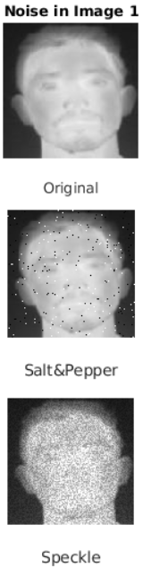
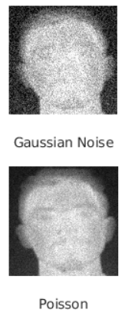

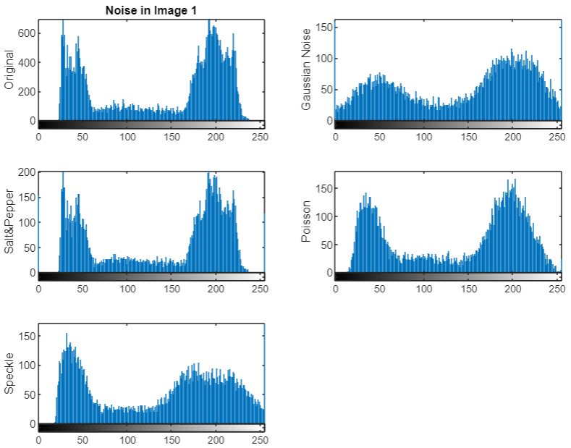


Image 1 Noise (Part 1)
Gaussian: mean = 0
variance = 0.02
Salt & Pepper:
density = 0.02
Speckle:
mean = 0
variance: 0.02
Poisson:
mean = intensity values of image

Slide 4
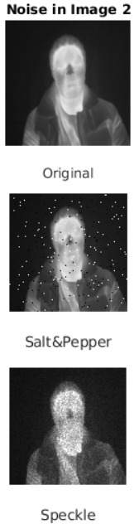
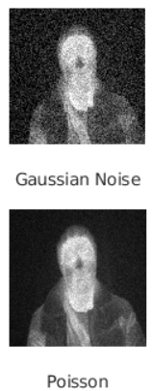
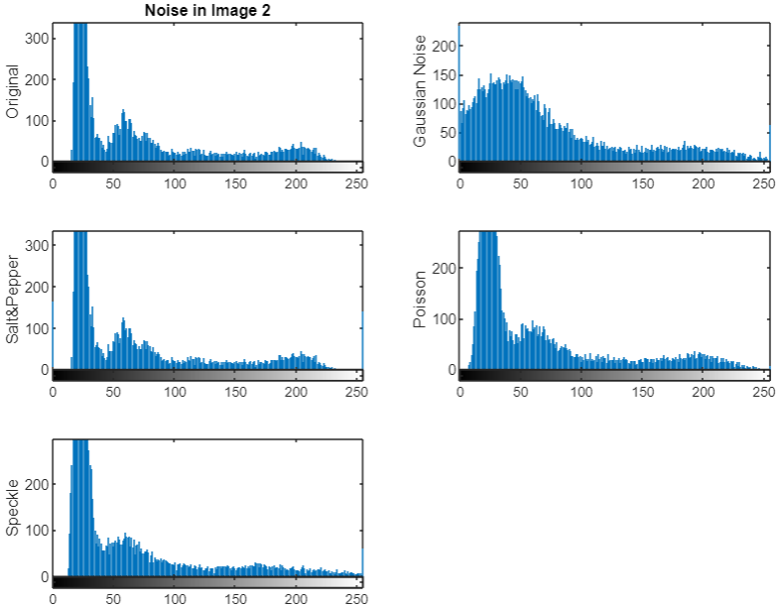
Image 2 Noise (Part 1)
Gaussian: mean = 0
variance = 0.02
Salt & Pepper:
density = 0.02
Speckle:
mean = 0
variance: 0.02
Poisson:
mean = intensity values of image

Slide 5
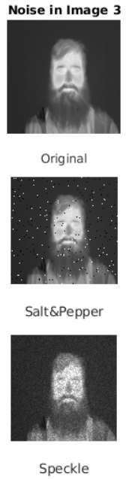
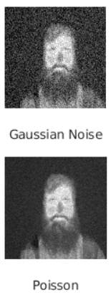
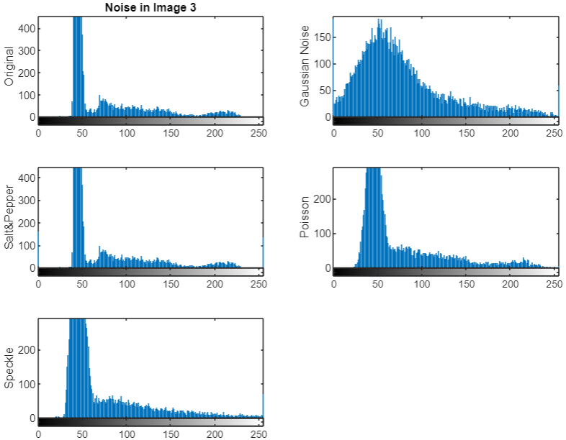
Image 3 Noise (Part 1)
Gaussian: mean = 0
variance = 0.02
Salt & Pepper:
density = 0.02
Speckle:
mean = 0
variance: 0.02
Poisson:
mean = intensity values of image

Slide 6
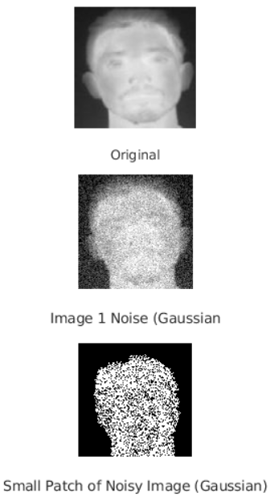
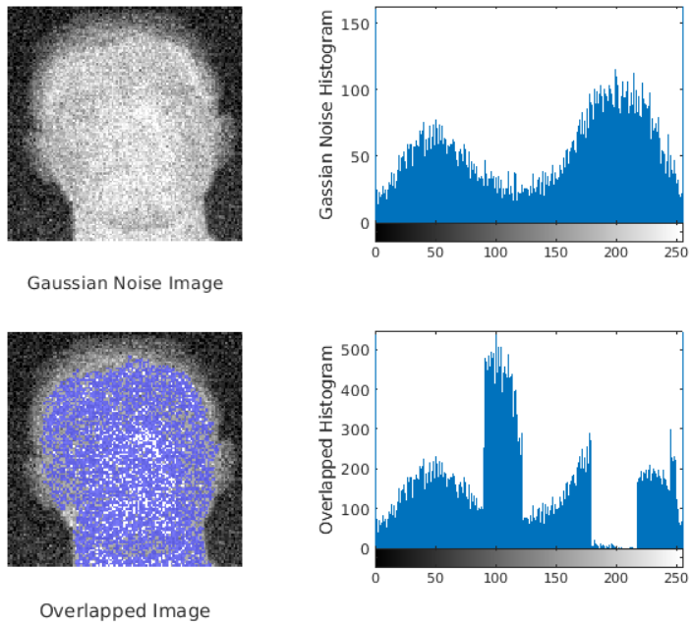

Estimate Noise Parameters (Part 2)
Segment a small patch of image with constant grey level

Slide 7
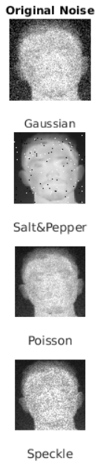
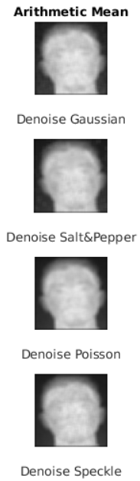
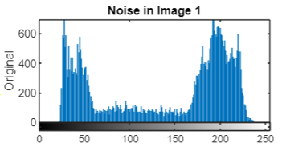
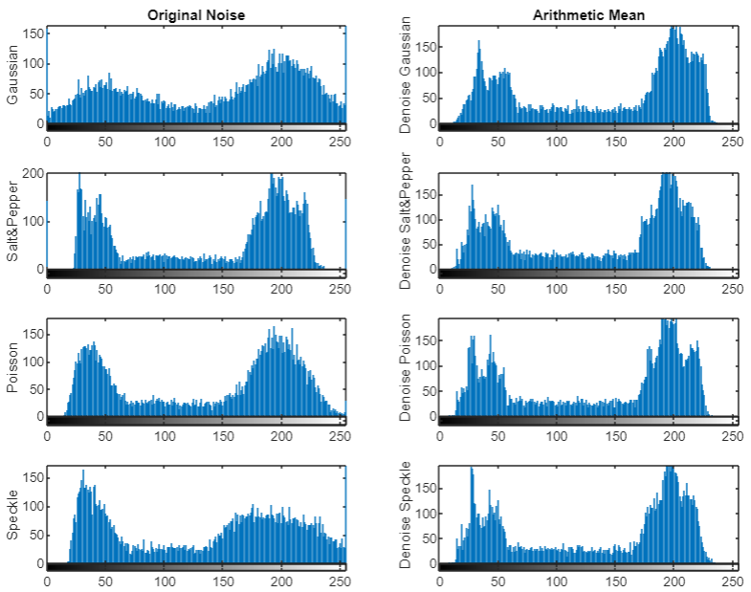
Arithmetic Mean (Part 3)
Best Result

Slide 8
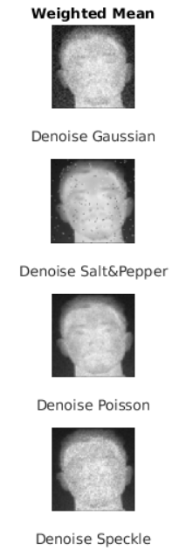
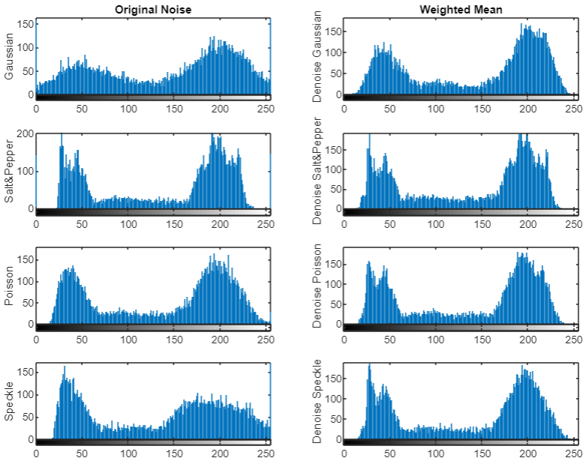
Weighted Mean
Best Result

Slide 9
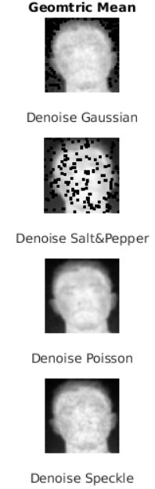

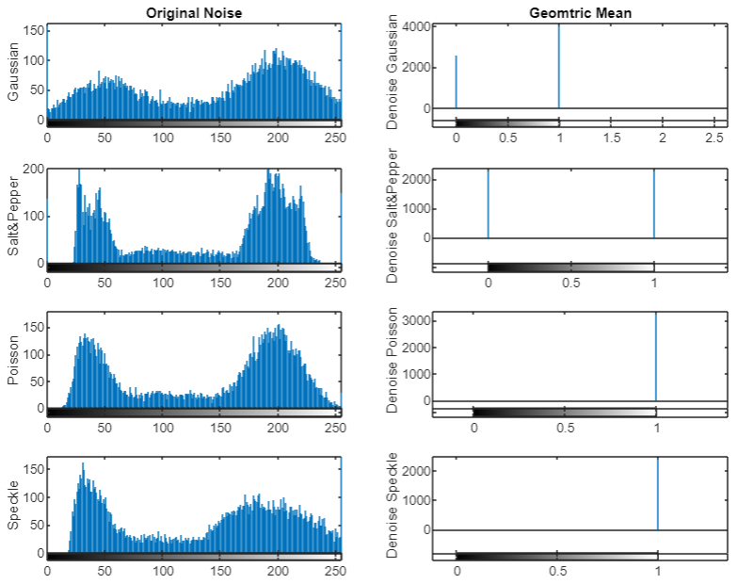
Geometric Mean
Best Result

Slide 10
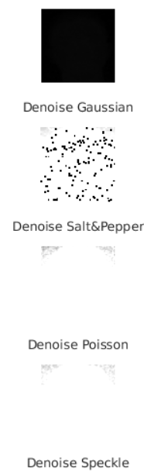
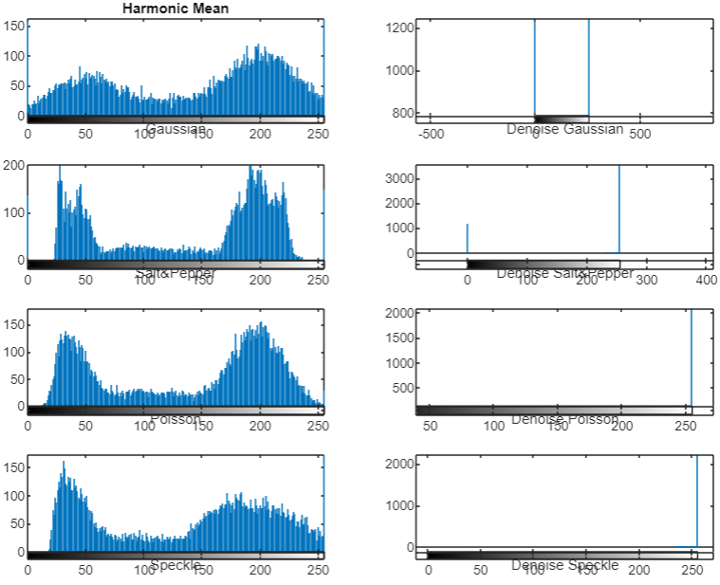
Harmonic Mean

Slide 11
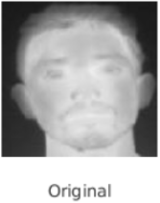
Comparison

