Slide 1

Exploratory Data Analysis
Go to Market Strategy for Insight for
Cab Investment Firm
08/20/2022

Slide 2

Agenda
Executive Summary
Problem Statement
Approach
EDA
EDA Summary
Recommendations

Slide 3
Executive Summary
The private firm XYZ would like to invest in the cab industry and need our Go-to-Market strategy to understand the market.
We used our expertise in data preparation and data analysis to find what cab company XYZ should invest in based on the data of the two companies.
Our data analysis will give XYZ the best understanding of the market and will help decide which cab company to invest in.

Slide 4
Problem Statement
There is remarkable growth in the cab industry and there are a lot of investors already in the cab investment market. The private firm XYZ would like to be apart of this investment as well.
They want our extensive knowledge and abilities in data analysis to understand the data about two cab companies for them to invest.
Both cab companies service a generous amount of people, but e need to compare performance and favorability. We need to help XYZ find the best investment based on the this data

Slide 5
Approach
We took in all the data collected from the two cab companies
Data Cleaning: cleaned the data by filling in all missing values and making sure all data was correctly inputted.
Data Preprocessing: joined the separated data form separate files into one dataset
Feature Engineering: added data based on data already given, such as will the date of the transaction we were able to separate out that data into three separate features (day, month, year)
Data Visualization: used various plotting methods to view the data in different ways to better understand the performance of each company

Slide 6
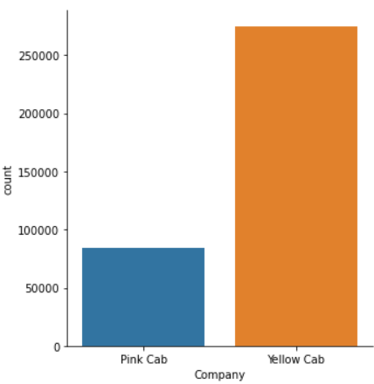
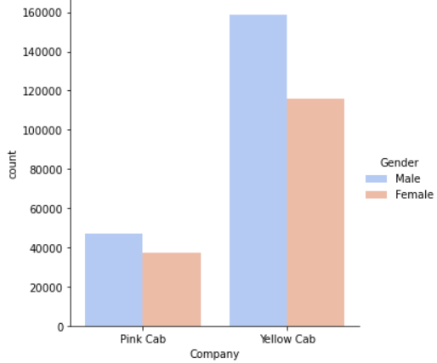
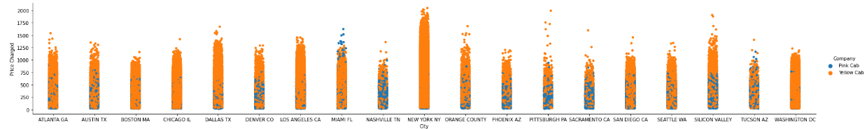
Exploratory Data Analysis (EDA)

Slide 7
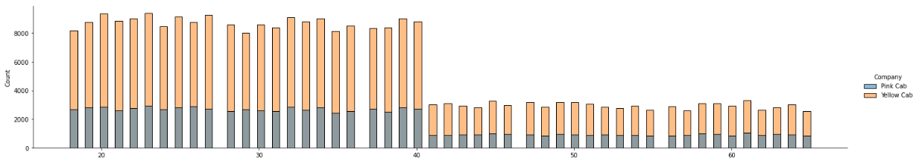
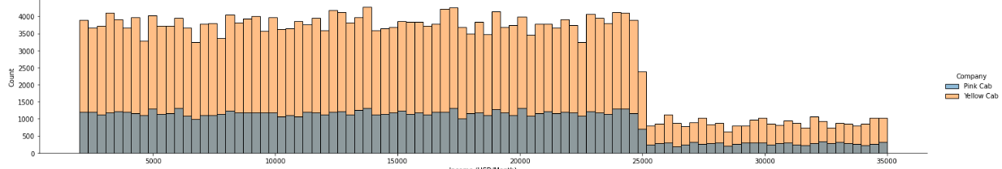

Slide 8
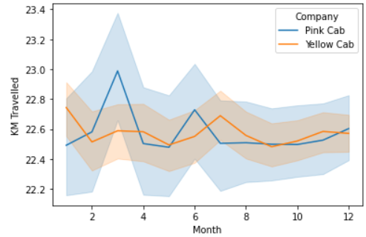
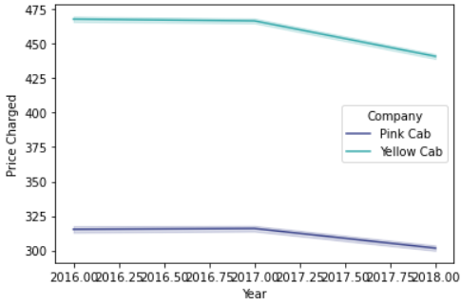
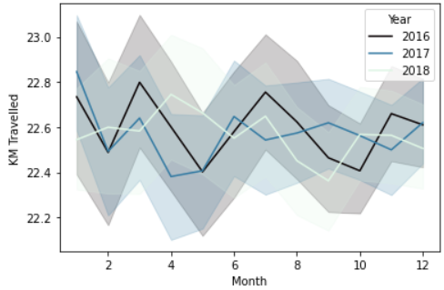
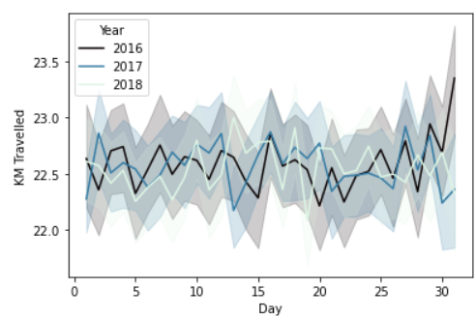

Slide 9
EDA Summary
There is a significantly larger amount of people using the Yellow Cab (about 270000) than the Pink Cab (90000).
More males than females use both cab companies, however there is a larger difference in male vs female usage in the Yellow Cab.
The top 5 cities for cab usage are NYC, Chicago, LA, Washington and Boston, respectively.
NYC has the highest price charge, along with Dallas and Silicon Valley
The Yellow Cab company has much higher rates in general throughout each city.
The Pink cab has higher prices in Miami and Tucson AZ.
The Yellow Cab has most business in NYC, Dallas, Chicago, and Washington.

Slide 10
EDA Summary (Cont.)
The Yellow Cab has control over NYC, LA, Chicago, Boston, Washington, San Diego, Atlanta, Austin, Miami, Seattle Silicon Valley and Seattle. Which means they have dominance in the majority of the cities.
The Pink Cab has control of Nashville, Phoenix, Pittsburgh, Sacramento and Denver.
Both companies have higher users from younger age brackets (20-40 range)
The Yellow Cab has a more steady month-by-month travel distance, but spikes in July.
The Pink Cab has spikes in travel distance during March and June.
Prices charged went down through the three years for both companies
For both companies, there are more people suing cabs from lower income bracket than higher income bracket. The dip in who uses cabs starts at $25000/Month Incomes

Slide 11
Recommendations
Based on the data given and with our expert data analysis, we can recommend that the Yellow Cab company is the better business to invest in.
The Yellow Cab company has:
A better more extensive hold on the market, especially in major cities like NYC and LA
Higher prices and more clients, which means more revenue
A larger range of people using the services

Slide 12
Thank You

