Slide 1
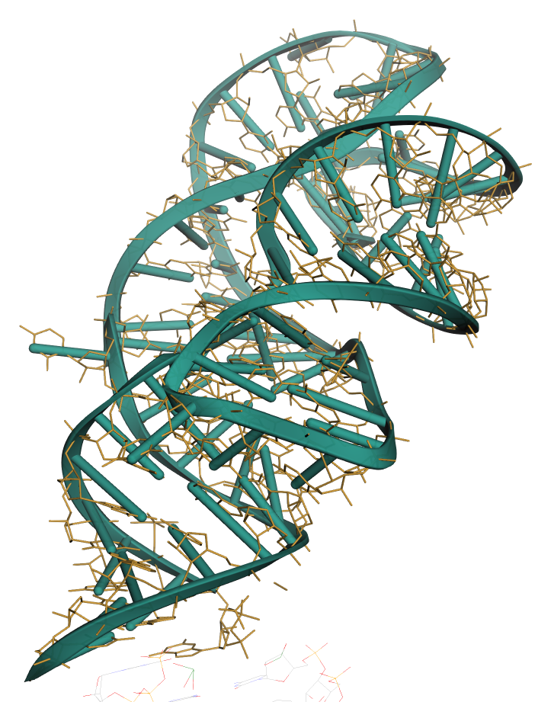
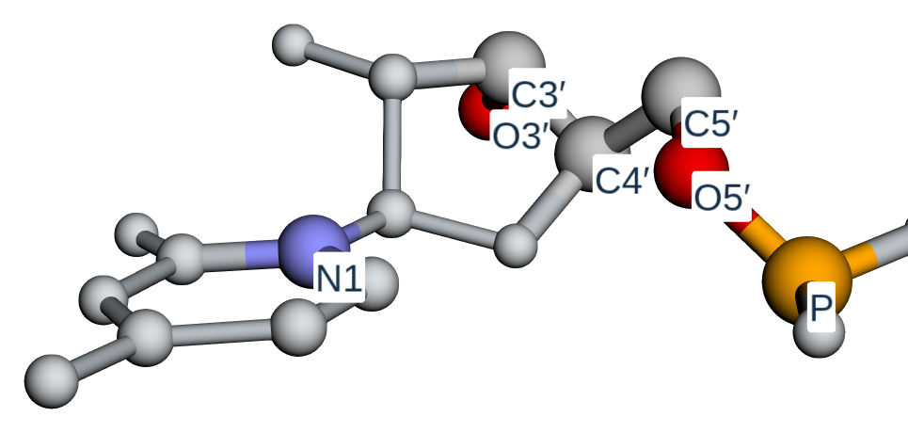
a
RNA tertiary structure
k = 32 nearest-neighbour residue graph
Task-specific readouts
A
C
Nucleotide identity
G
U
4-class probabilities · confidence
Base-pair state
classification
935 geometric descriptors per residue
Base stacking
classification
247 node
688 edge-derived
Secondary-structure class
seven-atom model input
θ
3-class classification
Angles
Distances
Orientations
Torsions
C1′
N
Solvent accessibility
Glycosidic
Local
Global
regression · relative SASA
+
Task-specific XGBoost
Reactivity target
P · O5′ · C5′ · C4′ · C3′ · O3′ · N1/N9
+
classification / regression
regression · RibonanzaNet
b Recovery by sequence population
c Confidence-threshold transport
temporal test
coverage
accuracy
same threshold, different population
All
64.6
90
95
81
80
Exact repeats
87.1
52
Sequence-novel
55.1
28
<80% identity
48.9
validation
repeats
non-repeats
Separate training evaluation: 70.0 family-permissive / 50.4 family-disjoint
d Evidence types for a design claim
backbone compatibility
→
forward-model consistency
→
experimental validation
native vs decoy
AF3
structure / function
not interchangeable

