Slide 1
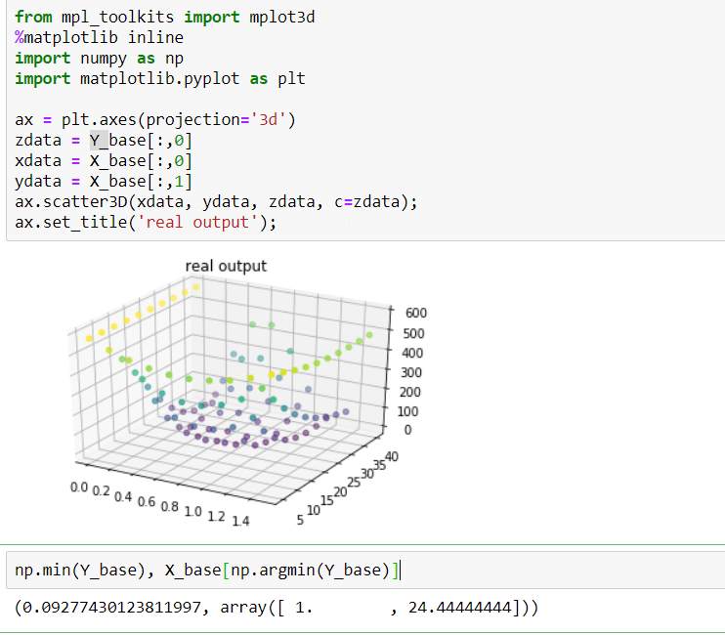
Task 1 :Bayesian optimization for an expensive function
Wenchen chen
4992024

Slide 2
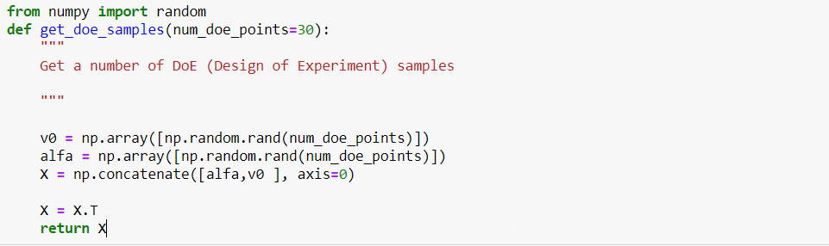
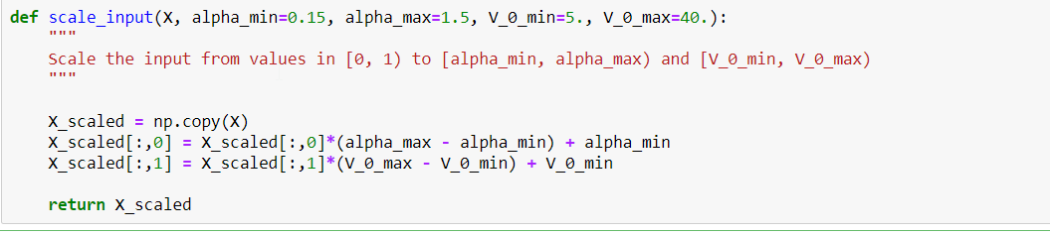
1.DOE

Slide 3
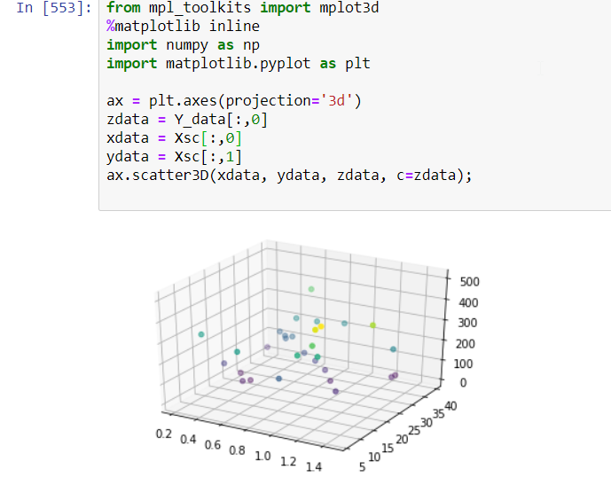
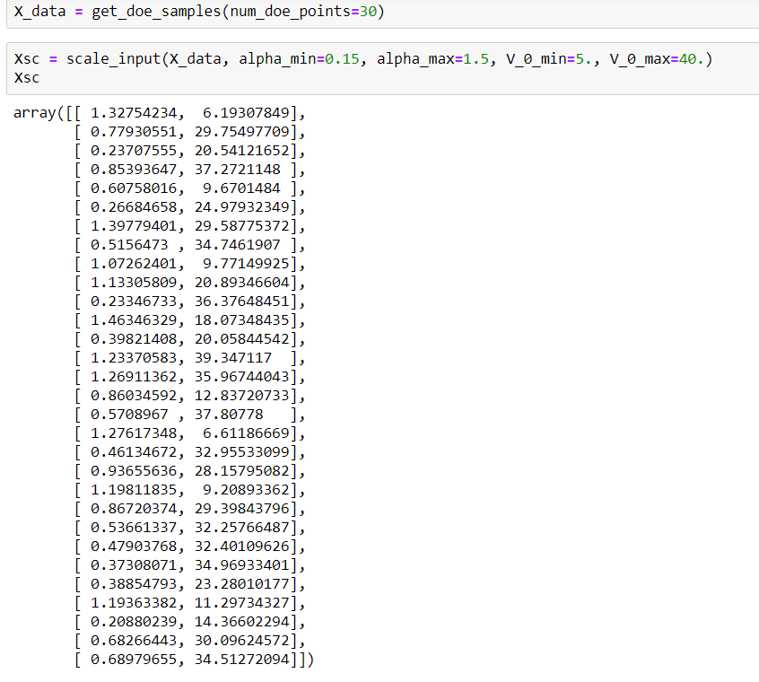
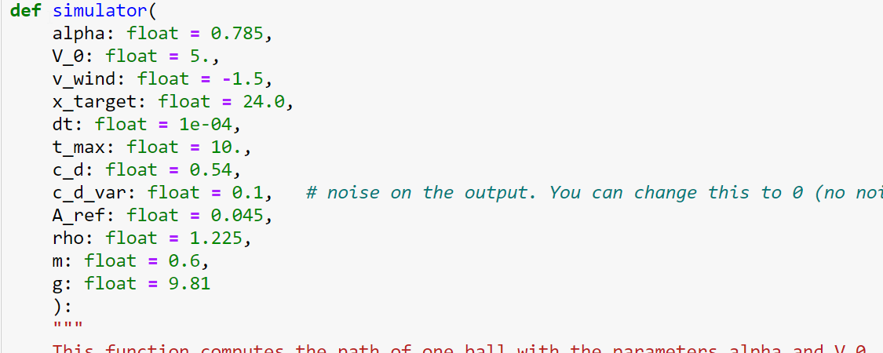
1.DOE (result)

Slide 4
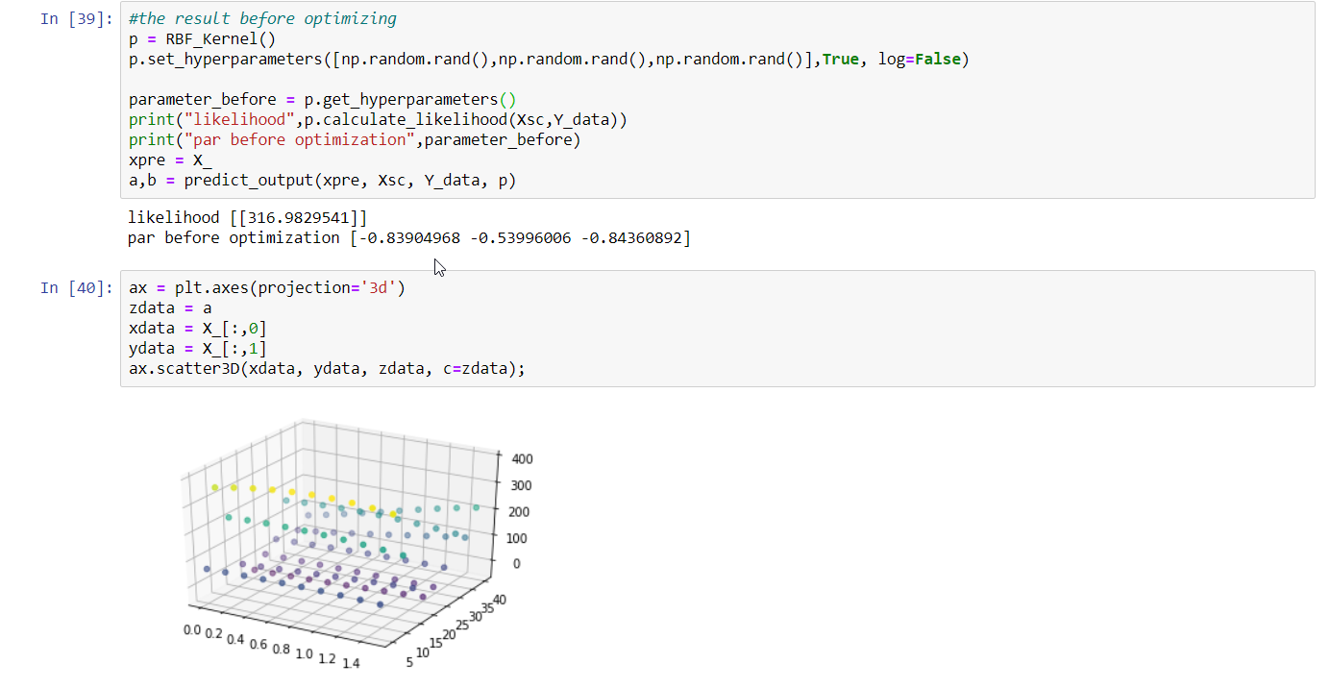
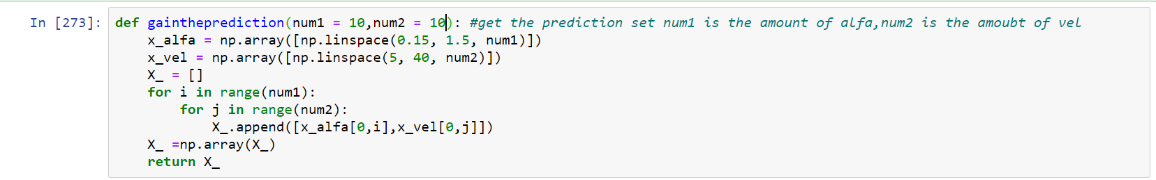
2. i.Select an arbitrary set of values on the hyperparameter 𝜃
Prediction range

Slide 5
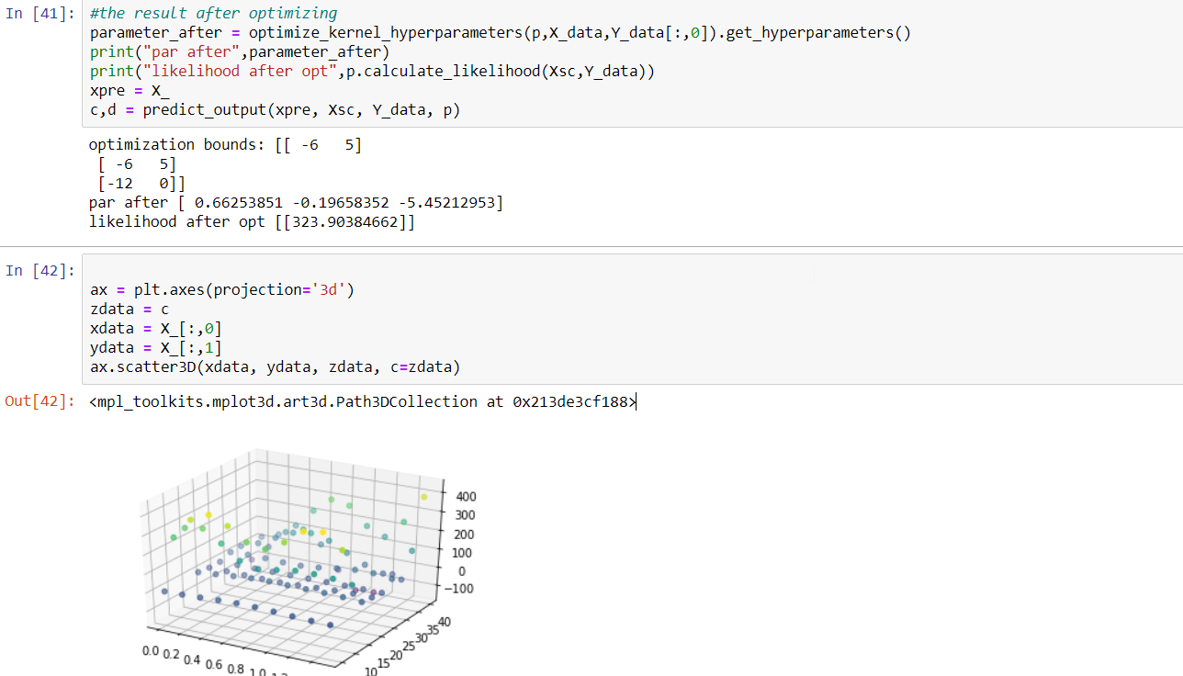
2. ii. Optimize the values of the hyperparameter 𝜽

Slide 6
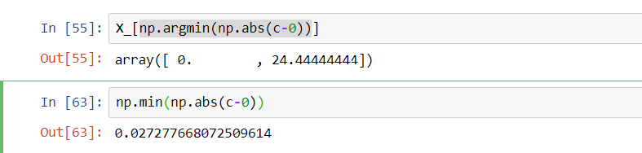
3. global minimum

Slide 7
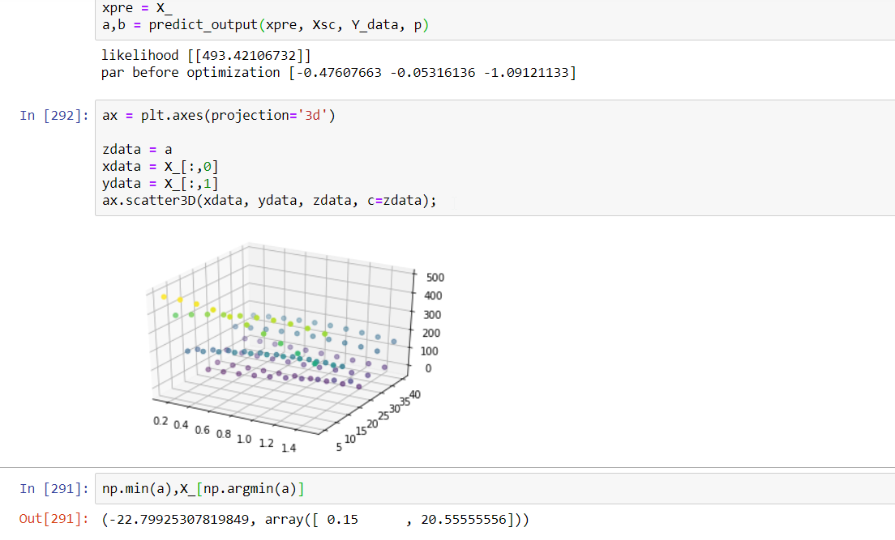
4.Improvement of accuracy
Method 1. DOE N = 50

Slide 8
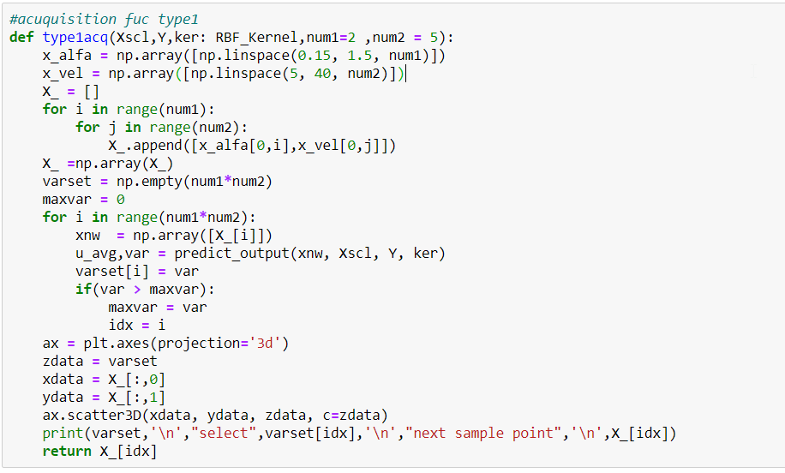

Method 2 Using acquisition function
A) type 1 acquisition function

Slide 9
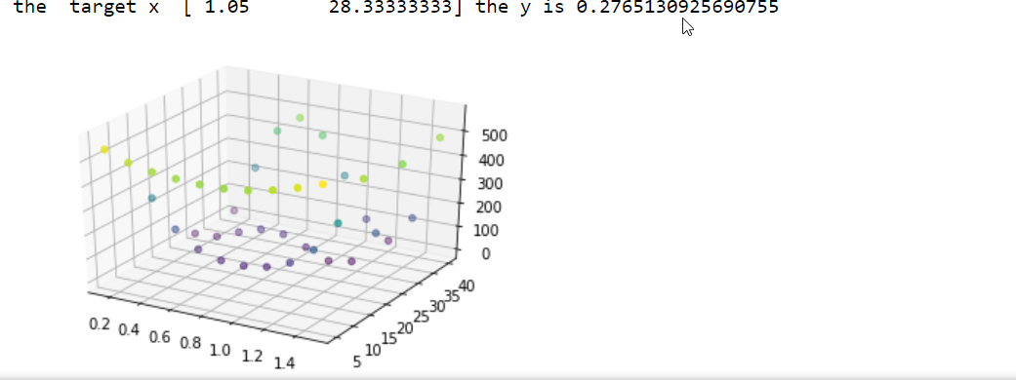
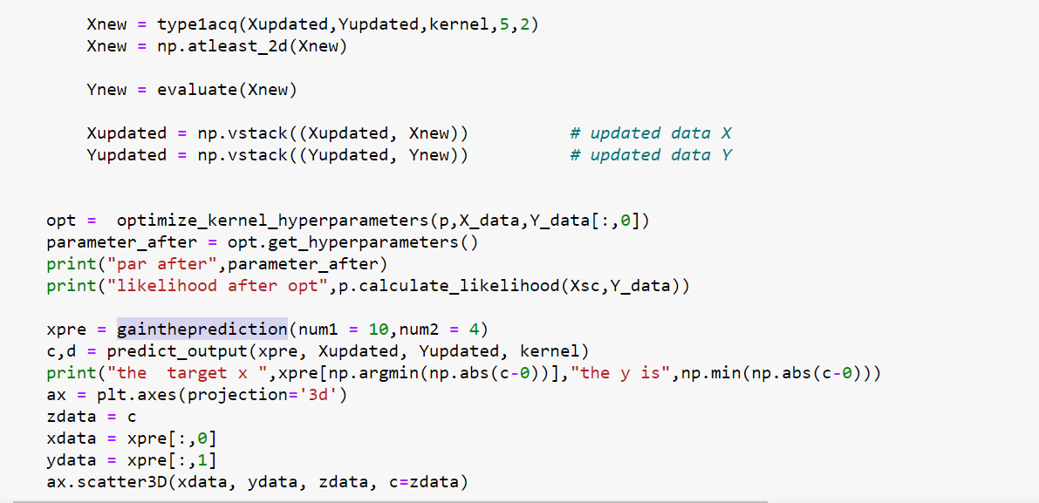
Result
40 (the 30 initial DoE + 10 by the adaptive sampling

Slide 10
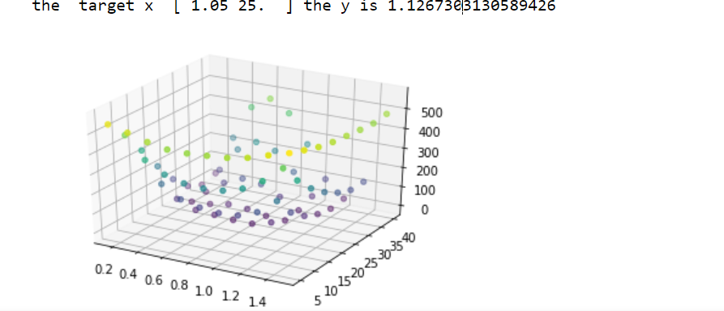
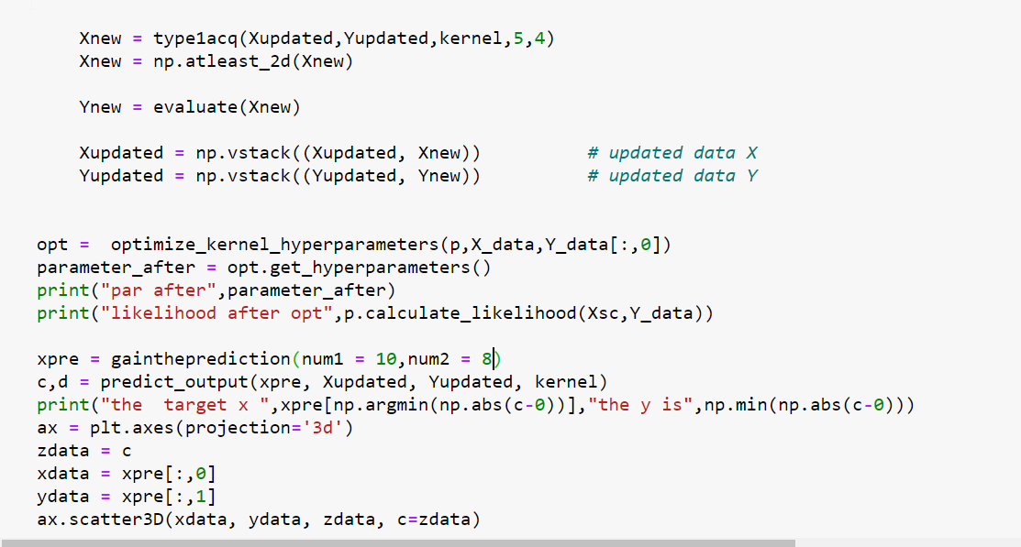
Result
50 (the 30 initial DoE + 20 by the adaptive sampling
Relative error of alfa = 0.05
Relative error of vel = 0.025
Relative error of Y = 11.44

Slide 11
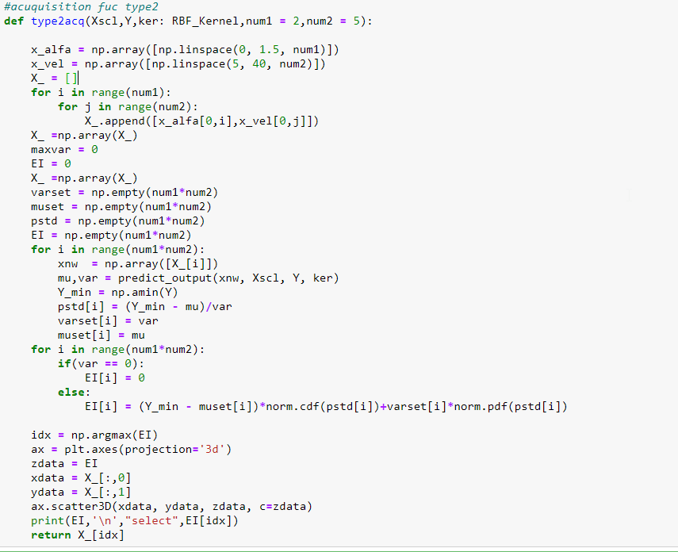
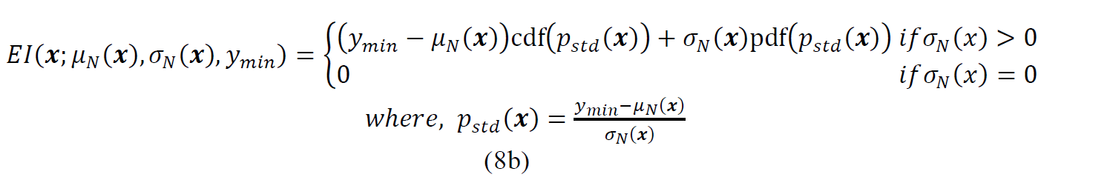
Method 2 Using acquisition function
B) type 2 acquisition function

Slide 12
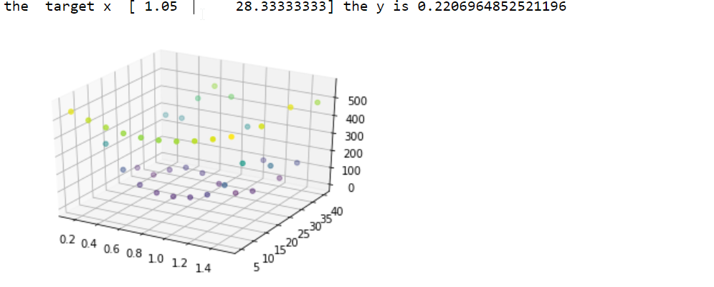
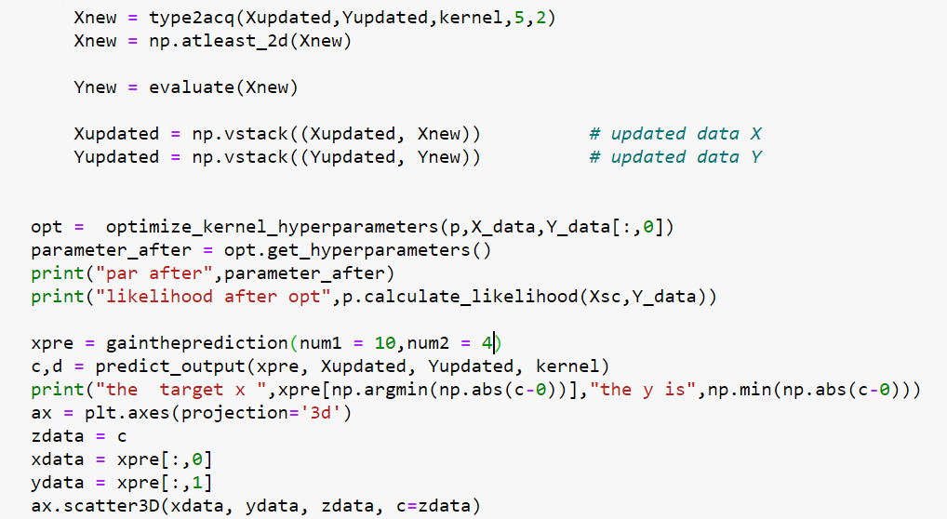
Result
40 (the 30 initial DoE + 10 by the adaptive sampling

Slide 13
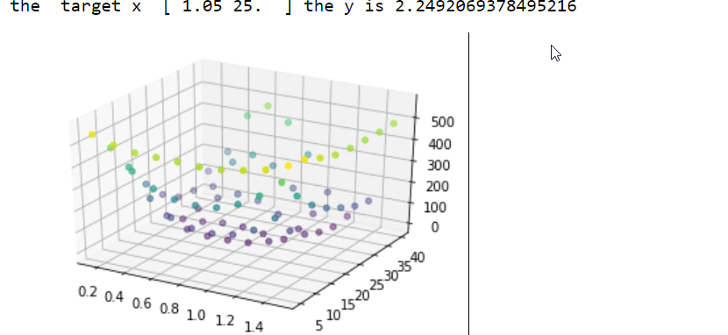
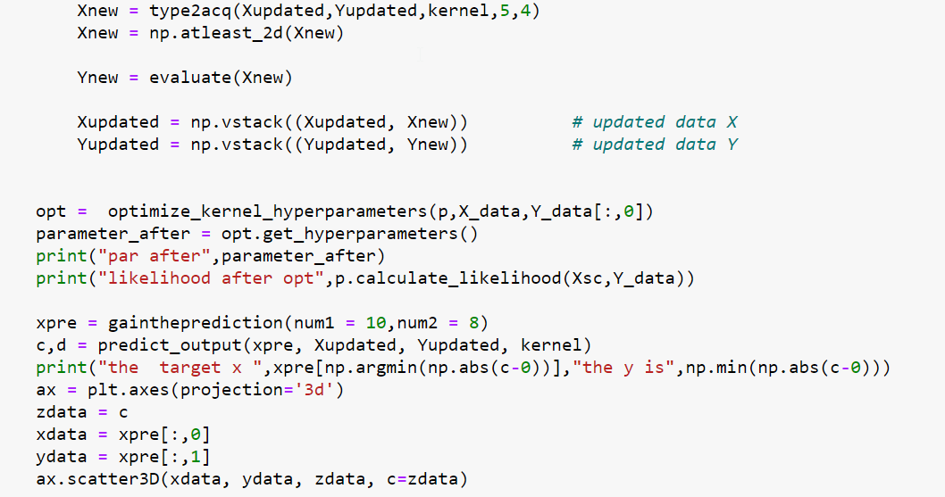
Result
50 (the 30 initial DoE + 20 by the adaptive sampling
Relative error of alfa = 0.05
Relative error of vel = 0.025
Relative error of Y = 265

Slide 14
Conclusion
Type1 acquisition is better than Type2 acquisition in this case
In order to get higher accuracy result ,more samples is much helpful

Slide 15
Task 2 :Reduction of high-dimensional output of a dataset

Slide 16
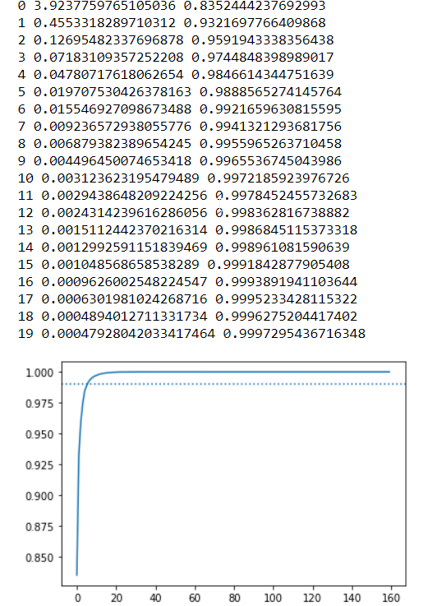
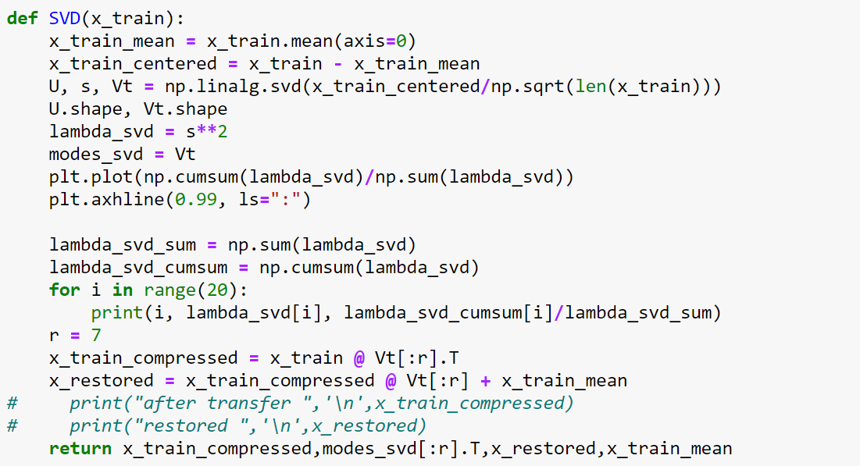
2.Choose the target dimension(7)
Energy

Slide 17
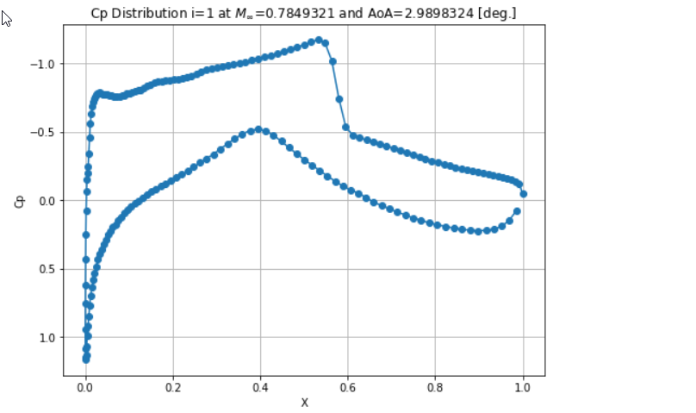
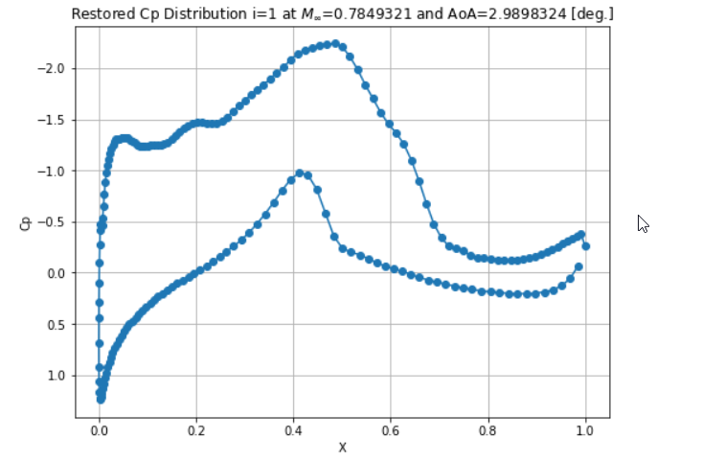
2.Restore result
Original
Restored

Slide 18
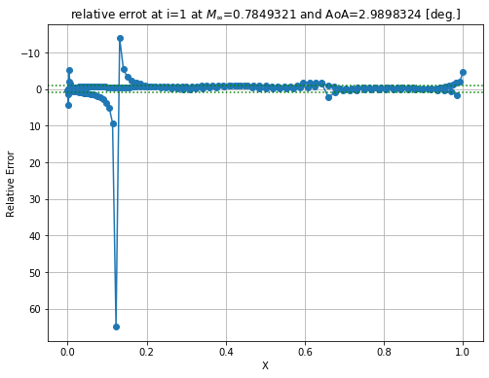
Relative error at each mesh point

Slide 19
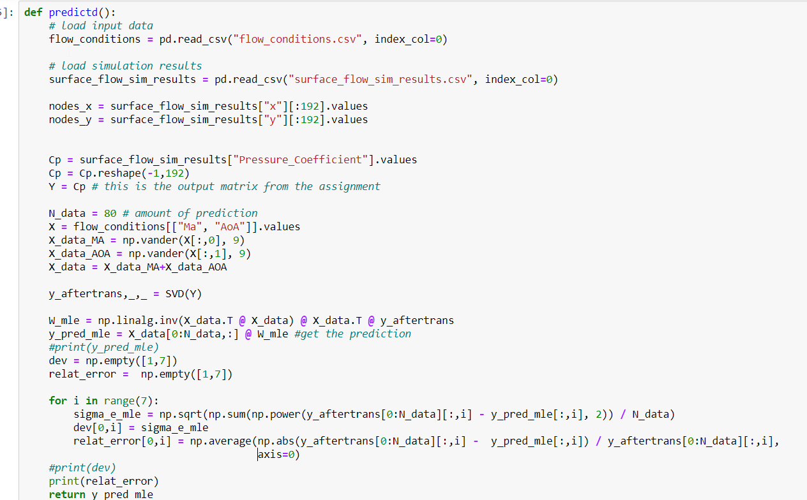

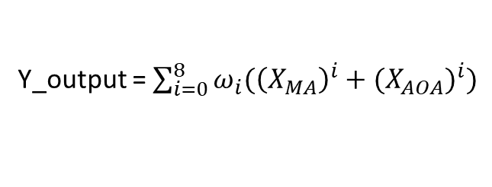
3.prediction(linear regression)
Y_output = $\sum_{i=0}^{8}{ω_{i}({\left(X_{MA}\right)}^{i}+{(X_{AOA})}^{i})}$
Xy_aftertrans : Y_output(160 samples as training data)
dev : standard deviation(80 samples used to compared)

Slide 20
Error result of compressed data
Relative error at 7 principal components

Slide 21
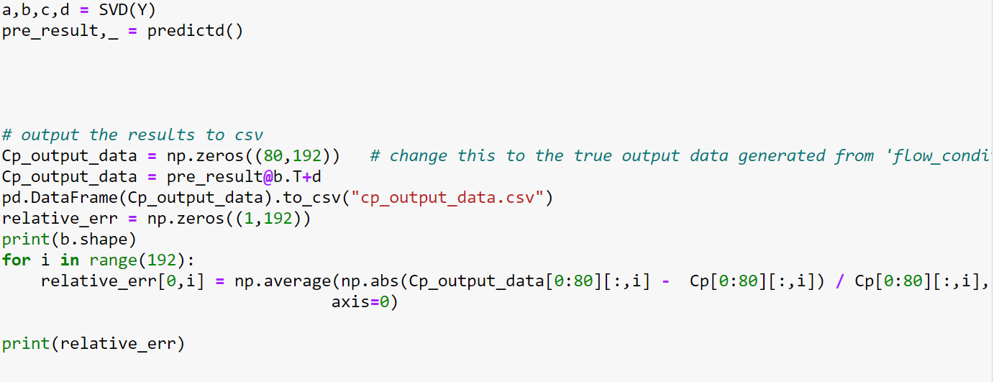
4.Decompress using predicted compressed data

Slide 22
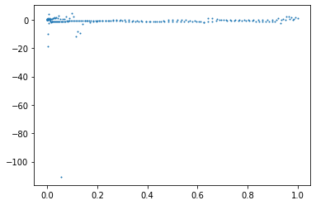
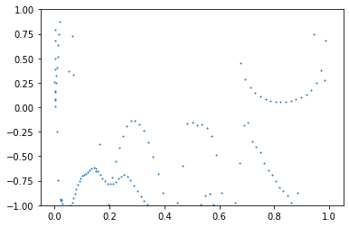
Error result of output data at each mesh point

