Slide 1
AMIDOL and ASKE-E
Eric Davis
This research was supported by the ASKE program under
DARPA-PA-18-02-AIE-FP-039

Slide 2
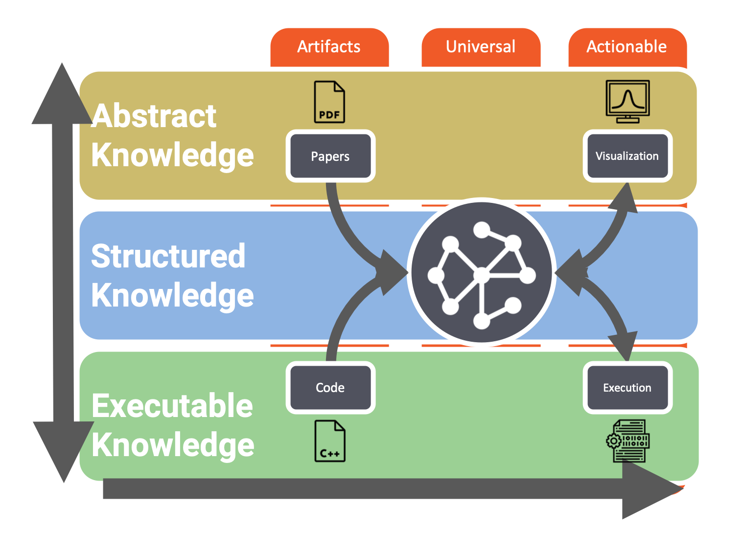
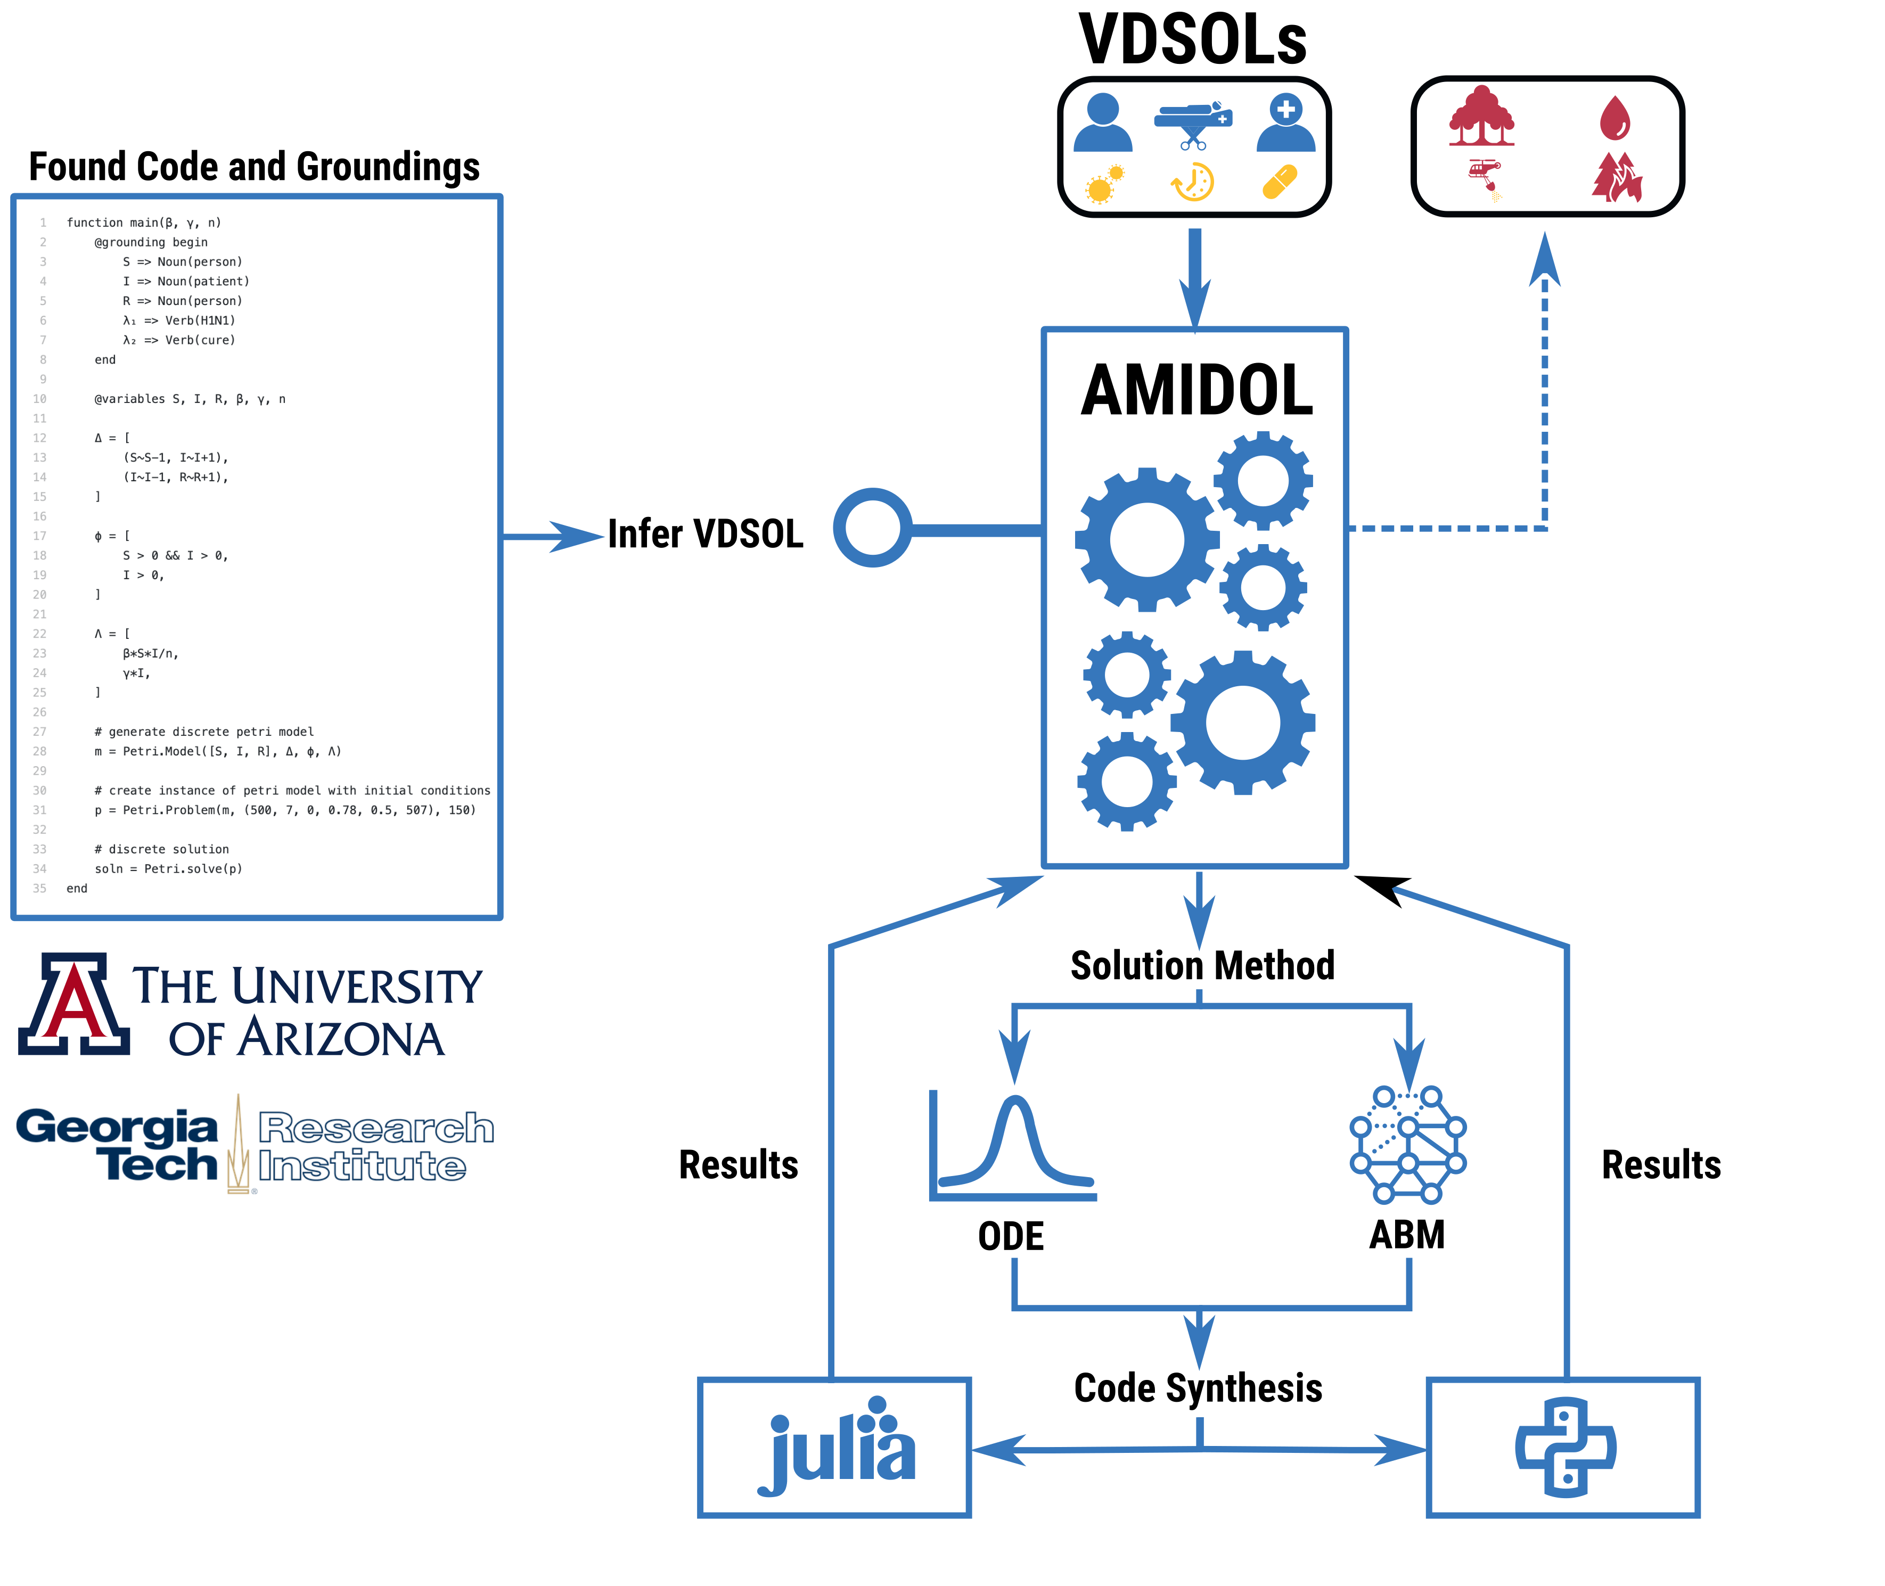
ASKE-E and AMIDOL
Primary High Level Tasks in ASKE-E
Augmenting and extending AMIDOL as a Service
Continuous model integration
Continuous model validation
Continuous model deployment
AaaS Focus
Model credibility
Model correctness
Model suitability for given domains and measures/use cases.

Slide 3
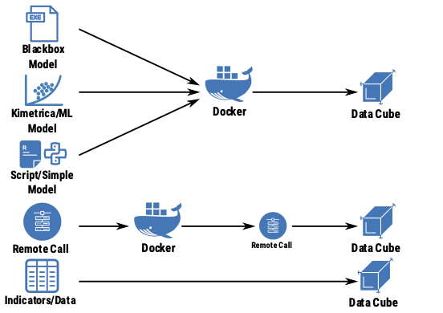
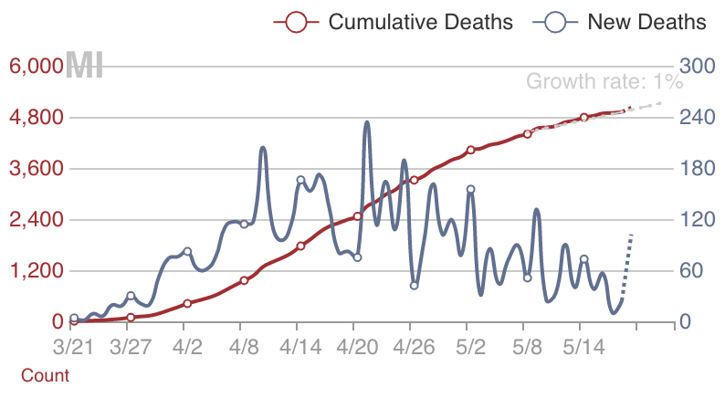
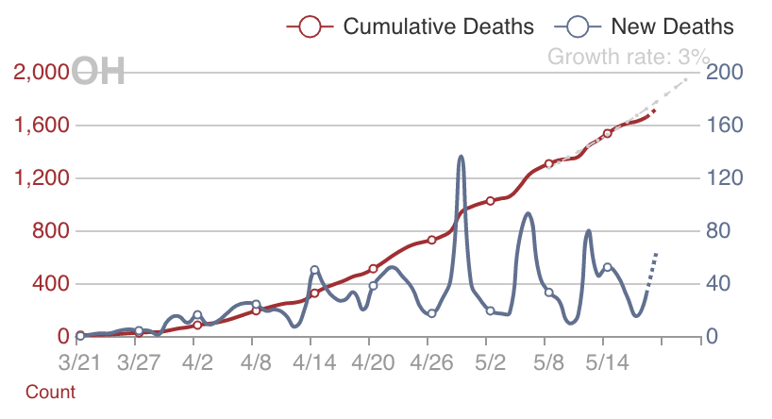
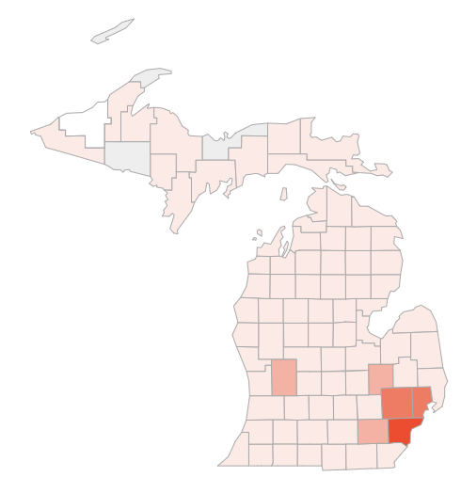
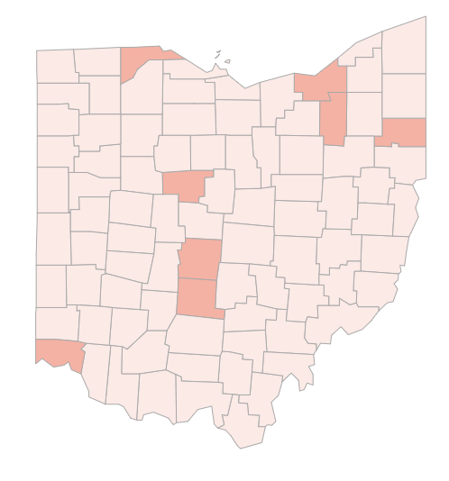
Tool-Chains for Data and Models
Multi-domain, multi-resolution tool chains to incorporate data and model from diverse domains.
AMIDOL graph-based model and results database.
Ability to deploy and integrate models and data through AMIDOL to closely couple with current tools and workflows, easy integration to disaster response and crisis.
n₀
d
r
r
M₀
M₁
??
r
r
n₁
d
Notes:
I don’t know if this is worth putting on the slide or just talking to it, but there is a nice story about adding features of the data into the model. When you go from SIR to SEIR you get the lag in initial time until peak infections correct (accuracy at small t), then when you go from SEIR to SEIRS you get the endemic equilibrium correct (accuracy at large t). These curves are drawn with the same biological parameters of the model taking the perspective that we are building physical models and not just doing curve fitting.

Slide 4
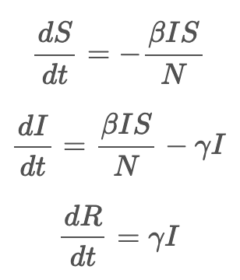
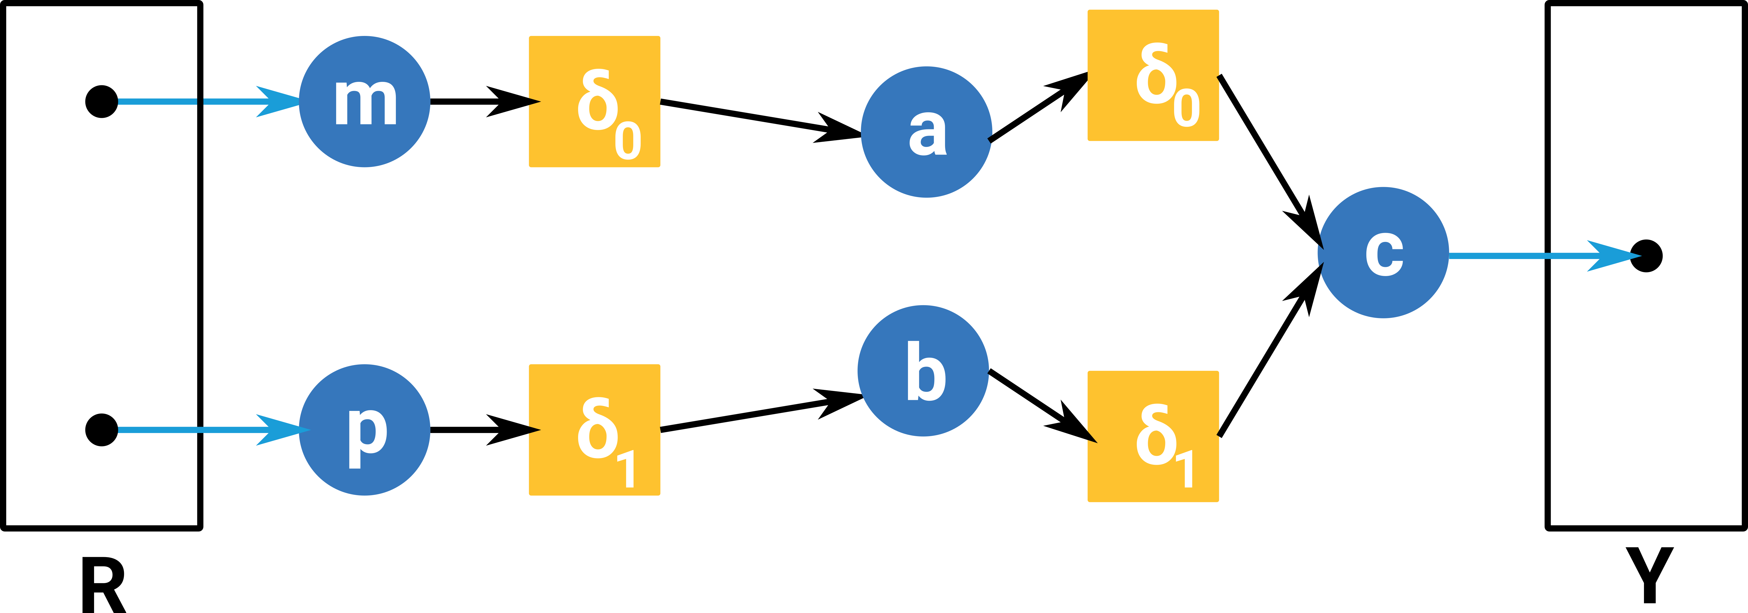
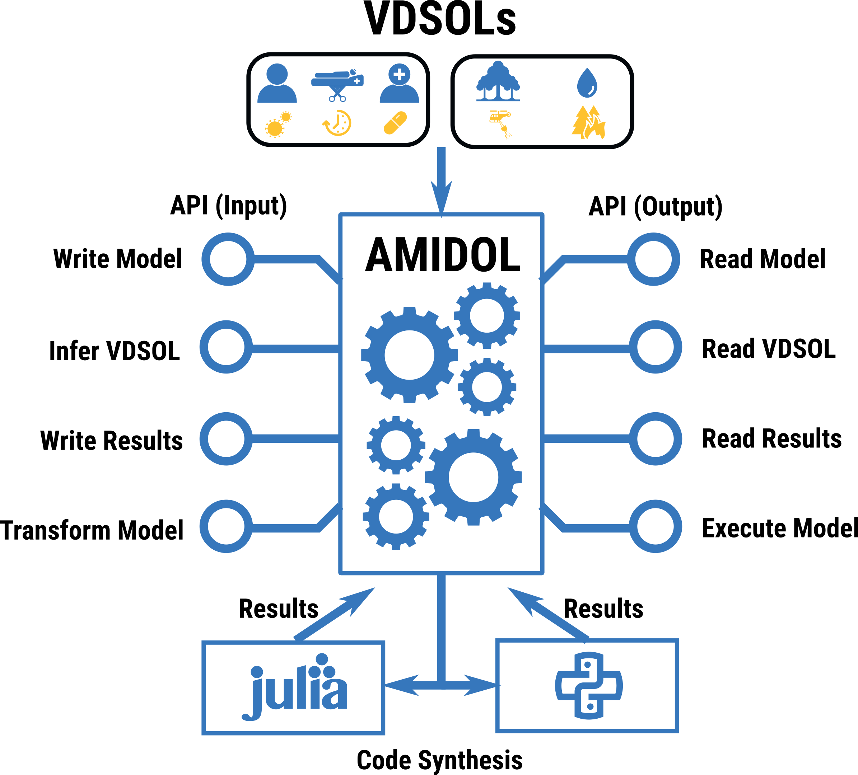
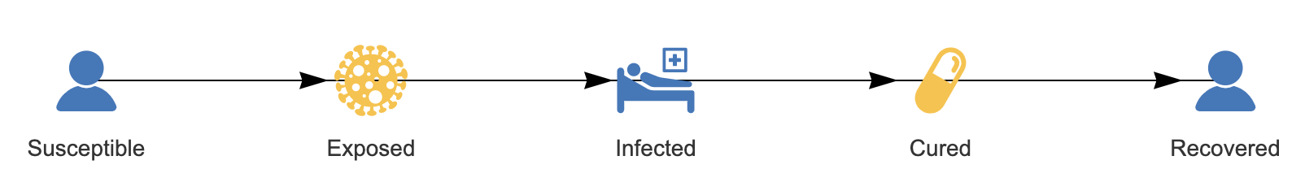
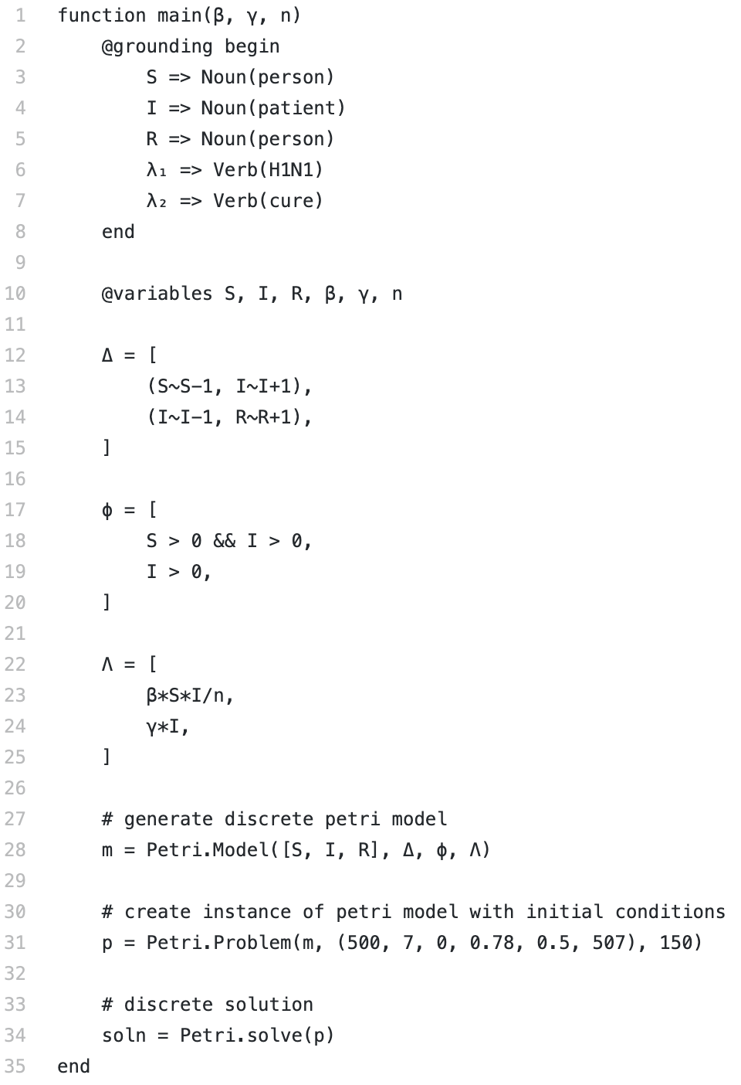
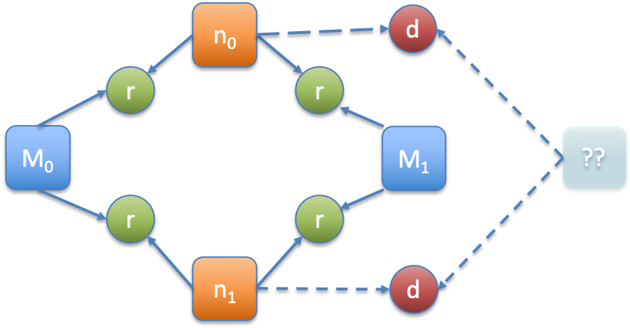
Extension of Model Synthesis capabilities
AMIDOL currently supports model synthesis in the form of DSLs
Diagrams
Equations
Julia and other code
Extend these capabilities, improve continuous V&V processes, and reduce the impact of human errors during crisis, detect inconsistencies, produce better, credible, predictive measures.
SIR Models – As Equations, Code, or Top-Down Developed
Extracted to Universal, and Comparable, Forms
ASKE: Model extraction, and novel code synthesis with correct-by-construction guarantees, comparability, and adaption for local differences.
Notes:
3. Data:
- How much data, what’s the quality, various assumptions. How are those expressed?
- Given the challenges of data, what can we say about these models and whether they’re useful and etc.
For aske2, promote within people using these models some formal notations that will allow these models to be extracted precisely and directly.

Slide 5

Credibility Questions and Comparison
Ability to…
Identify novel model characteristics
Model suitability for a given estimation during crisis
Model validation
Measure credibility
Model Comparisons
Model:Model
Model:Data
Data:Data
Identify what the primary sources of the differences were in the formal, universal, structure.

Slide 6
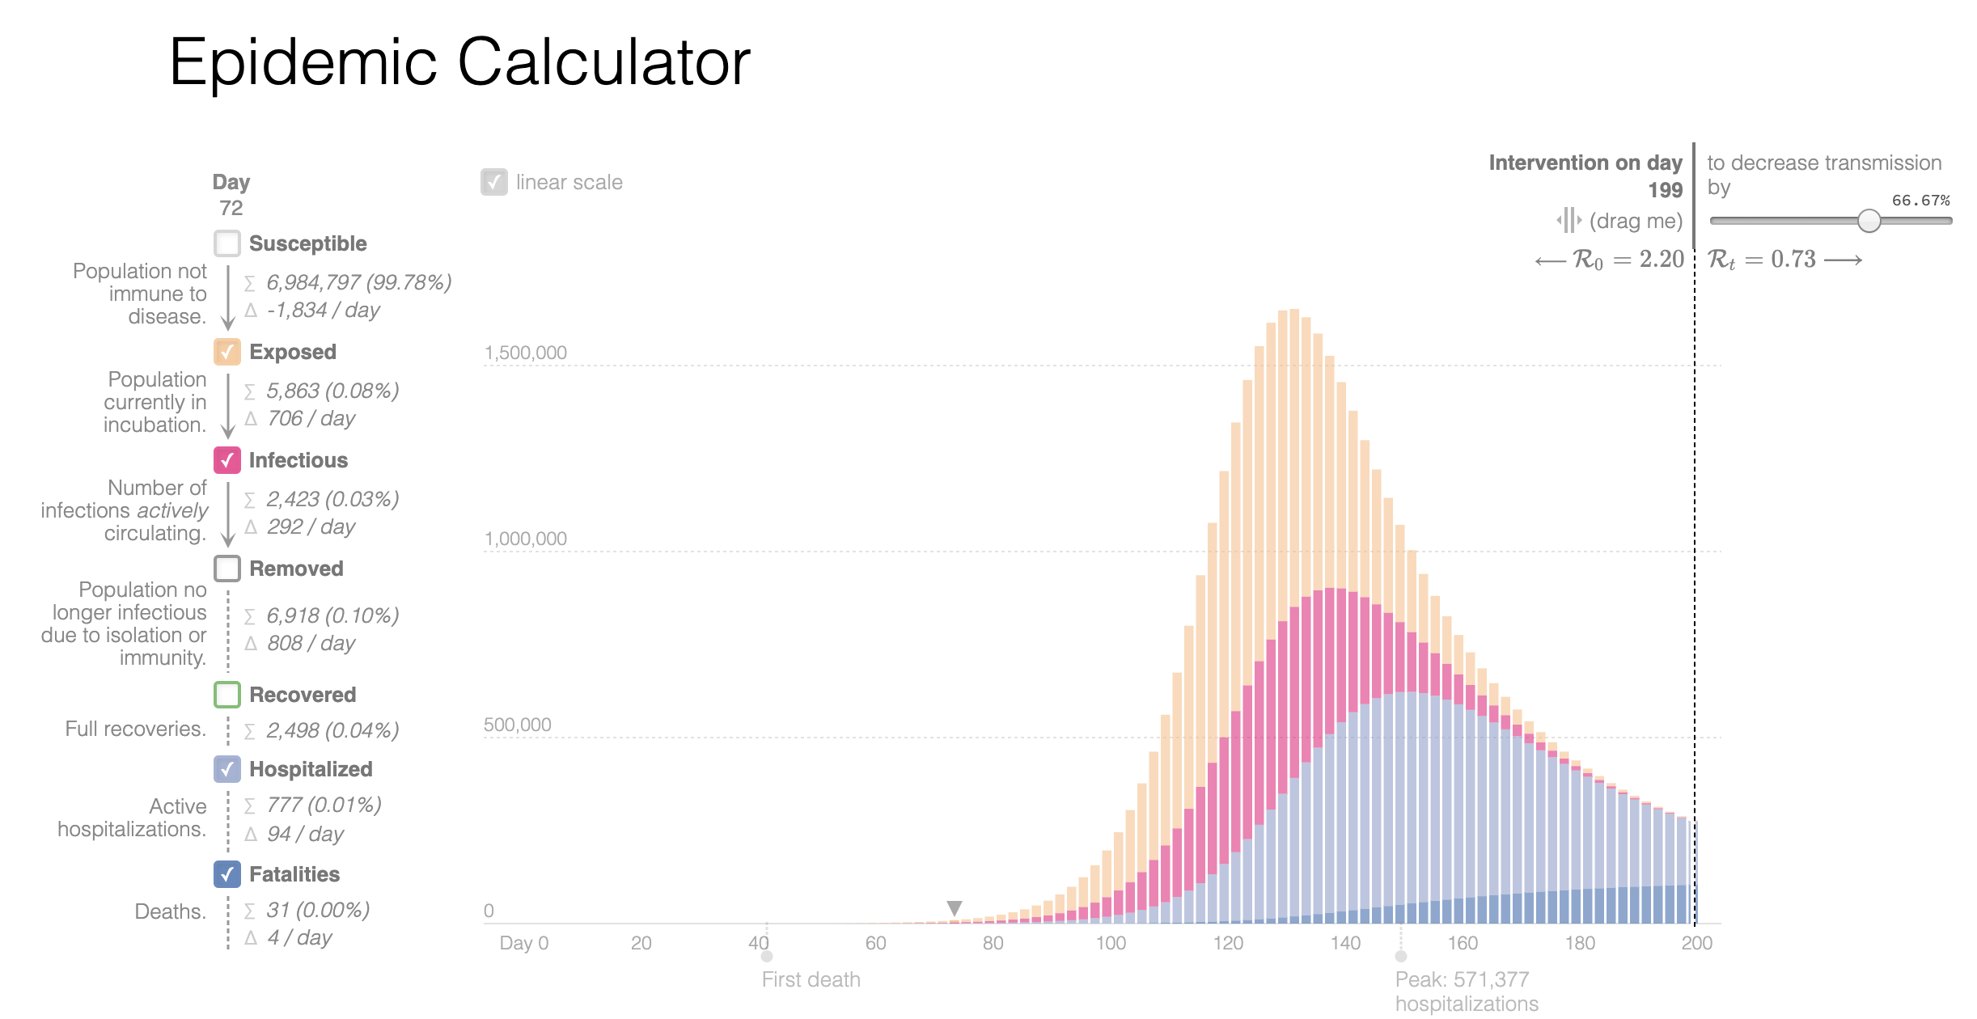
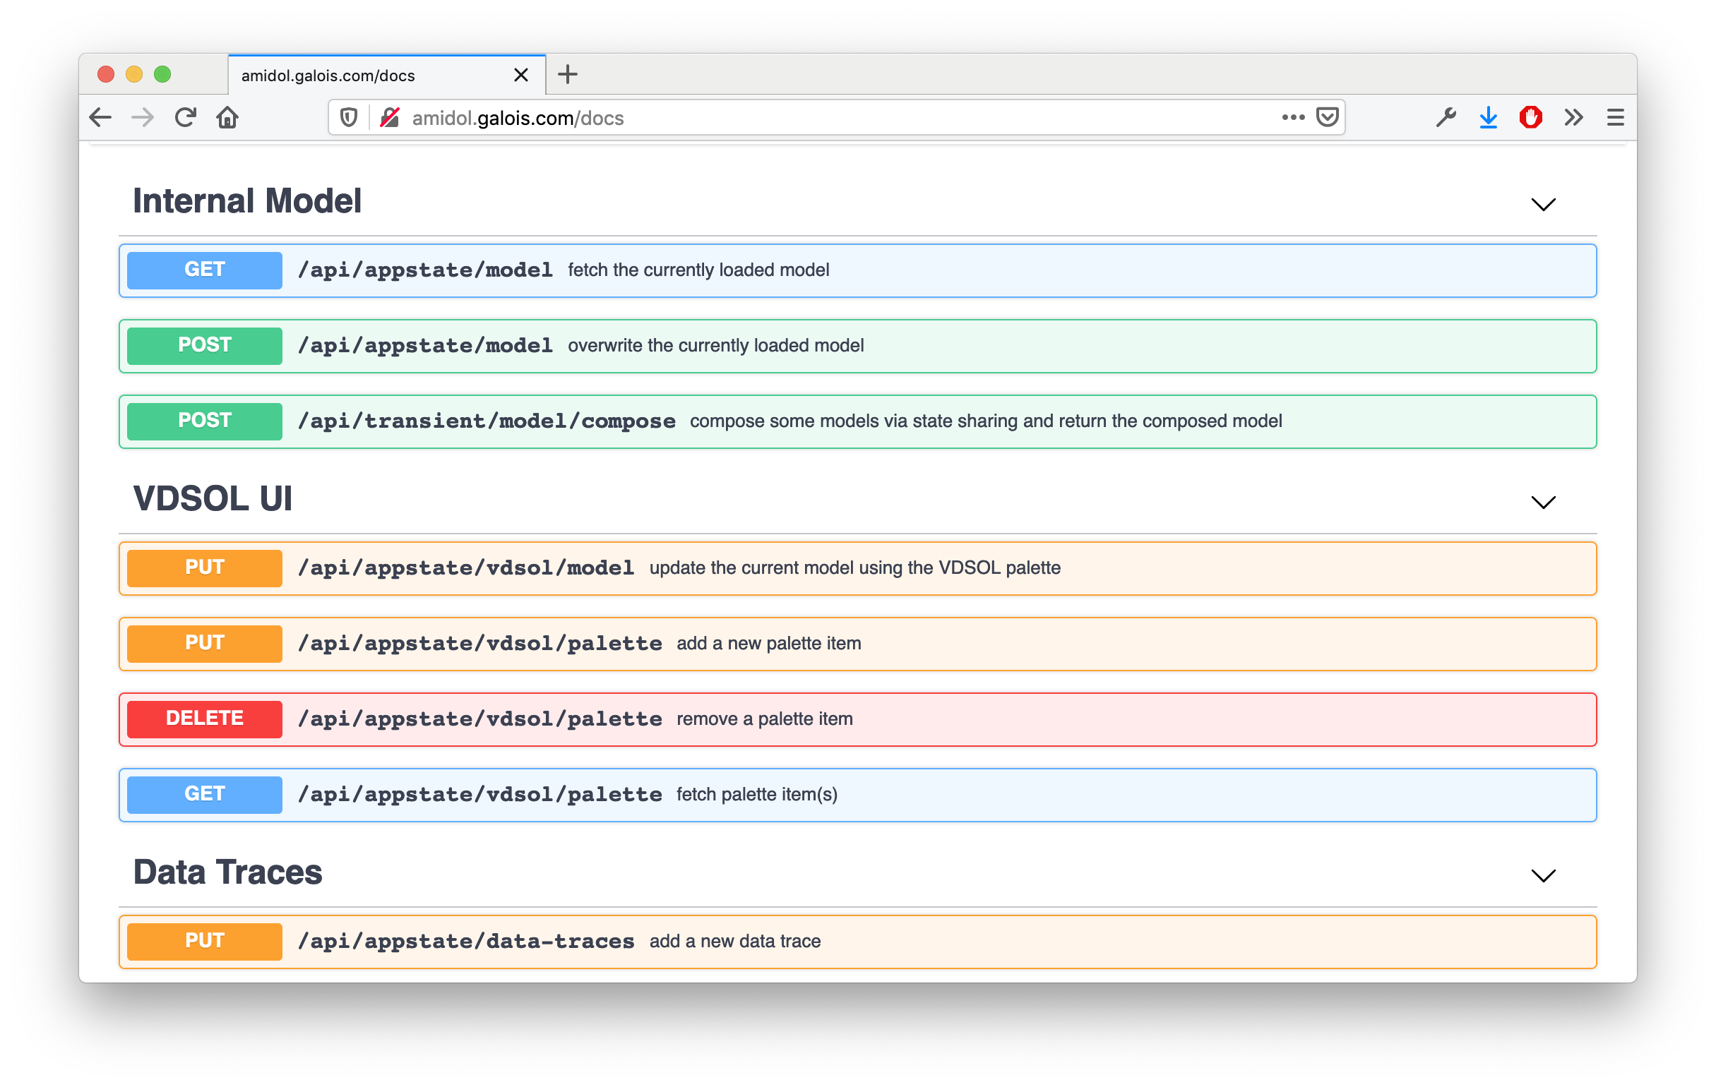
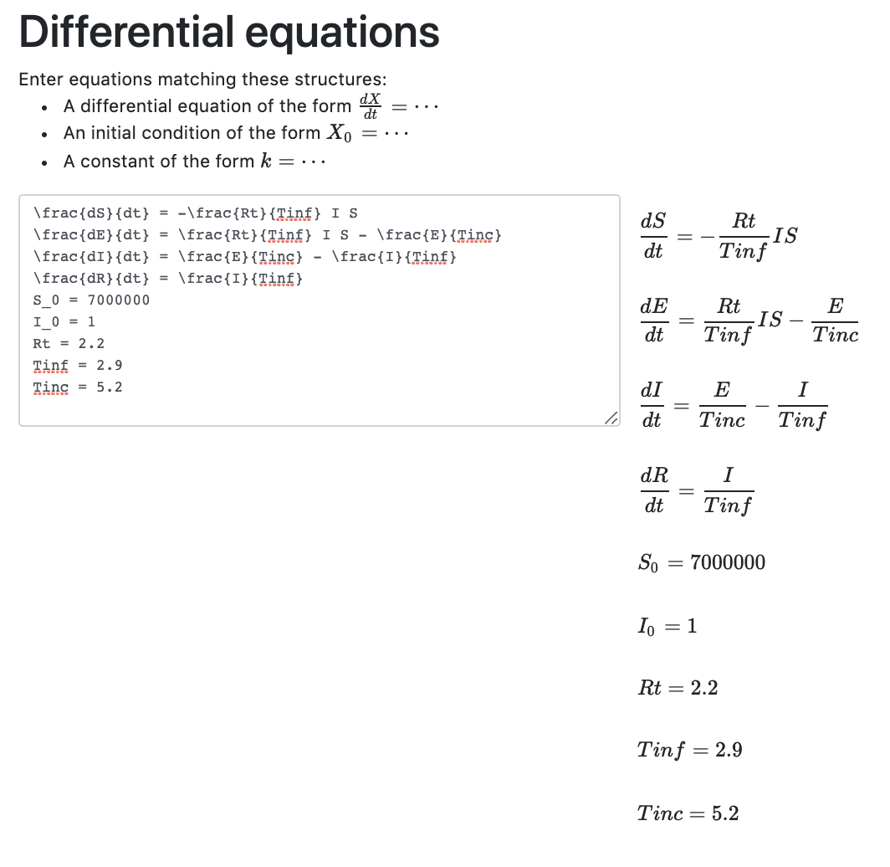
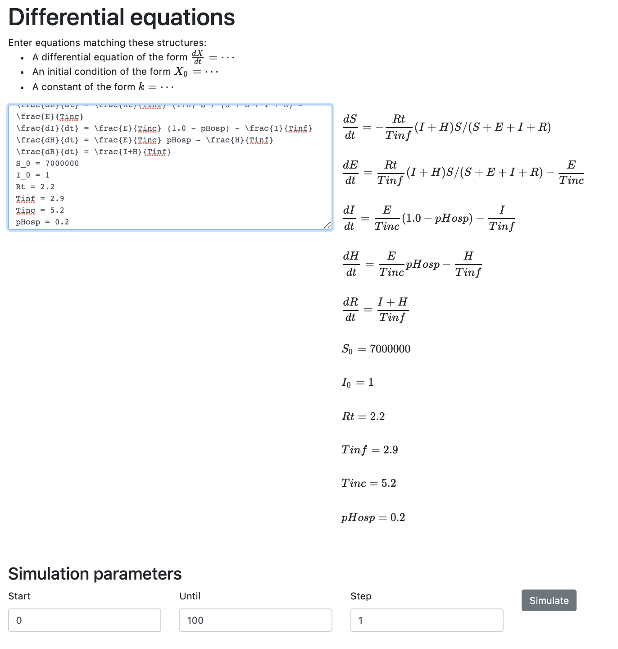
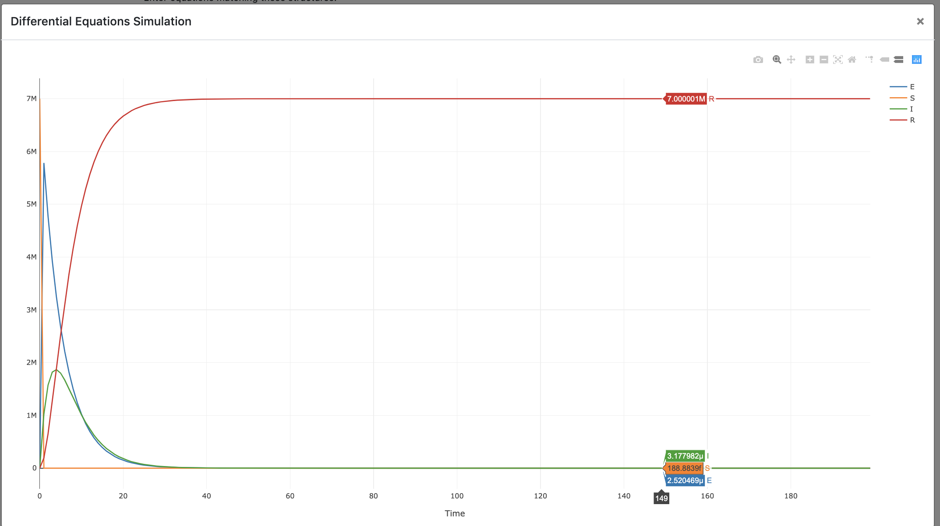
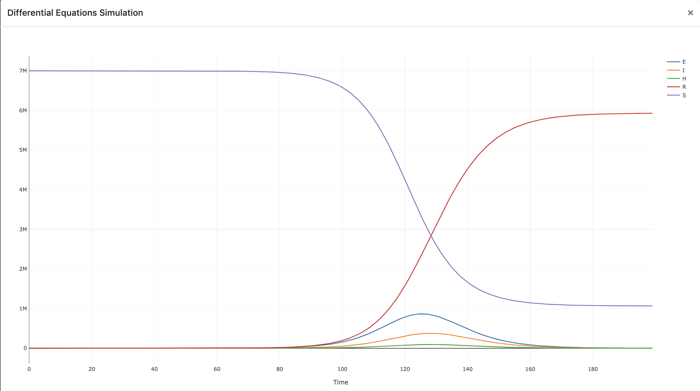
Extracting/exposing/verifing/comparing the structure and assumptions of models?
Answer: AMIDOL can synthesize models from code, equations, and diagrams, translating artifacts into universal representations, and testing assumptions. Model assumptions can be checked, and models can be
compared on the basis of measure similarity, structure, predictive power,
etc.
- High confidence models.
- Adapted for local concerns.
- Low effort model development, validation, and code synthesis.
APIs are exposed to allow AMIDOL to be used as a service, and to integrate deeply with existing tools and ecosystems.
Gabriel Goh’s SEIR Model
AMIDOL Synthesized Model doesn’t match the reported results.
AMIDOL identifies missing term, synthesizes correct model which matches reported results.
Notes:
2. Model extraction and comparison:
When you’re extracting models, how do you know that you’re doing well? What are the differences among models and how are they handled? Give a hint of this. Just an example.

