Slide 1
ASKE MD: Moving Down the Stack
May 16th, 2019 Breakout Session

Slide 2
ASKE Stack Overview
“Moving Down” the stack implies moving from domain specific to intermediate representations, or from intermediate representations to Machine/Implementation specific representations.

Slide 3
Grand Challenges I
Need an architecture which can represent domain knowledge for science to domain experts, but abstract away domain knowledge while preserving it using data provenance, and its consequences.
Layers must have a mechanism for abstraction and concretization of knowledge.
Abstraction and concretization should be lossless inverses of each other.
Abstraction occurs when moving down the stack.
Concretization occurs when moving up the stack.
Calling conventions
Caller abstracts when moving down.
Callee concretizes when moving up.
This limits the need for change to the intermediate representation when new domains are added.

Slide 4
ASKE Stack Layers
Does not imply a single application, or representation at each layer.
Implies the distinction of responsibilities in a layer, and the boundaries on these divisions of responsibility with respect to knowledge.

Slide 5
Grand Challenges II
Requires semantic casting of some artifacts as they transition layers.
Moving Down
Constraints of model.
Constraints on solution.
Constraints of results.
Moving Up
Execution errors and their consequences
Results, their interpretations, and their consequences

Slide 6
Grand Challenges III
Need a mechanism which allows for the removal or addition of semantic knowledge at each layer.
Likely involves some sort of domain specific typing and its interpretation.
Abstract Knowledge Layer ”knows” an object is a protein.
Structured Knowledge Layer “knows” an object has a label “protein” but not what that label means.
Need for a generalized mechanism for this process.

Slide 7
Technical Gaps
There is an ideal for this process, and there is the current.
Current:
Layers are not clear.
Domain experts, modelers, and software engineers are involved at all layers.
Ideal:
Layers clearly defined.
Knowledge is properly segmented, structured, and organized.
How do we bridge from current practice to ideal practice?
How do we translate between, and encode artifacts of side knowledge that need to be used?
Domain knowledge.
Error resulting from implementation.
Semantic interpretation on knowledge generalization and specificity between machine and domain layers.

Slide 8
Overarching Categories and Themes
Restrict domain knowledge to the top layer.
Restrict implementation to the bottom layer.
Layers define knowledge boundaries, not atomicity of implementation.

Slide 9
Solutions and Plans

Slide 10
Practical/Compelling Applications
Reusable model stack.
Forms the basis for a reusable modeling stack (MOMACS).
Specifications for encoding a domain
“knobs” to turn to fit the stack to a domain.
Model refinement and assumption checking - how to fix models on the basis of model/human assumption errors.
Knowledge extraction and domain casting.

Slide 11
Human Integration
Moving down the stack moves from domain science to quantitative scientist to machine engineer.
Casting current layer results into appropriate context for new layers assumptions.
f(Domain Knowledge) → Structured Knowledge
g(Structured Knowledge → Domain Knowledge

Slide 12
Community Components
Moving down the stack allows sharing of extracted knowledge between domains.
Moving between may illuminate and identify domain constraints and assumptions, and equivalences that were not previously realized.
Community standards on how to interpret layer results, and required context for layer translation.
Community interaction happens at the middle layer. Readers work primarily on the middle layer.

Slide 13
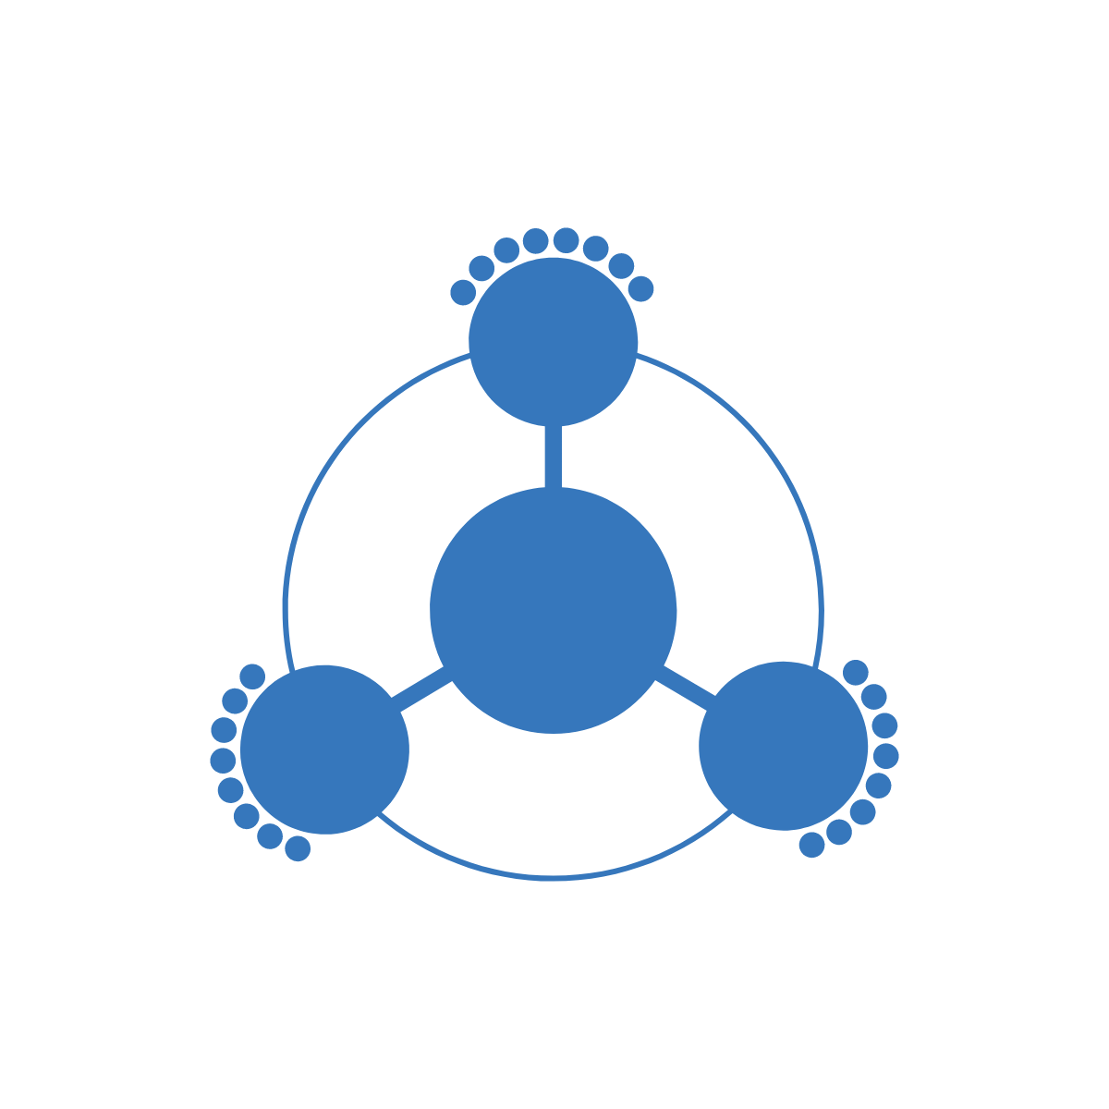
Powerful Connections Tools and Ecosystems
Standards for middle layer expressivity
Needs to cover all scientific models.
Middle layer representations must be:
Isomorphic.
Computing the isomorphisms needs to be performable.
Isomorphisms allow collaboration between focused ecosystems
Solve sub-problems efficiently.
Structured
Knowledge Layer

Slide 14

Mechanisms for Collaborative Progress
Between milestones, pairwise, or ring partnering to check middle layer compatibility and whether they are isomorphic.
Working groups to share tools in one ecosystem through isomorphic transforms.

